Slide 1
Core FB MC
Core Parallel Run KPI report
January 2021

Slide 2
Parallel Run KPI report
Introduction
Context
  According to Article 28(4) of the Core FB DA CCM, Core TSOs
    shall continuously monitor the effects and the performance of the application of this methodology during the parallel run
    shall develop, in coordination with the Core regulatory authorities, the Agency and stakeholders, the monitoring and performance criteria and report on the outcome of this monitoring on quarterly basis in a report
  Core TSOs & NEMOs have aligned on the
    Specific KPIs with NRAs and this alignment resulted in the format of this KPI report
    Frequency of provision of the report, which was increased to monthly, going beyond formal requirements
    Agreement to have the increased frequency reflected in the Core CCM amendment (November 2020)
In the next slide the overview of the KPIs covered in this monthly KPI report is provided:
  KPIs related to Capacity Calculation in blue
  KPIs related to Market Coupling simulations in green

Slide 3
Parallel Run KPI report
Overview of Core FB MC Parallel Run KPIs
  CNEC Selection Impact | Slide 7 - 50
    Average maximum AMR per CNE per BD
    Average maximum AMR per TSO per BD
    Average maximum AMR+LTAmargin per CNE per BD
    Average maximum AMR+LTAmargin per TSO per BD
  TSOs’ adjustment after validation | Slide 51 - 62
    Share of MTUs with intervention per TSO
    Total IVA applied per BD for each CNE affected by TSO intervention
  Power System Impact Analysis | Slide 63 - 101
    Min & max Net Position per BZ hub
    Virtual margins at MCP per TSO, per BD Slide 159 - 191
    *RAM before and after RAO per TSO
    *Average sensitivity of RAs per TSO
    Flow deviation on non-Core borders
Market Impact Assessment (FB Plain) Slide 102 - 159
    Most often presolved CNEs (top 20)
    Most limiting CNEs (top 20)
    Clearing prices, price spread and price convergence
    CNECs with highest non-zero shadow price in each hour per day
    Core Social Welfare
    Paradoxically Rejected Block orders (PRB)
  *Note: Since NRAO is not implemented in the capacity calculation in the reporting period KPIs 15 & 16 are not included.
Note: Elia and PSE switched from EC (limitation on Core NP) to AC (limitation on SDAC NP) during the course of January. As the MinMax NP KPI cannot reflect ACs (contrary to ECs)
a change in the patterns for BE and PL is observed
this underlines the theoretical character of this KPI

Slide 4
Parallel Run KPI report
Reporting period (Business days covered)
Context
The progressive transition towards ext//run started on the 16th of November 2020.
TSOs daily calculate a final flow-based domain for 7 Business Days per week.
In the current stage only a selection of Business Days will be published that are deemed sufficiently representative. Based on this selection TSOs + NEMOs perform the market coupling simulations.
A Reading Guide with a description of the KPIs is available on JAO.
13 Business Days were deemed as sufficiently representative. The KPI report contains the following Business Days (highlighted in green):
January ‘21
M | T | W | T | F | S | S
 |  |  |  | 1 | 2 | 3
4 | 5 | 6 | 7 | 8 | 9 | 10
11 | 12 | 13 | 14 | 15 | 16 | 17
18 | 19 | 20 | 21 | 22 | 23 | 24
25 | 26 | 27 | 28 | 29 | 30 | 31

Slide 5
Parallel Run KPI report -
Overview limitations & assumptions
Core project parties maintain an overview on the JAO website with the assumptions and limitations for specific Business days during the parallel run – see JAO website (LINK).
Note: Unknown issues can be present and can be discovered in the future as analysis continues. This might lead to the ex-post conclusion that results for certain BDs are invalid.German TSO names uses abbreviations: D2: Tennet GmbH, D4: TransnetBW, D7: Amprion, D8: 50Hertz
Description of issue / limitation | FROM BD | TO BD
For BD 1-1-2021 - 13-1-2021 the Ramr values for TTN branches are based on the values from 2020 of the action plan. The Ramr values were lower for this period. | 01/01/2021 | 13/01/2021
Due to an error in the input data file, not all the ČEPS´ CNECs were considered for DA Capacity Calculation for BD 20210113. As a result, the Final FB Domain does not include all the ČEPS´ CNECs it normally includes | 13/01/2021 | 13/01/2021
For BD 20/01 an issue occurred that prevented Elia applying minRAM reduction on its CNECs in relation to excessive loopflows. | 20/01/2021 | 20/01/2021
Processing LTR curtailments calculated during the individual validation are not processed in an updated LTA file | 16/11/2020 | 28/01/2021
The maximum Zone-to-Zone PTDFs are not correctly calculated, which can inflate the max z2z PTDFs and hence influence the CNEC selection in relation to the 5% PTDF threshold | 16/11/2020 | 02/02/2021
Since BD 20201116, flow-based parameters calculated with the help of the spanning method according to CCM Article 22(a) are published in case the capacity calculation fails to provide the flow-based parameters for strictly less than three consecutive hours. The parameters RAM, F_(ref,init) and F_ref of the MTU for which spanning was applied are not correctly calculated in the initial computation. This issue has no impact on the final flow-based parameters nor on the market coupling. | 16/11/2020 | 02/02/2021
Since BD 20210129 values related to the flow on the Monita cable are above maximum admissible power flow (600MW) for some of the timestamps as a consequence of BCI process (adaptations of Italy towards NPF target). BCI process works properly, but it includes nodes (represent the flow) of Monita cable in net position shifting process. There is a need for exclusion of the Monita nodes from BCI process to improve the quality of the published values that represent the flow on Monita. This issue was observed for BDs 20210129-20210202 (excluding 20210130) and may occur until this is solved. The impact on the results is not significantly influential. | 29/01/2021 | 20/03/2021
RTE fine validation process is still under implementation and will be ready by end of May 2021. A rough validation is already operational but triggered on a daily basis this validation would downgrade significantly the representativeness of the results. | 16/11/2020 | 31/05/2021
Merging tool uses an incorrect net position for DE/LU. This incorrect net position is distributed throughout the CGM, thus leading to unintended deviations of generation between Core IGMs and CGM. | 16/11/2020 | TBD
NRAO is not implemented yet and therefore results are without this optimization | 16/11/2020 | TBD
As TSOs are in a learning phase in terms of process and tools, the outcome of the local validation might temporarily lead to limited application of IVA and/or incomplete information on its justification | 16/11/2020 | TBD
A number of TSOs apply a fractional Ramr, but only rounded values are considered in the computation. This leads to slight inconsistency with operational values. | 10/12/2020 | TBD
When Elia applies IVA, it is applied on the CNEC which is congested (correct behavior) as well as the CNEC in the opposite direction which is not congested (incorrect behavior, being fixed). This artificially reduces the pre-solved domain in the market direction opposite to the best forecasted market direction. | 16/11/2021 | 17/02/2021
The Elia AC is missing, which can lead to a higher import position for BE than what is operationally feasible | 14/01/2021 | 19/02/2021
The DE-NO2 border is not included in the Non-Core Exchanges KPI but will be added as of April 2021 reporting. | 09/12/2020 | 31/03/2021

Slide 6
Parallel Run KPI report
Overview limitations & assumptions (part II)
Core project parties maintain an overview on the JAO website with the assumptions and limitations for specific Business days during the parallel run – see JAO website (LINK).
For the reporting period TSOs apply the following Ramr values:
TSOs | Ramr values |  | Comments
 | BDs | Value
APG | 01/01 – 31/01 | 18.4% | In line with linear trajectory in accordance with Action Plan.
CEPS | 01/01 – 31/01 | 70% | Static value
Eles | 01/01 – 31/01 | 70% | Static value
Elia | 01/01 – 31/01 | 70% minus excessive LF | In line with its derogation on loopflows, Elia defines the Ramr per CNEC per MTU taking 70% as a starting point and reducing in case of excessive loopflows
German TSOs | 01/01 – 31/01 | 21.3% | According to the German action plan: -Until BD 09/12: 11,5% (rounding required in CWE, therefore 12%) -From BD 10/12/2020 21,3%
HOPS | 01/01 – 31/01 | 70% | For majority of CNECs in the beginning, while for specific CNECs identified based on internal analysis (per ACER recommendation) will be defined differently (20% - 70%)
MAVIR | 01/01 – 31/01 | 30% - 70% | In a range of 30%-70%. 70% for the majority of the CNECs while 30%, 50% as well as 60% for a certain set of CNECs based on analysis. In parallel, a set of CNECs being close to high concentration of generation nodes has been set to MNECs as well
PSE | 01/01 – 31/01 | 5% - 40% | Calculated according ACER methodology for all CNECs
RTE | 01/01 – 31/01 | 70% | Static value
SEPS | 01/01 – 31/01 | 30% | Some CNECs can have higher Ramr value than 30%. Further updates towards the higher Ramr values are expected based on the derogation process.
TenneT NL | 01/01 – 31/01 | 20% - 70% | In line with action plan which defines Ramr per CNE in range 20-70%. In addition Ramr values per CNEC per MTU are updated to consider derogation on loopflows.
Transelectrica | 01/01 – 31/01 | 33% | Static value

Slide 7
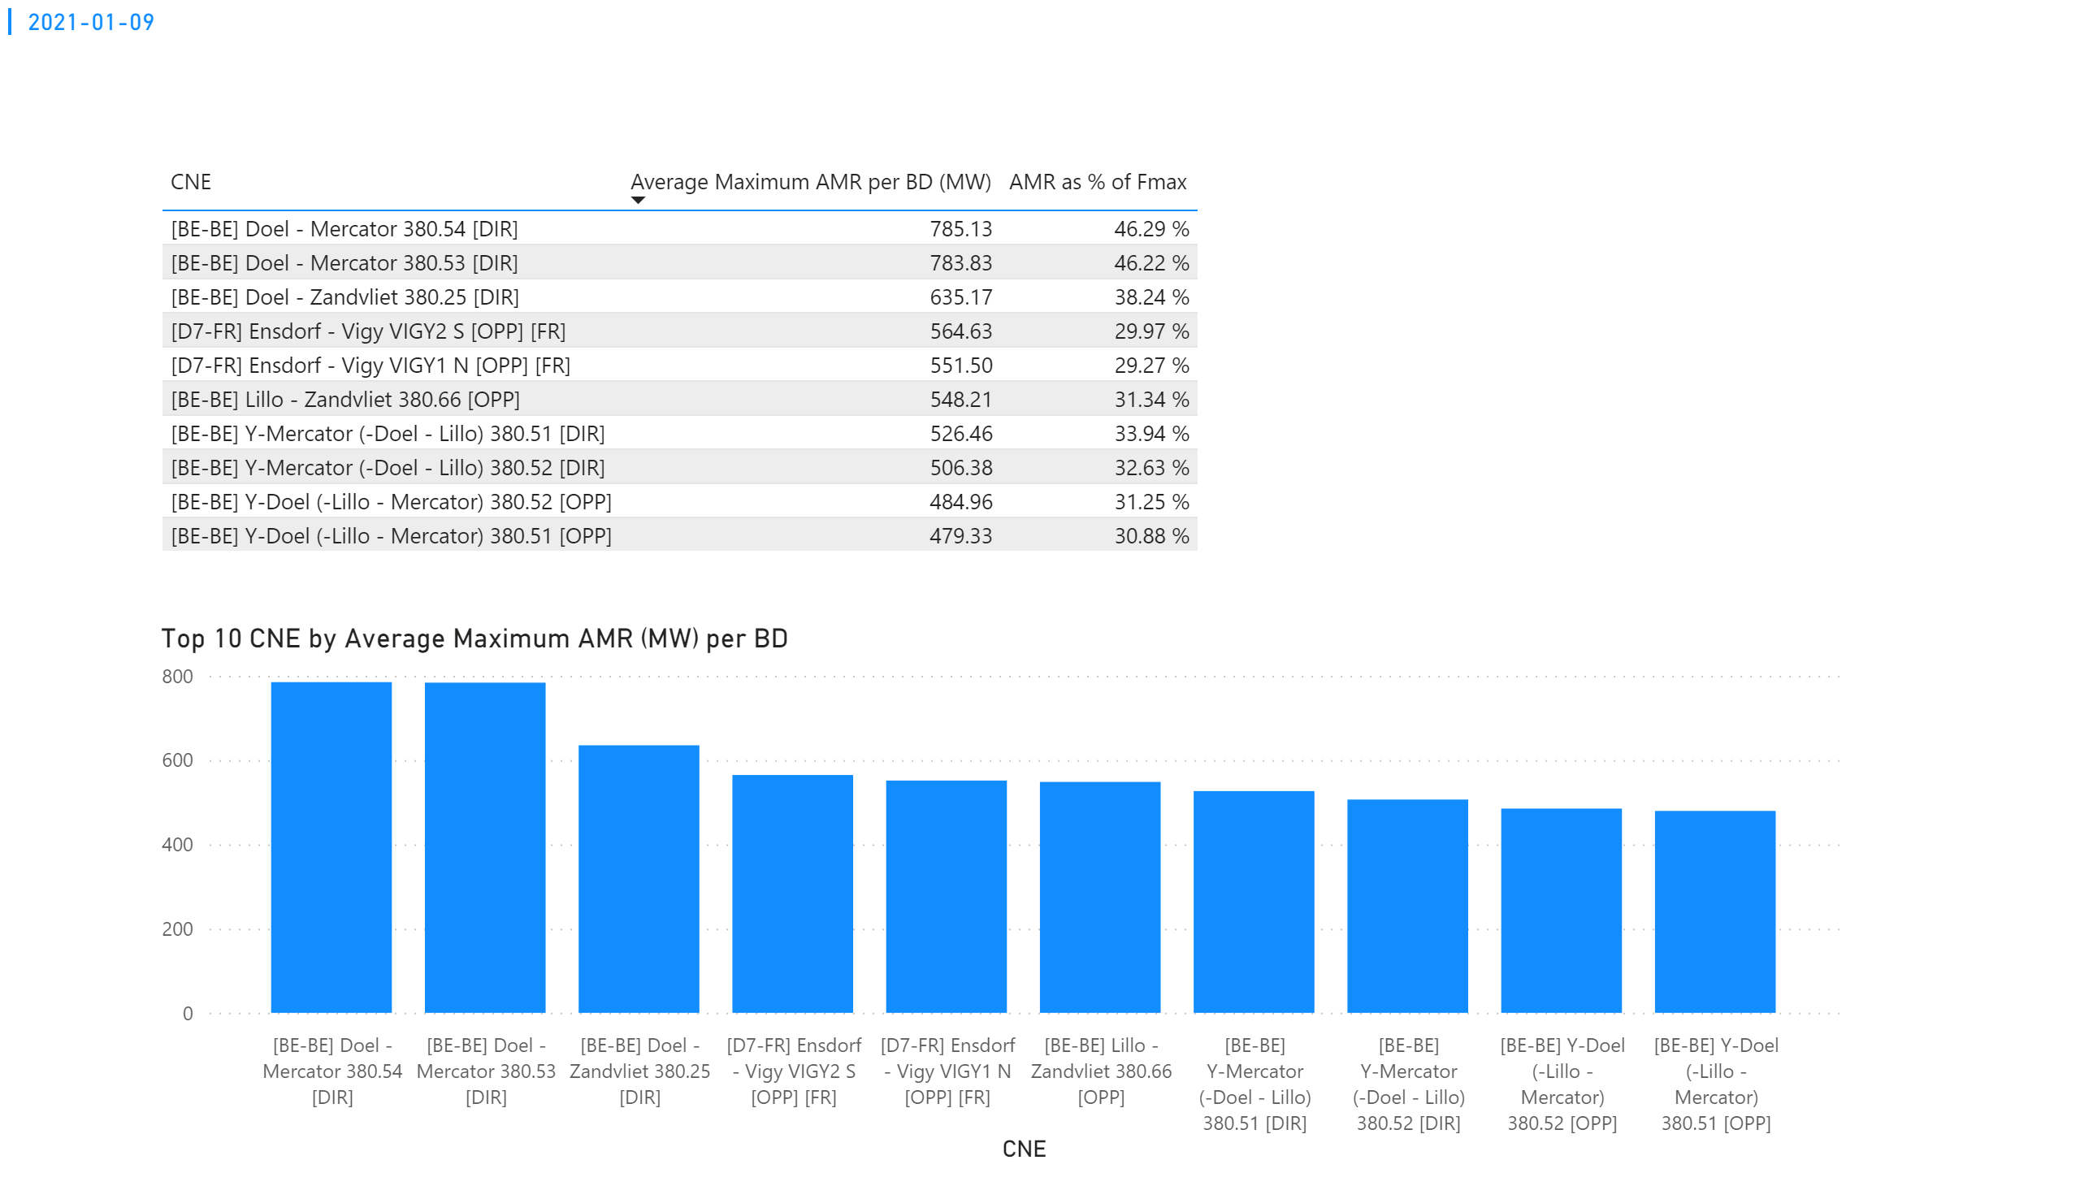
KPI 1
KPI 1: Average maximum AMR per CNE per BD
Notes:
tableEx
No alt text provided.
Top 10 CNE by Average Maximum AMR (MW) per BD
No alt text provided.
multiRowCard
No alt text provided.

Slide 8
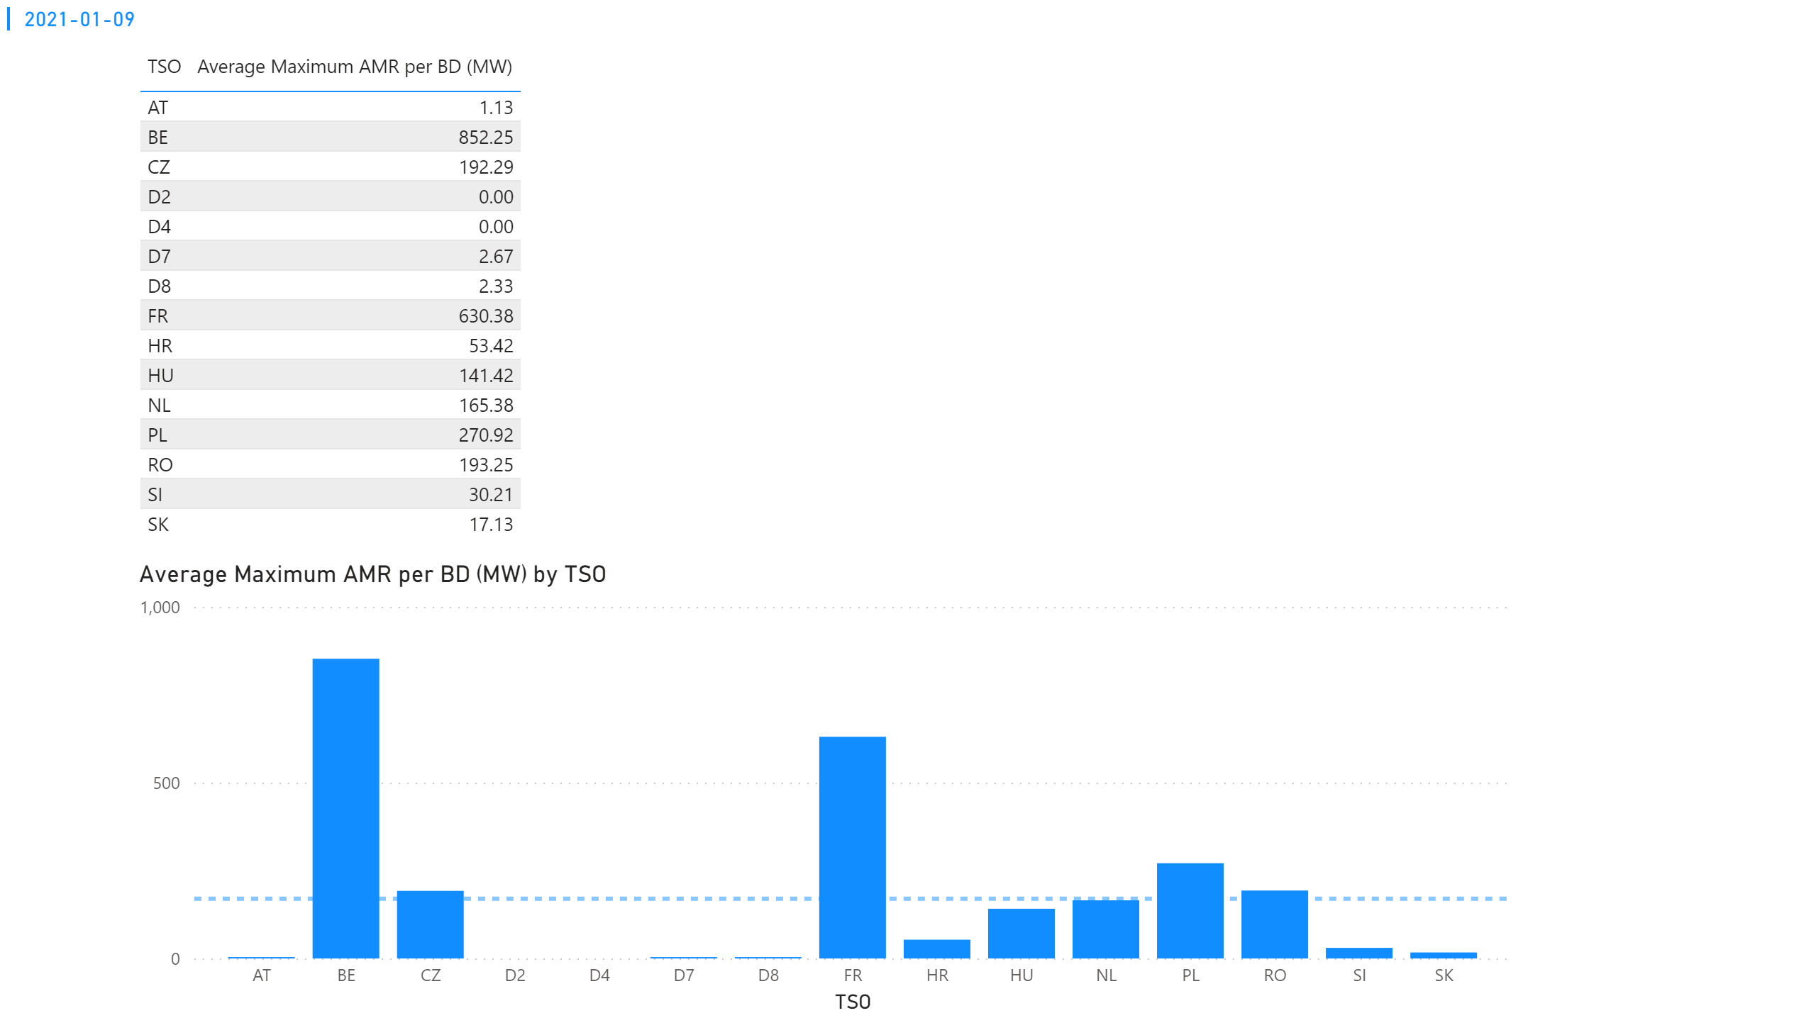
KPI 2
KPI 2: Average maximum AMR per CNE per TSO
Notes:
tableEx
No alt text provided.
Average Maximum AMR per BD (MW) by TSO
No alt text provided.
multiRowCard
No alt text provided.

Slide 9
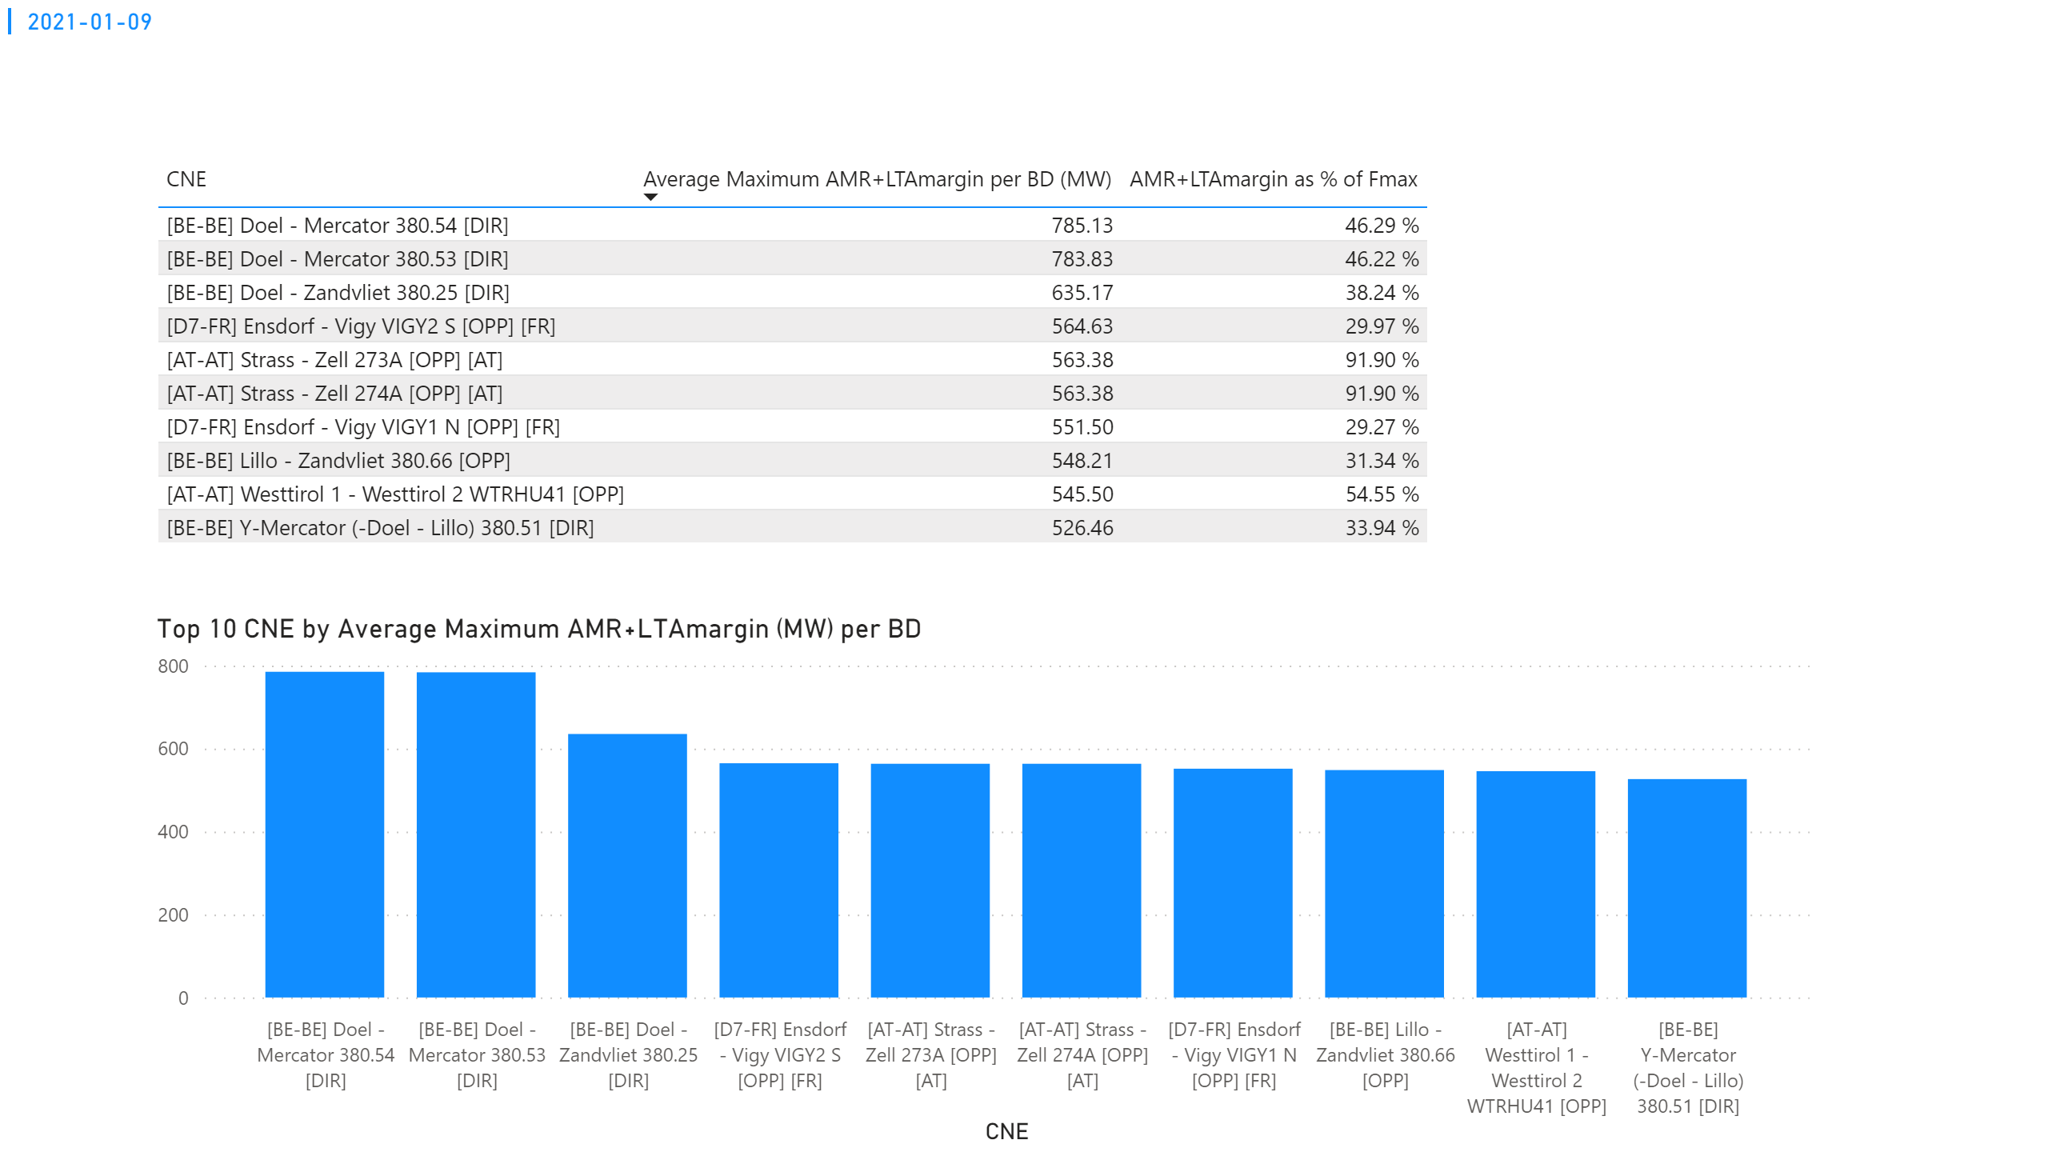
KPI 3
KPI 3: Average maximum AMR+LTAmargin per CNE per BD
Notes:
tableEx
No alt text provided.
Top 10 CNE by Average Maximum AMR+LTAmargin (MW) per BD
No alt text provided.
multiRowCard
No alt text provided.

Slide 10
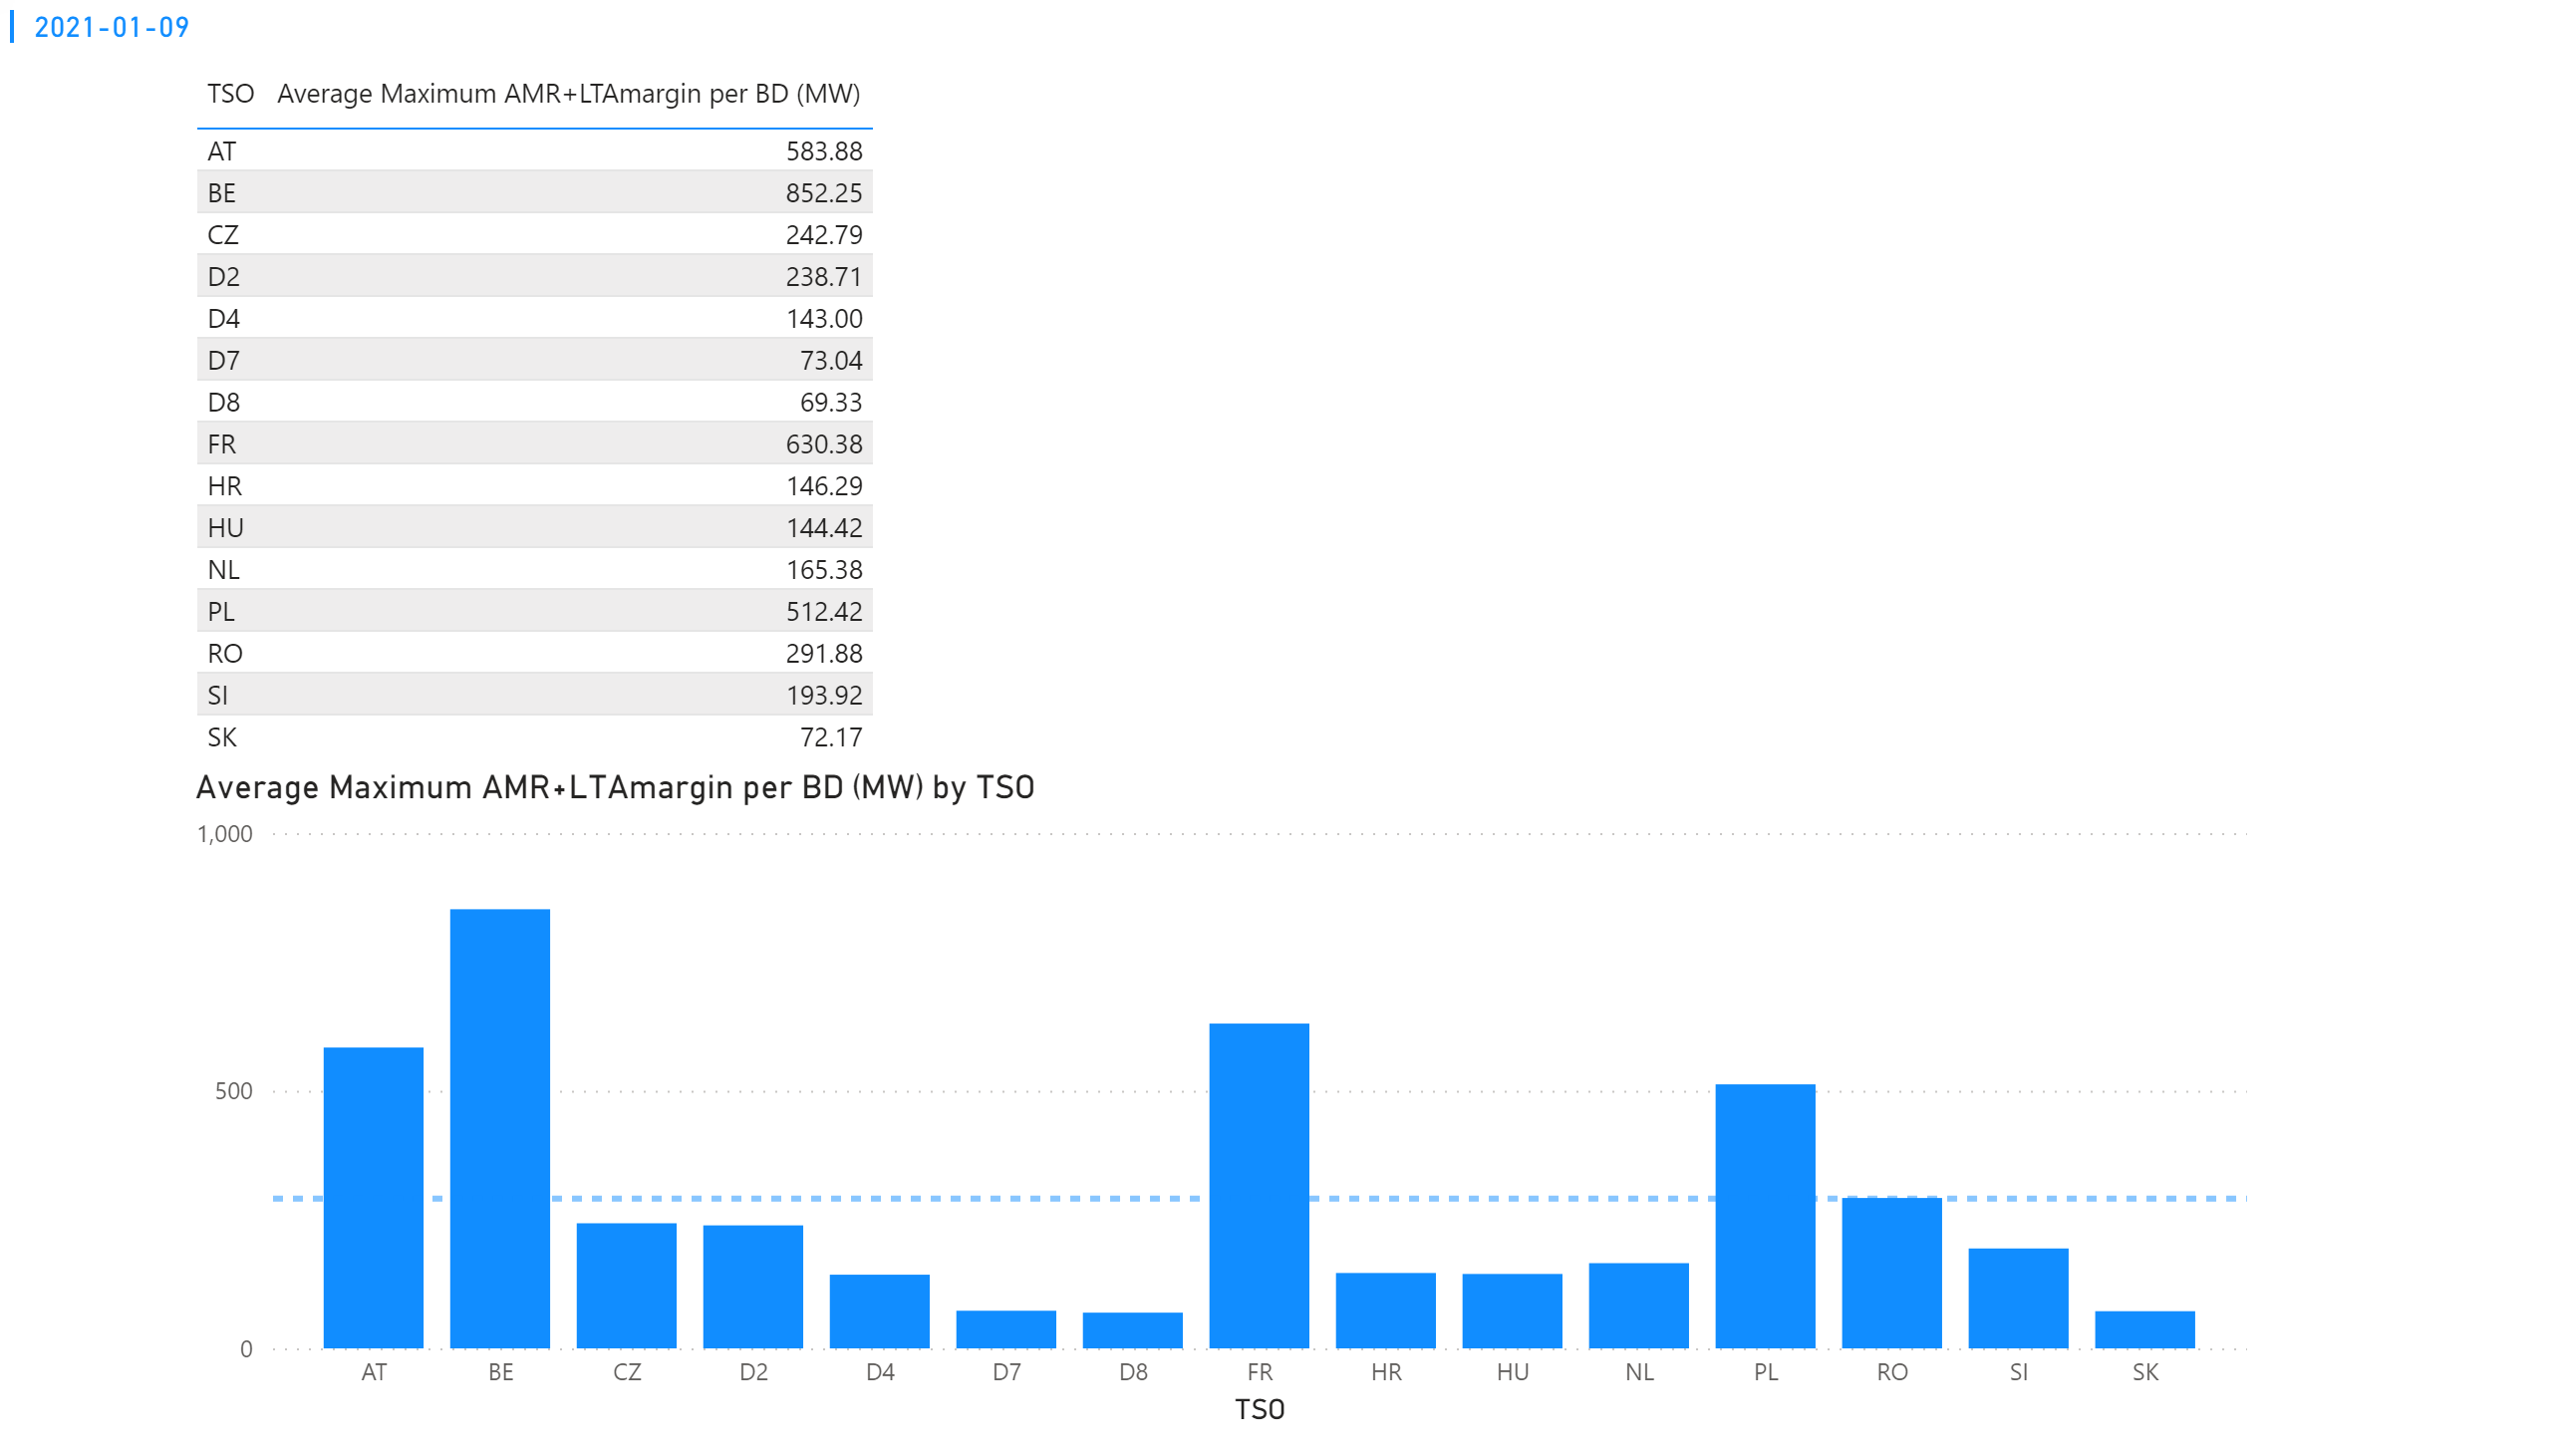
KPI 4
KPI 4: Average maximum AMR+LTAmargin per TSO per BD
Notes:
tableEx
No alt text provided.
multiRowCard
No alt text provided.
Average Maximum AMR+LTAmargin per BD (MW) by TSO
No alt text provided.

Slide 11
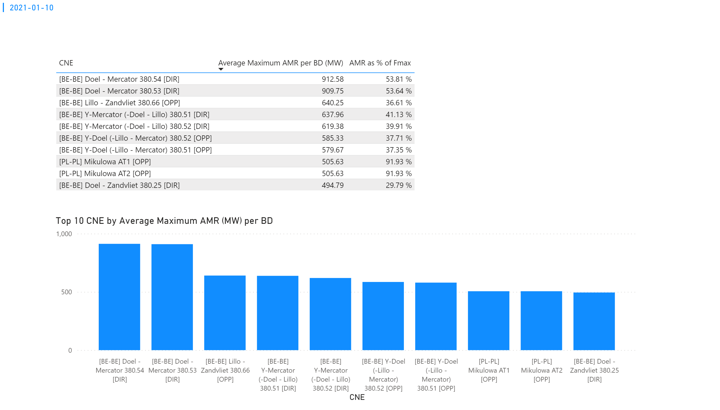
KPI 1
KPI 1: Average maximum AMR per CNE per BD
Notes:
tableEx
No alt text provided.
Top 10 CNE by Average Maximum AMR (MW) per BD
No alt text provided.
multiRowCard
No alt text provided.

Slide 12
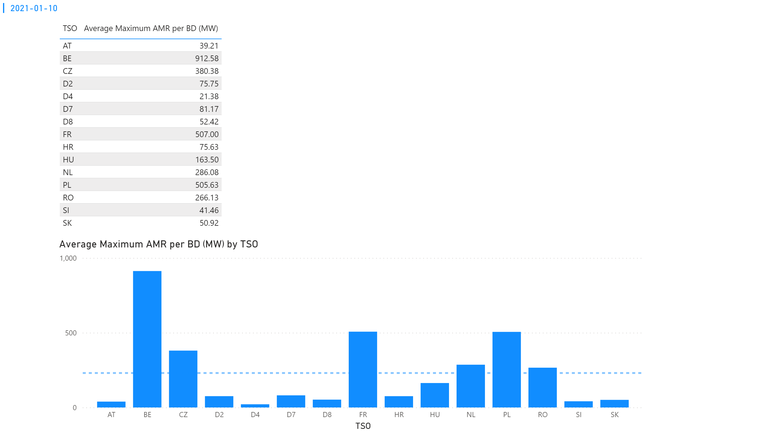
KPI 2
KPI 2: Average maximum AMR per CNE per TSO
Notes:
tableEx
No alt text provided.
Average Maximum AMR per BD (MW) by TSO
No alt text provided.
multiRowCard
No alt text provided.

Slide 13
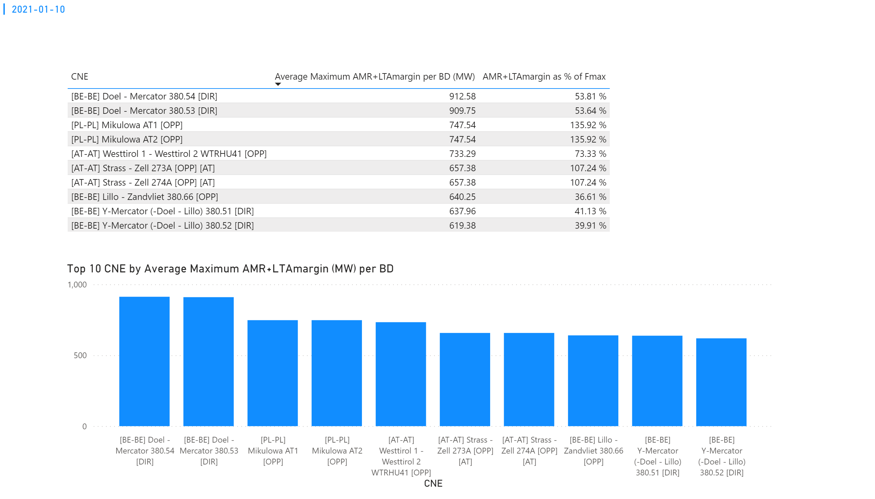
KPI 3
KPI 3: Average maximum AMR+LTAmargin per CNE per BD
Notes:
tableEx
No alt text provided.
Top 10 CNE by Average Maximum AMR+LTAmargin (MW) per BD
No alt text provided.
multiRowCard
No alt text provided.

Slide 14
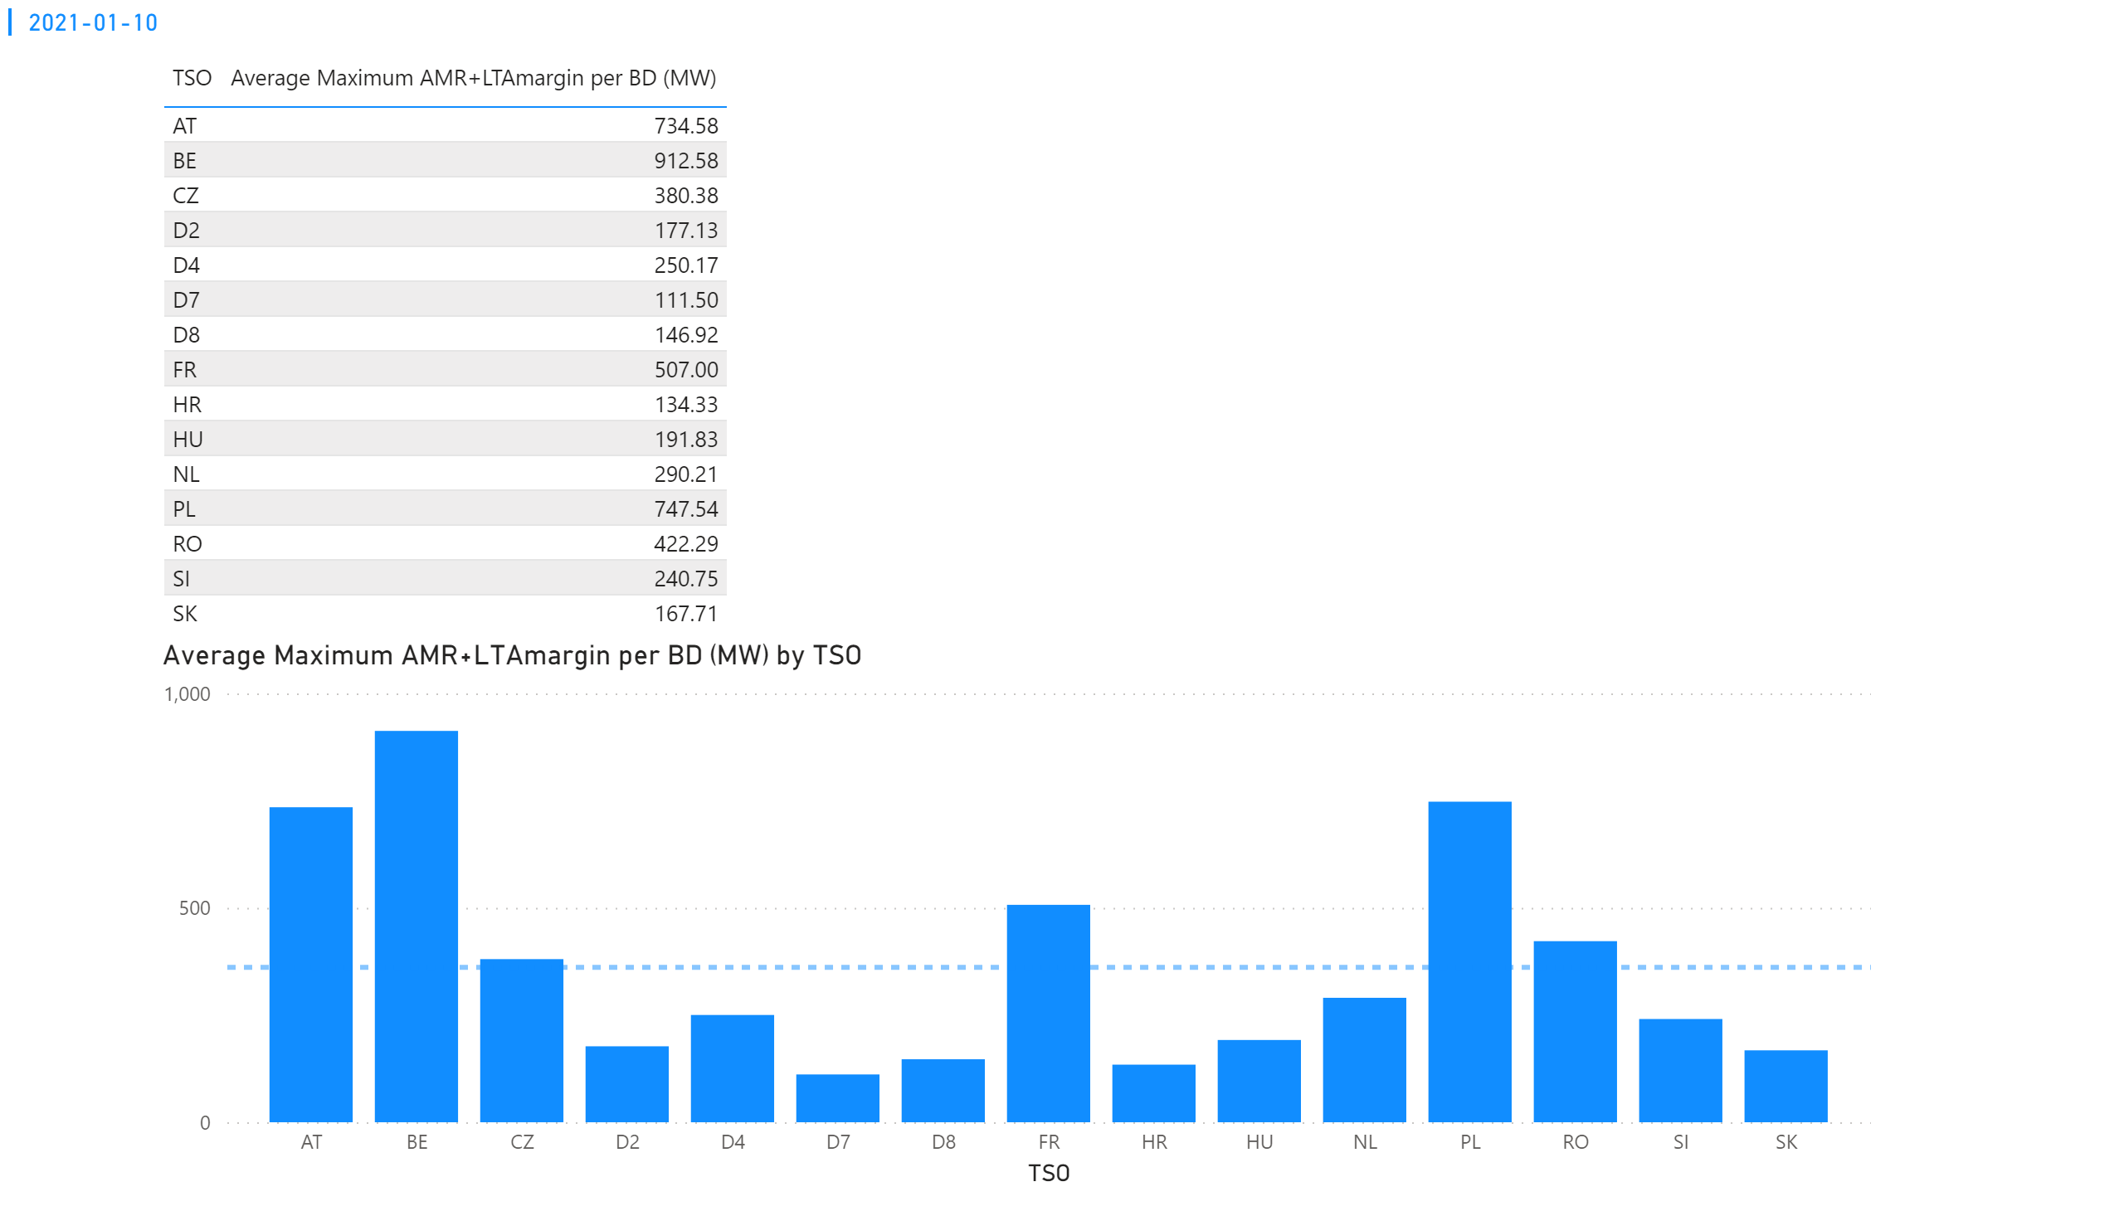
KPI 4
KPI 4: Average maximum AMR+LTAmargin per TSO per BD
Notes:
tableEx
No alt text provided.
multiRowCard
No alt text provided.
Average Maximum AMR+LTAmargin per BD (MW) by TSO
No alt text provided.

Slide 15
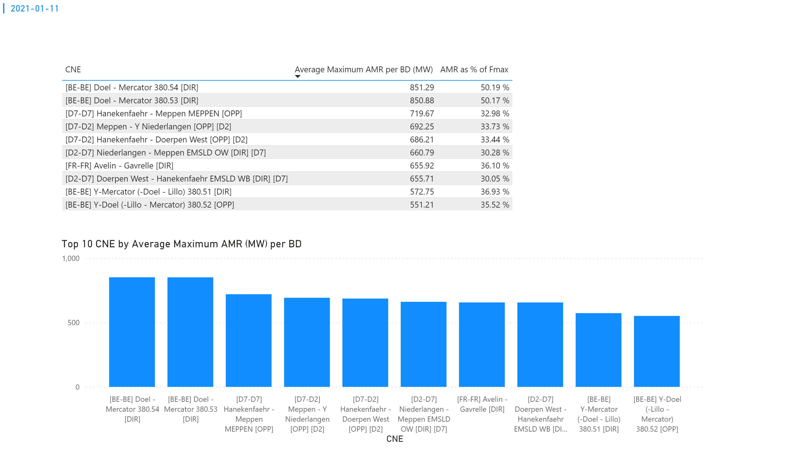
KPI 1
KPI 1: Average maximum AMR per CNE per BD
Notes:
tableEx
No alt text provided.
Top 10 CNE by Average Maximum AMR (MW) per BD
No alt text provided.
multiRowCard
No alt text provided.

Slide 16
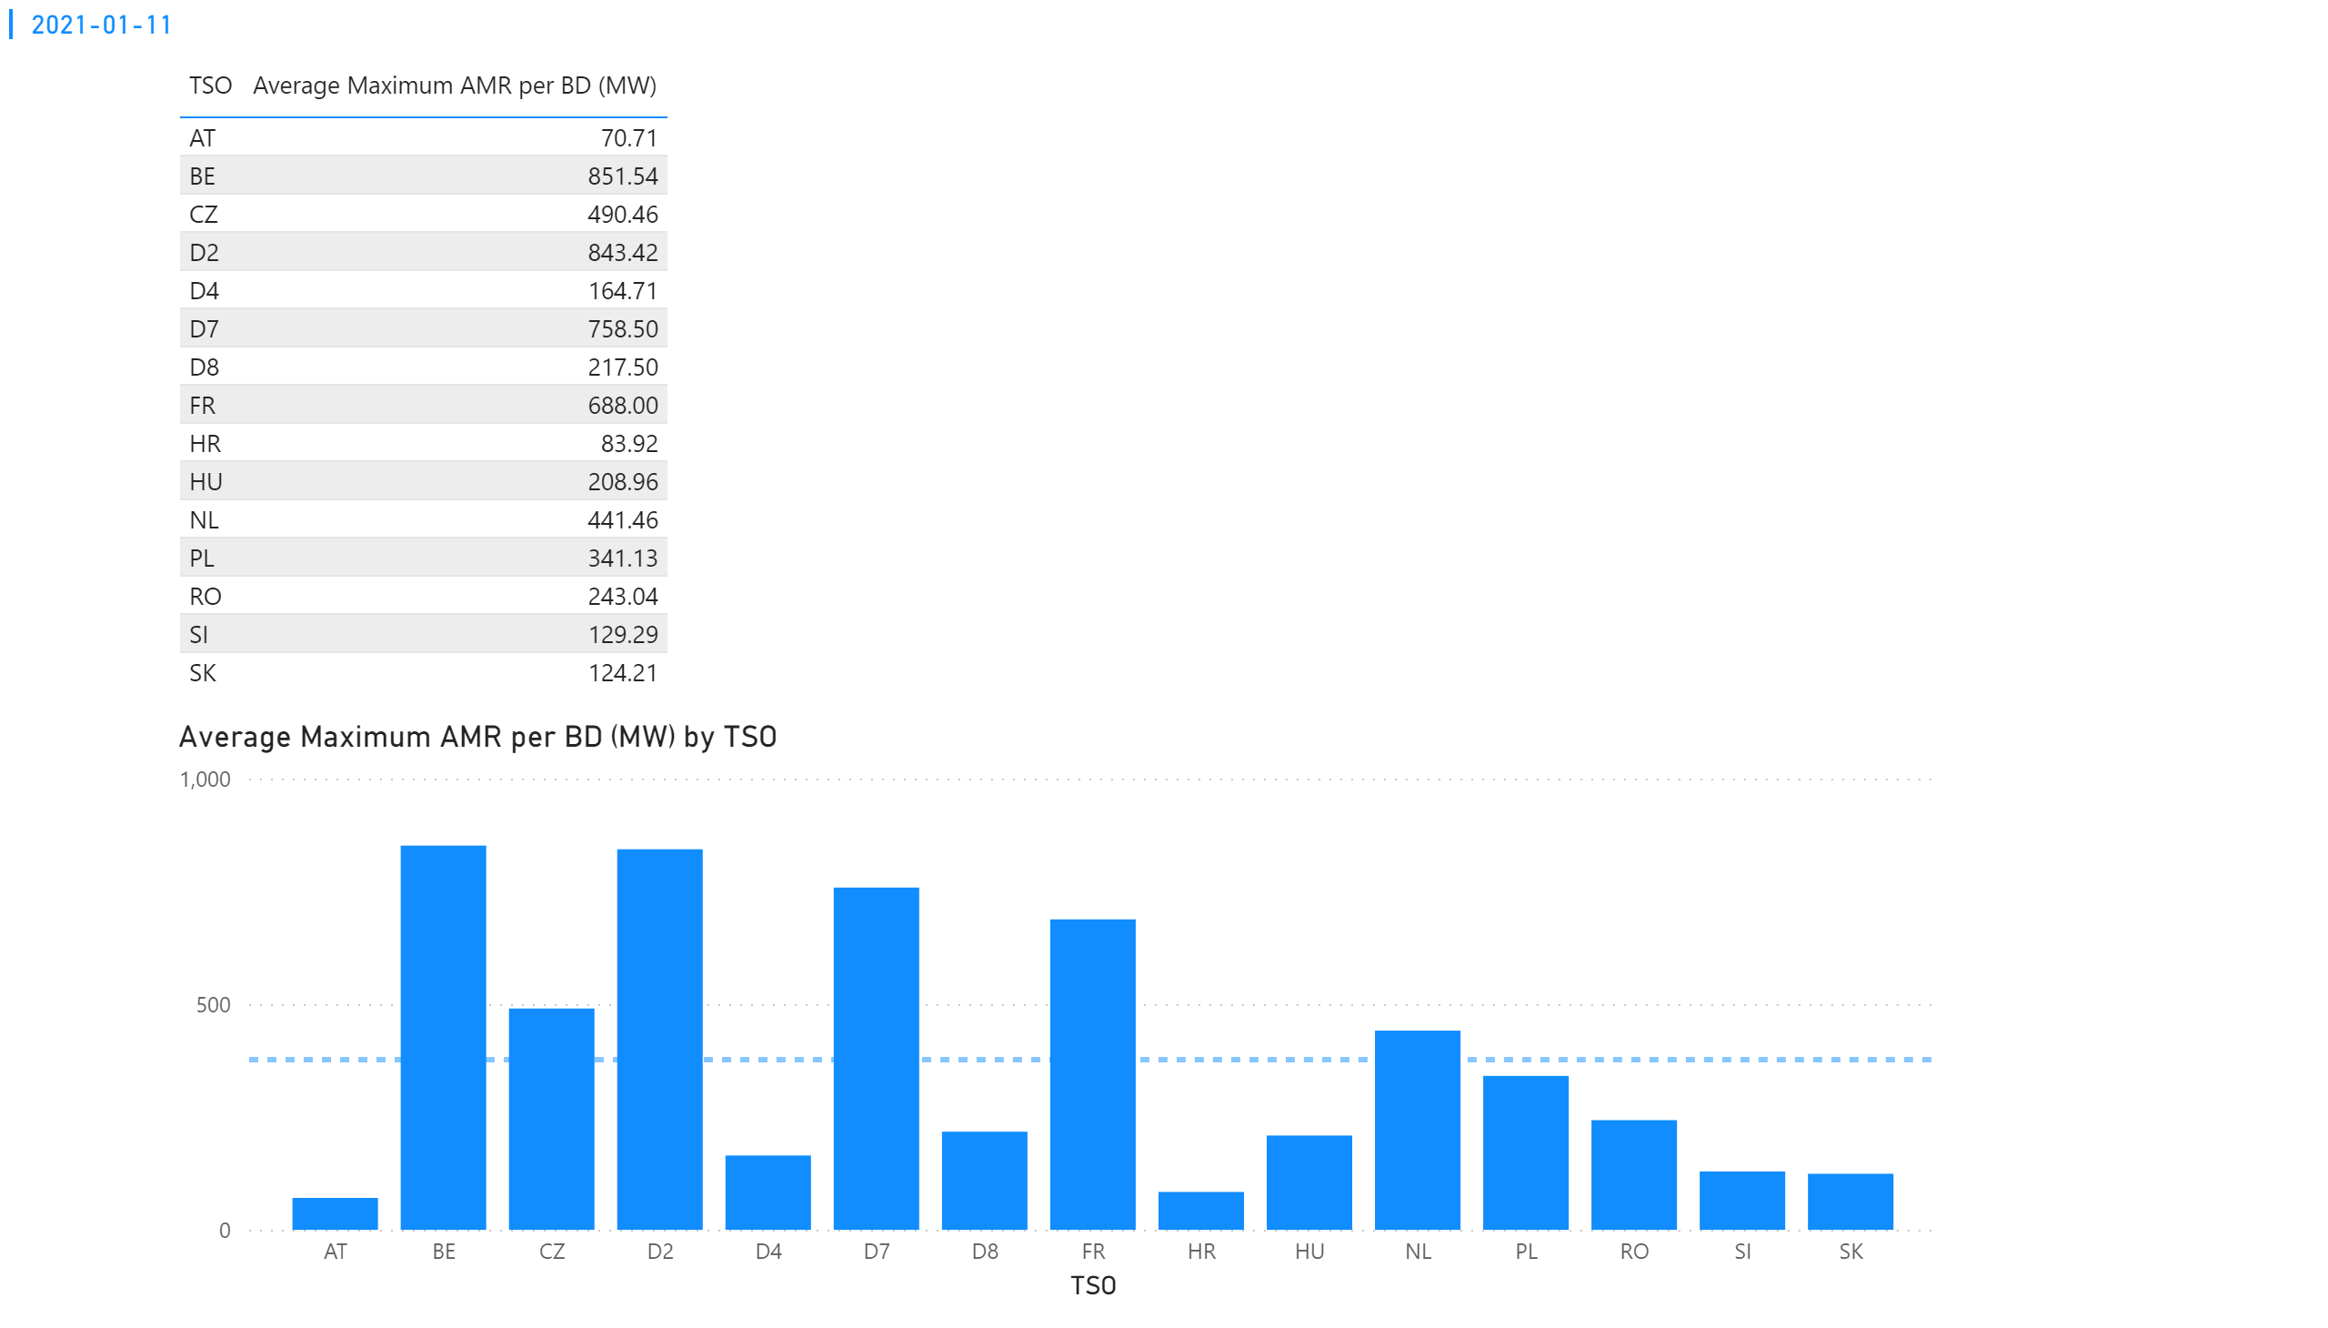
KPI 2
KPI 2: Average maximum AMR per CNE per TSO
Notes:
tableEx
No alt text provided.
Average Maximum AMR per BD (MW) by TSO
No alt text provided.
multiRowCard
No alt text provided.

Slide 17
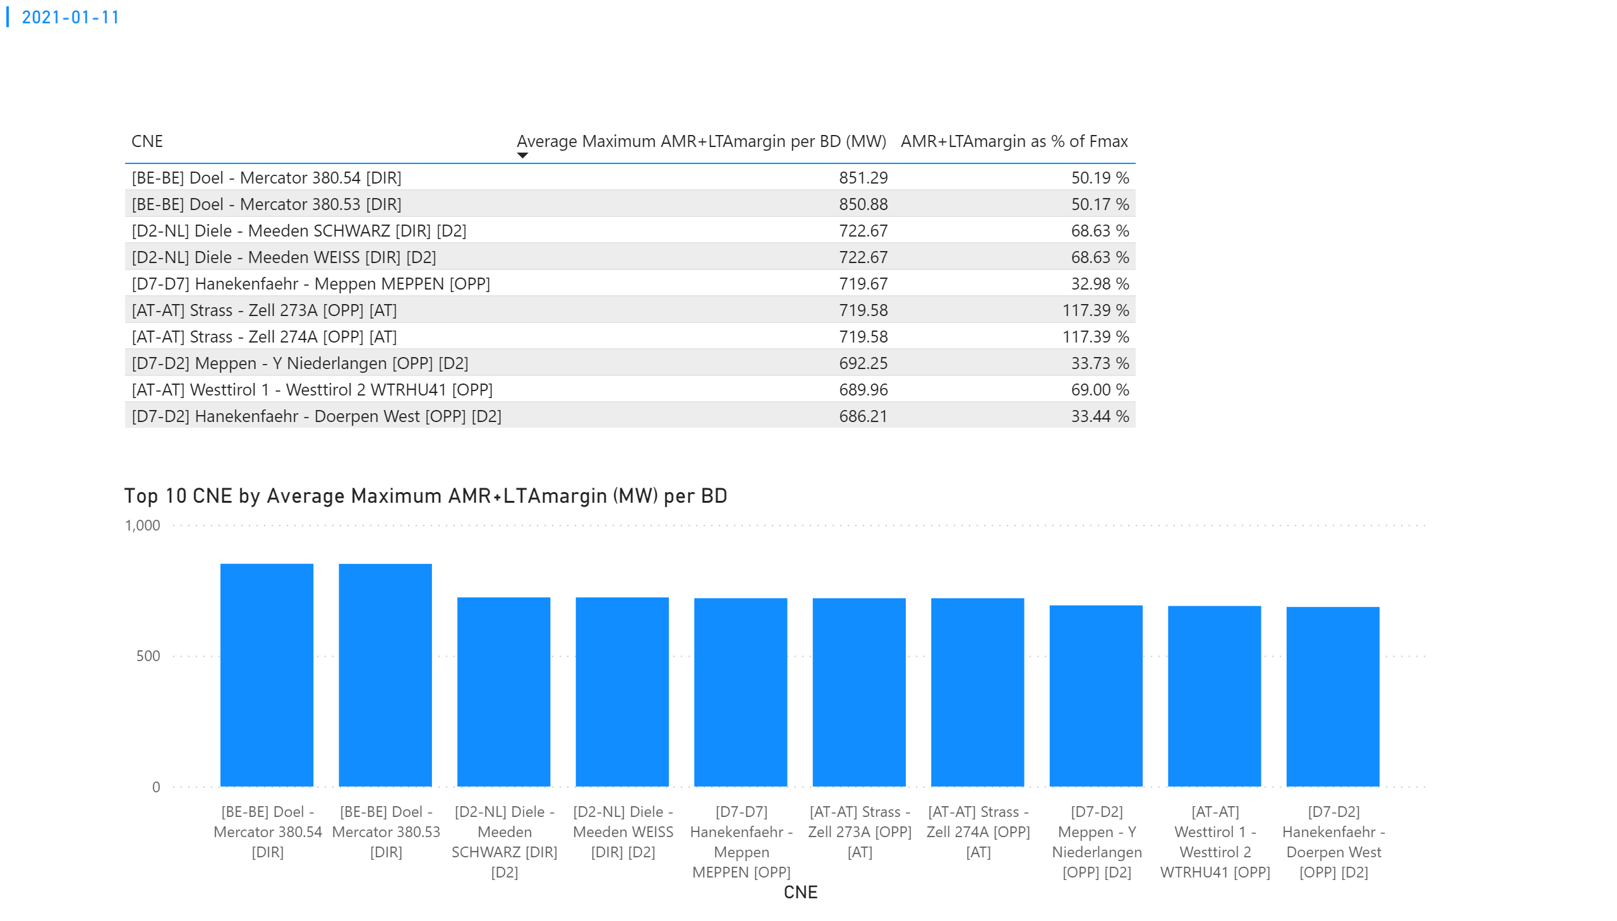
KPI 3
KPI 3: Average maximum AMR+LTAmargin per CNE per BD
Notes:
tableEx
No alt text provided.
Top 10 CNE by Average Maximum AMR+LTAmargin (MW) per BD
No alt text provided.
multiRowCard
No alt text provided.

Slide 18
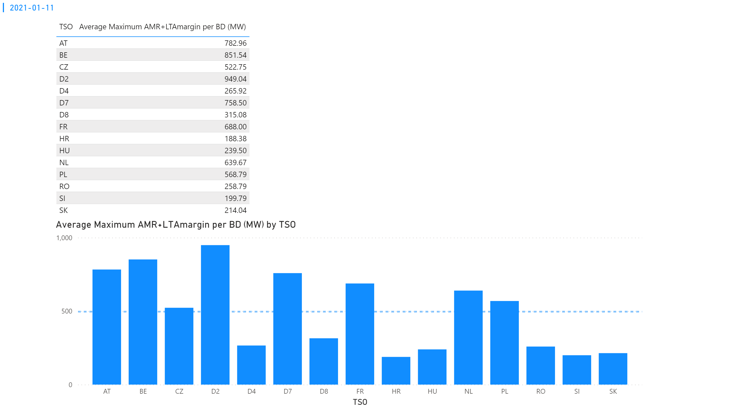
KPI 4
KPI 4: Average maximum AMR+LTAmargin per TSO per BD
Notes:
tableEx
No alt text provided.
multiRowCard
No alt text provided.
Average Maximum AMR+LTAmargin per BD (MW) by TSO
No alt text provided.

Slide 19
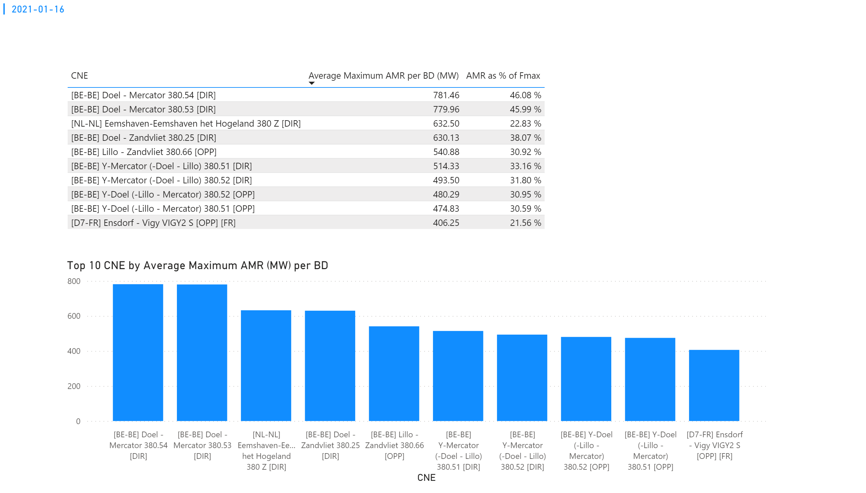
KPI 1
KPI 1: Average maximum AMR per CNE per BD
Notes:
tableEx
No alt text provided.
Top 10 CNE by Average Maximum AMR (MW) per BD
No alt text provided.
multiRowCard
No alt text provided.

Slide 20
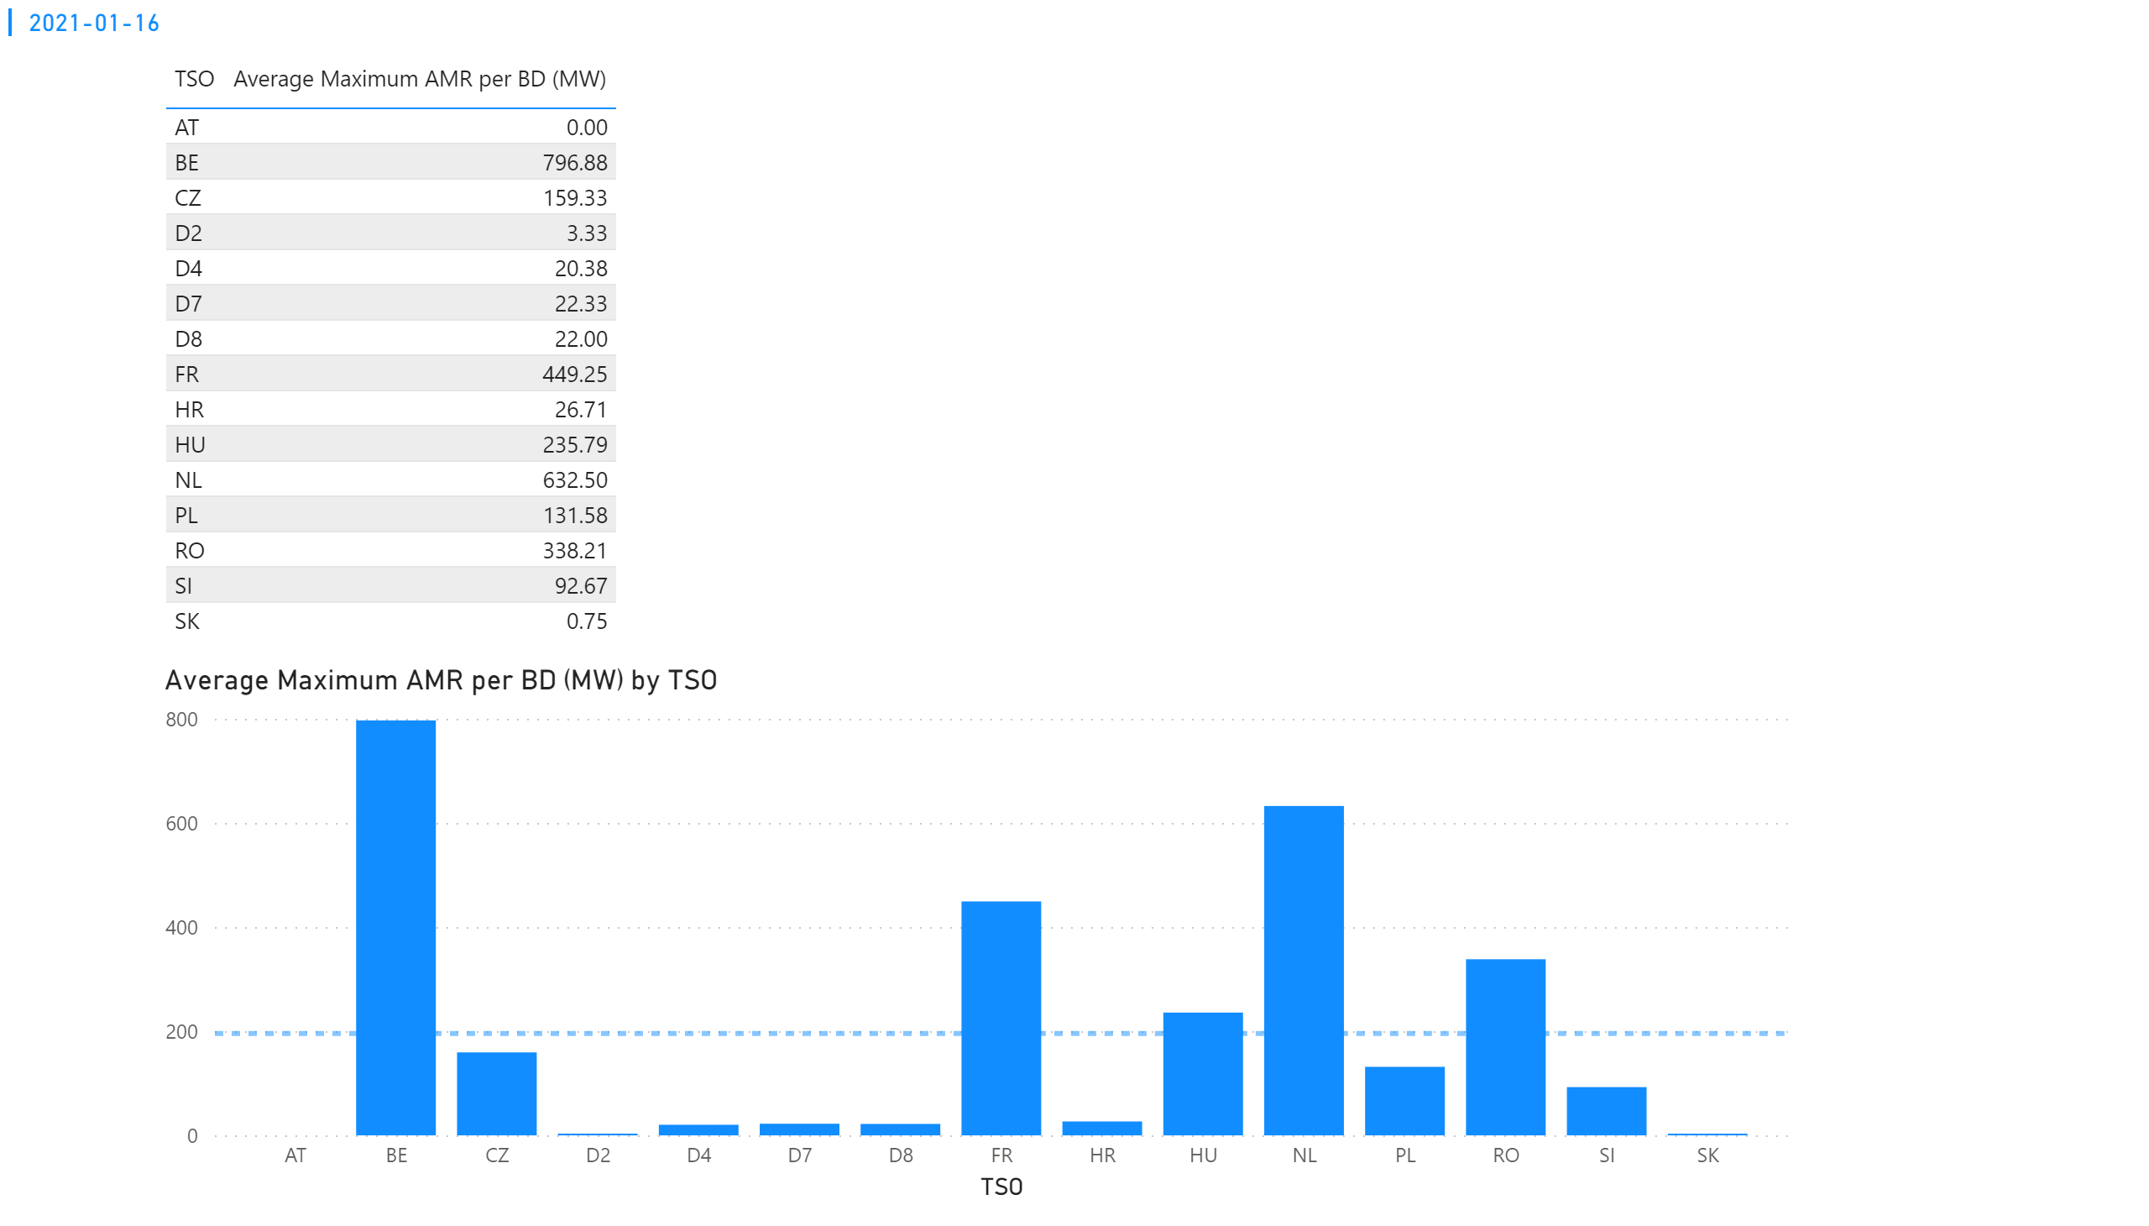
KPI 2
KPI 2: Average maximum AMR per CNE per TSO
Notes:
tableEx
No alt text provided.
Average Maximum AMR per BD (MW) by TSO
No alt text provided.
multiRowCard
No alt text provided.

Slide 21
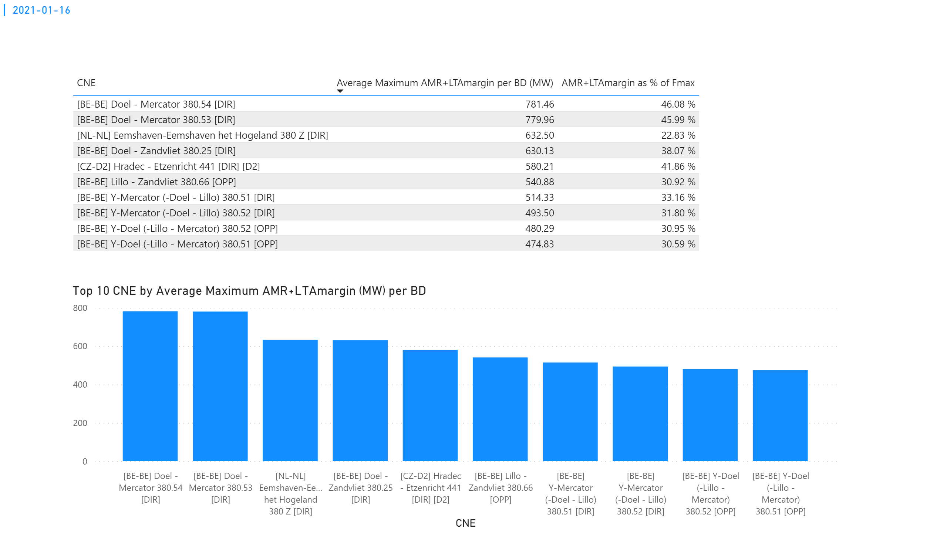
KPI 3
KPI 3: Average maximum AMR+LTAmargin per CNE per BD
Notes:
tableEx
No alt text provided.
Top 10 CNE by Average Maximum AMR+LTAmargin (MW) per BD
No alt text provided.
multiRowCard
No alt text provided.

Slide 22
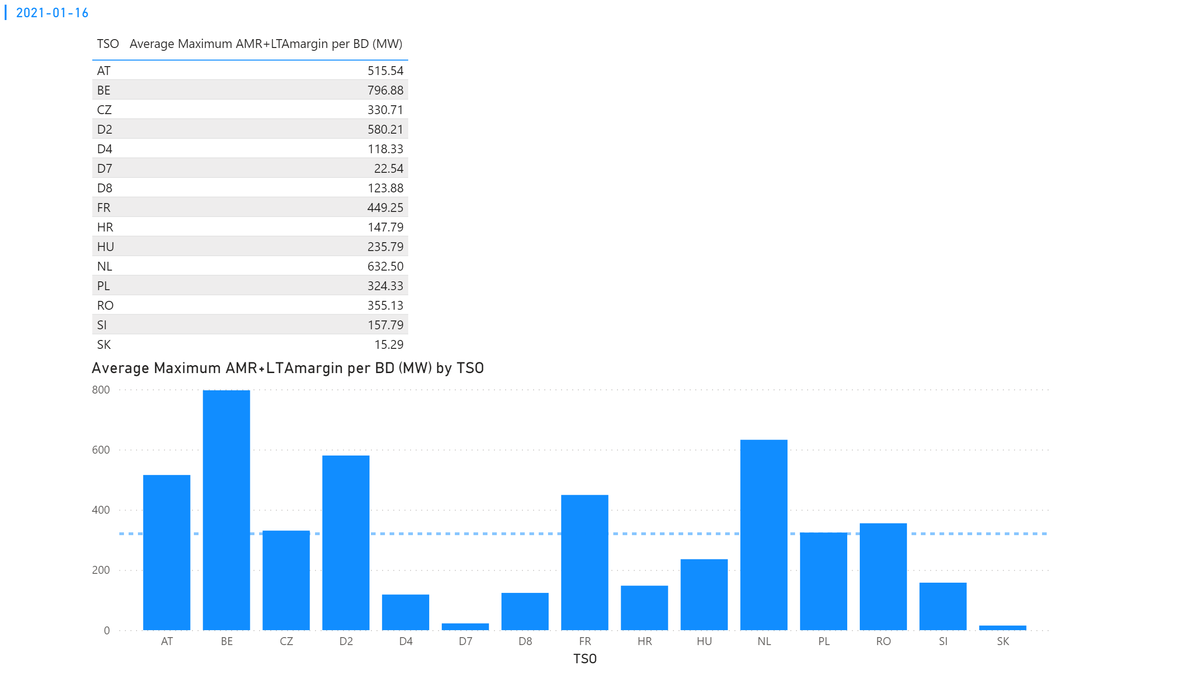
KPI 4
KPI 4: Average maximum AMR+LTAmargin per TSO per BD
Notes:
tableEx
No alt text provided.
multiRowCard
No alt text provided.
Average Maximum AMR+LTAmargin per BD (MW) by TSO
No alt text provided.

Slide 23
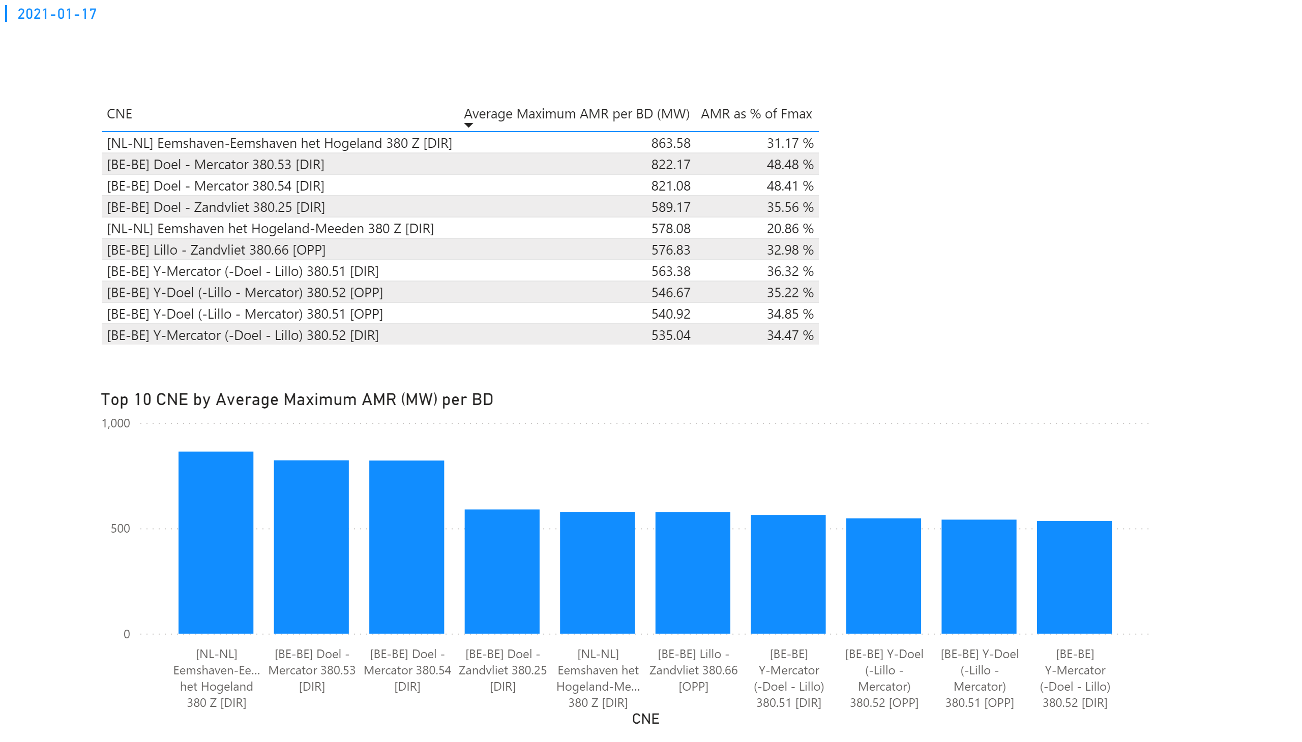
KPI 1
KPI 1: Average maximum AMR per CNE per BD
Notes:
tableEx
No alt text provided.
Top 10 CNE by Average Maximum AMR (MW) per BD
No alt text provided.
multiRowCard
No alt text provided.

Slide 24
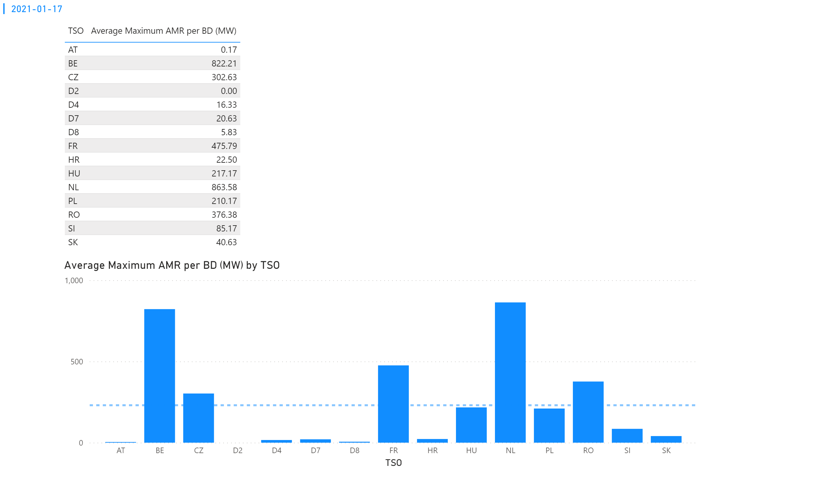
KPI 2
KPI 2: Average maximum AMR per CNE per TSO
Notes:
tableEx
No alt text provided.
Average Maximum AMR per BD (MW) by TSO
No alt text provided.
multiRowCard
No alt text provided.

Slide 25
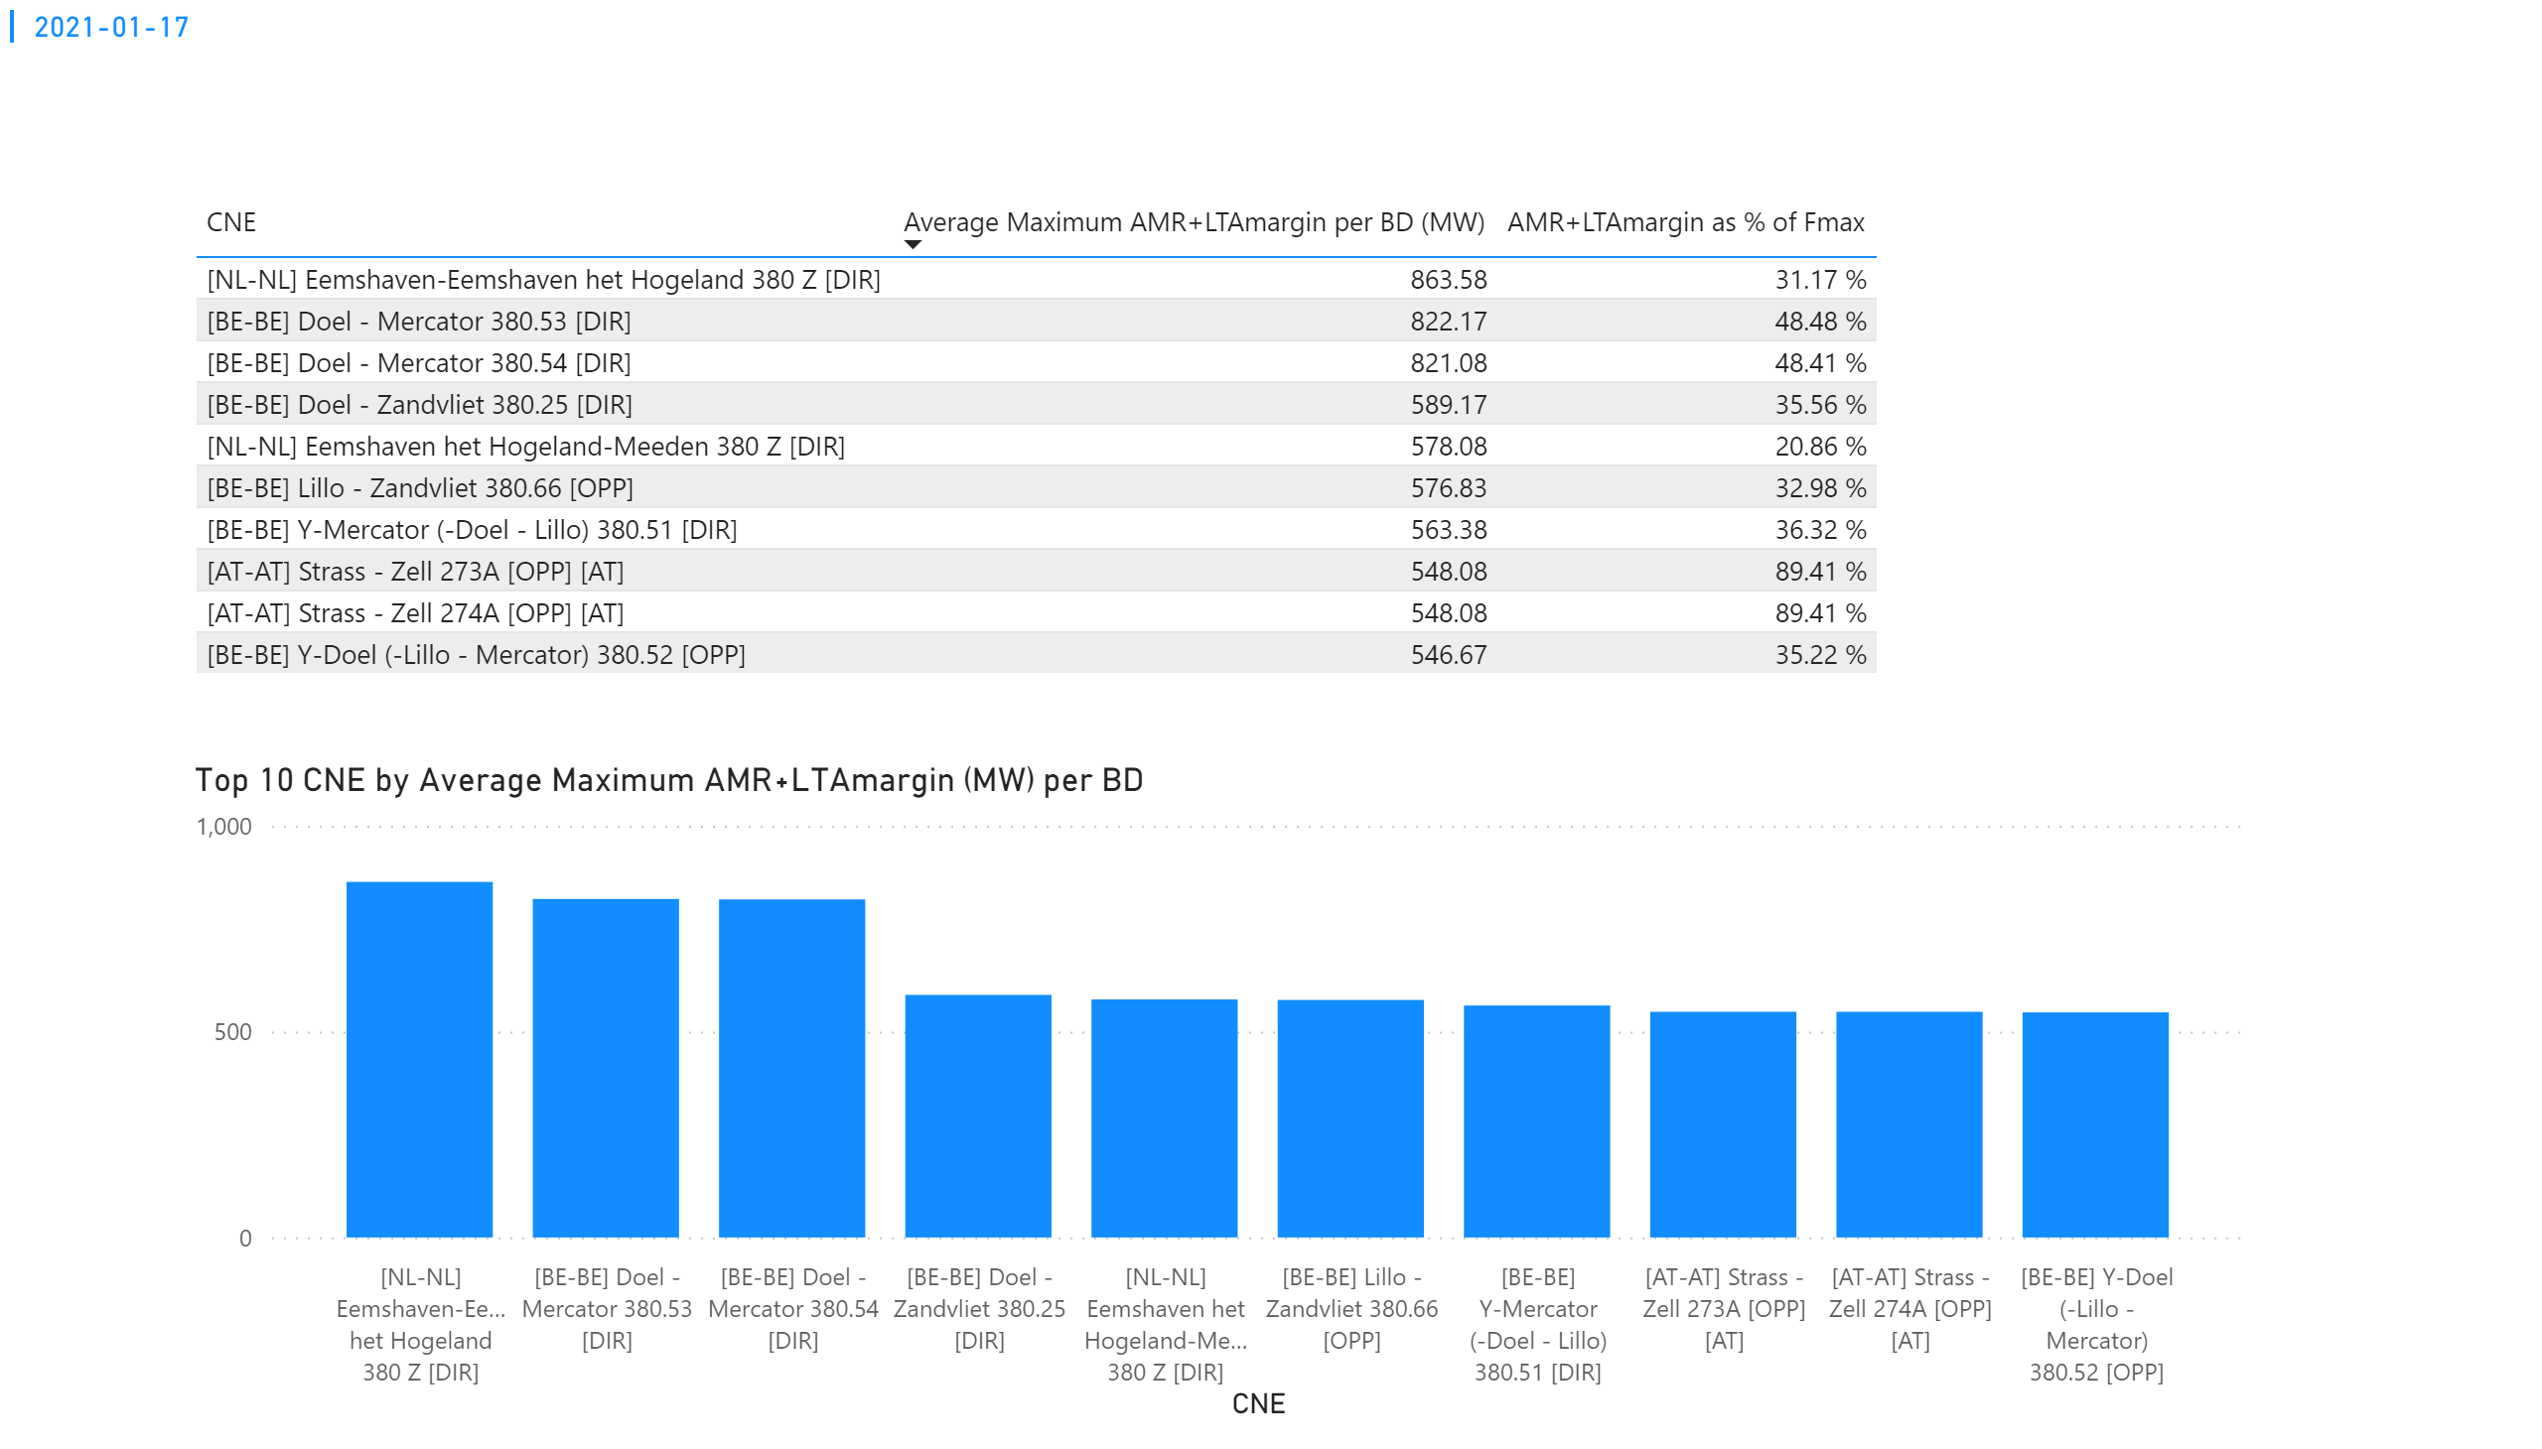
KPI 3
KPI 3: Average maximum AMR+LTAmargin per CNE per BD
Notes:
tableEx
No alt text provided.
Top 10 CNE by Average Maximum AMR+LTAmargin (MW) per BD
No alt text provided.
multiRowCard
No alt text provided.

Slide 26
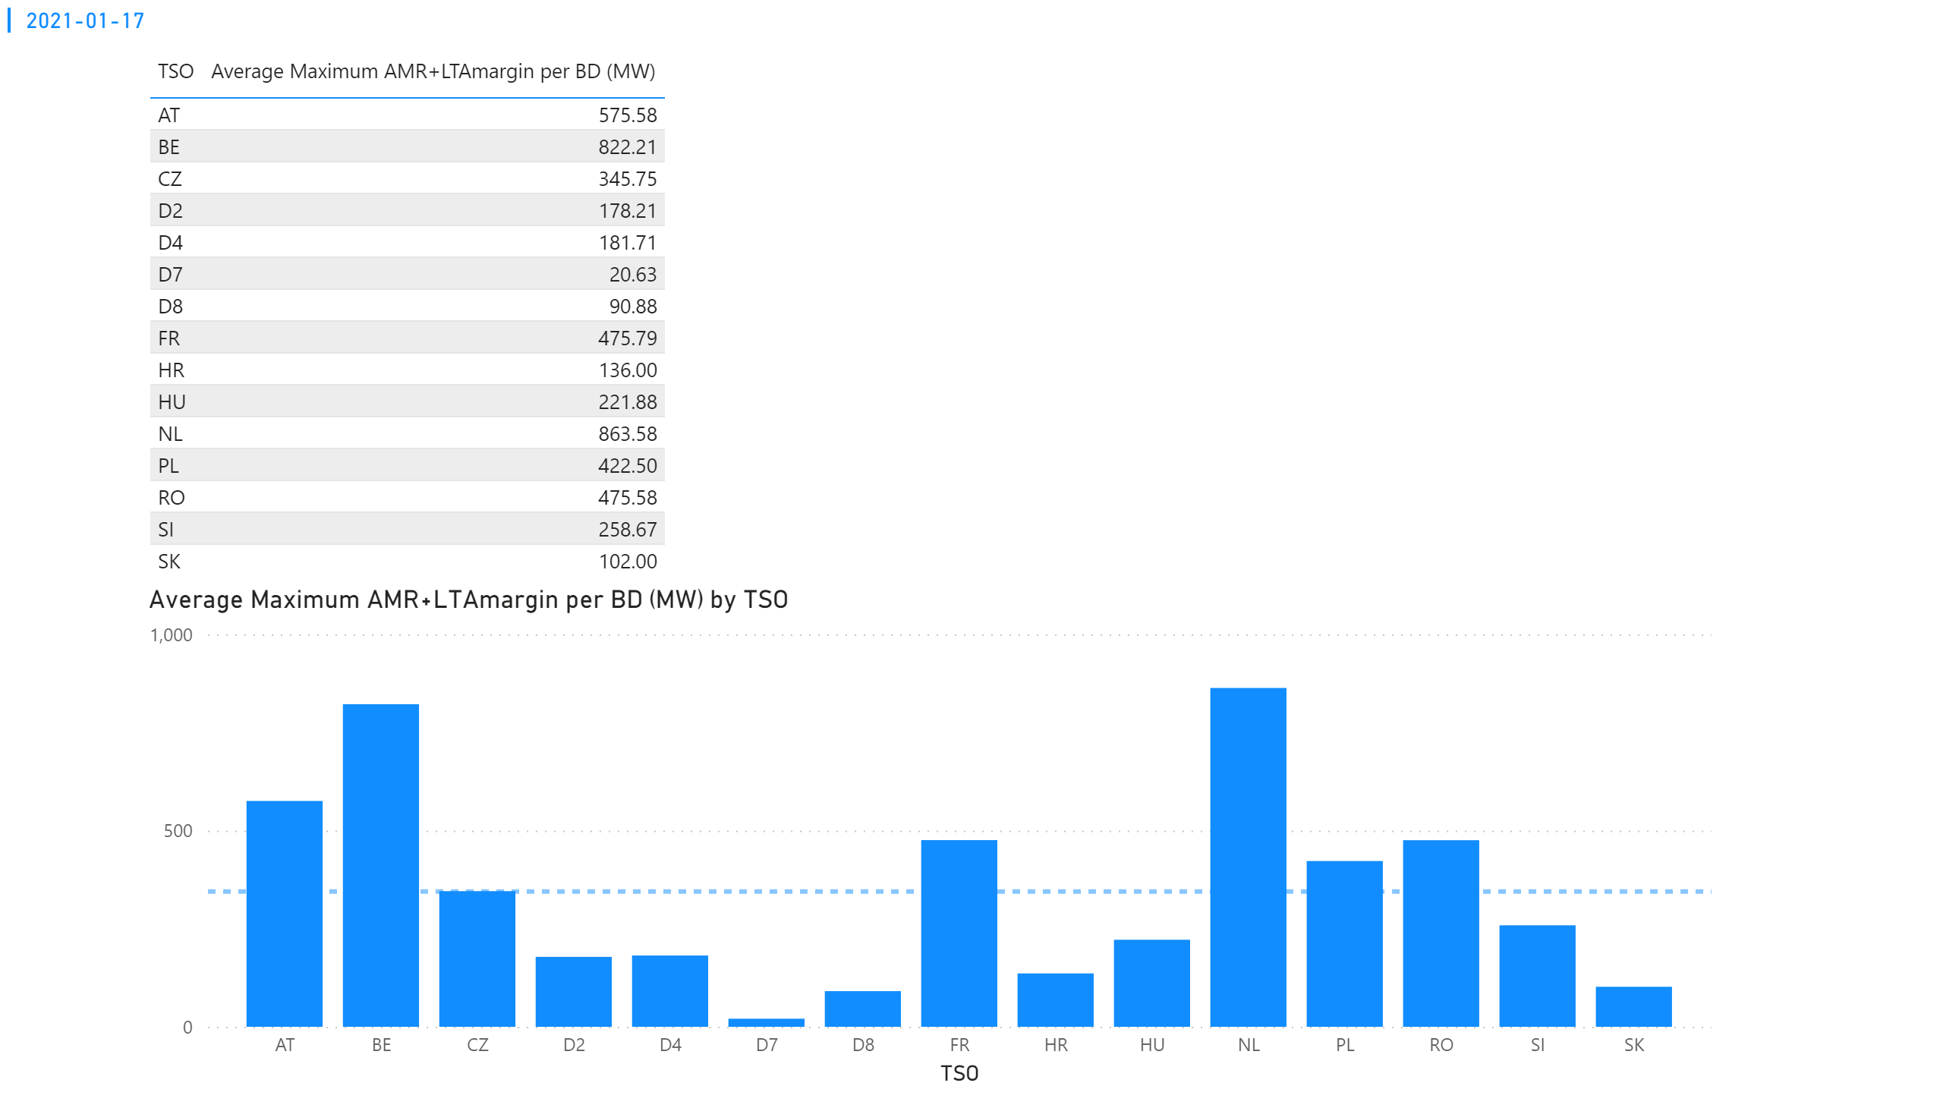
KPI 4
KPI 4: Average maximum AMR+LTAmargin per TSO per BD
Notes:
tableEx
No alt text provided.
multiRowCard
No alt text provided.
Average Maximum AMR+LTAmargin per BD (MW) by TSO
No alt text provided.

Slide 27
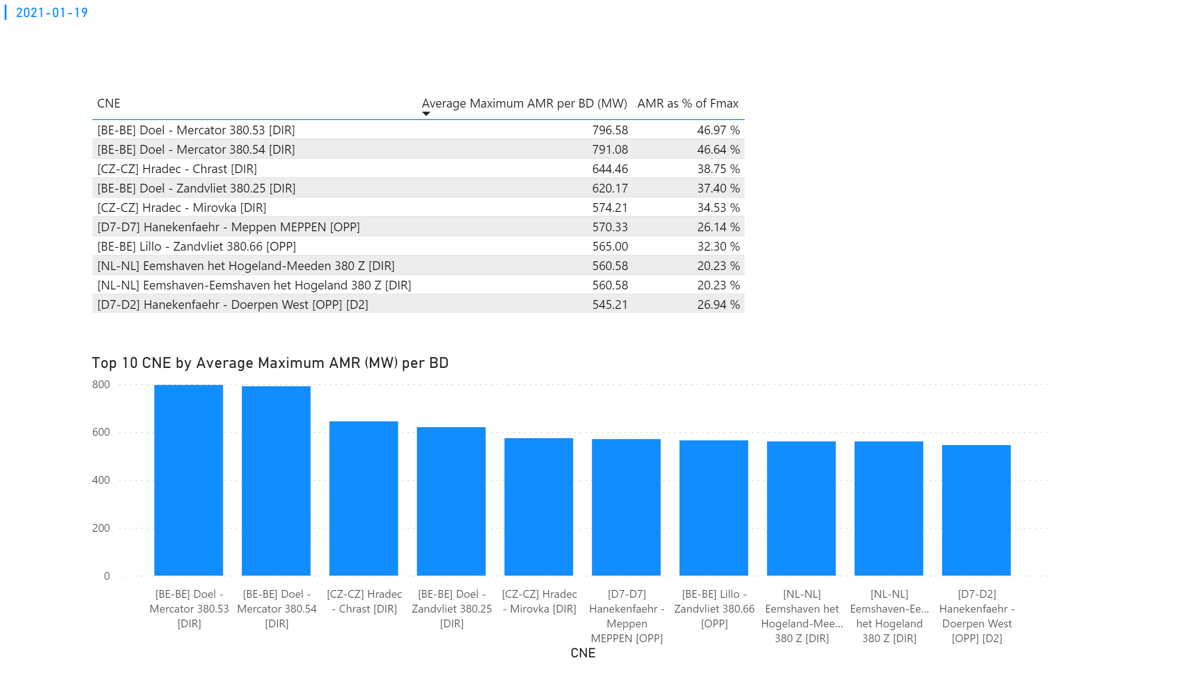
KPI 1
KPI 1: Average maximum AMR per CNE per BD
Notes:
tableEx
No alt text provided.
Top 10 CNE by Average Maximum AMR (MW) per BD
No alt text provided.
multiRowCard
No alt text provided.

Slide 28
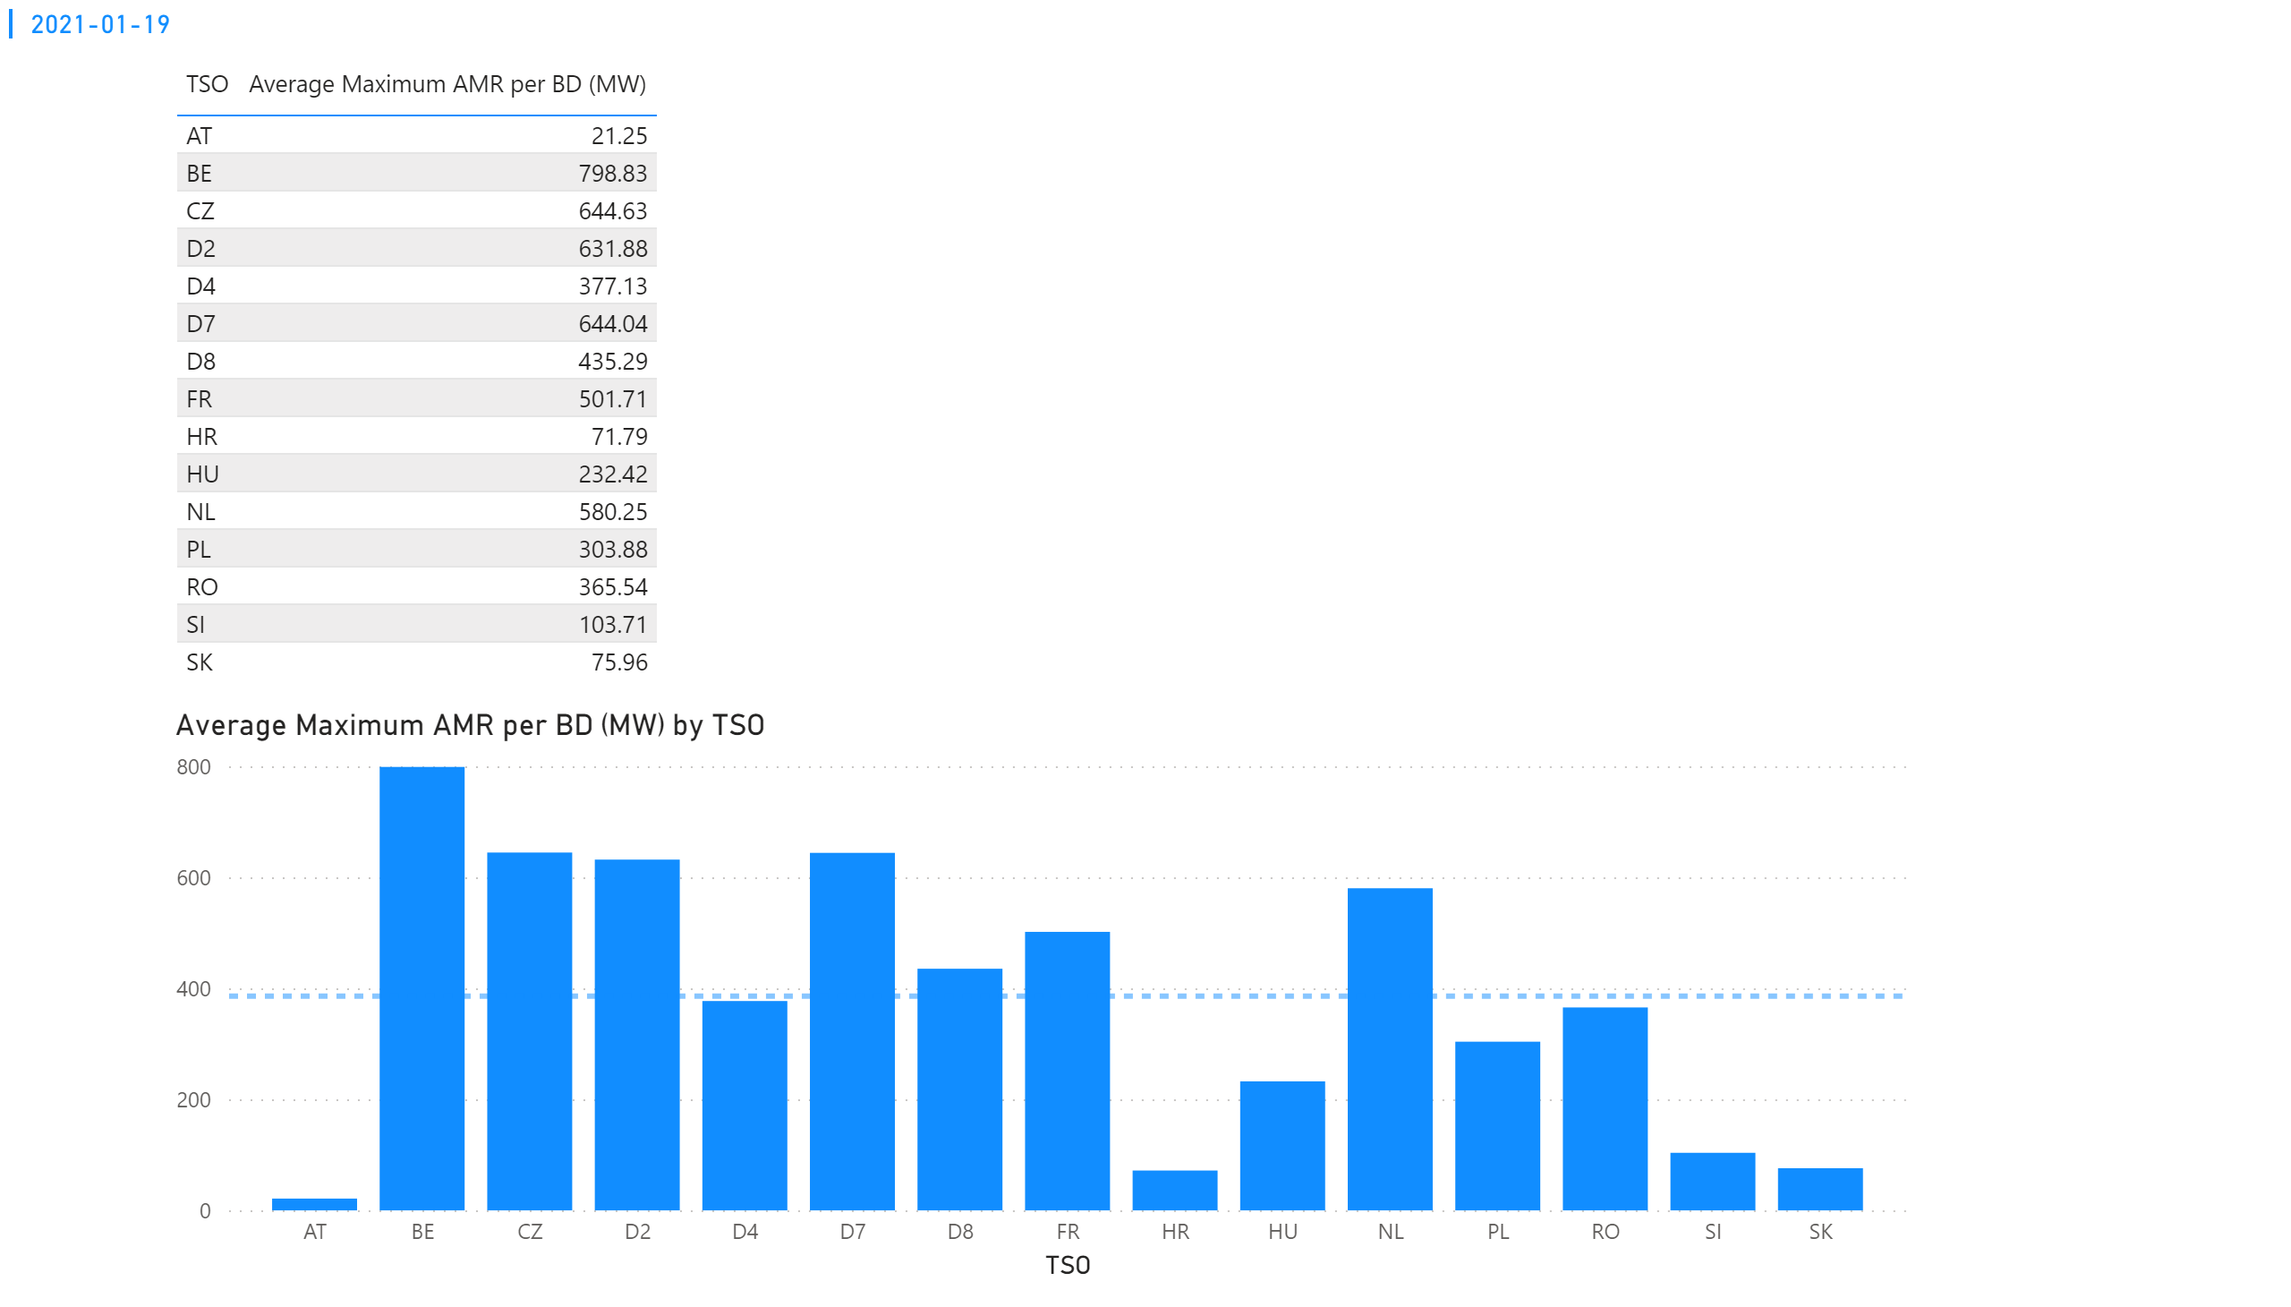
KPI 2
KPI 2: Average maximum AMR per CNE per TSO
Notes:
tableEx
No alt text provided.
Average Maximum AMR per BD (MW) by TSO
No alt text provided.
multiRowCard
No alt text provided.

Slide 29
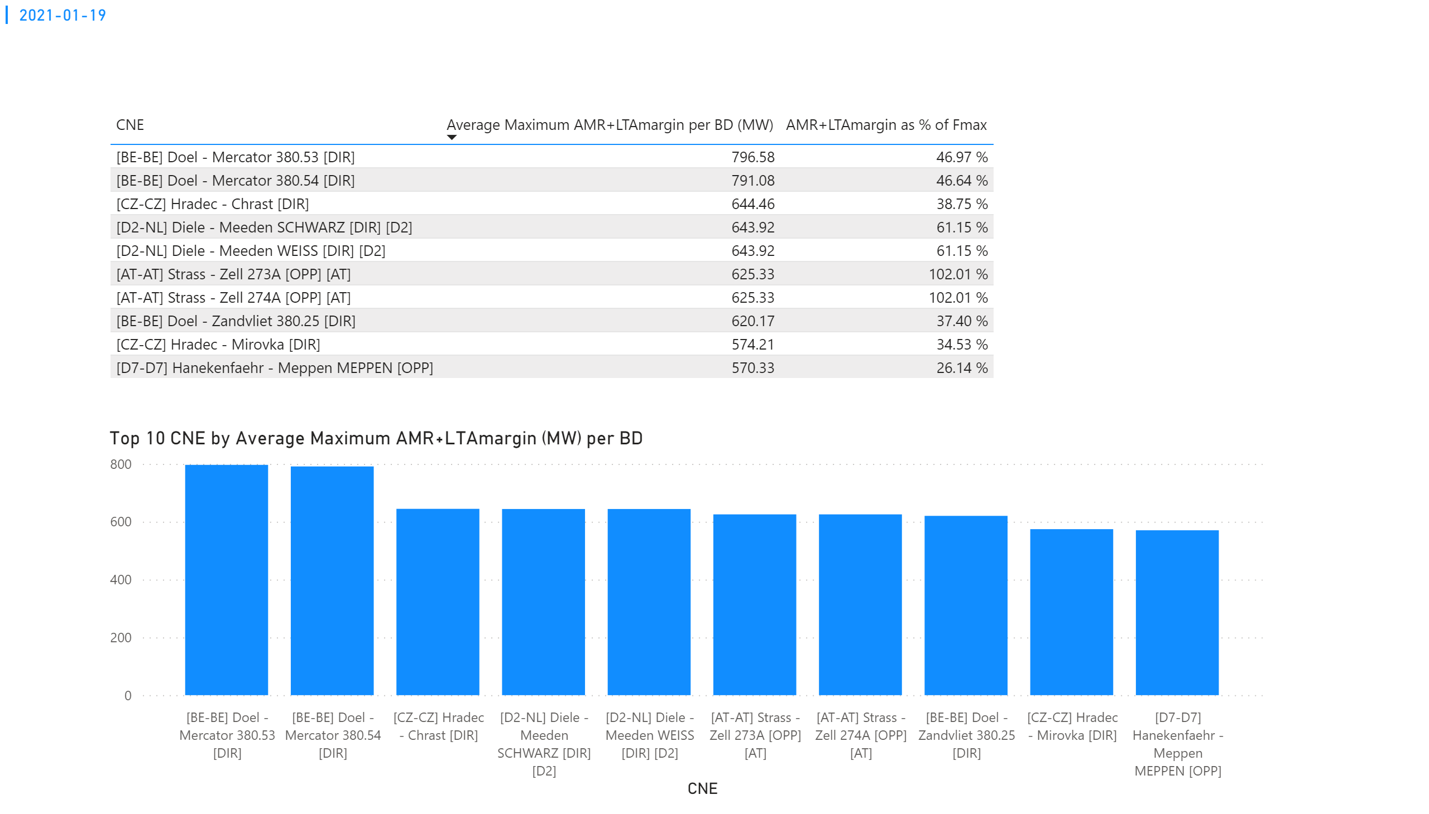
KPI 3
KPI 3: Average maximum AMR+LTAmargin per CNE per BD
Notes:
tableEx
No alt text provided.
Top 10 CNE by Average Maximum AMR+LTAmargin (MW) per BD
No alt text provided.
multiRowCard
No alt text provided.

Slide 30
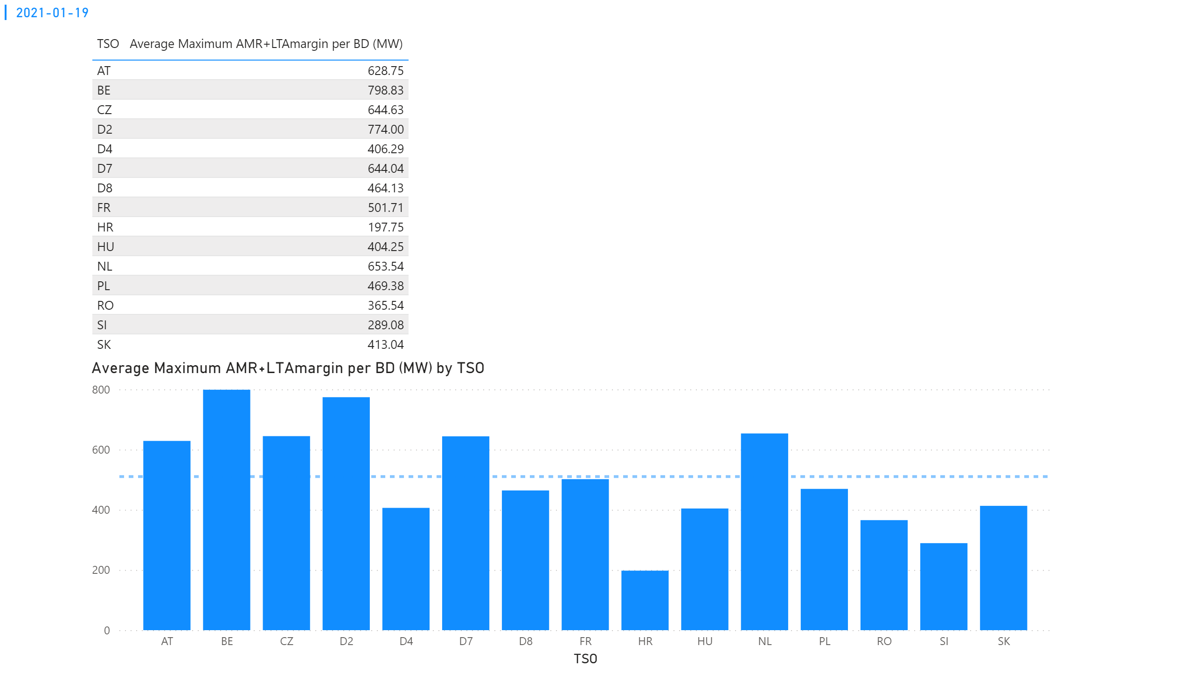
KPI 4
KPI 4: Average maximum AMR+LTAmargin per TSO per BD
Notes:
tableEx
No alt text provided.
multiRowCard
No alt text provided.
Average Maximum AMR+LTAmargin per BD (MW) by TSO
No alt text provided.

Slide 31
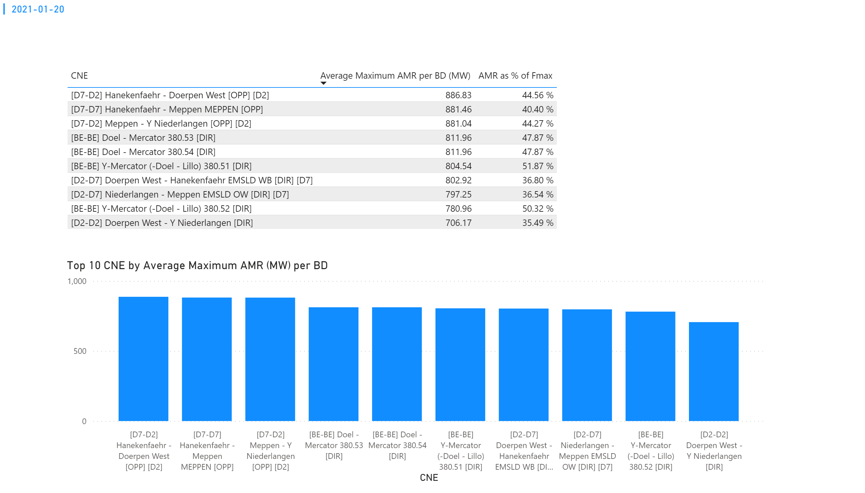
KPI 1
KPI 1: Average maximum AMR per CNE per BD
Notes:
tableEx
No alt text provided.
Top 10 CNE by Average Maximum AMR (MW) per BD
No alt text provided.
multiRowCard
No alt text provided.

Slide 32
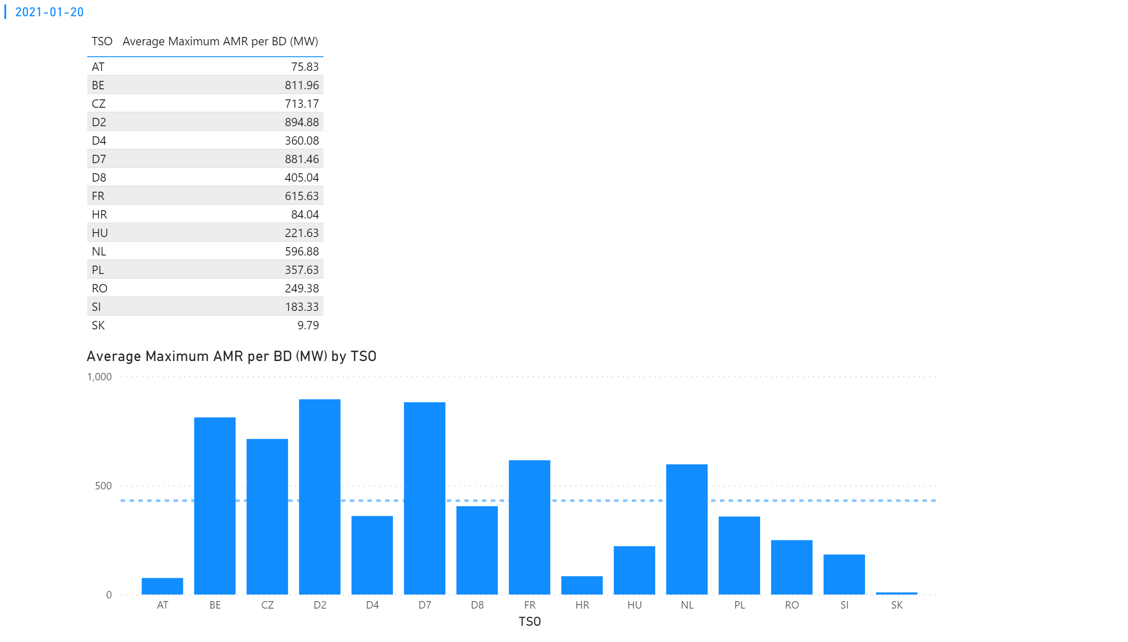
KPI 2
KPI 2: Average maximum AMR per CNE per TSO
Notes:
tableEx
No alt text provided.
Average Maximum AMR per BD (MW) by TSO
No alt text provided.
multiRowCard
No alt text provided.

Slide 33
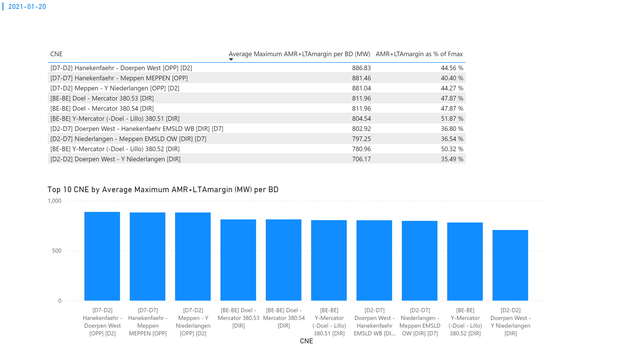
KPI 3
KPI 3: Average maximum AMR+LTAmargin per CNE per BD
Notes:
tableEx
No alt text provided.
Top 10 CNE by Average Maximum AMR+LTAmargin (MW) per BD
No alt text provided.
multiRowCard
No alt text provided.

Slide 34
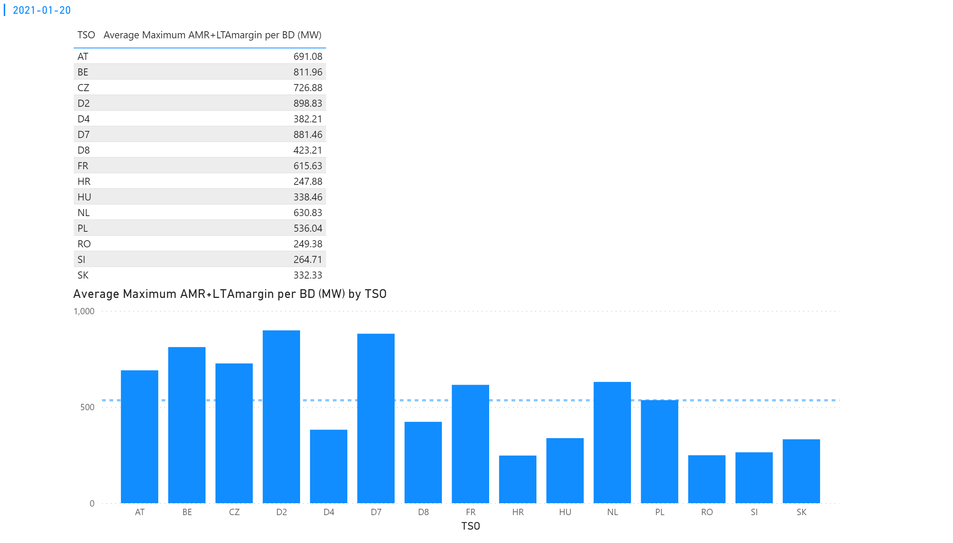
KPI 4
KPI 4: Average maximum AMR+LTAmargin per TSO per BD
Notes:
tableEx
No alt text provided.
multiRowCard
No alt text provided.
Average Maximum AMR+LTAmargin per BD (MW) by TSO
No alt text provided.

Slide 35
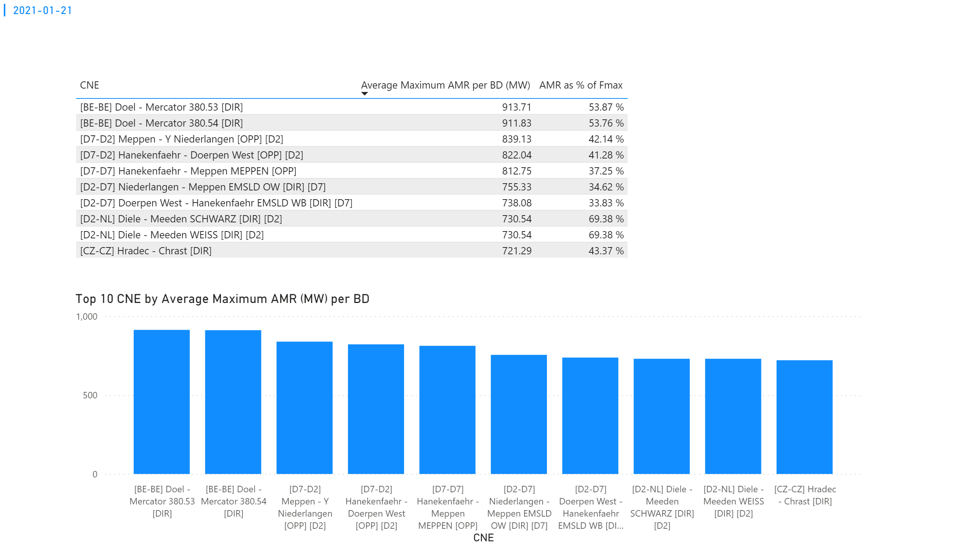
KPI 1
KPI 1: Average maximum AMR per CNE per BD
Notes:
tableEx
No alt text provided.
Top 10 CNE by Average Maximum AMR (MW) per BD
No alt text provided.
multiRowCard
No alt text provided.

Slide 36
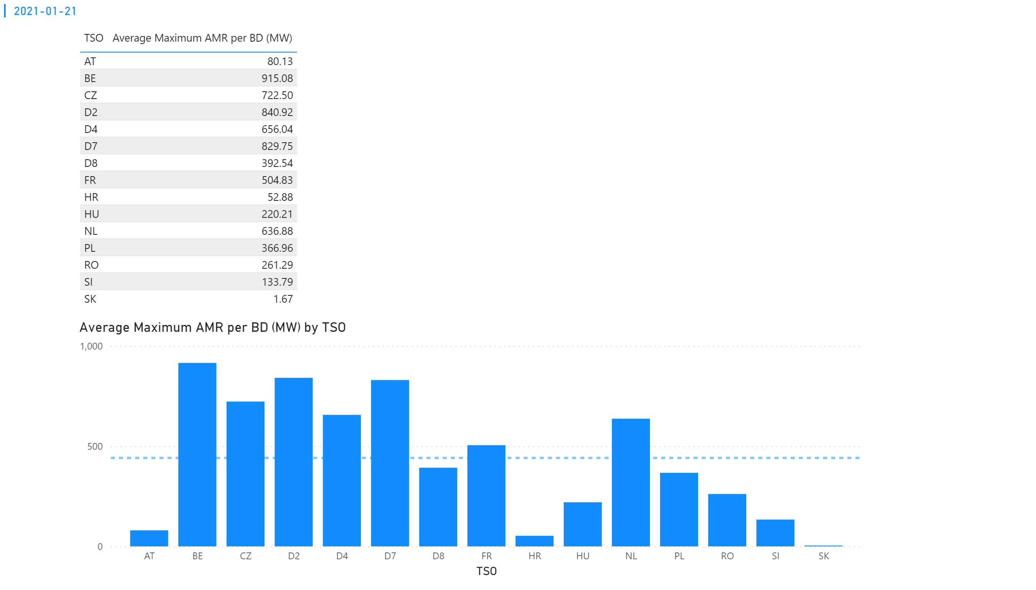
KPI 2
KPI 2: Average maximum AMR per CNE per TSO
Notes:
tableEx
No alt text provided.
Average Maximum AMR per BD (MW) by TSO
No alt text provided.
multiRowCard
No alt text provided.

Slide 37
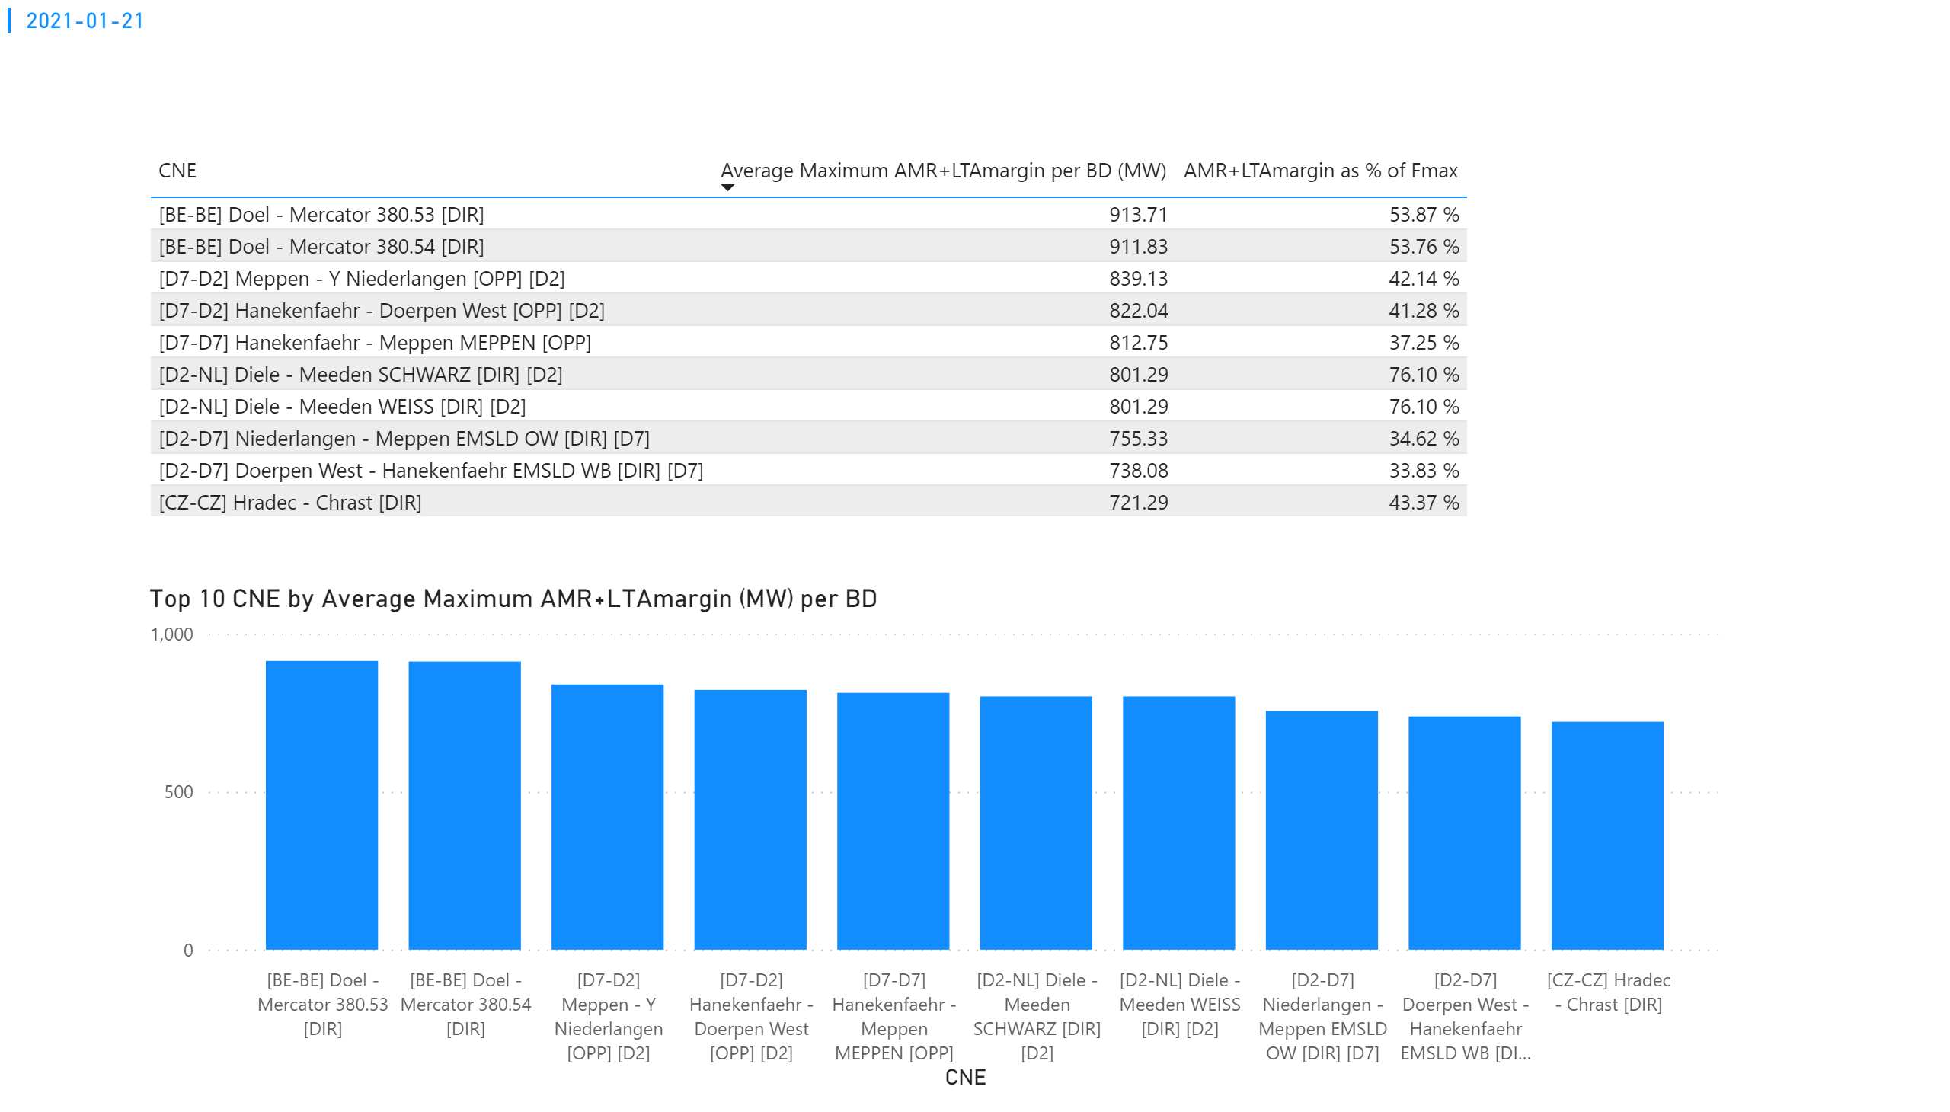
KPI 3
KPI 3: Average maximum AMR+LTAmargin per CNE per BD
Notes:
tableEx
No alt text provided.
Top 10 CNE by Average Maximum AMR+LTAmargin (MW) per BD
No alt text provided.
multiRowCard
No alt text provided.

Slide 38
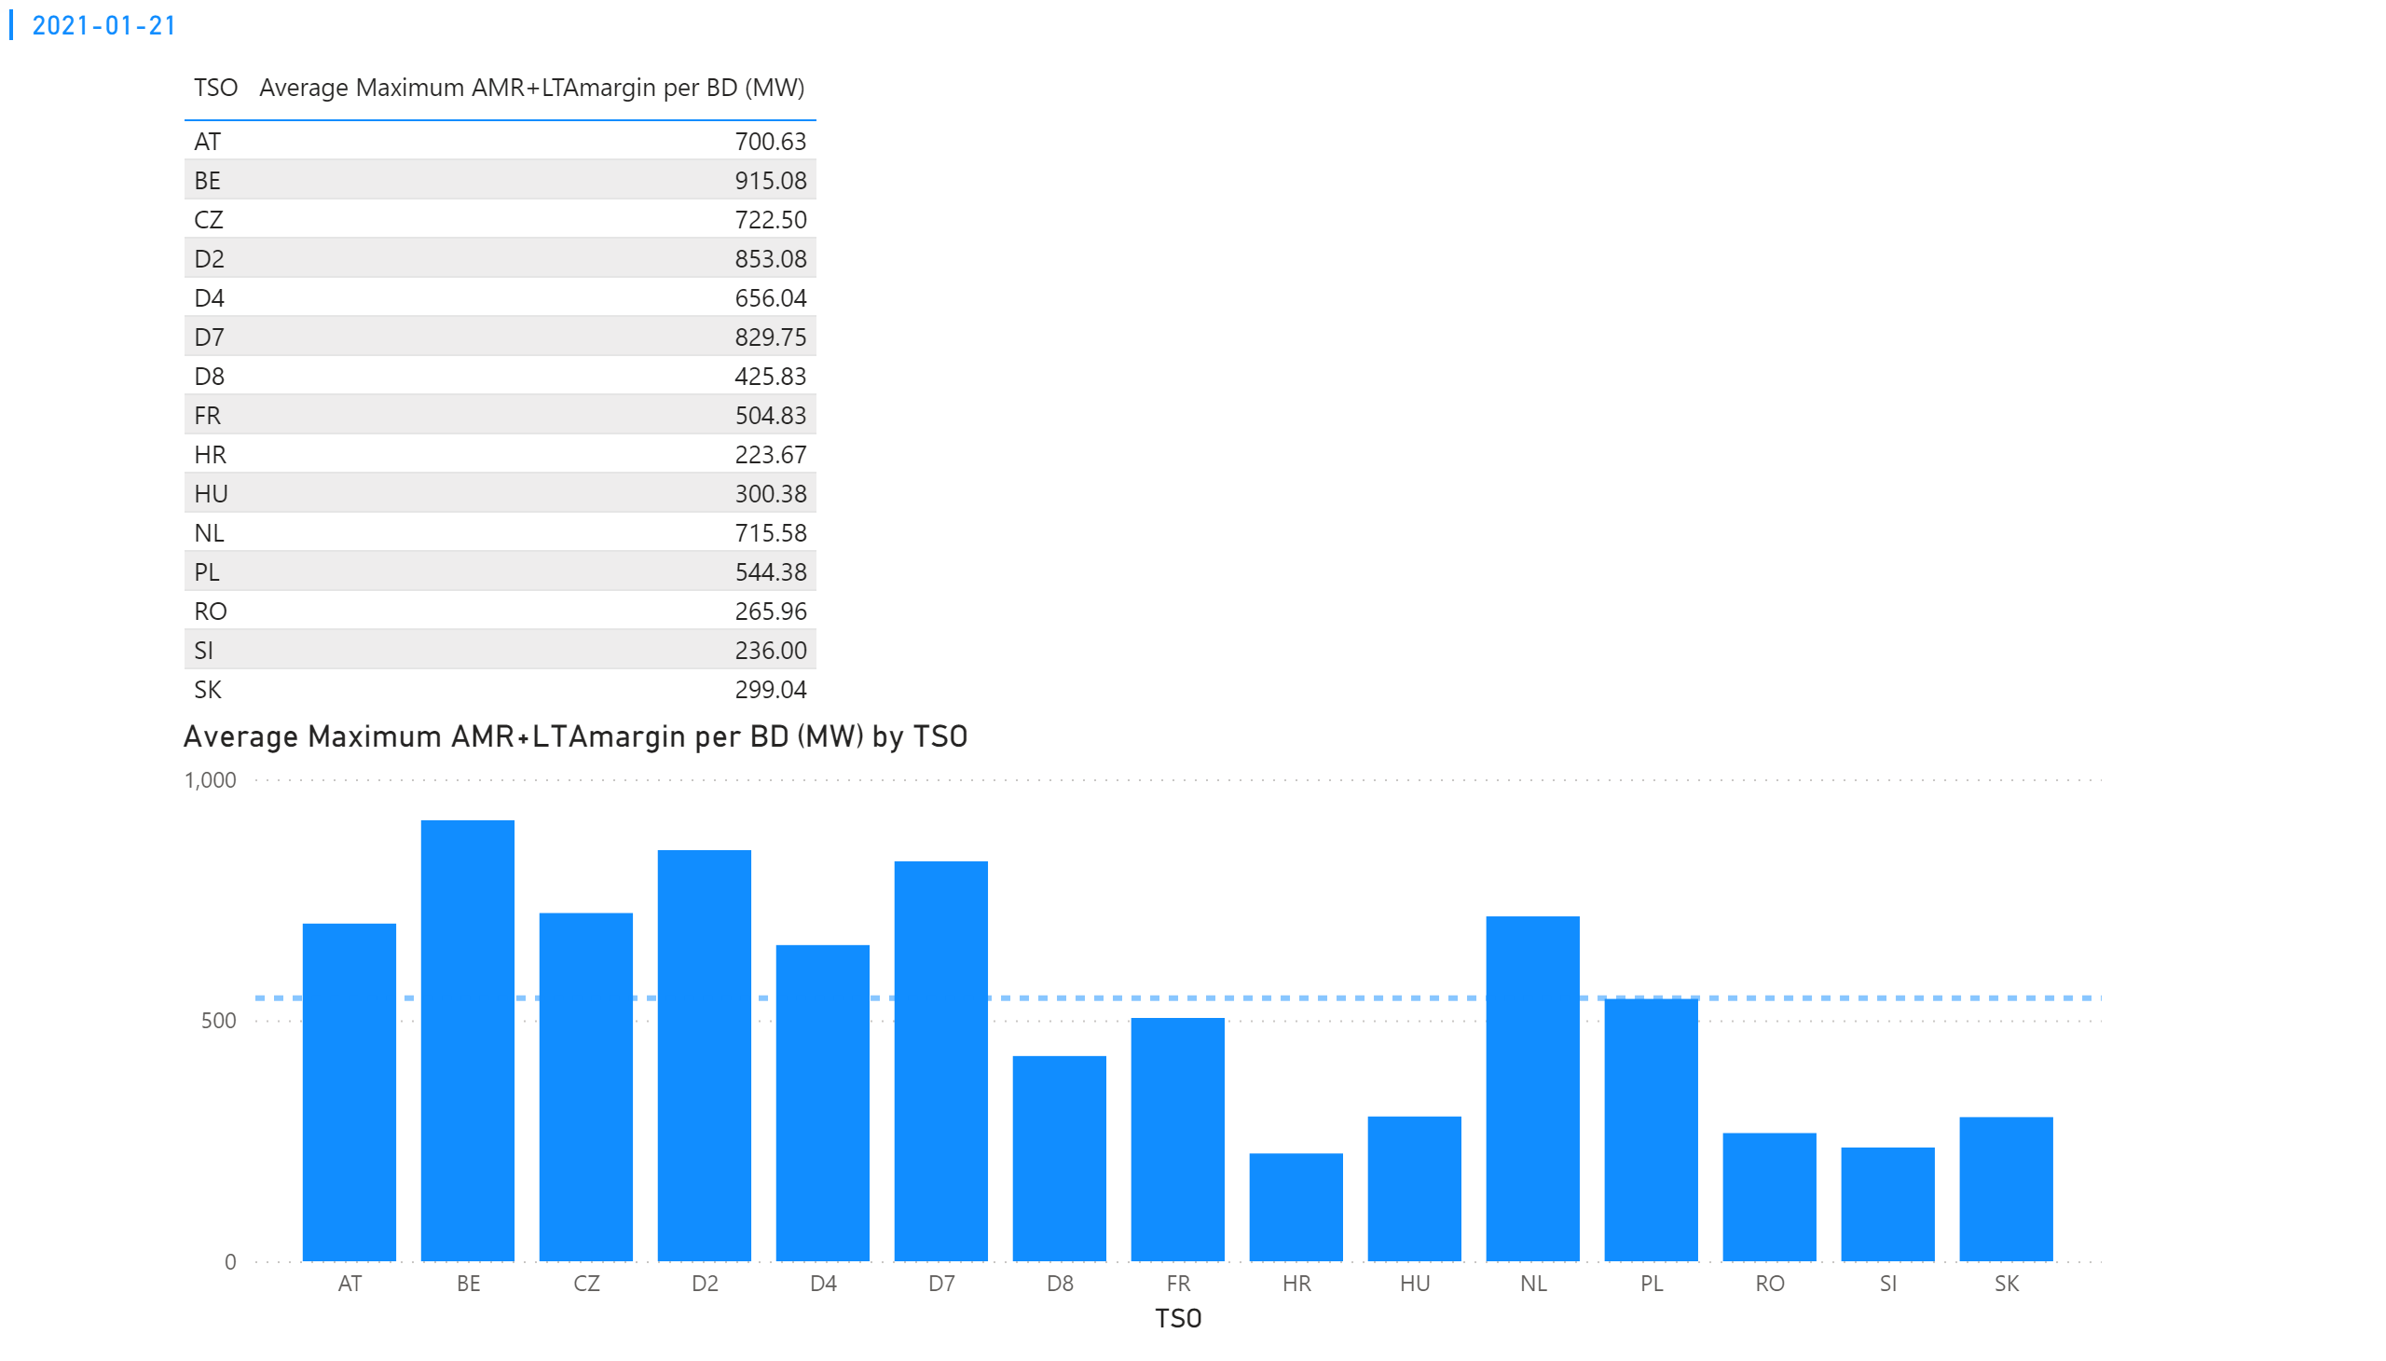
KPI 4
KPI 4: Average maximum AMR+LTAmargin per TSO per BD
Notes:
tableEx
No alt text provided.
multiRowCard
No alt text provided.
Average Maximum AMR+LTAmargin per BD (MW) by TSO
No alt text provided.

Slide 39
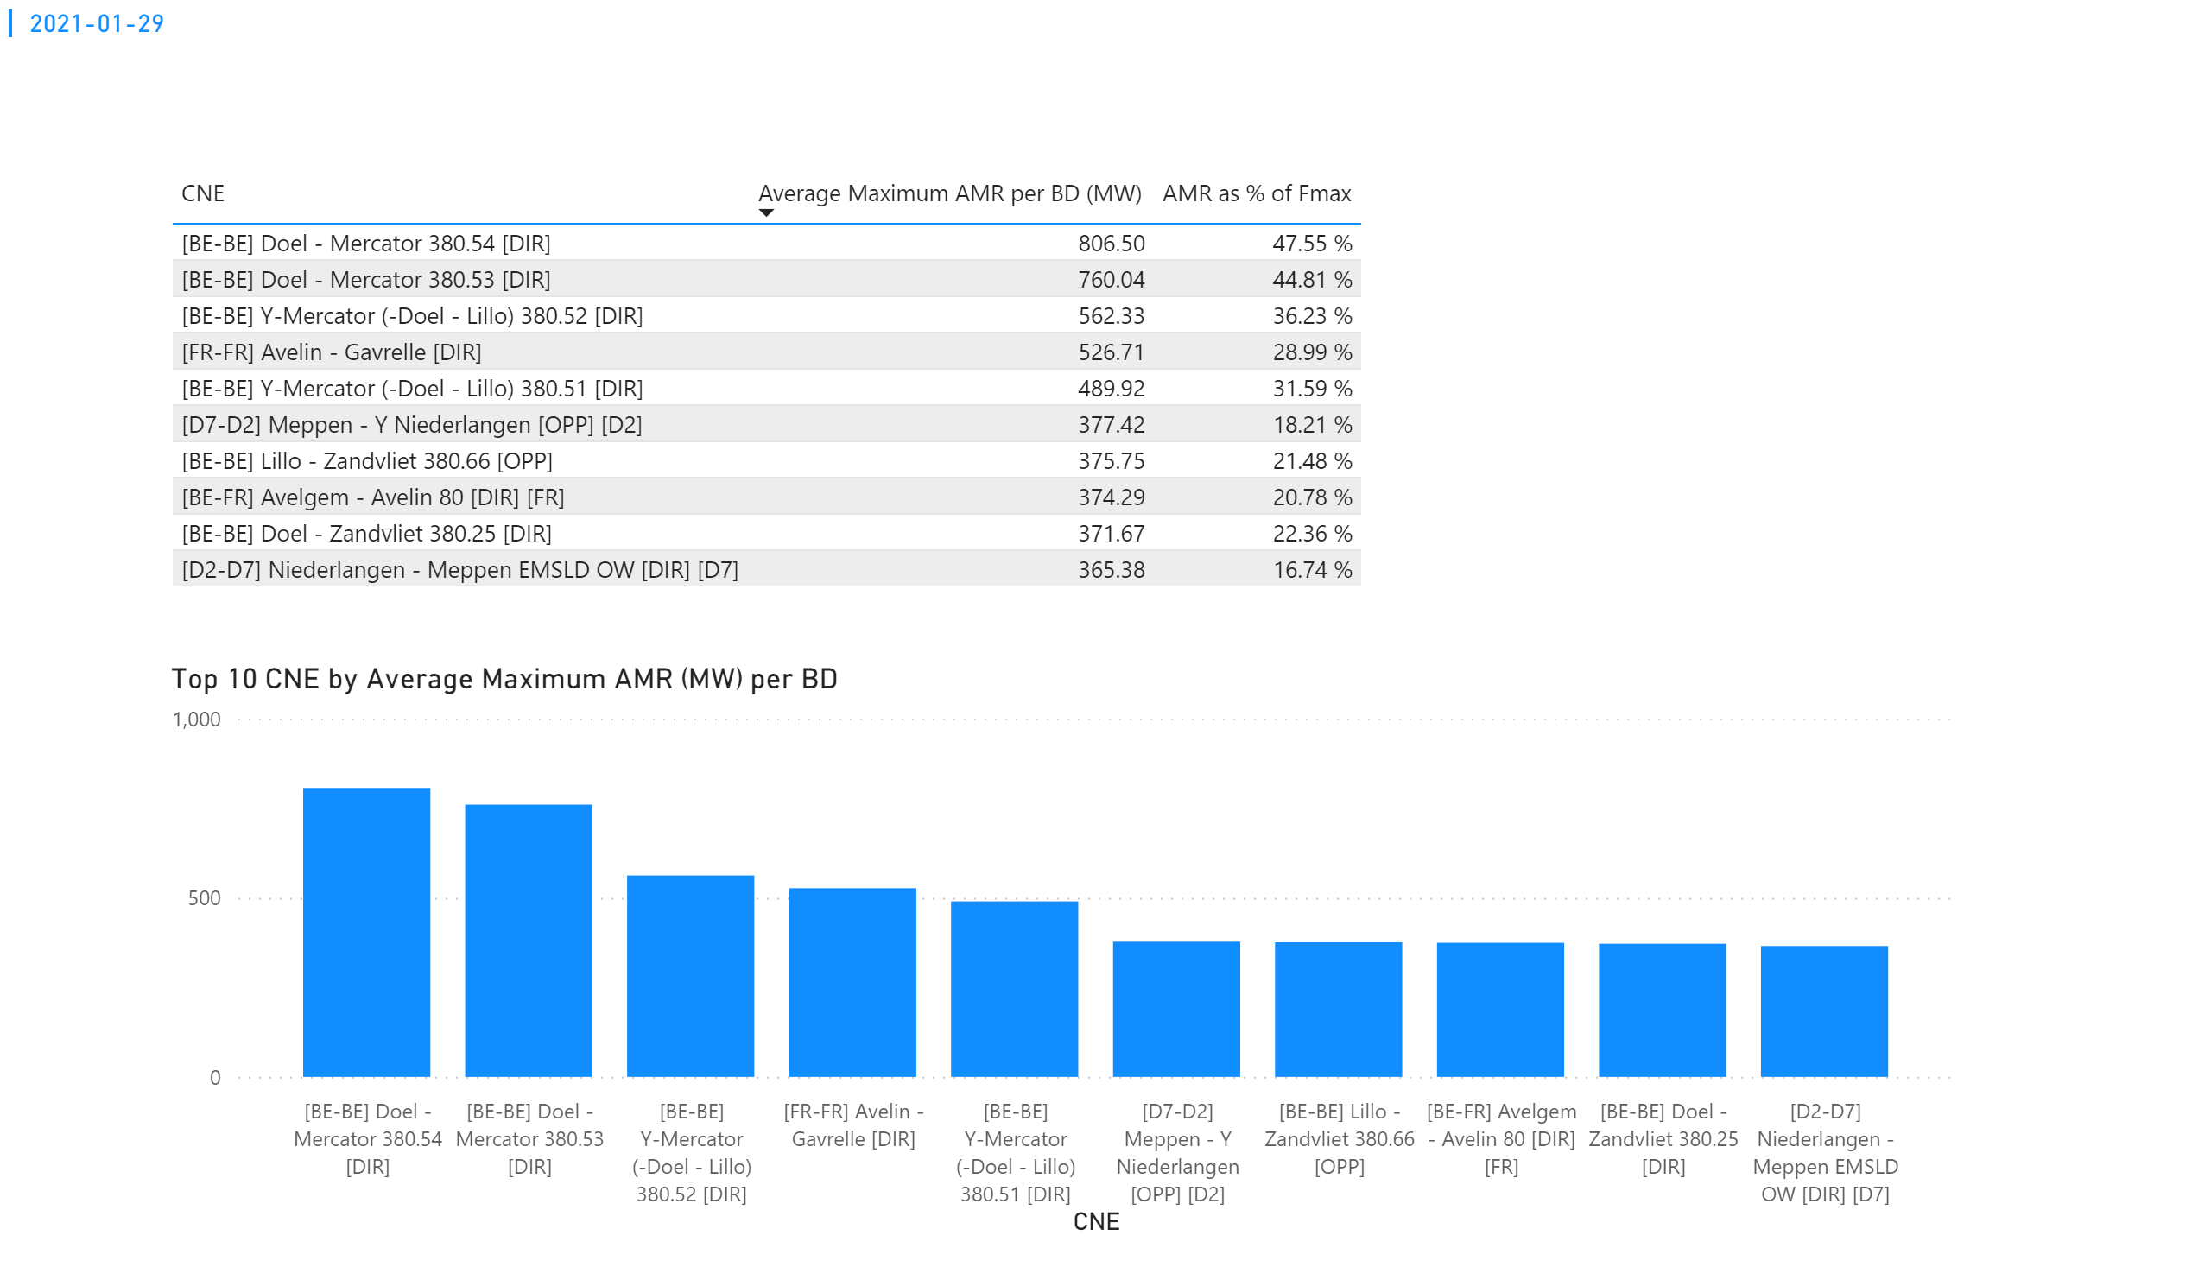
KPI 1
KPI 1: Average maximum AMR per CNE per BD
Notes:
tableEx
No alt text provided.
Top 10 CNE by Average Maximum AMR (MW) per BD
No alt text provided.
multiRowCard
No alt text provided.

Slide 40
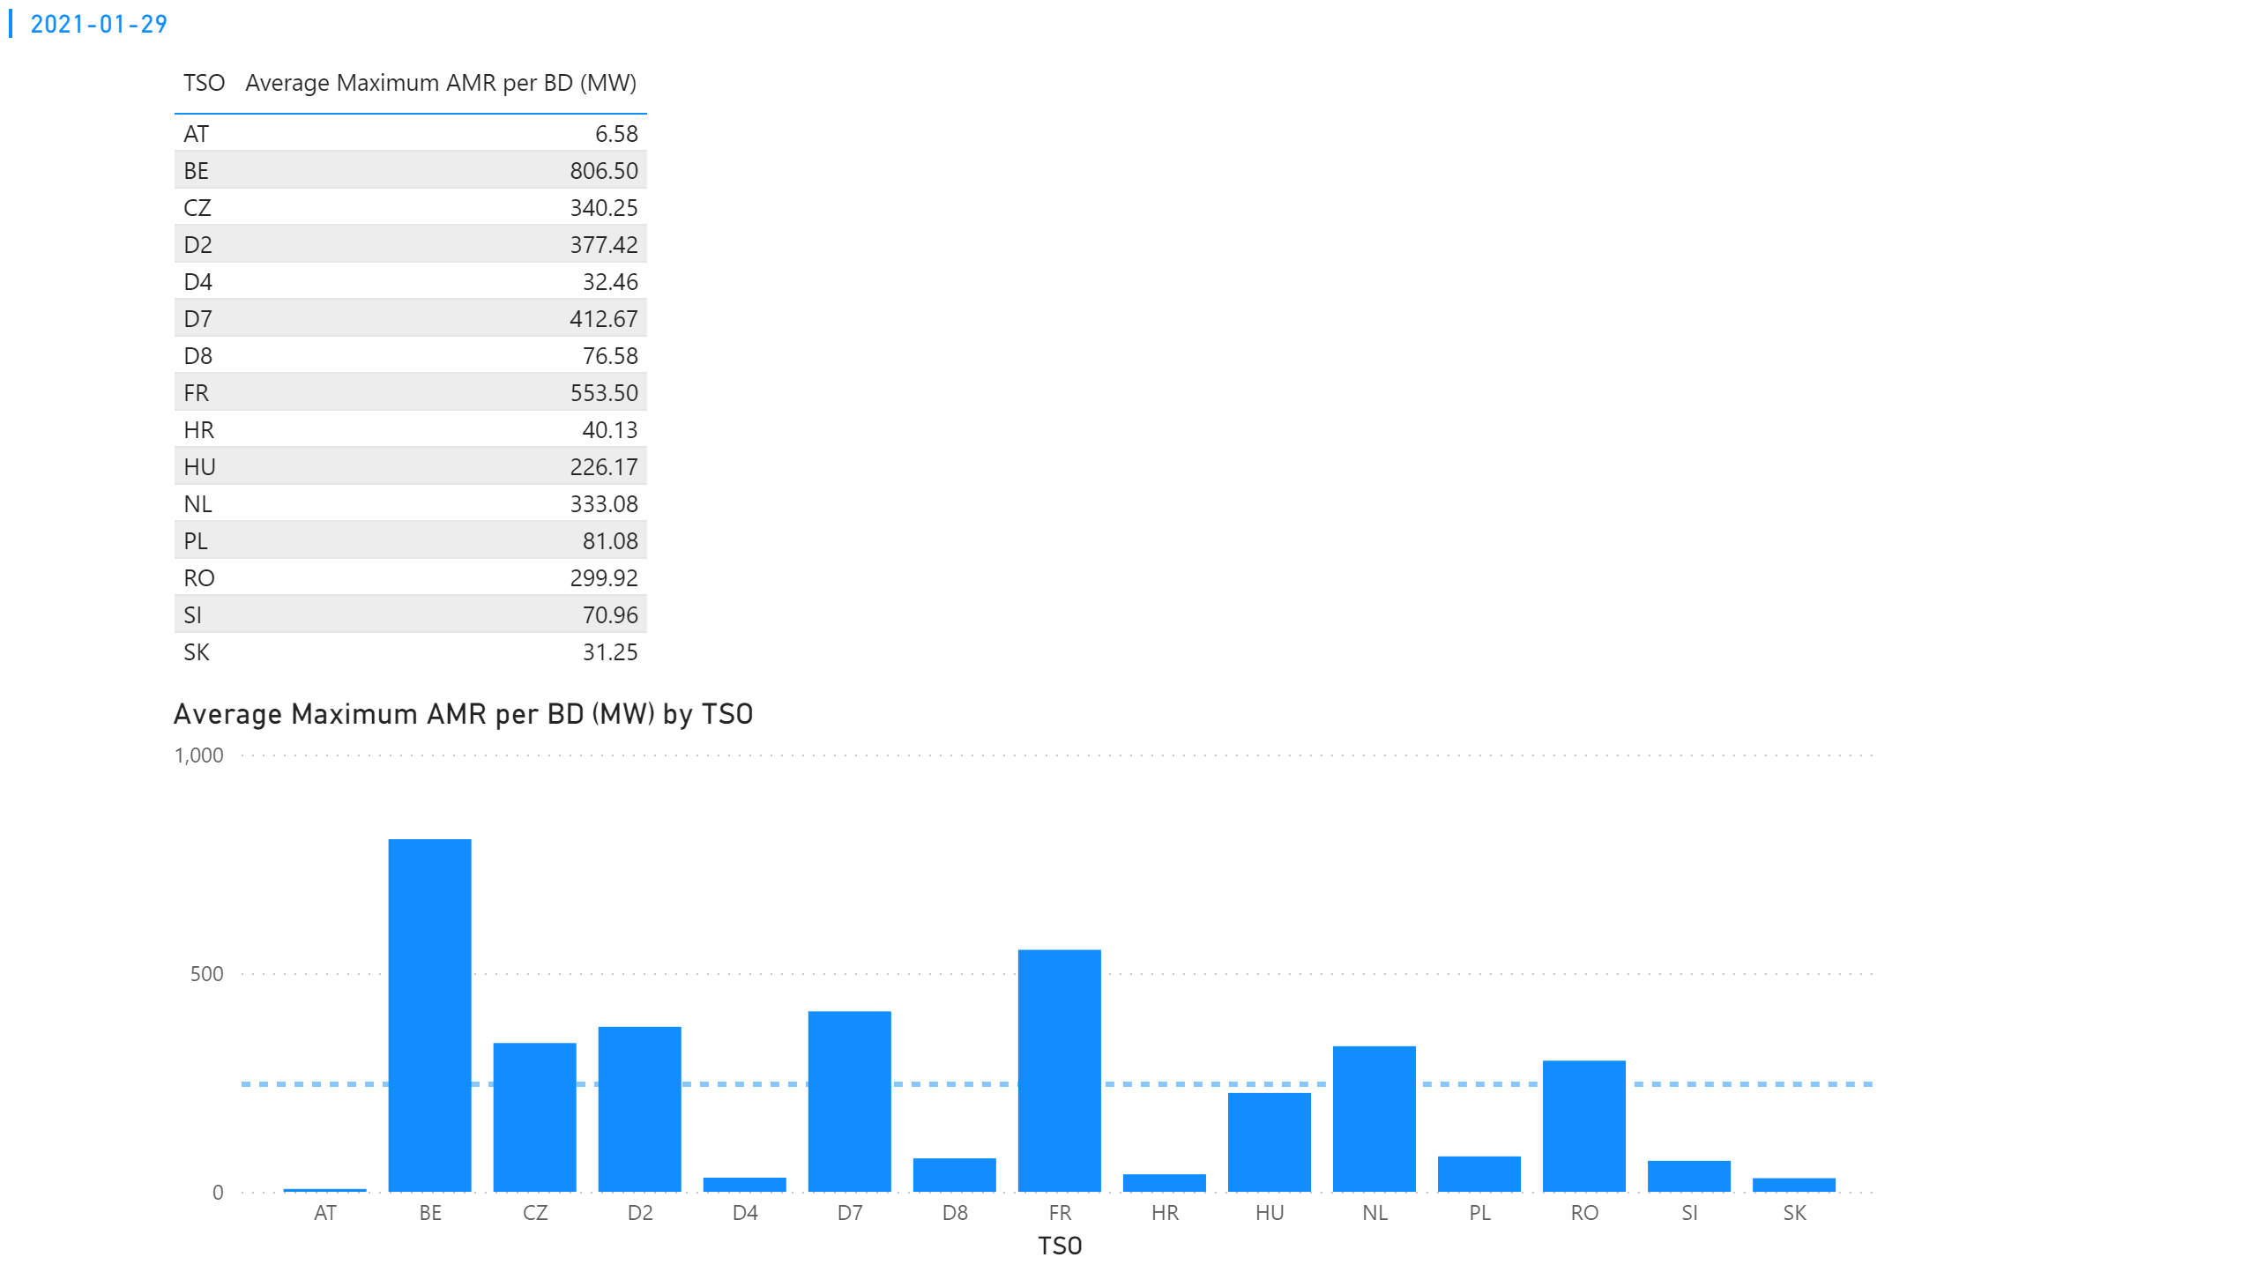
KPI 2
KPI 2: Average maximum AMR per CNE per TSO
Notes:
tableEx
No alt text provided.
Average Maximum AMR per BD (MW) by TSO
No alt text provided.
multiRowCard
No alt text provided.

Slide 41
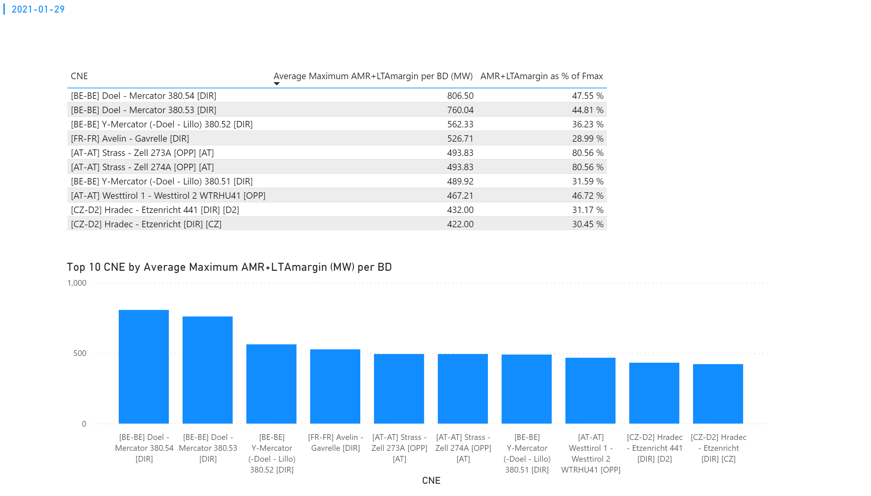
KPI 3
KPI 3: Average maximum AMR+LTAmargin per CNE per BD
Notes:
tableEx
No alt text provided.
Top 10 CNE by Average Maximum AMR+LTAmargin (MW) per BD
No alt text provided.
multiRowCard
No alt text provided.

Slide 42
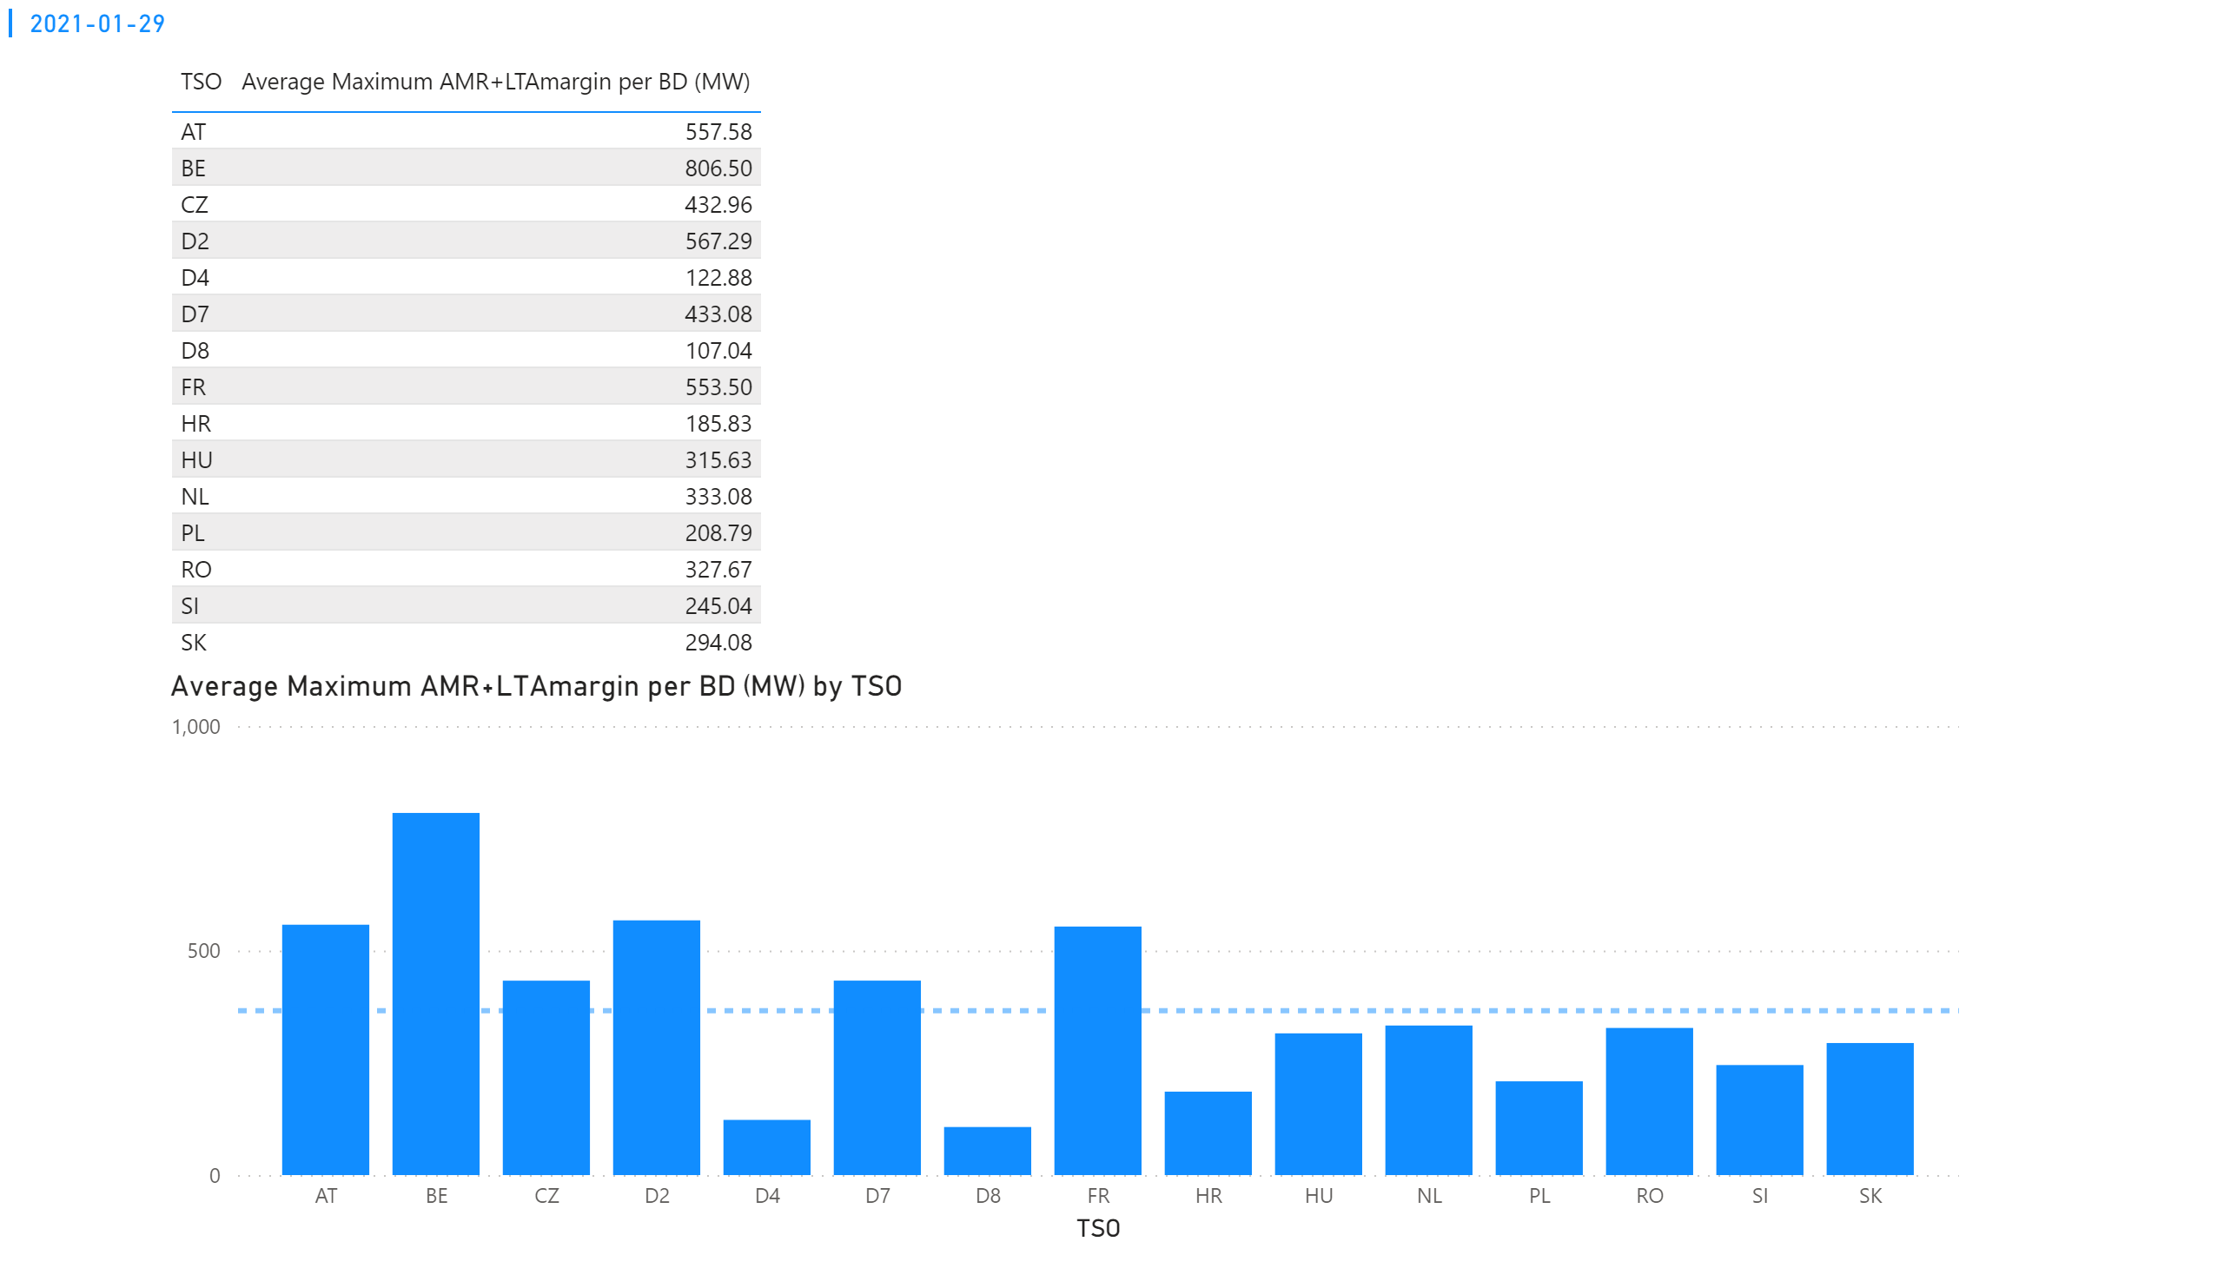
KPI 4
KPI 4: Average maximum AMR+LTAmargin per TSO per BD
Notes:
tableEx
No alt text provided.
multiRowCard
No alt text provided.
Average Maximum AMR+LTAmargin per BD (MW) by TSO
No alt text provided.

Slide 43
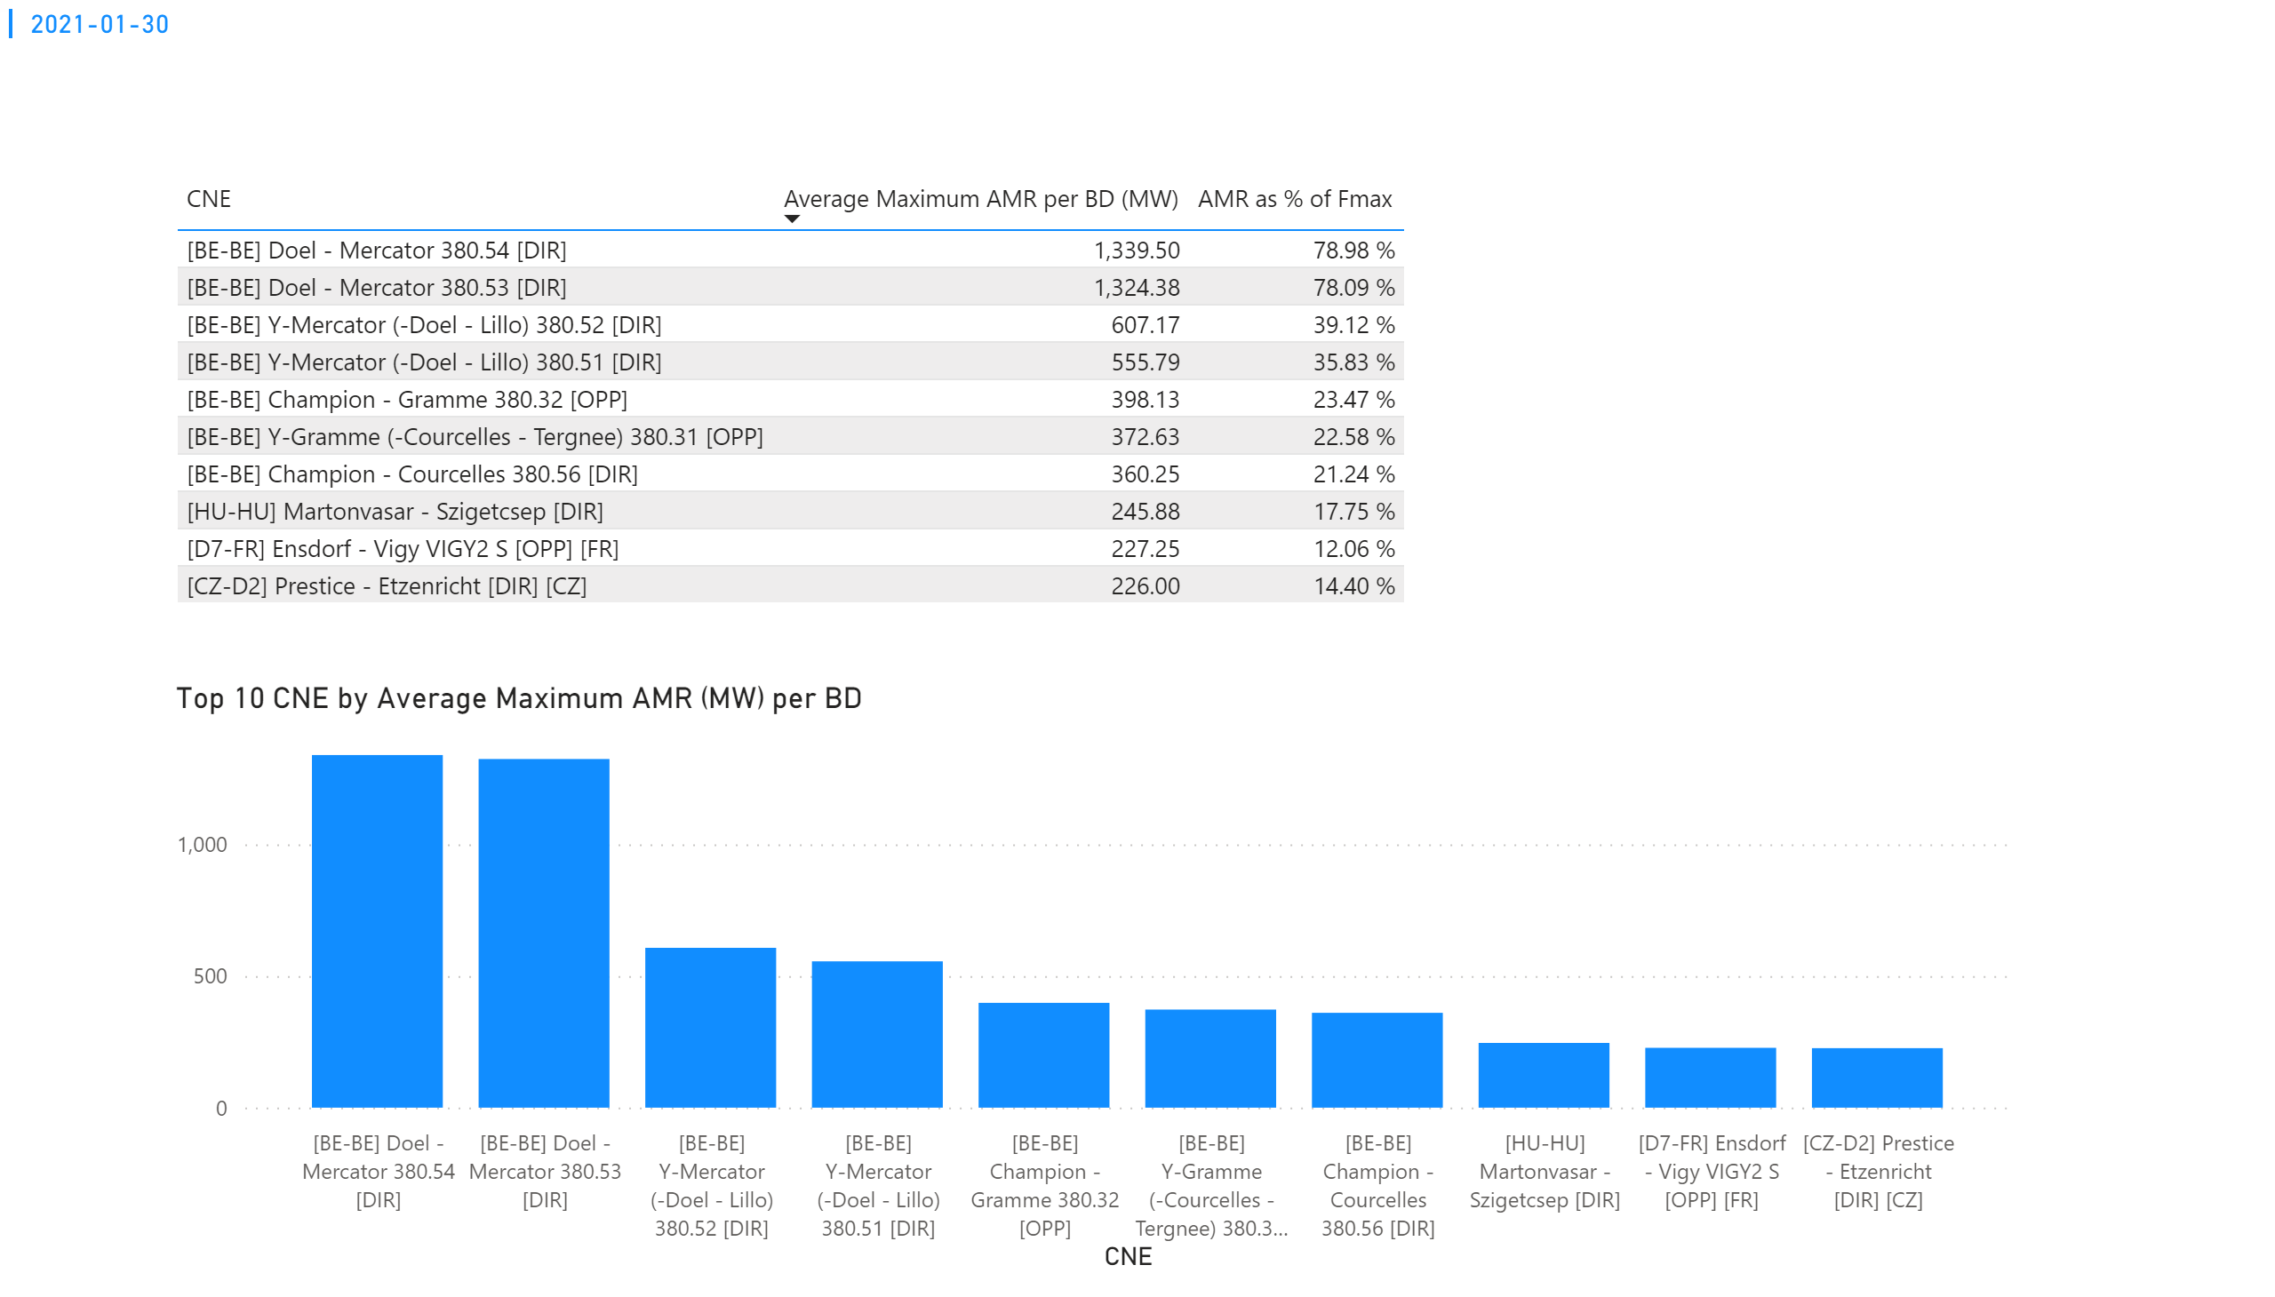
KPI 1
KPI 1: Average maximum AMR per CNE per BD
Notes:
tableEx
No alt text provided.
Top 10 CNE by Average Maximum AMR (MW) per BD
No alt text provided.
multiRowCard
No alt text provided.

Slide 44
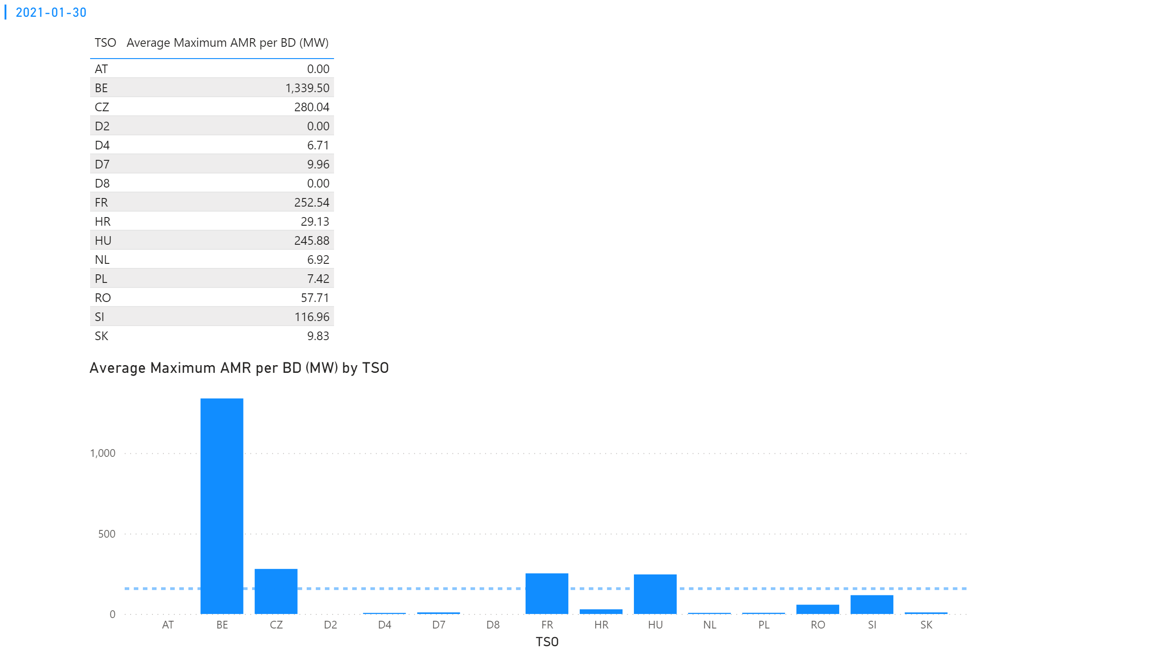
KPI 2
KPI 2: Average maximum AMR per CNE per TSO
Notes:
tableEx
No alt text provided.
Average Maximum AMR per BD (MW) by TSO
No alt text provided.
multiRowCard
No alt text provided.

Slide 45
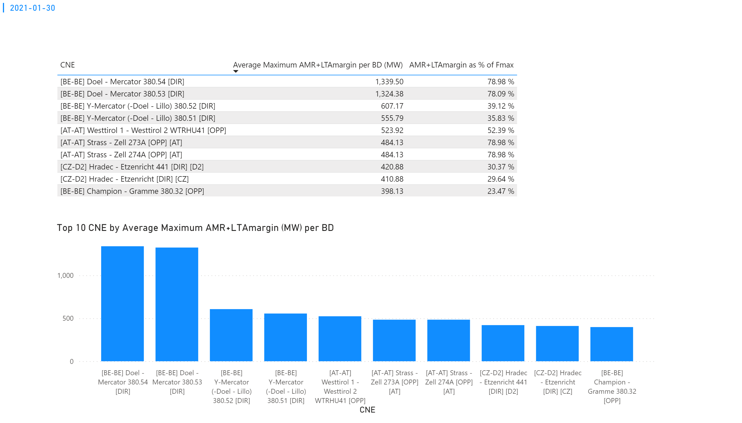
KPI 3
KPI 3: Average maximum AMR+LTAmargin per CNE per BD
Notes:
multiRowCard
No alt text provided.
tableEx
No alt text provided.
Top 10 CNE by Average Maximum AMR+LTAmargin (MW) per BD
No alt text provided.

Slide 46
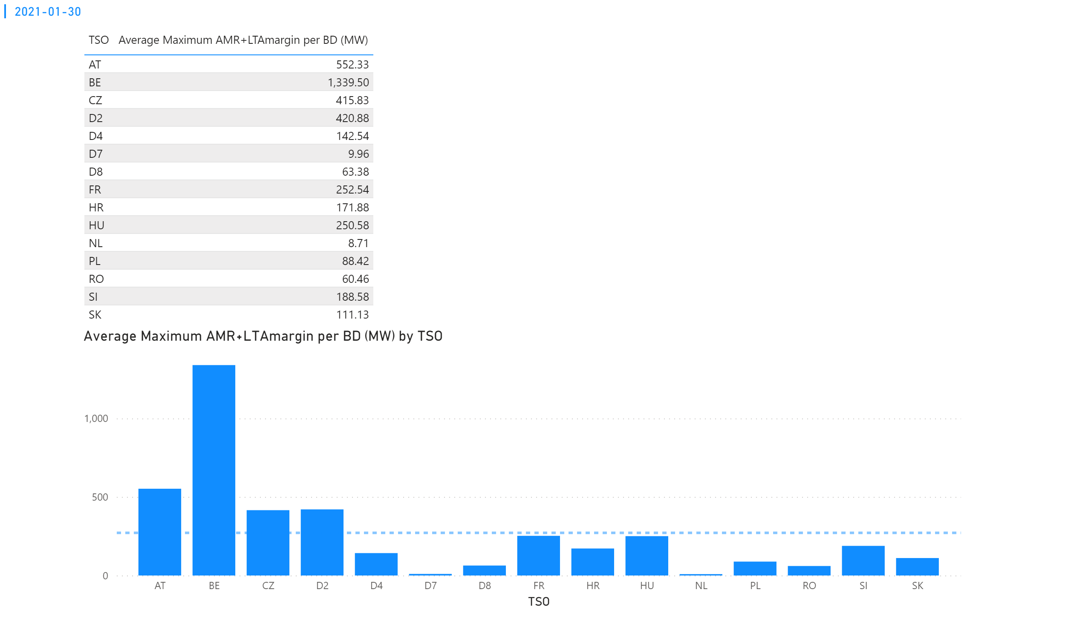
KPI 4
KPI 4: Average maximum AMR+LTAmargin per TSO per BD
Notes:
multiRowCard
No alt text provided.
tableEx
No alt text provided.
Average Maximum AMR+LTAmargin per BD (MW) by TSO
No alt text provided.

Slide 47
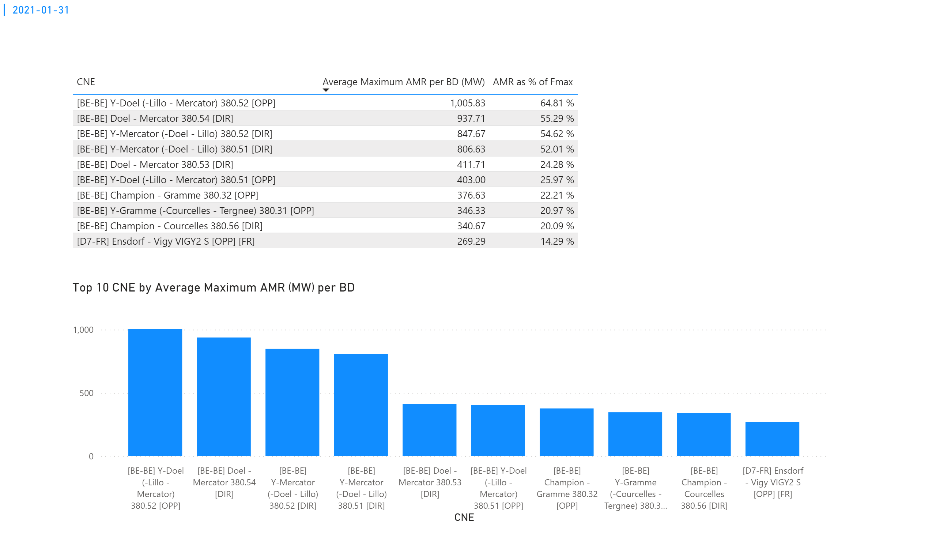
KPI 1
KPI 1: Average maximum AMR per CNE per BD
Notes:
tableEx
No alt text provided.
Top 10 CNE by Average Maximum AMR (MW) per BD
No alt text provided.
multiRowCard
No alt text provided.

Slide 48
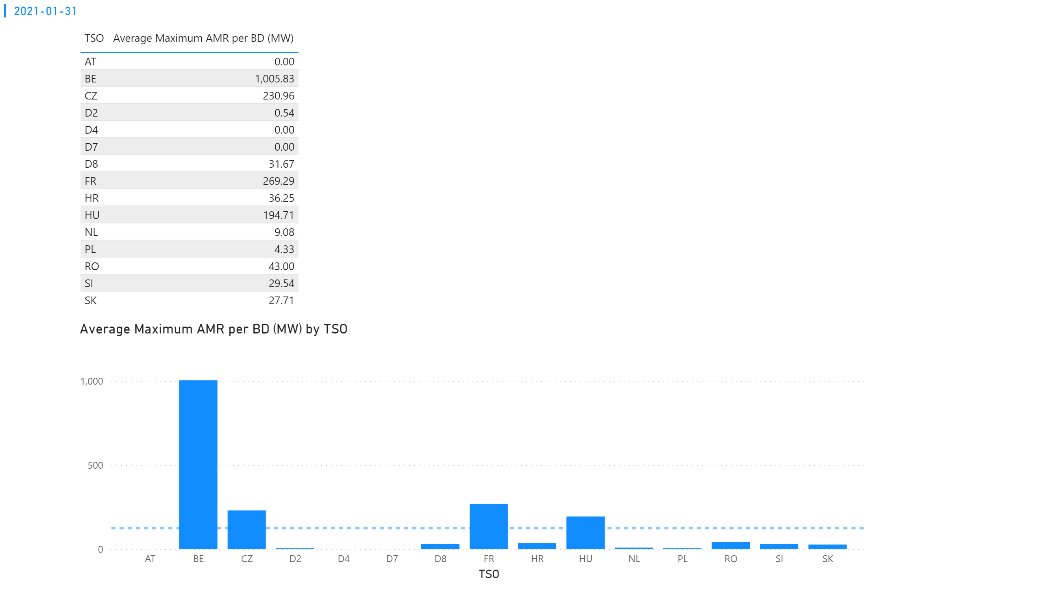
KPI 2
KPI 2: Average maximum AMR per CNE per TSO
Notes:
tableEx
No alt text provided.
Average Maximum AMR per BD (MW) by TSO
No alt text provided.
multiRowCard
No alt text provided.

Slide 49
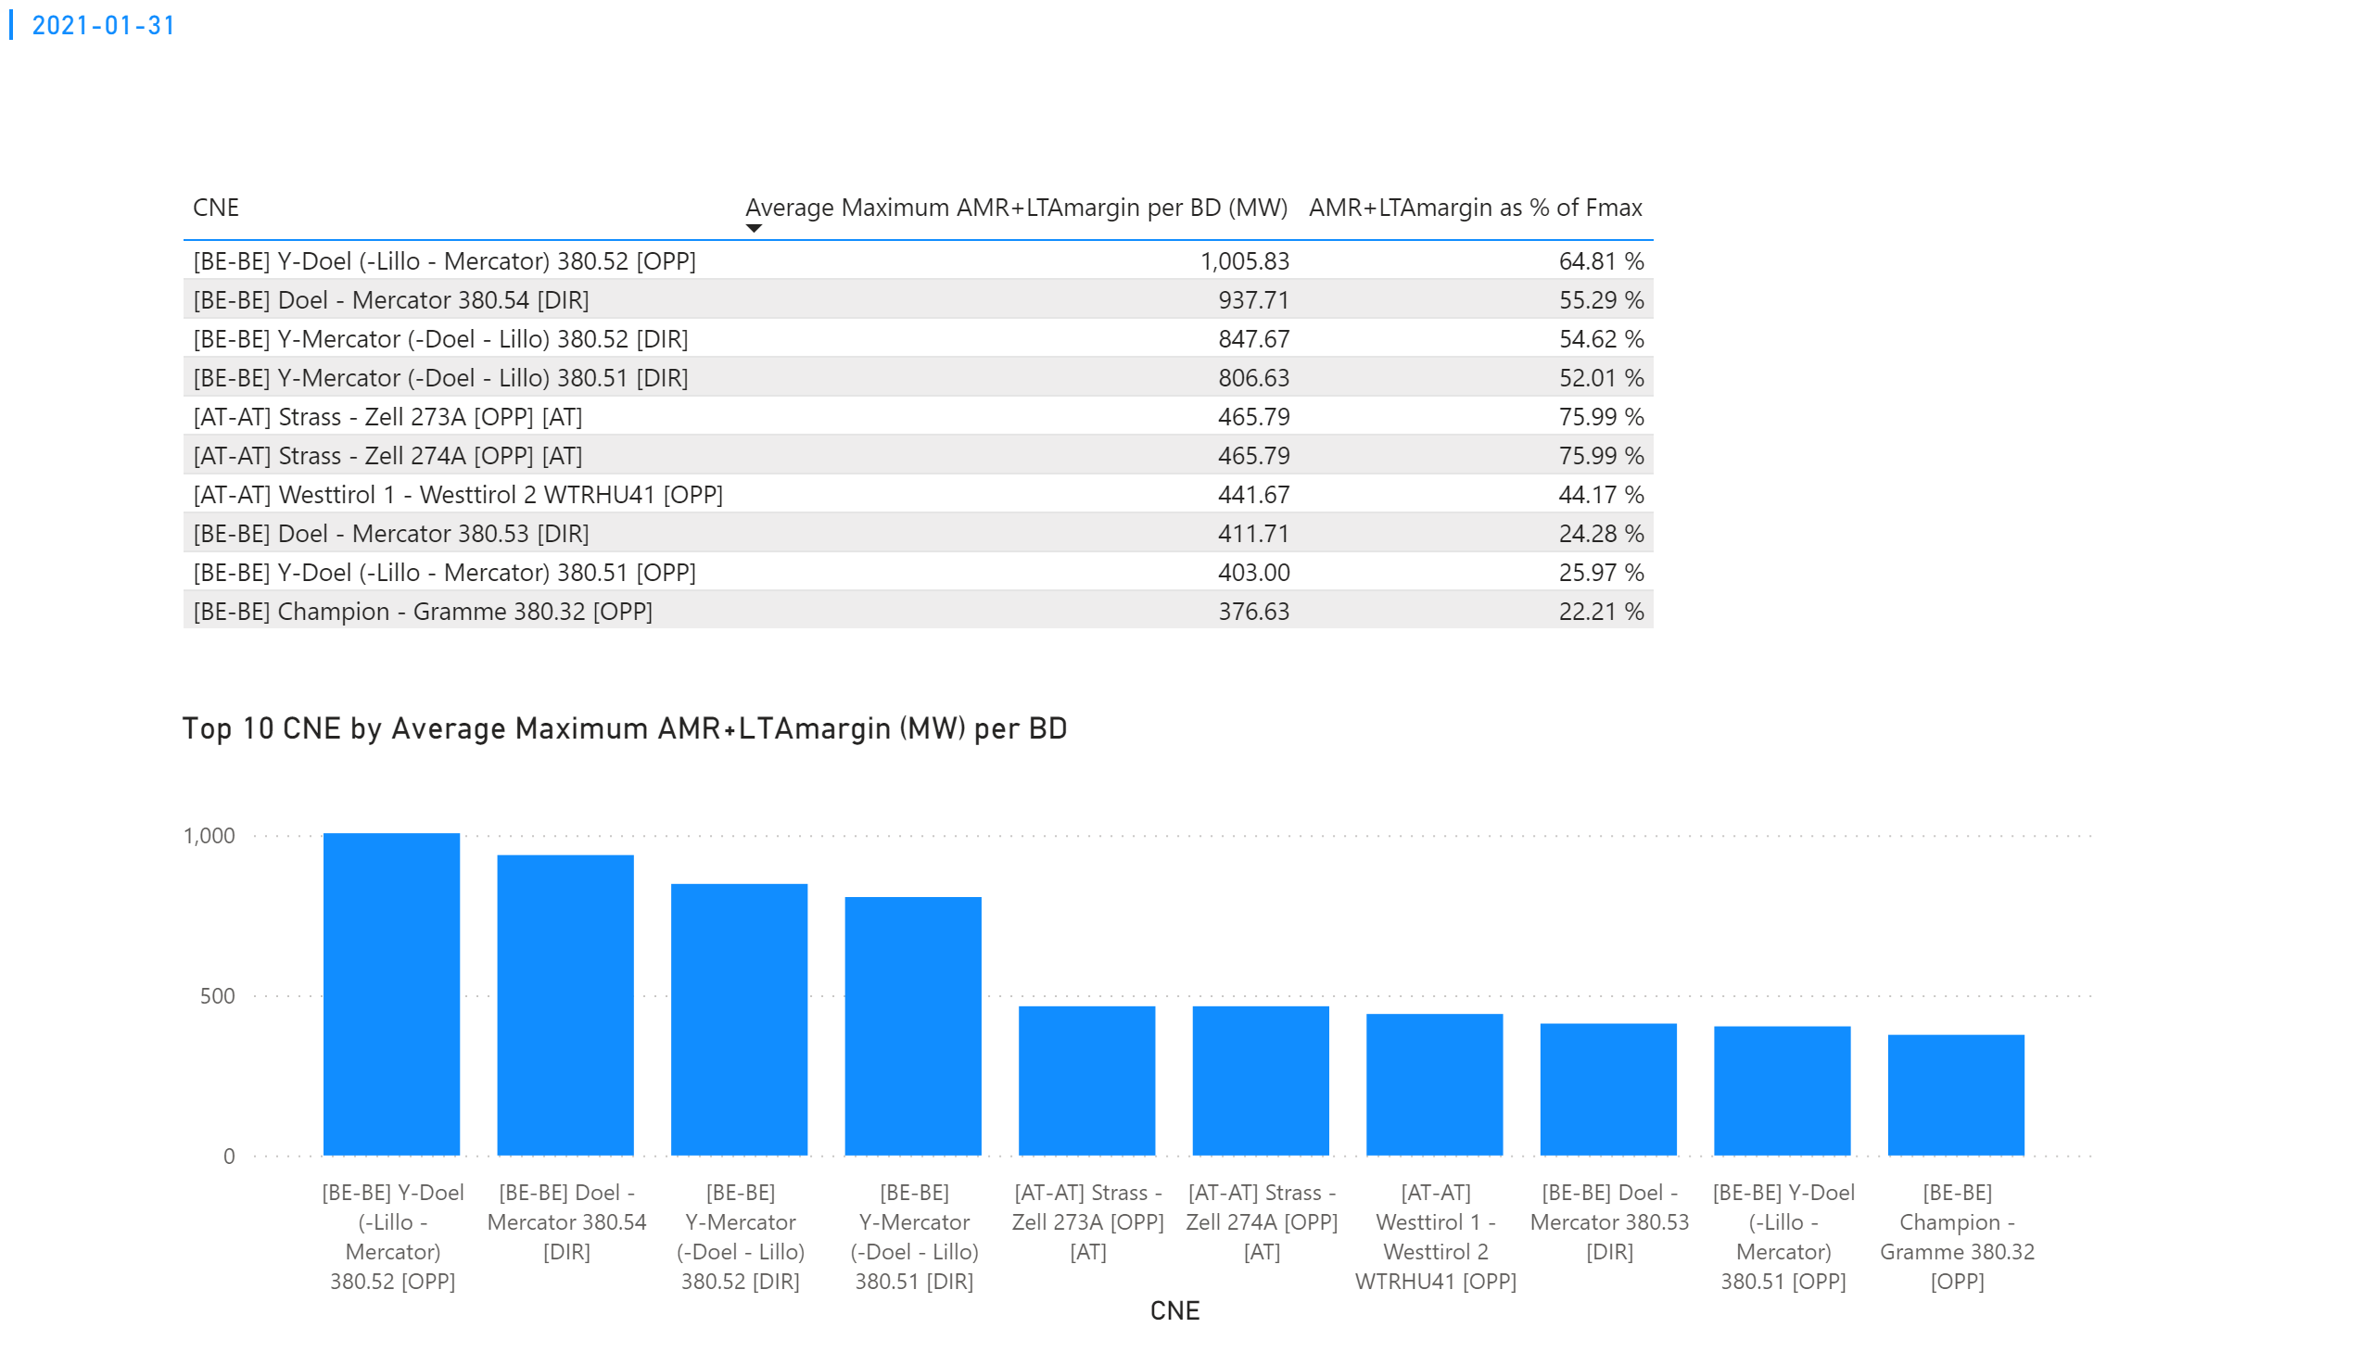
KPI 3
KPI 3: Average maximum AMR+LTAmargin per CNE per BD
Notes:
multiRowCard
No alt text provided.
tableEx
No alt text provided.
Top 10 CNE by Average Maximum AMR+LTAmargin (MW) per BD
No alt text provided.

Slide 50
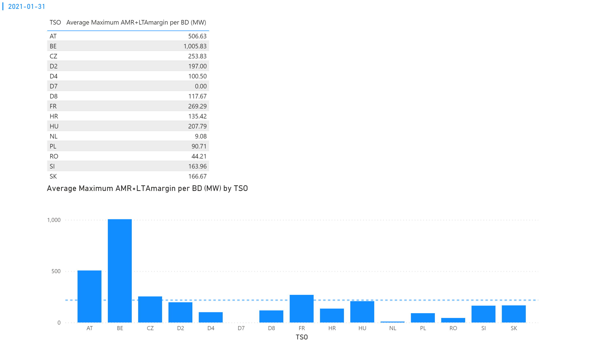
KPI 4
KPI 4: Average maximum AMR+LTAmargin per TSO per BD
Notes:
multiRowCard
No alt text provided.
tableEx
No alt text provided.
Average Maximum AMR+LTAmargin per BD (MW) by TSO
No alt text provided.

Slide 51
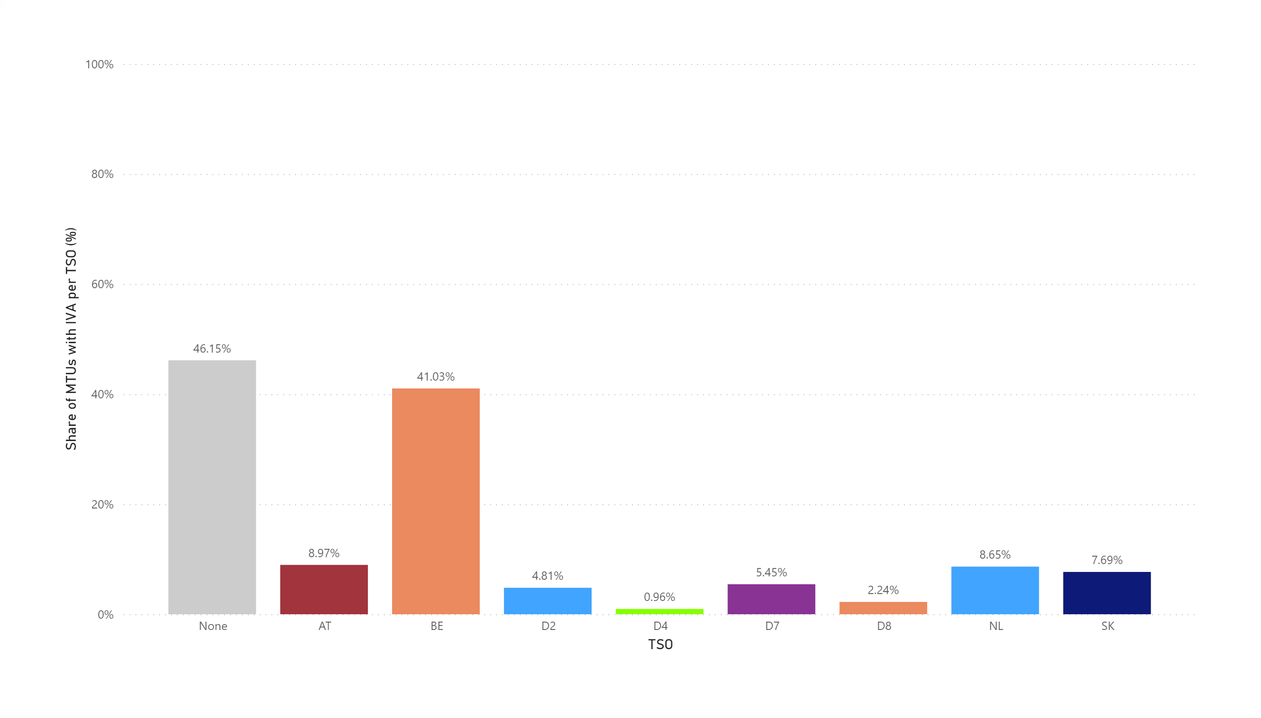
KPI 5
KPI 5: Share of MTUs with intervention per TSO
Total MTUs = 312 (13 BDs * 24h) | None | AT | BE | D2 | D4 | D7 | D8 | NL | SK
Distinct MTUs with IVA | 144 | 28 | 133 | 15 | 7 | 19 | 7 | 27 | 24
Share | 46.15% | 8.97% | 41.03% | 4.81% | 0.96% | .5.45% | 2.24% | 8.65% | 7.69%
Notes:
clusteredColumnChart
No alt text provided.

Slide 52
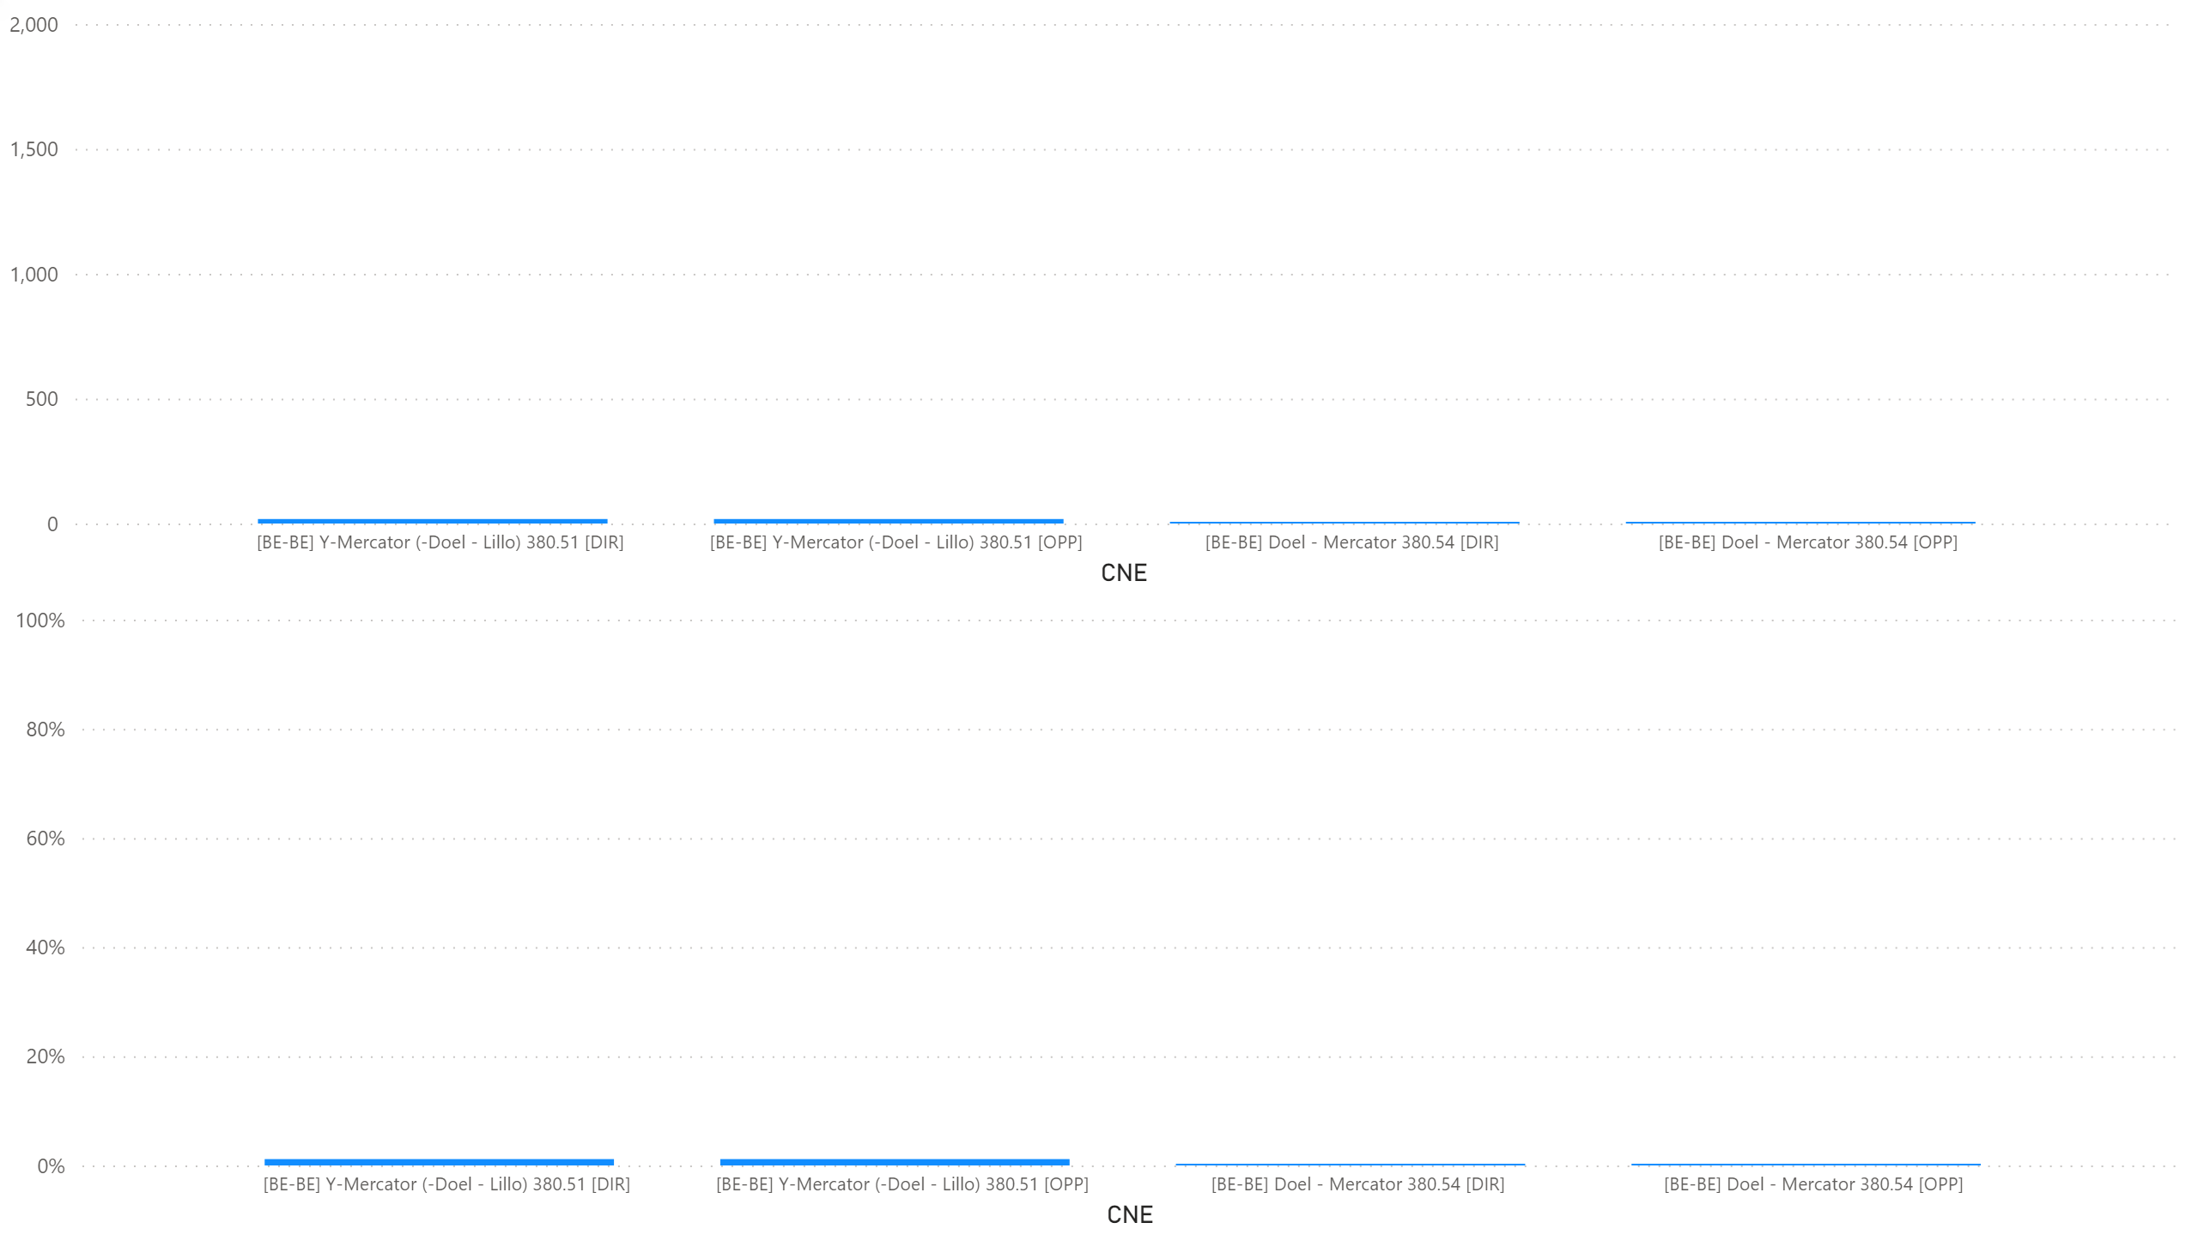
KPI6_0109
    KPI 6: Total IVA applied per MTU for each CNE affected by TSO intervention
    BD: 20210109 (top: in MW, bottom: in % of Fmax)
Notes:
clusteredColumnChart
No alt text provided.
clusteredColumnChart
No alt text provided.

Slide 53
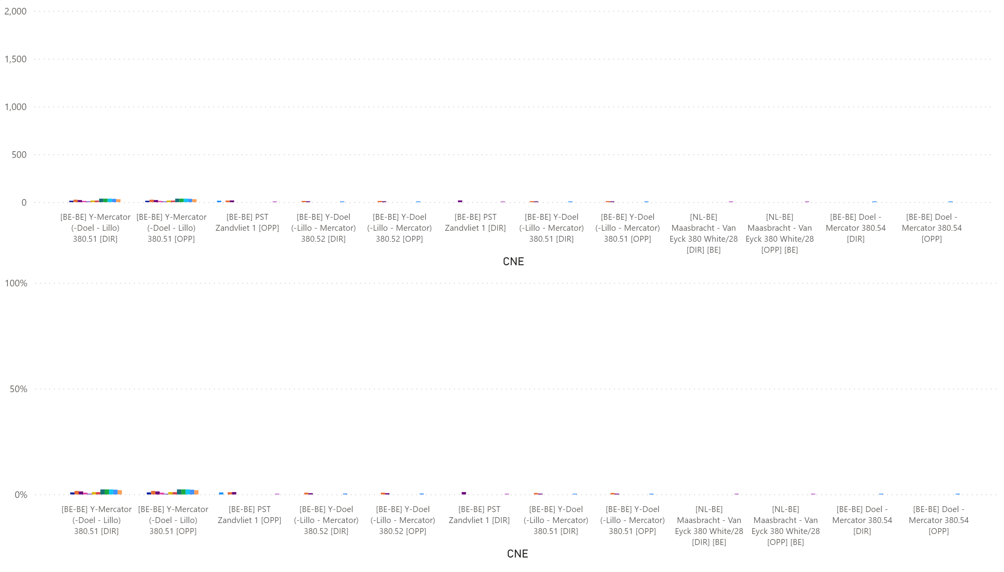
KPI6_0110
    KPI 6: Total IVA applied per MTU for each CNE affected by TSO intervention
    BD: 20210110 (top: in MW, bottom: in % of Fmax)
Notes:
clusteredColumnChart
No alt text provided.
clusteredColumnChart
No alt text provided.

Slide 54
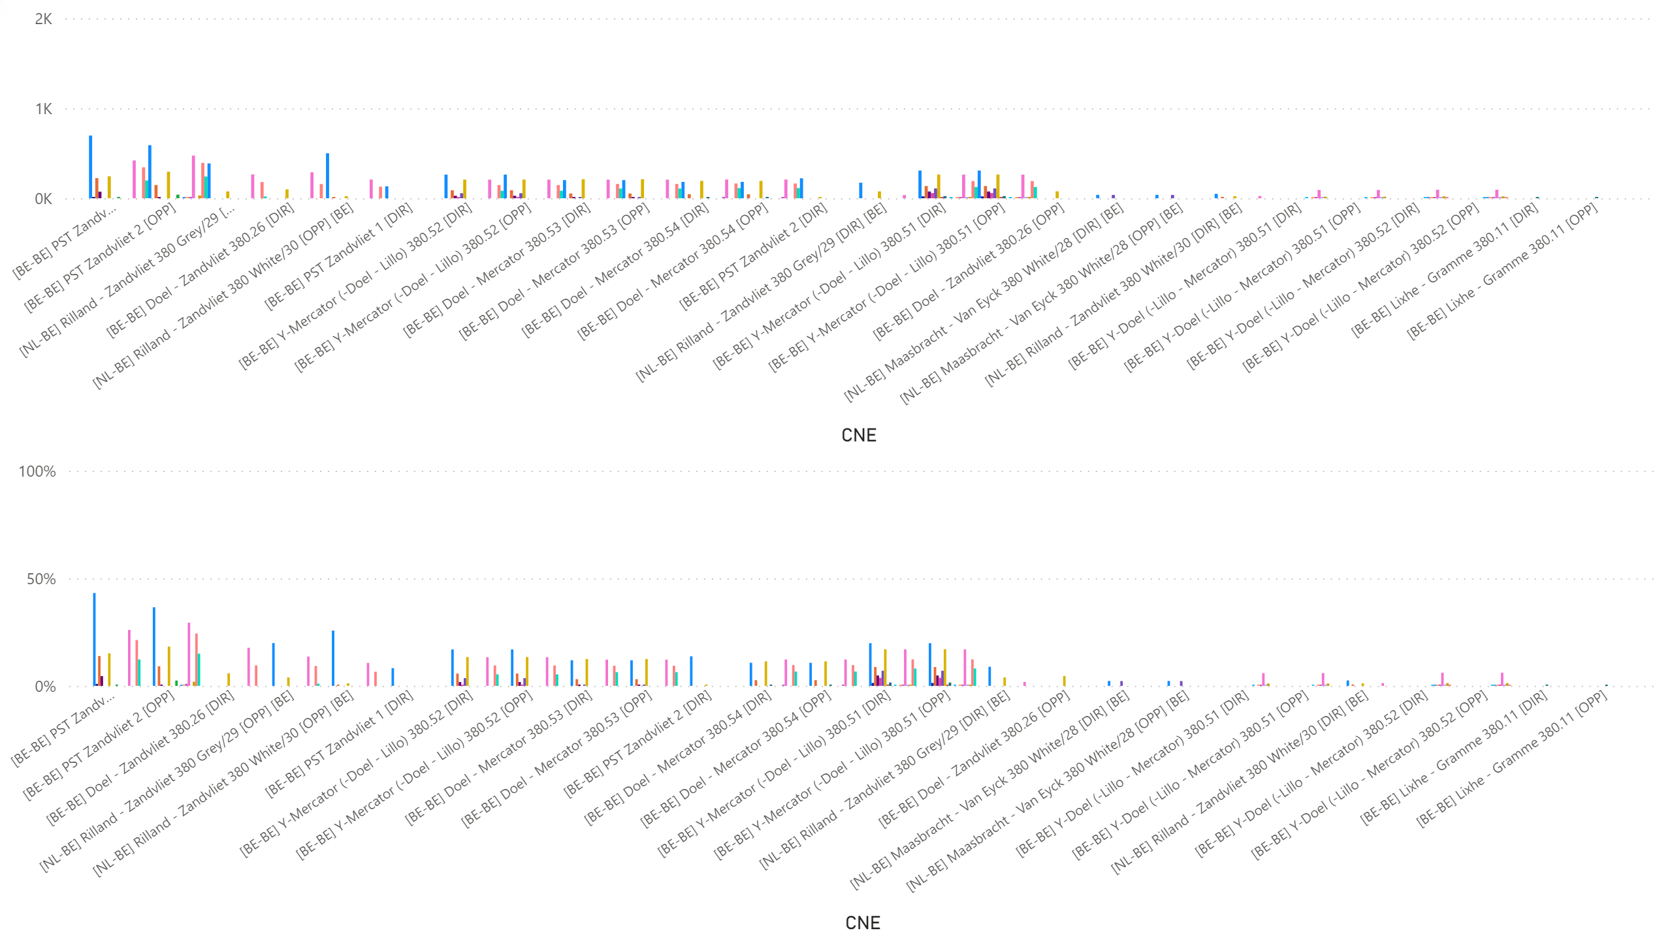
KPI6_0111
    KPI 6: Total IVA applied per MTU for each CNE affected by TSO intervention
    BD: 20210111 (top: in MW, bottom: in % of Fmax)
Notes:
clusteredColumnChart
No alt text provided.
clusteredColumnChart
No alt text provided.

Slide 55
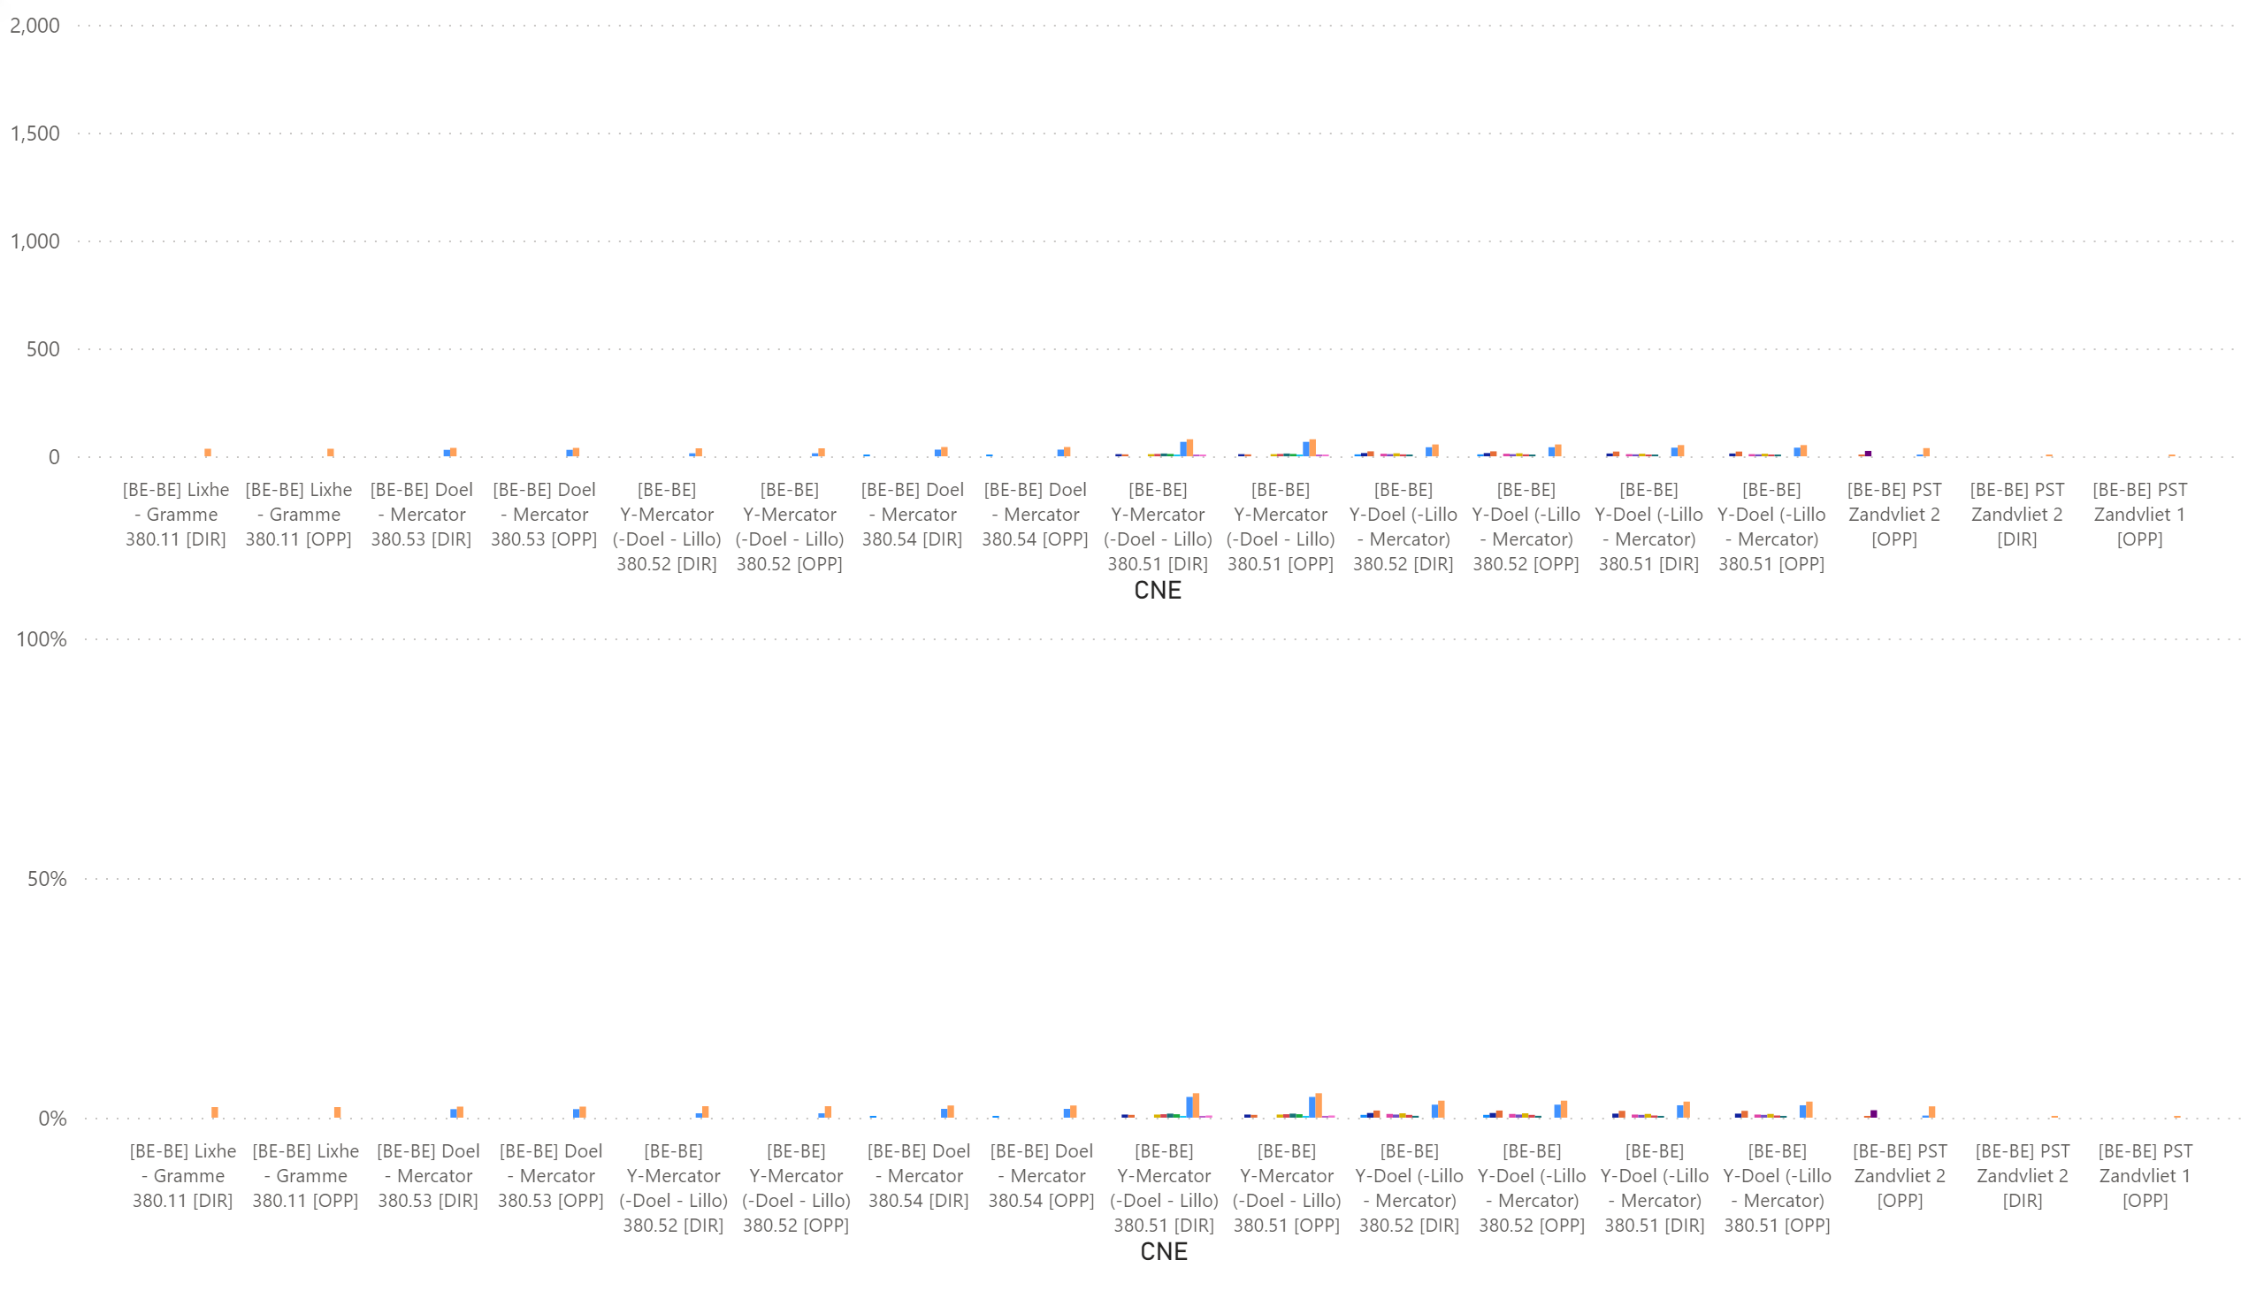
KPI6_0112
    KPI 6: Total IVA applied per MTU for each CNE affected by TSO intervention
    BD: 20210112 (top: in MW, bottom: in % of Fmax)
Notes:
clusteredColumnChart
No alt text provided.
clusteredColumnChart
No alt text provided.

Slide 56
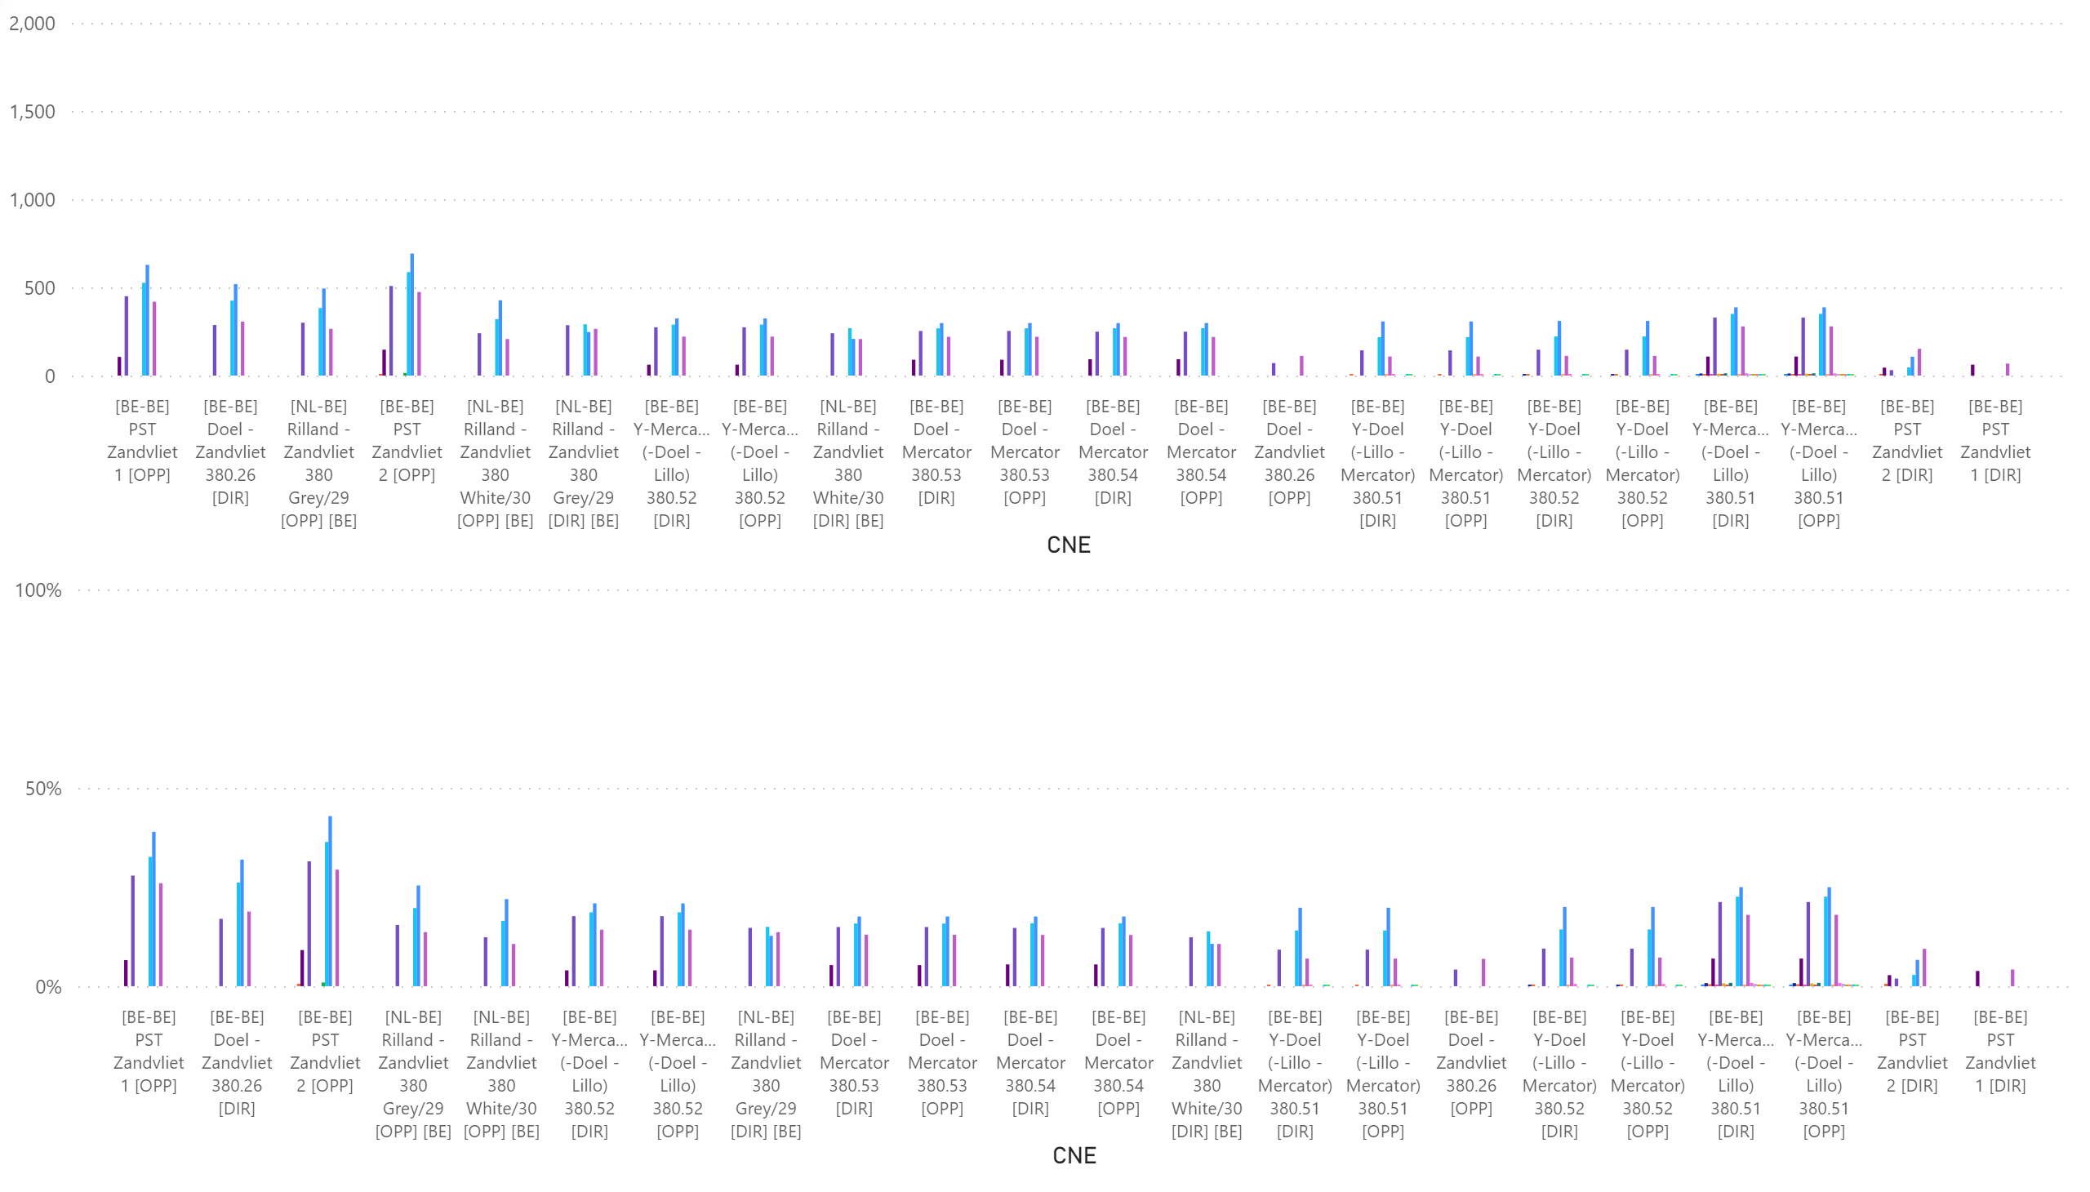
KPI6_0113
    KPI 6: Total IVA applied per MTU for each CNE affected by TSO intervention
    BD: 20210113 (top: in MW, bottom: in % of Fmax)
Notes:
clusteredColumnChart
No alt text provided.
clusteredColumnChart
No alt text provided.

Slide 57

KPI6_0116
    KPI 6: Total IVA applied per MTU for each CNE affected by TSO intervention
    BD: 20210116 (top: in MW, bottom: in % of Fmax)
Notes:
clusteredColumnChart
No alt text provided.
clusteredColumnChart
No alt text provided.

Slide 58

KPI6_0117
    KPI 6: Total IVA applied per MTU for each CNE affected by TSO intervention
    BD: 20210117 (top: in MW, bottom: in % of Fmax)
Notes:
clusteredColumnChart
No alt text provided.
clusteredColumnChart
No alt text provided.

Slide 59

KPI6_0119
    KPI 6: Total IVA applied per MTU for each CNE affected by TSO intervention
    BD: 20210119 (top: in MW, bottom: in % of Fmax)
Notes:
clusteredColumnChart
No alt text provided.
clusteredColumnChart
No alt text provided.

Slide 60

KPI6_0120
    KPI 6: Total IVA applied per MTU for each CNE affected by TSO intervention
    BD: 20210120 (top: in MW, bottom: in % of Fmax)
Notes:
clusteredColumnChart
No alt text provided.
clusteredColumnChart
No alt text provided.

Slide 61

KPI6_0121
    KPI 6: Total IVA applied per MTU for each CNE affected by TSO intervention
    BD: 20210121 (top: in MW, bottom: in % of Fmax)
Notes:
clusteredColumnChart
No alt text provided.
clusteredColumnChart
No alt text provided.

Slide 62

KPI6_0129
    KPI 6: Total IVA applied per MTU for each CNE affected by TSO intervention
    BD: 20210129 (top: in MW, bottom: in % of Fmax)
Notes:
clusteredColumnChart
No alt text provided.
clusteredColumnChart
No alt text provided.

Slide 63

KPI6_0130
    KPI 6: Total IVA applied per MTU for each CNE affected by TSO intervention
    BD: 20210131 (top: in MW, bottom: in % of Fmax)
Notes:
clusteredColumnChart
No alt text provided.
clusteredColumnChart
No alt text provided.

Slide 64

KPI6_0131
    KPI 6: Total IVA applied per MTU for each CNE affected by TSO intervention
    BD: 20210131 (top: in MW, bottom: in % of Fmax)
Notes:
clusteredColumnChart
No alt text provided.
clusteredColumnChart
No alt text provided.

Slide 65

AT
KPI 13: Min Max Net Positions (in MW) per TSO per BD
Notes:
2021-01-10
No alt text provided.
2021-01-11
No alt text provided.
2021-01-16
No alt text provided.
2021-01-13
No alt text provided.
2021-01-12
No alt text provided.
2021-01-09
No alt text provided.
card
No alt text provided.

Slide 66

AT
KPI 13: Min Max Net Positions (in MW) per TSO per BD
Notes:
2021-01-19
No alt text provided.
2021-01-20
No alt text provided.
2021-01-30
No alt text provided.
2021-01-29
No alt text provided.
2021-01-21
No alt text provided.
2021-01-17
No alt text provided.
card
No alt text provided.

Slide 67

AT
KPI 13: Min Max Net Positions (in MW) per TSO per BD
Notes:
2021-01-31
No alt text provided.
card
No alt text provided.

Slide 68

BE
KPI 13: Min Max Net Positions (in MW) per TSO per BD
Notes:
2021-01-10
No alt text provided.
2021-01-11
No alt text provided.
2021-01-16
No alt text provided.
2021-01-13
No alt text provided.
2021-01-12
No alt text provided.
2021-01-09
No alt text provided.
card
No alt text provided.

Slide 69

BE
KPI 13: Min Max Net Positions (in MW) per TSO per BD
Notes:
2021-01-19
No alt text provided.
2021-01-20
No alt text provided.
2021-01-30
No alt text provided.
2021-01-29
No alt text provided.
2021-01-21
No alt text provided.
2021-01-17
No alt text provided.
card
No alt text provided.

Slide 70

BE
KPI 13: Min Max Net Positions (in MW) per TSO per BD
Notes:
2021-01-31
No alt text provided.
card
No alt text provided.

Slide 71

CZ
KPI 13: Min Max Net Positions (in MW) per TSO per BD
Notes:
2021-01-09
No alt text provided.
2021-01-10
No alt text provided.
2021-01-11
No alt text provided.
2021-01-16
No alt text provided.
2021-01-13
No alt text provided.
2021-01-12
No alt text provided.
card
No alt text provided.

Slide 72

CZ
KPI 13: Min Max Net Positions (in MW) per TSO per BD
Notes:
2021-01-17
No alt text provided.
2021-01-19
No alt text provided.
2021-01-20
No alt text provided.
2021-01-30
No alt text provided.
2021-01-29
No alt text provided.
2021-01-21
No alt text provided.
card
No alt text provided.

Slide 73

CZ
KPI 13: Min Max Net Positions (in MW) per TSO per BD
Notes:
2021-01-31
No alt text provided.
card
No alt text provided.

Slide 74

DE
KPI 13: Min Max Net Positions (in MW) per TSO per BD
Notes:
2021-01-09
No alt text provided.
2021-01-10
No alt text provided.
2021-01-11
No alt text provided.
2021-01-16
No alt text provided.
2021-01-13
No alt text provided.
2021-01-12
No alt text provided.
card
No alt text provided.

Slide 75

DE
KPI 13: Min Max Net Positions (in MW) per TSO per BD
Notes:
2021-01-17
No alt text provided.
2021-01-19
No alt text provided.
2021-01-20
No alt text provided.
2021-01-30
No alt text provided.
2021-01-29
No alt text provided.
2021-01-21
No alt text provided.
card
No alt text provided.

Slide 76

DE
KPI 13: Min Max Net Positions (in MW) per TSO per BD
Notes:
2021-01-31
No alt text provided.
card
No alt text provided.

Slide 77

FR
KPI 13: Min Max Net Positions (in MW) per TSO per BD
Notes:
2021-01-09
No alt text provided.
2021-01-10
No alt text provided.
2021-01-11
No alt text provided.
2021-01-16
No alt text provided.
2021-01-13
No alt text provided.
2021-01-12
No alt text provided.
card
No alt text provided.

Slide 78

FR
KPI 13: Min Max Net Positions (in MW) per TSO per BD
Notes:
2021-01-17
No alt text provided.
2021-01-19
No alt text provided.
2021-01-20
No alt text provided.
2021-01-30
No alt text provided.
2021-01-29
No alt text provided.
2021-01-21
No alt text provided.
card
No alt text provided.

Slide 79

FR
KPI 13: Min Max Net Positions (in MW) per TSO per BD
Notes:
2021-01-31
No alt text provided.
card
No alt text provided.

Slide 80

HR
KPI 13: Min Max Net Positions (in MW) per TSO per BD
Notes:
2021-01-10
No alt text provided.
2021-01-11
No alt text provided.
2021-01-16
No alt text provided.
2021-01-13
No alt text provided.
2021-01-12
No alt text provided.
2021-01-09
No alt text provided.
card
No alt text provided.

Slide 81

HR
KPI 13: Min Max Net Positions (in MW) per TSO per BD
Notes:
2021-01-19
No alt text provided.
2021-01-20
No alt text provided.
2021-01-30
No alt text provided.
2021-01-29
No alt text provided.
2021-01-21
No alt text provided.
2021-01-17
No alt text provided.
card
No alt text provided.

Slide 82

HR
KPI 13: Min Max Net Positions (in MW) per TSO per BD
Notes:
2021-01-31
No alt text provided.
card
No alt text provided.

Slide 83

HU
KPI 13: Min Max Net Positions (in MW) per TSO per BD
Notes:
2021-01-10
No alt text provided.
2021-01-11
No alt text provided.
2021-01-16
No alt text provided.
2021-01-13
No alt text provided.
2021-01-12
No alt text provided.
2021-01-09
No alt text provided.
card
No alt text provided.

Slide 84

HU
KPI 13: Min Max Net Positions (in MW) per TSO per BD
Notes:
2021-01-19
No alt text provided.
2021-01-20
No alt text provided.
2021-01-30
No alt text provided.
2021-01-29
No alt text provided.
2021-01-21
No alt text provided.
2021-01-17
No alt text provided.
card
No alt text provided.

Slide 85

HU
KPI 13: Min Max Net Positions (in MW) per TSO per BD
Notes:
2021-01-31
No alt text provided.
card
No alt text provided.

Slide 86

NL
KPI 13: Min Max Net Positions (in MW) per TSO per BD
Notes:
2021-01-10
No alt text provided.
2021-01-11
No alt text provided.
2021-01-16
No alt text provided.
2021-01-13
No alt text provided.
2021-01-12
No alt text provided.
2021-01-09
No alt text provided.
card
No alt text provided.

Slide 87

NL
KPI 13: Min Max Net Positions (in MW) per TSO per BD
Notes:
2021-01-19
No alt text provided.
2021-01-20
No alt text provided.
2021-01-30
No alt text provided.
2021-01-29
No alt text provided.
2021-01-21
No alt text provided.
2021-01-17
No alt text provided.
card
No alt text provided.

Slide 88

NL
KPI 13: Min Max Net Positions (in MW) per TSO per BD
Notes:
2021-01-31
No alt text provided.
card
No alt text provided.

Slide 89

PL
KPI 13: Min Max Net Positions (in MW) per TSO per BD
Notes:
2021-01-10
No alt text provided.
2021-01-11
No alt text provided.
2021-01-16
No alt text provided.
2021-01-13
No alt text provided.
2021-01-12
No alt text provided.
2021-01-09
No alt text provided.
card
No alt text provided.

Slide 90

PL
KPI 13: Min Max Net Positions (in MW) per TSO per BD
Notes:
2021-01-19
No alt text provided.
2021-01-20
No alt text provided.
2021-01-30
No alt text provided.
2021-01-29
No alt text provided.
2021-01-21
No alt text provided.
2021-01-17
No alt text provided.
card
No alt text provided.

Slide 91

PL
KPI 13: Min Max Net Positions (in MW) per TSO per BD
Notes:
2021-01-31
No alt text provided.
card
No alt text provided.

Slide 92

RO
KPI 13: Min Max Net Positions (in MW) per TSO per BD
Notes:
2021-01-10
No alt text provided.
2021-01-11
No alt text provided.
2021-01-16
No alt text provided.
2021-01-13
No alt text provided.
2021-01-12
No alt text provided.
2021-01-09
No alt text provided.
card
No alt text provided.

Slide 93

RO
KPI 13: Min Max Net Positions (in MW) per TSO per BD
Notes:
2021-01-19
No alt text provided.
2021-01-20
No alt text provided.
2021-01-30
No alt text provided.
2021-01-29
No alt text provided.
2021-01-21
No alt text provided.
2021-01-17
No alt text provided.
card
No alt text provided.

Slide 94

RO
KPI 13: Min Max Net Positions (in MW) per TSO per BD
Notes:
2021-01-31
No alt text provided.
card
No alt text provided.

Slide 95

SI
KPI 13: Min Max Net Positions (in MW) per TSO per BD
Notes:
2021-01-10
No alt text provided.
2021-01-11
No alt text provided.
2021-01-16
No alt text provided.
2021-01-13
No alt text provided.
2021-01-12
No alt text provided.
2021-01-09
No alt text provided.
card
No alt text provided.

Slide 96

SI
KPI 13: Min Max Net Positions (in MW) per TSO per BD
Notes:
2021-01-19
No alt text provided.
2021-01-20
No alt text provided.
2021-01-30
No alt text provided.
2021-01-29
No alt text provided.
2021-01-21
No alt text provided.
2021-01-17
No alt text provided.
card
No alt text provided.

Slide 97

SI
KPI 13: Min Max Net Positions (in MW) per TSO per BD
Notes:
2021-01-31
No alt text provided.
card
No alt text provided.

Slide 98

SK
KPI 13: Min Max Net Positions (in MW) per TSO per BD
Notes:
2021-01-13
No alt text provided.
2021-01-16
No alt text provided.
card
No alt text provided.
2021-01-10
No alt text provided.
2021-01-11
No alt text provided.
2021-01-12
No alt text provided.
2021-01-09
No alt text provided.

Slide 99

SK
KPI 13: Min Max Net Positions (in MW) per TSO per BD
Notes:
card
No alt text provided.
2021-01-17
No alt text provided.
2021-01-19
No alt text provided.
2021-01-21
No alt text provided.
2021-01-30
No alt text provided.
2021-01-29
No alt text provided.
2021-01-20
No alt text provided.

Slide 100

SK
KPI 13: Min Max Net Positions (in MW) per TSO per BD
Notes:
card
No alt text provided.
2021-01-31
No alt text provided.

Slide 101

Parallel Run KPI report
CORE TSOs
KPI 17: NCE KPI_delta flow

Slide 102

Parallel Run KPI report
CORE TSOs
KPI 17: NCE KPI_delta exchange

Slide 103

KPI 17: Boxplot recap

Slide 104
Parallel Run KPI report
CORE FB MC
KPI 7: Most often presolved CNEs (TOP 20) 202101
Total BDs: 13 (312 hours)
CNE | Distinct Hours | Hours CNE was presolved | Average RAM | Max of RAM | Min of RAM | Max of z2zPTDF* | Max of sum z2z PTDF*
[SK-HU] Gabcikovo - Gyor [DIR] [HU] | 312 | 1021 | 81% | 98% | 59% | 0,41852 | 1,41257
[SI-HR] 220kV Cirkovce - Zerjavinc [DIR] [SI] | 312 | 892 | 91% | 133% | 70% | 0,0327 | 0,31497
[PL-PL] Mikulowa AT1 [OPP] | 312 | 2204 | 47% | 89% | 32% | 0,24484 | 0,85508
[AT-AT] Westtirol 1 - Westtirol 2 WTRHU41 [OPP] | 312 | 1863 | 101% | 125% | 71% | 0,18087 | 0,76635
[SI-HR] 220kV Cirkovce - Zerjavinc [OPP] [SI] | 312 | 981 | 102% | 126% | 83% | 0,1246 | 0,31497
[SK-SK] Bosaca - Varin [DIR] | 312 | 877 | 43% | 74% | 29% | 0,11067 | 0,41375
[SK-HU] Gabcikovo - Gyor [OPP] [HU] | 312 | 1337 | 99% | 145% | 69% | 0,15115 | 1,41257
[HR-HR] 400kV Zerjavinec - Tumbri [OPP] | 312 | 633 | 83% | 104% | 64% | 0,28156 | 1,00718
[AT-AT] Westtirol 1 - Westtirol 2 WTRHU41 [DIR] | 312 | 1689 | 105% | 131% | 73% | 0,03344 | 0,76913
[HU-HU] Paks - Sandorfalva [DIR] | 310 | 698 | 42% | 70% | 24% | 0,01766 | 0,47914
[BE-FR] Aubange - Mont St Martin 220.514 [OPP] [BE] | 310 | 690 | 101% | 160% | 72% | 0,03468 | 0,3051
[AT-D2] St. Peter 2 - Pleinting 258 [OPP] [AT] | 309 | 1132 | 81% | 122% | 68% | 0,05689 | 0,37564
[HR-SI] 400kV Melina - Divaca [DIR] [HR] | 304 | 717 | 65% | 87% | 51% | 0,30063 | 0,88362
[AT-D2] St. Peter 2 - Altheim 233_230 [DIR] [AT] | 293 | 662 | 84% | 90% | 74% | 0,06035 | 0,22272
[BE-BE] PST Van Eyck 2 [OPP] | 291 | 894 | 81% | 124% | 50% | 0,32838 | 0,76974
[CZ-D2] Hradec - Etzenricht [DIR] [CZ] | 288 | 906 | 84% | 99% | 66% | 0,28421 | 1,16695
[AT-AT] Westtirol 2 - Zell am Ziller 2 276 [OPP] | 286 | 655 | 70% | 89% | 58% | 0,10848 | 0,40929
[D2-NL] Diele - Meeden SCHWARZ [DIR] [D2] | 266 | 747 | 36% | 119% | 20% | 0,24708 | 0,54596
[D8-PL] Vierraden - Krajnik 1 [OPP] [PL] | 242 | 1630 | 34% | 41% | 26% | 0,18038 | 0,65289
[CZ-D2] Hradec - Etzenricht 441 [DIR] [D2] | 214 | 832 | 77% | 106% | 62% | 0,29616 | 1,21616
*Please note that the shown z2zPTDF values do not correspond to the maximum zone-to-zone PTDFs according to equation 5 of the Day-ahead CCM and hence are not the ones used for the CNEC Selection. The z2zPTDFs are calculated only between neighbouring BZs by the scripts used for external parallel run reporting. See KPI reading guide on JAO.

Slide 105
Parallel Run KPI report
CORE FB MC
KPI 8: Most limiting CNEs (TOP 20) 202101
Total BDs: 13 (312 hours)
CNE | Distinct Hours | Hours CNE has ShadowPrice | Max of Shadow Price | Average of RAM | Min of RAM | Max of RAM | Max of z2zPTDF* | Max of sum z2z PTDF*
DE_AL_import | 139 | 139 | 17,961 | 100% | 100% | 100% | 0 | 0
[D2-D2] Altheim - Sittling 219 [OPP] | 72 | 72 | 768,131 | 77% | 69% | 82% | 0,03428 | 0,21262
[D7-D7] Gronau - Gronau TR 441 E [OPP] | 71 | 71 | 547,898 | 28% | 23% | 44% | 0,14863 | 0,36769
[PL-PL] Mikulowa AT1 [OPP] | 49 | 50 | 145,997 | 47% | 35% | 57% | 0,17271 | 0,60494
[D2-D7] Grosskrotzenburg - Urberach UMAIN N2 [DIR] [D7] | 46 | 46 | 291,871 | 25% | 20% | 45% | 0,0775 | 0,31968
[D7-D7] Buerstadt - Lambsheim BUERST W [DIR] | 44 | 44 | 268,372 | 33% | 20% | 59% | 0,14759 | 0,51639
[D8-PL] Vierraden - Krajnik 1 [OPP] [PL] | 36 | 36 | 351,804 | 36% | 29% | 38% | 0,17781 | 0,6438
[CZ-PL] Nosovice - Wielopole [DIR] [PL] | 34 | 34 | 111,701 | 33% | 24% | 43% | 0,04683 | 1,20801
[BE-FR] Aubange - Mont St Martin 220.514 [DIR] [BE] | 33 | 33 | 120,415 | 63% | 41% | 79% | 0,13206 | 0,30446
[AT-D2] St. Peter 2 - Pleinting 258 [OPP] [AT] | 31 | 31 | 430,624 | 86% | 77% | 94% | 0,05485 | 0,36605
[BE-BE] PST Zandvliet 2 [DIR] | 31 | 31 | 73,178 | 56% | 43% | 69% | 0,11003 | 0,83177
[BE-FR] Avelgem - Avelin 380.80 [DIR] [BE] | 30 | 30 | 139,532 | 57% | 39% | 79% | 0,33229 | 0,78519
[BE-BE] Doel - Zandvliet 380.26 [OPP] | 29 | 29 | 97,014 | 51% | 42% | 71% | 0,10646 | 0,7964
[RO-RO] TR Portile de Fier 400 | 21 | 21 | 196,486 | 34% | 27% | 56% | 0,3731 | 0,41578
[BE-BE] PST Zandvliet 1 [DIR] | 20 | 20 | 58,537 | 55% | 48% | 63% | 0,10719 | 0,88518
BE_AL_import | 15 | 15 | 11,900 | 100% | 100% | 100% | 0 | 0
[D2-AT] Pleinting - St. Peter 258 [DIR] [D2] | 15 | 15 | 332,513 | 56% | 52% | 64% | 0,04823 | 0,29977
[BE-FR] Avelgem - Avelin 80 [DIR] [FR] | 15 | 15 | 29,780 | 71% | 54% | 88% | 0,33192 | 0,77756
[D7-D7] Y Paffendorf - Oberzier SECHTM S [DIR] | 13 | 13 | 21,277 | 73% | 64% | 80% | 0,17884 | 0,60184
[SK-SK] V.Dur - Levice 2 [DIR] | 11 | 11 | 53,624 | 31% | 30% | 32% | 0,17747 | 0,69315
*Please note that the shown z2zPTDF values do not correspond to the maximum zone-to-zone PTDFs according to equation 5 of the Day-ahead CCM and hence are not the ones used for the CNEC Selection. The z2zPTDFs are calculated only between neighbouring BZs by the scripts used for external parallel run reporting. See KPI reading guide on JAO.
The appearance of the ALEGrO virtual hubs (DE_AL_import & BE_AL_import) reflects how frequently the full capacity of the ALEGrO interconnector is used to optimize the exchanges during the market allocation. Indeed, ALEGrO is to be understood as a ‘market optimization variable’ and not as a ‘CNE limiting the FB domain’.

Slide 106


Parallel Run KPI report
KPI 9: Clearing prices, price spreads and price convergence
BD20210109

Slide 107


Parallel Run KPI report
KPI 9: Clearing prices, price spreads and price convergence
BD20210110

Slide 108


Parallel Run KPI report
KPI 9: Clearing prices, price spreads and price convergence
BD20210111

Slide 109


Parallel Run KPI report
KPI 9: Clearing prices, price spreads and price convergence
BD20210112

Slide 110


Parallel Run KPI report
KPI 9: Clearing prices, price spreads and price convergence
BD20210113

Slide 111


Parallel Run KPI report
KPI 9: Clearing prices, price spreads and price convergence
BD20210116

Slide 112


Parallel Run KPI report
KPI 9: Clearing prices, price spreads and price convergence
BD20210117

Slide 113


Parallel Run KPI report
KPI 9: Clearing prices, price spreads and price convergence
BD20210119

Slide 114


Parallel Run KPI report
KPI 9: Clearing prices, price spreads and price convergence
BD20210120

Slide 115


Parallel Run KPI report
KPI 9: Clearing prices, price spreads and price convergence
BD20210121

Slide 116


Parallel Run KPI report
KPI 9: Clearing prices, price spreads and price convergence
BD20210129

Slide 117


Parallel Run KPI report
KPI 9: Clearing prices, price spreads and price convergence
BD20210130

Slide 118


Parallel Run KPI report
KPI 9: Clearing prices, price spreads and price convergence
BD20210131

Slide 119
Parallel Run KPI report
CORE FB MC
KPI 10: Highest non-zero shadow prices in each hour for the simulated BD20210109
Hour | MAX of ShadowPrice | RAM %
1 | 142,1 | 255%
[D7-D7] Y Paffendorf - Oberzier SECHTM N [DIR] / N-1 Sechtem - Paffendorf - Oberzier SECHTM S | 23,46 | 70%
DE_AL_import / BASECASE | 1,02 | 100%
[BE-BE] PST Zandvliet 1 [DIR] / N-1 [BE-BE] PST Zandvliet 2 | 58,54 | 53%
[RO-RO] TR Portile de Fier 400/220 1 [OPP] / N-1 Portile de Fier - Resita | 142,1 | 32%
2 | 174,13 | 157%
[D7-D7] Y Paffendorf - Oberzier SECHTM N [DIR] / N-1 Sechtem - Paffendorf - Oberzier SECHTM S | 21,81 | 69%
[BE-BE] PST Zandvliet 1 [DIR] / N-1 [BE-BE] PST Zandvliet 2 | 46,46 | 56%
[RO-RO] TR Portile de Fier 400/220 1 [OPP] / N-1 Portile de Fier - Resita | 174,13 | 32%
3 | 179,6 | 254%
DE_AL_import / BASECASE | 3,74 | 100%
[BE-BE] PST Zandvliet 1 [DIR] / N-1 [BE-BE] PST Zandvliet 2 | 20,48 | 63%
[RO-RO] TR Portile de Fier 400/220 1 [OPP] / N-1 Portile de Fier - Resita | 179,6 | 32%
[D7-D7] Buerstadt - Lambsheim BUERST W [DIR] / N-1 Dahlem - Niederstedem SELHN W | 18,24 | 59%
4 | 196,49 | 182%
DE_AL_import / BASECASE | 2,42 | 100%
[RO-RO] TR Portile de Fier 400/220 1 [OPP] / N-1 Portile de Fier - Resita | 196,49 | 32%
[BE-BE] PST Zandvliet 1 [DIR] / N-1 [BE-BE] Doel - Zandvliet 380.26 | 22,09 | 51%
5 | 176,45 | 183%
DE_AL_import / BASECASE | 1,44 | 100%
[RO-RO] TR Portile de Fier 400/220 1 [OPP] / N-1 Portile de Fier - Resita | 176,45 | 32%
[BE-BE] PST Zandvliet 1 [DIR] / N-1 [BE-BE] Doel - Zandvliet 380.26 | 13,11 | 51%
6 | 117,66 | 186%
DE_AL_import / BASECASE | 1,87 | 100%
[BE-BE] PST Zandvliet 1 [DIR] / N-1 [BE-BE] PST Zandvliet 2 | 15,75 | 56%
[RO-RO] TR Portile de Fier 400/220 1 [OPP] / N-1 Portile de Fier - Resita | 117,66 | 30%
7 | 29,69 | 256%
[D7-D7] Y Paffendorf - Oberzier SECHTM N [DIR] / N-1 Sechtem - Paffendorf - Oberzier SECHTM S | 5,19 | 72%
DE_AL_import / BASECASE | 1,32 | 100%
[BE-BE] PST Zandvliet 1 [DIR] / N-1 [BE-BE] PST Zandvliet 2 | 22,15 | 57%
[RO-RO] TR Portile de Fier 400/220 1 [OPP] / N-1 Portile de Fier - Resita | 29,69 | 27%
8 | 30,71 | 230%
[D7-D7] Y Paffendorf - Oberzier SECHTM N [DIR] / N-1 Sechtem - Paffendorf - Oberzier SECHTM S | 2,19 | 69%
DE_AL_import / BASECASE | 3,09 | 100%
[BE-BE] PST Zandvliet 1 [DIR] / N-1 [BE-BE] PST Zandvliet 2 | 30,71 | 60%
22 | 0,67 | 154%
[NL-BE] Rilland-Zandvliet 380 W [DIR] [NL] / N-1 [BE-BE] PST Zandvliet 2 | 0,2 | 70%
[BE-FR] Avelgem - Avelin 80 [DIR] [FR] / N-1 [BE-FR] Avelgem - Mastaing 380.79 | 0,67 | 84%
23 | 12,97 | 243%
DE_AL_import / BASECASE | 1,12 | 100%
[BE-FR] Avelgem - Avelin 80 [DIR] [FR] / N-1 [BE-BE] Achene - Gramme 380.10 | 4,8 | 72%
[BE-BE] Doel - Zandvliet 380.26 [OPP] / N-1 [BE-BE] PST Zandvliet 1 | 12,97 | 71%
24 | 48,32 | 224%
[D7-D7] Y Paffendorf - Oberzier SECHTM S [DIR] / N-1 Sechtem - Paffendorf - Oberzier SECHTM N | 19,42 | 64%
DE_AL_import / BASECASE | 0,42 | 100%
[BE-BE] Doel - Zandvliet 380.26 [OPP] / N-1 [BE-BE] PST Zandvliet 1 | 48,32 | 60%

Slide 120
Parallel Run KPI report
CORE FB MC
KPI 10: Highest non-zero shadow prices in each hour for the simulated BD20210110 (part I)
Hour | MAX of ShadowPrice | RAM %
1 | 26,67 | 127%
[D7-D7] Y Paffendorf - Oberzier SECHTM S [DIR] / N-1 Sechtem - Paffendorf - Oberzier SECHTM N | 12,62 | 71%
[BE-BE] PST Zandvliet 1 [DIR] / N-1 [BE-BE] PST Zandvliet 2 | 26,67 | 56%
2 | 33,74 | 200%
[D7-D7] Y Paffendorf - Oberzier SECHTM S [DIR] / N-1 Sechtem - Paffendorf - Oberzier SECHTM N | 16,56 | 71%
[BE-BE] PST Zandvliet 1 [DIR] / N-1 [BE-BE] PST Zandvliet 2 | 33,74 | 54%
[RO-RO] TR Portile de Fier 400/220 1 [OPP] / N-1 Portile de Fier - Resita | 4,38 | 31%
[D7-D7] Gronau - Gronau TR 441 E [OPP] / N-1 Eemshaven-Meeden-Zwolle 380 W | 3,59 | 44%
3 | 19,47 | 207%
[D2-D7] Grosskrotzenburg - Urberach UMAIN N2 [DIR] [D7] / N-1 Dettingen - Grosskrotzenburg UMAIN S1 | 19,47 | 45%
[D7-D7] Y Paffendorf - Oberzier SECHTM S [DIR] / N-1 Sechtem - Paffendorf - Oberzier SECHTM N | 9,77 | 74%
[BE-BE] PST Zandvliet 1 [DIR] / N-1 [BE-BE] PST Zandvliet 2 | 19,15 | 56%
[RO-RO] TR Portile de Fier 400/220 1 [OPP] / N-1 Portile de Fier - Resita | 18,25 | 31%
4 | 14,63 | 203%
[D7-D7] Y Paffendorf - Oberzier SECHTM S [DIR] / N-1 Sechtem - Paffendorf - Oberzier SECHTM N | 2,12 | 70%
[BE-BE] PST Zandvliet 1 [DIR] / N-1 [BE-BE] PST Zandvliet 2 | 4,25 | 54%
[RO-RO] TR Portile de Fier 400/220 1 [OPP] / N-1 Portile de Fier - Resita | 14,63 | 31%
[D2-NL] Diele - Meeden SCHWARZ [DIR] [D2] / N-1 Diele - Meeden WEISS/W | 1,25 | 48%
5 | 11,45 | 196%
[D7-D7] Y Paffendorf - Oberzier SECHTM S [DIR] / N-1 Sechtem - Paffendorf - Oberzier SECHTM N | 1,69 | 74%
[RO-RO] TR Portile de Fier 400/220 1 [OPP] / N-1 Portile de Fier - Resita | 11,45 | 31%
[D2-NL] Diele - Meeden SCHWARZ [DIR] [D2] / N-1 Diele - Meeden WEISS/W | 3,46 | 42%
[BE-BE] PST Zandvliet 1 [DIR] / N-1 [BE-BE] Doel - Zandvliet 380.26 | 3,19 | 48%
6 | 25,39 | 216%
[D2-D7] Grosskrotzenburg - Urberach UMAIN N2 [DIR] [D7] / N-1 Dettingen - Grosskrotzenburg UMAIN S1 | 25,39 | 40%
[D7-D7] Y Paffendorf - Oberzier SECHTM S [DIR] / N-1 Sechtem - Paffendorf - Oberzier SECHTM N | 5,19 | 70%
[RO-RO] TR Portile de Fier 400/220 1 [OPP] / N-1 Portile de Fier - Resita | 3,17 | 32%
[NL-NL] Diemen-Lelystad 380 W [OPP] / N-1 Diemen-Lelystad 380 Z | 4,7 | 29%
[BE-BE] Doel - Zandvliet 380.26 [OPP] / N-1 [BE-BE] PST Zandvliet 1 | 7,19 | 44%
7 | 112,4 | 175%
DE_AL_import / BASECASE | 7,11 | 100%
[D7-D7] Gronau - Gronau TR 441 E [OPP] / N-1 Gronau - Kusenhorst HAMALD | 112,4 | 28%
[BE-BE] Doel - Zandvliet 380.26 [OPP] / N-1 [BE-BE] PST Zandvliet 1 | 38,39 | 47%
8 | 97,48 | 99%
[D2-D7] Grosskrotzenburg - Urberach UMAIN N2 [DIR] [D7] / N-1 Dettingen - Grosskrotzenburg UMAIN S1 | 97,48 | 32%
[D7-D7] Y Paffendorf - Oberzier SECHTM S [DIR] / N-1 Sechtem - Paffendorf - Oberzier SECHTM N | 3,55 | 67%
9 | 38,5 | 167%
[D7-D7] Y Paffendorf - Oberzier SECHTM S [DIR] / N-1 Sechtem - Paffendorf - Oberzier SECHTM N | 19,37 | 75%
[BE-BE] PST Zandvliet 1 [DIR] / N-1 [BE-BE] PST Zandvliet 2 | 38,5 | 57%
[D2-NL] Diele - Meeden SCHWARZ [DIR] [D2] / N-1 Gronau - Hanekenfaehr GRONAU W | 18,23 | 35%
10 | 45,78 | 233%
[D7-D7] Y Paffendorf - Oberzier SECHTM S [DIR] / N-1 Sechtem - Paffendorf - Oberzier SECHTM N | 21,28 | 80%
DE_AL_import / BASECASE | 0,12 | 100%
[BE-BE] PST Zandvliet 1 [DIR] / N-1 [BE-BE] PST Zandvliet 2 | 45,78 | 53%

Slide 121
Parallel Run KPI report
CORE FB MC
KPI 10: Highest non-zero shadow prices in each hour for the simulated BD20210110 (part II)
11 | 45,72 | 231%
[D7-D7] Y Paffendorf - Oberzier SECHTM S [DIR] / N-1 Sechtem - Paffendorf - Oberzier SECHTM N | 11,13 | 79%
DE_AL_import / BASECASE | 2,65 | 100%
[BE-BE] PST Zandvliet 1 [DIR] / N-1 [BE-BE] PST Zandvliet 2 | 45,72 | 52%
12 | 57,88 | 145%
DE_AL_import / BASECASE | 6,31 | 100%
[BE-BE] Doel - Zandvliet 380.26 [OPP] / N-1 [BE-BE] PST Zandvliet 1 | 57,88 | 45%
13 | 62,16 | 221%
[D7-D7] Y Paffendorf - Oberzier SECHTM S [DIR] / N-1 Sechtem - Paffendorf - Oberzier SECHTM N | 4,7 | 76%
DE_AL_import / BASECASE | 5,6 | 100%
[BE-BE] Doel - Zandvliet 380.26 [OPP] / N-1 [BE-BE] PST Zandvliet 1 | 62,16 | 45%
14 | 45,21 | 121%
[D7-D7] Y Paffendorf - Oberzier SECHTM S [DIR] / N-1 Sechtem - Paffendorf - Oberzier SECHTM N | 19,67 | 72%
[BE-BE] Doel - Zandvliet 380.26 [OPP] / N-1 [BE-BE] PST Zandvliet 1 | 45,21 | 49%
15 | 27,8 | 154%
DE_AL_import / BASECASE | 3,3 | 100%
[BE-BE] PST Zandvliet 1 [DIR] / N-1 [BE-BE] PST Zandvliet 2 | 27,8 | 54%
16 | 22,06 | 185%
[D2-D7] Grosskrotzenburg - Urberach UMAIN N2 [DIR] [D7] / N-1 Dettingen - Grosskrotzenburg UMAIN S1 | 1,89 | 33%
DE_AL_import / BASECASE | 2,63 | 100%
[BE-BE] PST Zandvliet 1 [DIR] / N-1 [BE-BE] PST Zandvliet 2 | 22,06 | 52%
19 | 47,73 | 130%
[D2-D7] Grosskrotzenburg - Urberach UMAIN N2 [DIR] [D7] / N-1 Dettingen - Grosskrotzenburg UMAIN S1 | 47,73 | 30%
DE_AL_import / BASECASE | 0,44 | 100%
20 | 84,07 | 174%
[D2-D7] Grosskrotzenburg - Urberach UMAIN N2 [DIR] [D7] / N-1 Dettingen - Grosskrotzenburg UMAIN S1 | 84,07 | 30%
DE_AL_import / BASECASE | 4,22 | 100%
[BE-BE] Doel - Zandvliet 380.26 [OPP] / N-1 [BE-BE] PST Zandvliet 1 | 31,69 | 44%
21 | 68,18 | 193%
DE_AL_import / BASECASE | 7,55 | 100%
[D2-NL] Diele - Meeden SCHWARZ [DIR] [D2] / N-1 Diele - Meeden WEISS/W | 5,59 | 49%
[BE-BE] Doel - Zandvliet 380.26 [OPP] / N-1 [BE-BE] PST Zandvliet 1 | 68,18 | 44%
22 | 75,17 | 210%
[D2-D7] Grosskrotzenburg - Urberach UMAIN N2 [DIR] [D7] / N-1 Dettingen - Grosskrotzenburg UMAIN S1 | 75,17 | 29%
DE_AL_import / BASECASE | 2,93 | 100%
[RO-RO] TR Portile de Fier 400/220 1 [OPP] / N-1 Portile de Fier - Resita | 0,94 | 31%
[BE-BE] Doel - Zandvliet 380.26 [OPP] / N-1 [BE-BE] PST Zandvliet 1 | 20,57 | 49%
23 | 66,77 | 226%
[D2-D7] Grosskrotzenburg - Urberach UMAIN N2 [DIR] [D7] / N-1 Dettingen - Grosskrotzenburg UMAIN S1 | 65,8 | 36%
DE_AL_import / BASECASE | 3,78 | 100%
[BE-BE] PST Zandvliet 1 [DIR] / N-1 [BE-BE] PST Zandvliet 2 | 26,85 | 58%
[RO-RO] TR Portile de Fier 400/220 1 [OPP] / N-1 Portile de Fier - Resita | 66,77 | 31%
24 | 217,56 | 205%
[D2-D7] Grosskrotzenburg - Urberach UMAIN N2 [DIR] [D7] / N-1 Dettingen - Grosskrotzenburg UMAIN S1 | 217,56 | 26%
DE_AL_import / BASECASE | 3,52 | 100%
[RO-RO] TR Portile de Fier 400/220 1 [OPP] / N-1 Portile de Fier - Resita | 155,14 | 33%
[BE-BE] Doel - Zandvliet 380.26 [OPP] / N-1 [BE-BE] PST Zandvliet 1 | 14,11 | 46%

Slide 122
Parallel Run KPI report
CORE FB MC
KPI 10: Highest non-zero shadow prices in each hour for the simulated BD20210111 (part I)
Hour | MAX of ShadowPrice | RAM %
1 | 200,31 | 128%
[D2-D7] Grosskrotzenburg - Urberach UMAIN N2 [DIR] [D7] / N-1 Dettingen - Grosskrotzenburg UMAIN S1 | 200,31 | 28%
DE_AL_import / BASECASE | 1,83 | 100%
2 | 134,72 | 187%
[D2-D7] Grosskrotzenburg - Urberach UMAIN N2 [DIR] [D7] / N-1 Dettingen - Grosskrotzenburg UMAIN S1 | 134,72 | 31%
DE_AL_import / BASECASE | 1,13 | 100%
[BE-FR] Avelgem - Avelin 380.80 [DIR] [BE] / N-1 [BE-FR] Avelgem - Mastaing 380.79 | 2,75 | 57%
3 | 127,47 | 174%
[D2-D7] Grosskrotzenburg - Urberach UMAIN N2 [DIR] [D7] / N-1 Dettingen - Grosskrotzenburg UMAIN S1 | 127,47 | 30%
DE_AL_import / BASECASE | 0,52 | 100%
[BE-FR] Aubange - Mont St Martin 220.514 [DIR] [BE] / N-1 [BE-FR] Achene - Lonny 380.19 | 7,67 | 44%
4 | 122,03 | 74%
[D2-D7] Grosskrotzenburg - Urberach UMAIN N2 [DIR] [D7] / N-1 Dettingen - Grosskrotzenburg UMAIN S1 | 122,03 | 30%
[BE-FR] Aubange - Mont St Martin 220.514 [DIR] [BE] / N-1 [BE-FR] Achene - Lonny 380.19 | 13,31 | 44%
5 | 95,68 | 75%
[D2-D7] Grosskrotzenburg - Urberach UMAIN N2 [DIR] [D7] / N-1 Dettingen - Grosskrotzenburg UMAIN S1 | 95,68 | 29%
[BE-FR] Aubange - Mont St Martin 220.514 [DIR] [BE] / N-1 [BE-FR] Achene - Lonny 380.19 | 10,44 | 47%
6 | 130,88 | 86%
[D2-D7] Grosskrotzenburg - Urberach UMAIN N2 [DIR] [D7] / N-1 Dettingen - Grosskrotzenburg UMAIN S1 | 130,88 | 24%
[D4-D7] Pulverdingen - Hoheneck HO PU WS [OPP] [D7] / N-1 Buerstadt - Lambsheim BUERST W | 3 | 20%
[BE-FR] Aubange - Mont St Martin 220.514 [DIR] [BE] / N-1 [BE-FR] Achene - Lonny 380.19 | 16,11 | 42%
7 | 57,53 | 222%
DE_AL_import / BASECASE | 5,4 | 100%
[BE-BE] PST Zandvliet 1 [DIR] / N-1 [BE-BE] PST Zandvliet 2 | 57,53 | 59%
[D4-D7] Pulverdingen - Hoheneck HO PU WS [OPP] [D7] / N-1 Buerstadt - Lambsheim BUERST W | 4,08 | 23%
[BE-FR] Aubange - Mont St Martin 220.514 [DIR] [BE] / N-1 [BE-FR] Achene - Lonny 380.19 | 19,32 | 41%
8 | 97,01 | 152%
DE_AL_import / BASECASE | 10,41 | 100%
[BE-BE] Doel - Zandvliet 380.26 [OPP] / N-1 [BE-BE] PST Zandvliet 2 | 97,01 | 52%
9 | 101,87 | 149%
[NL-NL] Diemen-Lelystad 380 W [OPP] / N-1 Diemen-Lelystad 380 Z | 39,46 | 25%
[BE-BE] Doel - Zandvliet 380.26 [OPP] / N-1 [BE-BE] PST Zandvliet 2 | 13,97 | 53%
[BE-FR] Avelgem - Avelin 380.80 [DIR] [BE] / N-1 [BE-FR] Avelgem - Mastaing 380.79 | 101,87 | 70%
10 | 528,11 | 128%
DE_AL_import / BASECASE | 14,34 | 100%
[D7-D7] Gronau - Gronau TR 441 E [OPP] / N-1 Gronau - Kusenhorst HAMALD | 528,11 | 28%
11 | 115,89 | 77%
[D7-D7] Gronau - Gronau TR 441 E [OPP] / N-1 Gronau - Kusenhorst HAMALD | 115,89 | 28%
[BE-FR] Avelgem - Avelin 380.80 [DIR] [BE] / N-1 [BE-FR] Avelgem - Mastaing 380.79 | 81,2 | 48%

Slide 123
Parallel Run KPI report
CORE FB MC
KPI 10: Highest non-zero shadow prices in each hour for the simulated BD20210111 (part II)
12 | 88,82 | 174%
[PL-PL] Mikulowa AT1 [OPP] / N-1 Remptendorf - Redwitz 413 | 16,92 | 45%
[NL-NL] Diemen-Lelystad 380 W [OPP] / N-1 Diemen-Lelystad 380 Z | 37,31 | 25%
[BE-BE] Doel - Zandvliet 380.26 [OPP] / N-1 [BE-BE] PST Zandvliet 2 | 10,34 | 54%
[BE-FR] Avelgem - Avelin 380.80 [DIR] [BE] / N-1 [BE-FR] Avelgem - Mastaing 380.79 | 88,82 | 50%
13 | 85,37 | 173%
[D7-D7] Gronau - Gronau TR 441 E [OPP] / N-1 Gronau - Kusenhorst HAMALD | 32,32 | 28%
[PL-PL] Mikulowa AT1 [OPP] / N-1 Remptendorf - Redwitz 413 | 18,84 | 45%
[BE-BE] Doel - Zandvliet 380.26 [OPP] / N-1 [BE-BE] PST Zandvliet 2 | 22,47 | 54%
[BE-FR] Avelgem - Avelin 380.80 [DIR] [BE] / N-1 [BE-FR] Avelgem - Mastaing 380.79 | 85,37 | 46%
14 | 76,57 | 177%
[D7-D7] Gronau - Gronau TR 441 E [OPP] / N-1 Gronau - Kusenhorst HAMALD | 29,07 | 27%
[PL-PL] Mikulowa AT1 [OPP] / BASECASE | 27,37 | 45%
[BE-BE] Doel - Zandvliet 380.26 [OPP] / N-1 [BE-BE] PST Zandvliet 2 | 20,04 | 54%
[BE-FR] Avelgem - Avelin 380.80 [DIR] [BE] / N-1 [BE-FR] Avelgem - Mastaing 380.79 | 76,57 | 50%
15 | 72,81 | 173%
[D7-D7] Gronau - Gronau TR 441 E [OPP] / N-1 Gronau - Kusenhorst HAMALD | 28,14 | 27%
[PL-PL] Mikulowa AT1 [OPP] / N-1 Remptendorf - Redwitz 413 | 30,89 | 45%
[BE-BE] Doel - Zandvliet 380.26 [OPP] / N-1 [BE-BE] PST Zandvliet 2 | 18,88 | 54%
[BE-FR] Avelgem - Avelin 380.80 [DIR] [BE] / N-1 [BE-FR] Avelgem - Mastaing 380.79 | 72,81 | 47%
16 | 67,19 | 178%
[D7-D7] Gronau - Gronau TR 441 E [OPP] / N-1 Gronau - Kusenhorst HAMALD | 10,53 | 27%
[PL-PL] Mikulowa AT1 [OPP] / N-1 Mirovka - Cebin | 30,33 | 47%
[BE-BE] Doel - Zandvliet 380.26 [OPP] / N-1 [BE-BE] PST Zandvliet 2 | 21,32 | 54%
[BE-FR] Avelgem - Avelin 380.80 [DIR] [BE] / N-1 [BE-FR] Avelgem - Mastaing 380.79 | 67,19 | 49%
17 | 114,48 | 245%
[D2-D2] Altheim - Sittling 219 [OPP] / N-1 Altheim - Sittling 220 | 114,48 | 78%
[D8-PL] Vierraden - Krajnik 1 [OPP] [PL] / N-1 Krajnik - Plewiska | 8,58 | 29%
[D7-D7] Gronau - Gronau TR 441 E [OPP] / N-1 Gronau - Kusenhorst HAMALD | 62,28 | 27%
[BE-BE] Doel - Zandvliet 380.26 [OPP] / N-1 [BE-BE] PST Zandvliet 2 | 8,85 | 54%
[BE-FR] Avelgem - Avelin 380.80 [DIR] [BE] / N-1 [BE-FR] Avelgem - Mastaing 380.79 | 72,36 | 56%
18 | 191,81 | 356%
[SK-PL] Lemesany - Krosno Iskrz 1 [DIR] [PL] / N-1 Lemesany - Krosno Iskrz 2 | 3,15 | 42%
[D2-D2] Altheim - Sittling 219 [OPP] / N-1 Altheim - Sittling 220 | 73,78 | 76%
DE_AL_import / BASECASE | 4,13 | 100%
[D7-D7] Gronau - Gronau TR 441 E [OPP] / N-1 Gronau - Kusenhorst HAMALD | 191,81 | 27%
[BE-BE] Doel - Zandvliet 380.26 [OPP] / N-1 [BE-BE] PST Zandvliet 2 | 6,25 | 54%
[BE-FR] Avelgem - Avelin 380.80 [DIR] [BE] / N-1 [BE-FR] Avelgem - Mastaing 380.79 | 47,88 | 57%

Slide 124
Parallel Run KPI report
CORE FB MC
KPI 10: Highest non-zero shadow prices in each hour for the simulated BD20210111 (part III)
19 | 142,75 | 356%
[AT-D2] St. Peter 2 - Pleinting 258 [OPP] [AT] / N-1 St. Peter - Altheim_Simbach 233_230 | 79,48 | 81%
DE_AL_import / BASECASE | 4,41 | 100%
[D7-D7] Gronau - Gronau TR 441 E [OPP] / N-1 Gronau - Kusenhorst HAMALD | 142,75 | 27%
[PL-PL] Mikulowa AT1 [OPP] / N-1 Mirovka - Cebin | 15,91 | 47%
[BE-BE] Doel - Zandvliet 380.26 [OPP] / N-1 [BE-BE] PST Zandvliet 2 | 50,79 | 54%
[BE-FR] Avelgem - Avelin 380.80 [DIR] [BE] / N-1 [BE-FR] Avelgem - Mastaing 380.79 | 129,69 | 46%
20 | 187,18 | 335%
[D2-D2] Altheim - Sittling 219 [OPP] / N-1 Altheim - Sittling 220 | 187,18 | 76%
DE_AL_import / BASECASE | 5,18 | 100%
[D7-D7] Gronau - Gronau TR 441 E [OPP] / N-1 Gronau - Kusenhorst HAMALD | 140,76 | 27%
[PL-PL] Mikulowa AT1 [OPP] / N-1 Mirovka - Cebin | 10,37 | 47%
[BE-BE] PST Zandvliet 2 [DIR] / N-1 [BE-BE] PST Van Eyck 1 | 64,83 | 44%
[BE-FR] Avelgem - Avelin 380.80 [DIR] [BE] / N-1 [BE-FR] Avelgem - Mastaing 380.79 | 129,06 | 40%
21 | 233,79 | 184%
[D2-D2] Altheim - Sittling 219 [OPP] / N-1 Altheim - Sittling 220 | 233,79 | 76%
[D7-D7] Gronau - Gronau TR 441 E [OPP] / N-1 Gronau - Kusenhorst HAMALD | 147,65 | 27%
[BE-BE] PST Zandvliet 2 [DIR] / N-1 [BE-BE] PST Van Eyck 1 | 11,43 | 43%
[BE-FR] Avelgem - Avelin 380.80 [DIR] [BE] / N-1 [BE-FR] Avelgem - Mastaing 380.79 | 139,53 | 39%
22 | 113,48 | 185%
[AT-D2] St. Peter 2 - Pleinting 258 [OPP] [AT] / N-1 Pleinting - Pirach 257 | 59,46 | 87%
[D7-D7] Buerstadt - Lambsheim BUERST W [DIR] / N-1 Rheinau - Hoheneck KUGELB W | 24,96 | 31%
[D7-D7] Gronau - Gronau TR 441 E [OPP] / N-1 Gronau - Kusenhorst HAMALD | 103,77 | 26%
[BE-FR] Avelgem - Avelin 380.80 [DIR] [BE] / N-1 [BE-FR] Avelgem - Mastaing 380.79 | 113,48 | 40%
23 | 130,49 | 280%
[AT-D2] St. Peter 2 - Pleinting 258 [OPP] [AT] / N-1 Pleinting - Pirach 257 | 91,15 | 87%
[D2-D7] Grosskrotzenburg - Urberach UMAIN N2 [DIR] [D7] / N-1 Dettingen - Grosskrotzenburg UMAIN S1 | 119,88 | 20%
DE_AL_import / BASECASE | 6,72 | 100%
[D7-D7] Buerstadt - Lambsheim BUERST W [DIR] / N-1 Rheinau - Hoheneck KUGELB W | 130,49 | 32%
[BE-FR] Aubange - Mont St Martin 220.514 [DIR] [BE] / N-1 [BE-FR] Achene - Lonny 380.19 | 30,97 | 41%
24 | 238,42 | 237%
[AT-D2] St. Peter 2 - Pleinting 258 [OPP] [AT] / N-1 Pleinting - Pirach 257 | 65,63 | 87%
DE_AL_import / BASECASE | 14,93 | 100%
[D7-D7] Buerstadt - Lambsheim BUERST W [DIR] / N-1 Rheinau - Hoheneck KUGELB W | 238,42 | 27%
[D7-D7] Gronau - Gronau TR 441 E [OPP] / N-1 Gronau - Kusenhorst HAMALD | 12,09 | 23%

Slide 125
Parallel Run KPI report
CORE FB MC
KPI 10: Highest non-zero shadow prices in each hour for the simulated BD20210112 (part I)
Hour | MAX of ShadowPrice | RAM %
1 | 255,75 | 303%
[AT-D2] St. Peter 2 - Pleinting 258 [OPP] [AT] / N-1 Pleinting - Pirach 257 | 143,6 | 94%
[CZ-PL] Nosovice - Wielopole [DIR] [PL] / N-1 Albrechtice - Dobrzen | 24,11 | 42%
[CZ-D8] Hradec - Rohrsdorf 446 [OPP] [D8] / N-1 Hradec - Rohrsdorf 1 | 18,41 | 47%
DE_AL_import / BASECASE | 15,96 | 100%
[D7-D7] Buerstadt - Lambsheim BUERST W [DIR] / N-1 Rheinau - Hoheneck KUGELB W | 255,75 | 20%
2 | 268,37 | 250%
[AT-D2] St. Peter 2 - Pleinting 258 [OPP] [AT] / N-1 Pleinting - Pirach 257 | 140,33 | 92%
[CZ-PL] Nosovice - Wielopole [DIR] [PL] / N-1 Albrechtice - Dobrzen | 15,58 | 38%
DE_AL_import / BASECASE | 16,66 | 100%
[D7-D7] Buerstadt - Lambsheim BUERST W [DIR] / N-1 Rheinau - Hoheneck KUGELB W | 268,37 | 20%
3 | 212,16 | 314%
[AT-D2] St. Peter 2 - Pleinting 258 [OPP] [AT] / N-1 Pleinting - Pirach 257 | 86,43 | 92%
[CZ-PL] Nosovice - Wielopole [DIR] [PL] / N-1 Albrechtice - Dobrzen | 8,53 | 37%
DE_AL_import / BASECASE | 13 | 100%
[D7-D7] Buerstadt - Lambsheim BUERST W [DIR] / N-1 Rheinau - Hoheneck KUGELB W | 212,16 | 25%
[BE-FR] Avelgem - Avelin 380.80 [DIR] [BE] / N-1 [BE-FR] Avelgem - Mastaing 380.79 | 3,61 | 59%
4 | 138,59 | 250%
[AT-D2] St. Peter 2 - Pleinting 258 [OPP] [AT] / N-1 Pleinting - Pirach 257 | 33,89 | 92%
[CZ-PL] Nosovice - Wielopole [DIR] [PL] / N-1 Albrechtice - Dobrzen | 2,82 | 36%
[D7-D7] Buerstadt - Lambsheim BUERST W [DIR] / N-1 Rheinau - Hoheneck KUGELB W | 138,59 | 29%
[D7-D7] Gronau - Gronau TR 441 E [OPP] / N-1 Gronau - Kusenhorst HAMALD | 26,85 | 25%
[BE-FR] Aubange - Mont St Martin 220.514 [DIR] [BE] / N-1 [BE-BE] Achene - Gramme 380.10 | 120,42 | 68%
5 | 102,07 | 328%
[AT-D2] St. Peter 2 - Pleinting 258 [OPP] [AT] / N-1 Pleinting - Pirach 257 | 41,09 | 94%
[CZ-PL] Nosovice - Wielopole [DIR] [PL] / N-1 Albrechtice - Dobrzen | 4,45 | 37%
DE_AL_import / BASECASE | 1,73 | 100%
[D7-D7] Buerstadt - Lambsheim BUERST W [DIR] / N-1 Rheinau - Hoheneck KUGELB W | 102,07 | 27%
[BE-FR] Aubange - Mont St Martin 220.514 [DIR] [BE] / N-1 [BE-BE] Achene - Gramme 380.10 | 59,59 | 71%
6 | 116,03 | 379%
[AT-D2] St. Peter 2 - Pleinting 258 [OPP] [AT] / N-1 Pleinting - Pirach 257 | 58,75 | 92%
[CZ-PL] Nosovice - Wielopole [DIR] [PL] / N-1 Albrechtice - Dobrzen | 11,96 | 43%
[D2-D7] Grosskrotzenburg - Urberach UMAIN N2 [DIR] [D7] / N-1 Dettingen - Grosskrotzenburg UMAIN S1 | 116,03 | 23%
[CZ-D8] Hradec - Rohrsdorf 445 [OPP] [D8] / N-1 Hradec - Rohrsdorf 2 | 31,1 | 48%
DE_AL_import / BASECASE | 0,57 | 100%
[BE-FR] Avelgem - Avelin 80 [DIR] [FR] / N-1 [BE-FR] Avelgem - Mastaing 380.79 | 15,94 | 73%
7 | 214,06 | 235%
[AT-D2] St. Peter 2 - Pleinting 258 [OPP] [AT] / N-1 Pleinting - Pirach 257 | 214,06 | 87%
[D2-D7] Grosskrotzenburg - Urberach UMAIN N2 [DIR] [D7] / N-1 Dettingen - Grosskrotzenburg UMAIN S1 | 93,14 | 21%
DE_AL_import / BASECASE | 1,45 | 100%
[D7-D7] Gronau - Gronau TR 441 E [OPP] / N-1 Gronau - Kusenhorst HAMALD | 16,42 | 27%

Slide 126
Parallel Run KPI report
CORE FB MC
KPI 10: Highest non-zero shadow prices in each hour for the simulated BD20210112 (part II)
8 | 93,1 | 317%
[AT-D2] St. Peter 2 - Pleinting 258 [OPP] [AT] / N-1 St. Peter - Altheim_Simbach 233_230 | 93,1 | 85%
[SK-PL] Lemesany - Krosno Iskrz 2 [DIR] [PL] / N-1 Lemesany - Krosno Iskrz 1 | 28,81 | 63%
DE_AL_import / BASECASE | 3,88 | 100%
[D7-D7] Gronau - Gronau TR 441 E [OPP] / N-1 Gronau - Kusenhorst HAMALD | 20,43 | 27%
[D7-D7] Buerstadt - Lambsheim BUERST W [DIR] / N-1 Rheinau - Hoheneck KUGELB O | 45,93 | 42%
9 | 139,15 | 276%
[SK-PL] Lemesany - Krosno Iskrz 2 [DIR] [PL] / N-1 Lemesany - Krosno Iskrz 1 | 29,6 | 61%
[D2-D2] Altheim - Sittling 219 [OPP] / N-1 Altheim - Sittling 220 | 139,15 | 76%
DE_AL_import / BASECASE | 0,49 | 100%
[D2-NL] Diele - Meeden SCHWARZ [DIR] [D2] / N-1 Diele - Meeden WEISS/W | 11,92 | 38%
10 | 203,02 | 238%
[SK-PL] Lemesany - Krosno Iskrz 2 [DIR] [PL] / N-1 Lemesany - Krosno Iskrz 1 | 29,41 | 53%
DE_AL_import / BASECASE | 5,53 | 100%
[D7-D7] Gronau - Gronau TR 441 E [OPP] / N-1 Gronau - Kusenhorst HAMALD | 203,02 | 30%
[D2-AT] Pleinting - St. Peter 258 [DIR] [D2] / N-1 Tauern - Tauern TAPST | 127,91 | 55%
11 | 174,73 | 292%
[SK-PL] Lemesany - Krosno Iskrz 2 [DIR] [PL] / N-1 Lemesany - Krosno Iskrz 1 | 4,24 | 57%
[D2-D2] Altheim - Sittling 219 [OPP] / N-1 Altheim - Sittling 220 | 174,73 | 77%
DE_AL_import / BASECASE | 4,74 | 100%
[D7-D7] Gronau - Gronau TR 441 E [OPP] / N-1 Gronau - Kusenhorst HAMALD | 22,96 | 30%
[D7-D7] Buerstadt - Lambsheim BUERST W [DIR] / N-1 Rheinau - Hoheneck KUGELB O | 55,59 | 28%
12 | 165,15 | 261%
[SK-PL] Lemesany - Krosno Iskrz 2 [DIR] [PL] / N-1 Lemesany - Krosno Iskrz 1 | 1,45 | 56%
[D2-D2] Altheim - Sittling 219 [OPP] / N-1 Altheim - Sittling 220 | 165,15 | 78%
DE_AL_import / BASECASE | 6,64 | 100%
[D7-D7] Buerstadt - Lambsheim BUERST W [DIR] / N-1 Rheinau - Hoheneck KUGELB O | 91,94 | 26%
13 | 154,62 | 205%
[D2-D2] Altheim - Sittling 219 [OPP] / N-1 Altheim - Sittling 220 | 154,62 | 78%
DE_AL_import / BASECASE | 6,16 | 100%
[D7-D7] Buerstadt - Lambsheim BUERST W [DIR] / N-1 Rheinau - Hoheneck KUGELB O | 85,24 | 26%
14 | 161,04 | 205%
[D2-D2] Altheim - Sittling 219 [OPP] / N-1 Altheim - Sittling 220 | 161,04 | 79%
DE_AL_import / BASECASE | 6,6 | 100%
[D7-D7] Buerstadt - Lambsheim BUERST W [DIR] / N-1 Rheinau - Hoheneck KUGELB O | 91,47 | 26%
15 | 193,74 | 241%
[D2-D2] Altheim - Sittling 219 [OPP] / N-1 Altheim - Sittling 220 | 193,74 | 79%
DE_AL_import / BASECASE | 7,22 | 100%
[D8-PL] Vierraden - Krajnik 1 [OPP] [PL] / N-1 Prestice - Chrast | 3,15 | 36%
[D7-D7] Buerstadt - Lambsheim BUERST W [DIR] / N-1 Rheinau - Hoheneck KUGELB O | 99,69 | 27%
16 | 137,6 | 205%
[D2-D2] Altheim - Sittling 219 [OPP] / N-1 Altheim - Sittling 220 | 137,6 | 79%
DE_AL_import / BASECASE | 8,39 | 100%
[D7-D7] Buerstadt - Lambsheim BUERST W [DIR] / N-1 Rheinau - Hoheneck KUGELB O | 117,67 | 26%

Slide 127
Parallel Run KPI report
CORE FB MC
KPI 10: Highest non-zero shadow prices in each hour for the simulated BD20210112 (part III)
17 | 103,45 | 207%
[D2-D2] Altheim - Sittling 219 [OPP] / N-1 Altheim - Sittling 220 | 103,45 | 79%
DE_AL_import / BASECASE | 1,09 | 100%
[D7-D7] Gronau - Gronau TR 441 E [OPP] / N-1 Gronau - Kusenhorst HAMALD | 35,42 | 28%
18 | 173,81 | 131%
DE_AL_import / BASECASE | 4,67 | 100%
[D7-D7] Gronau - Gronau TR 441 E [OPP] / N-1 Gronau - Kusenhorst HAMALD | 173,81 | 31%
19 | 154,47 | 297%
[D2-D7] Grosskrotzenburg - Urberach UMAIN N2 [DIR] [D7] / N-1 Dettingen - Grosskrotzenburg UMAIN S1 | 154,47 | 20%
[D2-D2] Altheim - Sittling 219 [OPP] / N-1 Altheim - Sittling 220 | 109,22 | 79%
DE_AL_import / BASECASE | 1,54 | 100%
[BE-FR] Avelgem - Avelin 380.80 [DIR] [BE] / N-1 [BE-FR] Avelgem - Mastaing 380.79 | 6,73 | 54%
[BE-BE] PST Zandvliet 2 [DIR] / N-1 [BE-BE] Gramme - Lixhe 380.11 | 25,11 | 44%
20 | 160,58 | 241%
[D2-D7] Grosskrotzenburg - Urberach UMAIN N2 [DIR] [D7] / N-1 Dettingen - Grosskrotzenburg UMAIN S1 | 98,13 | 20%
[D2-D2] Altheim - Sittling 219 [OPP] / N-1 Altheim - Sittling 220 | 160,58 | 79%
[PL-PL] Mikulowa AT1 [OPP] / N-1 Mirovka - Cebin | 0,4 | 46%
[BE-BE] PST Zandvliet 2 [DIR] / N-1 [BE-BE] PST Van Eyck 1 | 12,86 | 43%
[BE-FR] Avelgem - Avelin 380.80 [DIR] [BE] / N-1 [BE-FR] Avelgem - Mastaing 380.79 | 58,16 | 52%
21 | 62,68 | 209%
[D2-D2] Altheim - Sittling 219 [OPP] / N-1 Altheim - Sittling 220 | 62,68 | 80%
[D7-D7] Gronau - Gronau TR 441 E [OPP] / N-1 Gronau - Kusenhorst HAMALD | 6,86 | 31%
[BE-BE] PST Zandvliet 2 [DIR] / N-1 [BE-BE] PST Van Eyck 1 | 22,49 | 43%
[BE-FR] Avelgem - Avelin 380.80 [DIR] [BE] / N-1 [BE-FR] Avelgem - Mastaing 380.79 | 60,32 | 54%
22 | 129,79 | 201%
[D2-D2] Altheim - Sittling 219 [OPP] / N-1 Altheim - Sittling 220 | 69,66 | 79%
[D7-D7] Gronau - Gronau TR 441 E [OPP] / N-1 Gronau - Kusenhorst HAMALD | 129,79 | 30%
[BE-BE] Doel - Zandvliet 380.26 [OPP] / N-1 [BE-BE] PST Zandvliet 2 | 19,67 | 50%
[BE-FR] Aubange - Mont St Martin 220.514 [DIR] [BE] / N-1 [BE-FR] Achene - Lonny 380.19 | 73,51 | 42%
23 | 138,81 | 284%
[D2-D7] Grosskrotzenburg - Urberach UMAIN N2 [DIR] [D7] / N-1 Dettingen - Grosskrotzenburg UMAIN S1 | 72,91 | 25%
[D2-D2] Altheim - Sittling 219 [OPP] / N-1 Altheim - Sittling 220 | 138,81 | 82%
DE_AL_import / BASECASE | 11,29 | 100%
[D7-D7] Gronau - Gronau TR 441 E [OPP] / N-1 Gronau - Kusenhorst HAMALD | 113,58 | 27%
[BE-BE] Doel - Zandvliet 380.26 [OPP] / N-1 [BE-BE] PST Zandvliet 2 | 69,86 | 50%
24 | 253,37 | 262%
[AT-D2] St. Peter 2 - Pleinting 258 [OPP] [AT] / N-1 Pleinting - Pirach 257 | 53,97 | 87%
[D2-D7] Grosskrotzenburg - Urberach UMAIN N2 [DIR] [D7] / N-1 Dettingen - Grosskrotzenburg UMAIN S1 | 253,37 | 26%
DE_AL_import / BASECASE | 3,06 | 100%
[BE-BE] Doel - Zandvliet 380.26 [OPP] / N-1 [BE-BE] PST Zandvliet 2 | 7,53 | 49%

Slide 128
Parallel Run KPI report
CORE FB MC
KPI 10: Highest non-zero shadow prices in each hour for the simulated BD20210113 (part I)
Hour | MAX of ShadowPrice | RAM %
1 | 198,67 | 244%
[AT-D2] St. Peter 2 - Pleinting 258 [OPP] [AT] / N-1 Pleinting - Pirach 257 | 6,58 | 86%
[D2-D7] Grosskrotzenburg - Urberach UMAIN N2 [DIR] [D7] / N-1 Dettingen - Grosskrotzenburg UMAIN S1 | 198,67 | 22%
DE_AL_import / BASECASE | 5,55 | 100%
[D7-D7] Buerstadt - Lambsheim BUERST W [DIR] / N-1 Rheinau - Hoheneck KUGELB W | 60,67 | 36%
2 | 111,6 | 190%
[D2-D7] Grosskrotzenburg - Urberach UMAIN N2 [DIR] [D7] / N-1 Dettingen - Grosskrotzenburg UMAIN S1 | 111,6 | 23%
DE_AL_import / BASECASE | 7,3 | 100%
[D7-D7] Buerstadt - Lambsheim BUERST W [DIR] / N-1 Rheinau - Hoheneck KUGELB W | 96,05 | 36%
[D7-D7] Gronau - Gronau TR 441 E [OPP] / N-1 Gronau - Kusenhorst HAMALD | 12,73 | 30%
3 | 177,46 | 168%
DE_AL_import / BASECASE | 11,17 | 100%
[D7-D7] Buerstadt - Lambsheim BUERST W [DIR] / N-1 Rheinau - Hoheneck KUGELB W | 177,46 | 37%
[D7-D7] Gronau - Gronau TR 441 E [OPP] / N-1 Gronau - Kusenhorst HAMALD | 6,61 | 32%
4 | 160,61 | 209%
DE_AL_import / BASECASE | 10,01 | 100%
[D7-D7] Buerstadt - Lambsheim BUERST W [DIR] / N-1 Rheinau - Hoheneck KUGELB W | 160,61 | 32%
[D7-D7] Gronau - Gronau TR 441 E [OPP] / N-1 Gronau - Kusenhorst HAMALD | 1,96 | 29%
[PL-PL] Mikulowa AT1 [OPP] / N-1 Chrast - Hradec | 4,12 | 48%
5 | 141,04 | 307%
[AT-D2] St. Peter 2 - Pleinting 258 [OPP] [AT] / N-1 Pleinting - Pirach 257 | 18,84 | 86%
DE_AL_import / BASECASE | 7,53 | 100%
[D7-D7] Buerstadt - Lambsheim BUERST W [DIR] / N-1 Rheinau - Hoheneck KUGELB W | 57,06 | 28%
[D7-D7] Buerstadt - Y Pfungstadt RIED W [OPP] / N-1 Buerstadt - Pfungstadt RIED O | 141,04 | 21%
[D7-D7] Gronau - Gronau TR 441 E [OPP] / N-1 Gronau - Kusenhorst HAMALD | 13,06 | 24%
[PL-PL] Mikulowa AT1 [OPP] / N-1 Chrast - Hradec | 16,09 | 48%
6 | 219,16 | 304%
[AT-D2] St. Peter 2 - Pleinting 258 [OPP] [AT] / N-1 Pleinting - Pirach 257 | 64,88 | 86%
[D2-D7] Grosskrotzenburg - Urberach UMAIN N2 [DIR] [D7] / N-1 Dettingen - Grosskrotzenburg UMAIN S1 | 219,16 | 20%
[CZ-D8] Hradec - Rohrsdorf 446 [OPP] [D8] / N-1 Hradec - Rohrsdorf 1 | 15,39 | 53%
DE_AL_import / BASECASE | 6,44 | 100%
[D7-D7] Gronau - Gronau TR 441 E [OPP] / N-1 Gronau - Kusenhorst HAMALD | 64,44 | 24%
[NL-NL] Diemen-Lelystad 380 W [OPP] / N-1 Diemen-Lelystad 380 Z | 42,02 | 21%
7 | 209,79 | 313%
[D2-D7] Grosskrotzenburg - Urberach UMAIN N2 [DIR] [D7] / N-1 Dettingen - Grosskrotzenburg UMAIN S1 | 56,51 | 20%
[D2-D2] Altheim - Sittling 219 [OPP] / N-1 Altheim - Sittling 220 | 153,6 | 79%
DE_AL_import / BASECASE | 11,51 | 100%
[D7-D7] Buerstadt - Lambsheim BUERST W [DIR] / N-1 Rheinau - Hoheneck KUGELB W | 81,79 | 41%
[D7-D7] Gronau - Gronau TR 441 E [OPP] / N-1 Gronau - Kusenhorst HAMALD | 209,79 | 28%
[PL-PL] Mikulowa AT1 [OPP] / N-1 Chrast - Hradec | 28 | 46%
8 | 187,66 | 341%
[D2-D2] Altheim - Sittling 219 [OPP] / N-1 Altheim - Sittling 220 | 87,7 | 79%
DE_AL_import / BASECASE | 14,18 | 100%
[RO-RO] TR Rosiori 400/220 1 [DIR] / N-1 Rosiori - Gadalin | 16,71 | 37%
[D7-D7] Gronau - Gronau TR 441 E [OPP] / N-1 Gronau - Kusenhorst HAMALD | 32,98 | 28%
[PL-PL] Mikulowa AT1 [OPP] / N-1 Prestice - Chrast | 31,15 | 44%
[D7-D7] Buerstadt - Lambsheim BUERST W [DIR] / N-1 Rheinau - Hoheneck KUGELB O | 187,66 | 26%
[CZ-PL] Nosovice - Wielopole [DIR] [PL] / N-1 Hradec - Mirovka | 2,21 | 27%

Slide 129
Parallel Run KPI report
CORE FB MC
KPI 10: Highest non-zero shadow prices in each hour for the simulated BD20210113 (part II)
9 | 153,32 | 270%
DE_AL_import / BASECASE | 13,91 | 100%
[PL-PL] Mikulowa AT1 [OPP] / N-1 Hradec - Mirovka | 48,18 | 48%
[RO-RO] TR Rosiori 400/220 1 [DIR] / N-1 Rosiori - Gadalin | 41,11 | 38%
[D7-D7] Gronau - Gronau TR 441 E [OPP] / N-1 Gronau - Kusenhorst HAMALD | 113,39 | 28%
[D7-D7] Buerstadt - Lambsheim BUERST W [DIR] / N-1 Rheinau - Hoheneck KUGELB O | 153,32 | 31%
[CZ-PL] Nosovice - Wielopole [DIR] [PL] / N-1 Hradec - Mirovka | 21,28 | 25%
10 | 240,12 | 307%
[D8-PL] Vierraden - Krajnik 1 [OPP] [PL] / N-1 Hradec - Mirovka | 41,26 | 38%
[D2-D2] Altheim - Sittling 219 [OPP] / N-1 Altheim - Sittling 220 | 49,48 | 78%
DE_AL_import / BASECASE | 17,96 | 100%
[RO-RO] TR Rosiori 400/220 1 [DIR] / N-1 Rosiori - Gadalin | 31,24 | 37%
[D7-D7] Gronau - Gronau TR 441 E [OPP] / N-1 Gronau - Kusenhorst HAMALD | 39,35 | 28%
[D7-D7] Buerstadt - Lambsheim BUERST W [DIR] / N-1 Rheinau - Hoheneck KUGELB O | 240,12 | 26%
11 | 207,1 | 270%
[D8-PL] Vierraden - Krajnik 1 [OPP] [PL] / N-1 Hradec - Mirovka | 50,87 | 37%
[D2-D2] Altheim - Sittling 219 [OPP] / N-1 Altheim - Sittling 220 | 109,61 | 78%
DE_AL_import / BASECASE | 16,31 | 100%
[D7-D7] Gronau - Gronau TR 441 E [OPP] / N-1 Gronau - Kusenhorst HAMALD | 59,89 | 28%
[D7-D7] Buerstadt - Lambsheim BUERST W [DIR] / N-1 Rheinau - Hoheneck KUGELB O | 207,1 | 26%
12 | 190,11 | 276%
[D2-D2] Altheim - Sittling 219 [OPP] / N-1 Altheim - Sittling 220 | 161,63 | 78%
DE_AL_import / BASECASE | 15,21 | 100%
[D7-D7] Gronau - Gronau TR 441 E [OPP] / N-1 Gronau - Kusenhorst HAMALD | 61,19 | 28%
[PL-PL] Mikulowa AT1 [OPP] / N-1 Prestice - Chrast | 70,38 | 43%
[D7-D7] Buerstadt - Lambsheim BUERST W [DIR] / N-1 Rheinau - Hoheneck KUGELB O | 190,11 | 26%
13 | 213,58 | 278%
[AT-D2] St. Peter 2 - Pleinting 258 [OPP] [AT] / N-1 St. Peter - Altheim_Simbach 234_230 | 92,43 | 77%
DE_AL_import / BASECASE | 16,87 | 100%
[PL-PL] Mikulowa AT1 [OPP] / N-1 Hradec - Mirovka | 95,6 | 47%
[D7-D7] Gronau - Gronau TR 441 E [OPP] / N-1 Gronau - Kusenhorst HAMALD | 65,7 | 28%
[D7-D7] Buerstadt - Lambsheim BUERST W [DIR] / N-1 Rheinau - Hoheneck KUGELB O | 213,58 | 26%
14 | 195,1 | 309%
[AT-D2] St. Peter 2 - Pleinting 258 [OPP] [AT] / N-1 St. Peter - Altheim_Simbach 234_230 | 90,14 | 77%
[D8-PL] Vierraden - Krajnik 1 [OPP] [PL] / N-1 Hradec - Mirovka | 98,75 | 37%
DE_AL_import / BASECASE | 14,29 | 100%
[D7-D7] Gronau - Gronau TR 441 E [OPP] / N-1 Gronau - Kusenhorst HAMALD | 59,03 | 28%
[PL-PL] Mikulowa AT1 [OPP] / N-1 Chrast - Hradec | 7,29 | 43%
[D7-D7] Buerstadt - Lambsheim BUERST W [DIR] / N-1 Grafenrheinfeld - Hoepfingen ge (411) | 195,1 | 23%
15 | 172,14 | 319%
[D2-D2] Altheim - Sittling 219 [OPP] / N-1 Altheim - Sittling 220 | 160,05 | 78%
DE_AL_import / BASECASE | 15,49 | 100%
[D7-D7] Gronau - Gronau TR 441 E [OPP] / N-1 Gronau - Kusenhorst HAMALD | 116,56 | 28%
[PL-PL] Mikulowa AT1 [OPP] / N-1 Chrast - Hradec | 13,01 | 43%
[PL-PL] Mikulowa AT1 [OPP] / N-1 Mirovka - Cebin | 92,46 | 43%
[D7-D7] Buerstadt - Lambsheim BUERST W [DIR] / N-1 Rheinau - Hoheneck KUGELB O | 172,14 | 26%
16 | 150,82 | 277%
[D2-D2] Altheim - Sittling 219 [OPP] / N-1 Altheim - Sittling 220 | 145,33 | 78%
DE_AL_import / BASECASE | 6,69 | 100%
[PL-PL] Mikulowa AT1 [OPP] / N-1 Hradec - Rohrsdorf 1 | 85,98 | 44%
[D7-D7] Buerstadt - Lambsheim BUERST W [DIR] / N-1 Rheinau - Hoheneck KUGELB O | 117,93 | 27%
[D7-D7] Mengede - Y Huellen WESTFL W [DIR] / N-1 Hattingen - Witten KEMNAD S | 150,82 | 29%

Slide 130
Parallel Run KPI report
CORE FB MC
KPI 10: Highest non-zero shadow prices in each hour for the simulated BD20210113 (part III)
17 | 195,88 | 175%
[D2-D2] Altheim - Sittling 219 [OPP] / N-1 Altheim - Sittling 220 | 137,93 | 78%
[D7-D7] Bischofsheim - Y Pfungstadt RIED W [DIR] / N-1 Pfungstadt - Urberach GRIESH O | 78,97 | 21%
[PL-PL] Mikulowa AT1 [OPP] / N-1 Hradec - Mirovka | 77,81 | 48%
[D7-D7] Mengede - Y Huellen WESTFL W [DIR] / N-1 Hattingen - Witten KEMNAD S | 195,88 | 29%
18 | 547,9 | 287%
[D2-D2] Altheim - Sittling 219 [OPP] / N-1 Altheim - Sittling 220 | 54,93 | 78%
DE_AL_import / BASECASE | 14,97 | 100%
[RO-RO] TR Rosiori 400/220 1 [DIR] / N-1 Rosiori - Gadalin | 12,14 | 38%
[D7-D7] Gronau - Gronau TR 441 E [OPP] / N-1 Gronau - Kusenhorst HAMALD | 547,9 | 28%
[PL-PL] Mikulowa AT1 [OPP] / N-1 Remptendorf - Redwitz 414 | 22,47 | 43%
19 | 454,17 | 294%
[D2-D2] Altheim - Sittling 219 [OPP] / N-1 Altheim - Sittling 220 | 11,46 | 79%
DE_AL_import / BASECASE | 12,61 | 100%
[D8-D8] Neuenhagen - Vierraden 304 [DIR] / N-1 Hagenwerder - Mikulowa 2 | 4,96 | 30%
[RO-RO] TR Rosiori 400/220 1 [DIR] / N-1 Rosiori - Gadalin | 9,97 | 38%
[D7-D7] Gronau - Gronau TR 441 E [OPP] / N-1 Gronau - Kusenhorst HAMALD | 454,17 | 28%
[D7-D2] Urberach - Grosskrotzenburg [OPP] [D2] / N-1 Dettingen - Grosskrotzenburg UMAIN S1 | 30,4 | 20%
20 | 248,81 | 264%
[D8-PL] Vierraden - Krajnik 1 [OPP] [PL] / N-1 Hradec - Mirovka | 50,15 | 38%
[D2-D2] Altheim - Sittling 219 [OPP] / N-1 Altheim - Sittling 220 | 128,31 | 79%
DE_AL_import / BASECASE | 6,55 | 100%
[D7-D7] Gronau - Gronau TR 441 E [OPP] / N-1 Gronau - Kusenhorst HAMALD | 149,27 | 27%
[D7-D2] Urberach - Grosskrotzenburg [OPP] [D2] / N-1 Dettingen - Grosskrotzenburg UMAIN S1 | 248,81 | 20%
21 | 223,77 | 312%
[D2-D2] Altheim - Sittling 219 [OPP] / N-1 Altheim - Sittling 220 | 223,77 | 79%
DE_AL_import / BASECASE | 9,78 | 100%
[D7-D7] Buerstadt - Lambsheim BUERST W [DIR] / N-1 Rheinau - Hoheneck KUGELB W | 115,23 | 40%
[D7-D7] Gronau - Gronau TR 441 E [OPP] / N-1 Gronau - Kusenhorst HAMALD | 81,86 | 27%
[PL-PL] Mikulowa AT1 [OPP] / N-1 Prestice - Chrast | 50,37 | 45%
[D7-D2] Urberach - Grosskrotzenburg [OPP] [D2] / N-1 Dettingen - Grosskrotzenburg UMAIN S1 | 7,31 | 20%
22 | 233,72 | 288%
[D2-D2] Altheim - Sittling 219 [OPP] / N-1 Altheim - Sittling 220 | 129,27 | 79%
DE_AL_import / BASECASE | 14,6 | 100%
[D7-D7] Buerstadt - Lambsheim BUERST W [DIR] / N-1 Rheinau - Hoheneck KUGELB W | 0,45 | 38%
[PL-PL] Mikulowa AT1 [OPP] / N-1 Hradec - Mirovka | 20,34 | 50%
[NL-NL] Diemen-Lelystad 380 W [OPP] / N-1 Diemen-Lelystad 380 Z | 233,72 | 22%
23 | 263,89 | 269%
[D2-D7] Grosskrotzenburg - Urberach UMAIN N2 [DIR] [D7] / N-1 Dettingen - Grosskrotzenburg UMAIN S1 | 263,89 | 20%
[D2-D2] Altheim - Sittling 219 [OPP] / N-1 Altheim - Sittling 220 | 128,54 | 79%
DE_AL_import / BASECASE | 4,79 | 100%
[PL-PL] Mikulowa AT1 [OPP] / N-1 Prestice - Chrast | 113,71 | 47%
[NL-NL] Diemen-Lelystad 380 W [OPP] / N-1 Diemen-Lelystad 380 Z | 34,37 | 22%
24 | 291,87 | 276%
[AT-D2] St. Peter 2 - Pleinting 258 [OPP] [AT] / N-1 Pleinting - Pirach 257 | 38,06 | 87%
[D2-D7] Grosskrotzenburg - Urberach UMAIN N2 [DIR] [D7] / N-1 Dettingen - Grosskrotzenburg UMAIN S1 | 291,87 | 20%
DE_AL_import / BASECASE | 5,82 | 100%
[PL-PL] Mikulowa AT1 [OPP] / N-1 Prestice - Chrast | 102,64 | 48%
[NL-NL] Diemen-Lelystad 380 W [OPP] / N-1 Diemen-Lelystad 380 Z | 49,42 | 22%

Slide 131
Parallel Run KPI report
CORE FB MC
KPI 10: Highest non-zero shadow prices in each hour for the simulated BD20210116 (part I)
Hour | MAX of ShadowPrice | RAM %
1 | 73,18 | 213%
DE_AL_import / BASECASE | 8,47 | 100%
[CZ-D2] Prestice - Etzenricht 442 [DIR] [D2] / N-1 Hradec - Etzenricht | 12,36 | 60%
[BE-BE] PST Zandvliet 2 [DIR] / N-1 [BE-BE] PST Zandvliet 1 | 73,18 | 52%
2 | 51 | 202%
DE_AL_import / BASECASE | 5,43 | 100%
[CZ-D2] Prestice - Etzenricht 442 [DIR] [D2] / N-1 Hradec - Etzenricht | 11,1 | 60%
[BE-BE] Doel - Zandvliet 380.26 [OPP] / N-1 [BE-BE] PST Zandvliet 2 | 51 | 42%
3 | 39,78 | 206%
DE_AL_import / BASECASE | 4,25 | 100%
[CZ-D2] Prestice - Etzenricht 442 [DIR] [D2] / N-1 Hradec - Etzenricht | 0,59 | 60%
[BE-BE] PST Zandvliet 2 [DIR] / N-1 [BE-BE] Doel - Zandvliet 380.26 | 39,78 | 45%
4 | 24,17 | 151%
DE_AL_import / BASECASE | 2,8 | 100%
[BE-BE] PST Zandvliet 2 [DIR] / N-1 [BE-BE] PST Zandvliet 1 | 24,17 | 51%
5 | 0,05 | 153%
DE_AL_import / BASECASE | 0,01 | 100%
[BE-BE] PST Zandvliet 2 [DIR] / N-1 [BE-BE] PST Zandvliet 1 | 0,05 | 53%
7 | 7,71 | 158%
DE_AL_import / BASECASE | 0,89 | 100%
[BE-BE] PST Zandvliet 2 [DIR] / N-1 [BE-BE] PST Zandvliet 1 | 7,71 | 58%
8 | 24,18 | 121%
[BE-BE] PST Zandvliet 2 [DIR] / N-1 [BE-BE] PST Zandvliet 1 | 15,93 | 56%
[BE-FR] Aubange - Mont St Martin 220.514 [DIR] [BE] / N-1 [BE-BE] Achene - Gramme 380.10 | 24,18 | 65%
9 | 32,55 | 150%
DE_AL_import / BASECASE | 3,53 | 100%
[BE-BE] Doel - Zandvliet 380.26 [OPP] / N-1 [BE-BE] PST Zandvliet 2 | 32,55 | 50%

Slide 132
Parallel Run KPI report
CORE FB MC
KPI 10: Highest non-zero shadow prices in each hour for the simulated BD20210116(part II)
10 | 15,79 | 127%
[BE-BE] PST Zandvliet 2 [DIR] / N-1 [BE-BE] PST Zandvliet 1 | 4,77 | 58%
[BE-FR] Avelgem - Avelin 80 [DIR] [FR] / N-1 [BE-FR] Avelgem - Mastaing 380.79 | 15,79 | 69%
11 | 14,03 | 114%
[BE-BE] PST Zandvliet 2 [DIR] / N-1 [BE-BE] PST Zandvliet 1 | 4,24 | 56%
[BE-FR] Avelgem - Avelin 80 [DIR] [FR] / N-1 [BE-FR] Avelgem - Mastaing 380.79 | 14,03 | 57%
12 | 12,96 | 141%
DE_AL_import / BASECASE | 1,47 | 100%
[NL-BE] Rilland-Zandvliet 380 W [DIR] [NL] / N-1 [BE-BE] PST Zandvliet 2 | 12,96 | 41%
13 | 23,24 | 120%
[BE-BE] PST Van Eyck 2 [DIR] / N-1 [BE-BE] PST Van Eyck 1 | 1,56 | 61%
[BE-FR] Avelgem - Avelin 80 [DIR] [FR] / N-1 [BE-FR] Avelgem - Mastaing 380.79 | 23,24 | 59%
14 | 15,82 | 132%
[BE-BE] PST Van Eyck 2 [DIR] / N-1 [BE-BE] PST Van Eyck 1 | 1,05 | 65%
[BE-FR] Avelgem - Avelin 80 [DIR] [FR] / N-1 [BE-FR] Avelgem - Mastaing 380.79 | 15,82 | 67%
20 | 12,32 | 162%
DE_AL_import / BASECASE | 1,43 | 100%
[BE-BE] PST Zandvliet 2 [DIR] / N-1 [BE-BE] PST Zandvliet 1 | 12,32 | 62%
21 | 11,17 | 159%
DE_AL_import / BASECASE | 1,29 | 100%
[BE-BE] PST Zandvliet 2 [DIR] / N-1 [BE-BE] PST Zandvliet 1 | 11,17 | 59%
23 | 0,32 | 168%
DE_AL_import / BASECASE | 0,04 | 100%
[BE-BE] PST Zandvliet 2 [DIR] / N-1 [BE-BE] PST Zandvliet 1 | 0,32 | 68%
24 | 15,11 | 332%
[D7-D7] Y Paffendorf - Oberzier SECHTM N [DIR] / N-1 Sechtem - Paffendorf - Oberzier SECHTM S | 0,1 | 52%
DE_AL_import / BASECASE | 0,45 | 100%
[RO-RO] TR Portile de Fier 400/220 1 [OPP] / N-1 TR Portile de Fier 400/220 2 | 7,21 | 47%
[BE-BE] PST Zandvliet 2 [DIR] / N-1 [BE-BE] PST Zandvliet 1 | 9,06 | 65%
[BE-FR] Avelgem - Avelin 380.80 [DIR] [BE] / N-1 [BE-FR] Avelgem - Mastaing 380.79 | 15,11 | 68%

Slide 133
Parallel Run KPI report
CORE FB MC
KPI 10: Highest non-zero shadow prices in each hour for the simulated BD20210117 (part I)
Hour | MAX of ShadowPrice | RAM %
1 | 15,3 | 197%
DE_AL_import / BASECASE | 1,77 | 100%
[RO-RO] TR Portile de Fier 400/220 1 [OPP] / N-1 Portile de Fier - Resita | 14,12 | 35%
[BE-BE] PST Zandvliet 2 [DIR] / N-1 [BE-BE] PST Zandvliet 1 | 15,3 | 62%
2 | 11,06 | 143%
[RO-RO] TR Portile de Fier 400/220 1 [OPP] / N-1 Portile de Fier - Resita | 11,06 | 35%
[NL-BE] Rilland-Zandvliet 380 W [DIR] [NL] / N-1 [BE-BE] PST Zandvliet 2 | 2,31 | 41%
[BE-FR] Avelgem - Avelin 380.80 [DIR] [BE] / N-1 [BE-FR] Avelgem - Mastaing 380.79 | 6,81 | 67%
3 | 9,62 | 164%
[RO-RO] TR Portile de Fier 400/220 1 [OPP] / N-1 TR Portile de Fier 400/220 2 | 7,02 | 56%
[NL-BE] Rilland-Zandvliet 380 W [DIR] [NL] / N-1 [BE-BE] PST Zandvliet 2 | 3,25 | 41%
[BE-FR] Avelgem - Avelin 380.80 [DIR] [BE] / N-1 [BE-FR] Avelgem - Mastaing 380.79 | 9,62 | 67%
4 | 2,79 | 36%
[RO-RO] TR Portile de Fier 400/220 1 [OPP] / N-1 Portile de Fier - Resita | 2,79 | 36%
5 | 2,24 | 36%
[RO-RO] TR Portile de Fier 400/220 1 [OPP] / N-1 Portile de Fier - Resita | 2,24 | 36%
8 | 4,6 | 147%
[BE-BE] PST Zandvliet 2 [DIR] / N-1 [BE-BE] PST Zandvliet 1 | 1,36 | 66%
[BE-FR] Avelgem - Avelin 80 [DIR] [FR] / N-1 [BE-FR] Avelgem - Mastaing 380.79 | 4,6 | 81%
10 | 32,24 | 236%
DE_AL_import / BASECASE | 3,78 | 100%
[BE-BE] PST Zandvliet 2 [DIR] / N-1 [BE-BE] PST Zandvliet 1 | 32,24 | 60%
[BE-FR] Avelgem - Avelin 80 [DIR] [FR] / N-1 [BE-FR] Avelgem - Mastaing 380.79 | 0,7 | 77%
11 | 15,02 | 228%
DE_AL_import / BASECASE | 1,42 | 100%
[BE-BE] PST Zandvliet 2 [DIR] / N-1 [BE-BE] PST Zandvliet 1 | 15,02 | 59%
[BE-FR] Avelgem - Avelin 80 [DIR] [FR] / N-1 [BE-FR] Avelgem - Mastaing 380.79 | 10,2 | 70%

Slide 134
Parallel Run KPI report
CORE FB MC
KPI 10: Highest non-zero shadow prices in each hour for the simulated BD20210117 (part II)
12 | 22,19 | 158%
DE_AL_import / BASECASE | 2,62 | 100%
[BE-BE] PST Zandvliet 2 [DIR] / N-1 [BE-BE] PST Zandvliet 1 | 22,19 | 58%
13 | 29,78 | 118%
[BE-BE] PST Zandvliet 2 [DIR] / N-1 [BE-BE] PST Zandvliet 1 | 8,82 | 57%
[BE-FR] Avelgem - Avelin 80 [DIR] [FR] / N-1 [BE-FR] Avelgem - Mastaing 380.79 | 29,78 | 61%
14 | 14,58 | 158%
DE_AL_import / BASECASE | 1,72 | 100%
[BE-BE] PST Zandvliet 2 [DIR] / N-1 [BE-BE] PST Zandvliet 1 | 14,58 | 58%
20 | 21,61 | 102%
[BE-BE] Doel - Zandvliet 380.26 [OPP] / N-1 [BE-BE] PST Zandvliet 2 | 12,86 | 48%
[BE-FR] Avelgem - Avelin 80 [DIR] [FR] / N-1 [BE-BE] Achene - Gramme 380.10 | 21,61 | 54%
21 | 50,92 | 147%
DE_AL_import / BASECASE | 5,41 | 100%
[BE-BE] Doel - Zandvliet 380.26 [OPP] / N-1 [BE-BE] PST Zandvliet 2 | 50,92 | 47%
22 | 39,55 | 149%
DE_AL_import / BASECASE | 4,2 | 100%
[BE-BE] Doel - Zandvliet 380.26 [OPP] / N-1 [BE-BE] PST Zandvliet 2 | 39,55 | 49%
23 | 33,98 | 152%
DE_AL_import / BASECASE | 3,62 | 100%
[BE-BE] PST Zandvliet 2 [DIR] / N-1 [BE-BE] Doel - Zandvliet 380.26 | 33,98 | 52%
24 | 22,62 | 269%
[D7-D7] Y Paffendorf - Oberzier SECHTM N [DIR] / N-1 Sechtem - Paffendorf - Oberzier SECHTM S | 0,37 | 52%
DE_AL_import / BASECASE | 0,65 | 100%
[BE-FR] Avelgem - Avelin 80 [DIR] [FR] / N-1 [BE-FR] Avelgem - Mastaing 380.79 | 22,62 | 67%
[BE-BE] PST Zandvliet 2 [DIR] / N-1 [BE-BE] Doel - Zandvliet 380.26 | 14,9 | 50%

Slide 135
Parallel Run KPI report
CORE FB MC
KPI 10: Highest non-zero shadow prices in each hour for the simulated BD20210119 (part I)
Hour | MAX of ShadowPrice | RAM %
1 | 108,46 | 154%
[CZ-D8] Hradec - Rohrsdorf 446 [OPP] [D8] / N-1 Hradec - Rohrsdorf 1 | 33,26 | 45%
[D2-D2] Altheim - Sittling 219 [OPP] / N-1 Altheim - Sittling 220 | 92,43 | 74%
[D7-D7] Buerstadt - Lambsheim BUERST W [DIR] / N-1 Rheinau - Hoheneck KUGELB W | 108,46 | 34%
2 | 104,82 | 196%
[CZ-PL] Nosovice - Wielopole [DIR] [PL] / N-1 Albrechtice - Dobrzen | 15,94 | 35%
[CZ-D8] Hradec - Rohrsdorf 446 [OPP] [D8] / N-1 Hradec - Rohrsdorf 1 | 26,96 | 47%
[D2-D2] Altheim - Sittling 219 [OPP] / N-1 Altheim - Sittling 220 | 83,56 | 78%
[D7-D7] Buerstadt - Lambsheim BUERST W [DIR] / N-1 Rheinau - Hoheneck KUGELB W | 104,82 | 36%
3 | 152,99 | 209%
[CZ-PL] Nosovice - Wielopole [DIR] [PL] / N-1 Albrechtice - Dobrzen | 15,52 | 33%
[D2-D2] Altheim - Sittling 219 [OPP] / N-1 Altheim - Sittling 220 | 152,99 | 75%
[D7-D7] Buerstadt - Lambsheim BUERST W [DIR] / N-1 Rheinau - Hoheneck KUGELB W | 83,49 | 38%
[BE-FR] Aubange - Mont St Martin 220.514 [DIR] [BE] / N-1 [BE-FR] Achene - Lonny 380.19 | 18,77 | 63%
4 | 161,06 | 215%
[CZ-PL] Nosovice - Wielopole [DIR] [PL] / N-1 Albrechtice - Dobrzen | 18,24 | 32%
[D2-D2] Altheim - Sittling 219 [OPP] / N-1 Altheim - Sittling 220 | 161,06 | 73%
[D7-D7] Buerstadt - Lambsheim BUERST W [DIR] / N-1 Rheinau - Hoheneck KUGELB W | 32,34 | 43%
[BE-FR] Aubange - Mont St Martin 220.514 [DIR] [BE] / N-1 [BE-BE] Achene - Gramme 380.10 | 3,08 | 67%
5 | 162,98 | 282%
[CZ-PL] Nosovice - Wielopole [DIR] [PL] / N-1 Albrechtice - Dobrzen | 21,77 | 35%
[CZ-D8] Hradec - Rohrsdorf 446 [OPP] [D8] / N-1 Hradec - Rohrsdorf 1 | 6,48 | 48%
[D2-D2] Altheim - Sittling 219 [OPP] / N-1 Altheim - Sittling 220 | 162,98 | 74%
[D7-D7] Buerstadt - Lambsheim BUERST W [DIR] / N-1 Rheinau - Hoheneck KUGELB W | 7,83 | 46%
[BE-FR] Avelgem - Avelin 80 [DIR] [FR] / N-1 [BE-FR] Avelgem - Mastaing 380.79 | 0,53 | 80%
6 | 331,72 | 213%
[D2-D2] Altheim - Sittling 219 [OPP] / N-1 Altheim - Sittling 220 | 331,72 | 73%
[D7-D7] Buerstadt - Lambsheim BUERST W [DIR] / N-1 Rheinau - Hoheneck KUGELB W | 17,62 | 52%
[BE-FR] Avelgem - Avelin 80 [DIR] [FR] / N-1 [BE-FR] Avelgem - Mastaing 380.79 | 0,87 | 88%
7 | 354,39 | 324%
[D8-PL] Vierraden - Krajnik 1 [OPP] [PL] / N-1 Hradec - Mirovka | 34,9 | 35%
[CZ-D8] Hradec - Rohrsdorf 446 [OPP] [D8] / N-1 Hradec - Rohrsdorf 1 | 11,29 | 43%
[D2-D2] Altheim - Sittling 219 [OPP] / N-1 Altheim - Sittling 220 | 354,39 | 73%
[D2-NL] Diele - Meeden SCHWARZ [DIR] [D2] / N-1 Gronau - Hanekenfaehr GRONAU W | 6,56 | 29%
[D7-D7] Buerstadt - Lambsheim BUERST W [DIR] / N-1 Rheinau - Hoheneck KUGELB W | 25 | 55%
[BE-FR] Aubange - Mont St Martin 220.514 [DIR] [BE] / N-1 [BE-FR] Achene - Lonny 380.19 | 28,95 | 59%
[SK-SK] V.Dur - Levice 1 [DIR] / N-1 V.Dur - Levice 2 | 11,55 | 29%
8 | 351,8 | 226%
[D8-PL] Vierraden - Krajnik 1 [OPP] [PL] / N-1 Hradec - Mirovka | 351,8 | 37%
[D7-D7] Gronau - Gronau TR 441 E [OPP] / N-1 Gronau - Kusenhorst HAMALD | 78,97 | 26%
[BE-BE] PST Zandvliet 2 [DIR] / N-1 [BE-BE] PST Zandvliet 1 | 5,96 | 55%
[BE-FR] Avelgem - Avelin 380.80 [DIR] [BE] / N-1 [BE-FR] Avelgem - Mastaing 380.79 | 92,21 | 78%
[SK-SK] V.Dur - Levice 1 [DIR] / N-1 V.Dur - Levice 2 | 72,65 | 29%

Slide 136
Parallel Run KPI report
CORE FB MC
KPI 10: Highest non-zero shadow prices in each hour for the simulated BD20210119 (part II)
9 | 649,59 | 229%
[CZ-PL] Nosovice - Wielopole [DIR] [PL] / N-1 Albrechtice - Dobrzen | 111,7 | 26%
[BE-BE] PST Zandvliet 2 [DIR] / N-1 [BE-BE] PST Zandvliet 1 | 33,74 | 69%
[D7-D7] Gronau - Hanekenfaehr GRONAU W [OPP] / N-1 Hanekenfaehr - Kusenhorst - Kottigerhook MUENST | 126,9 | 22%
[BE-FR] Aubange - Mont St Martin 220.514 [DIR] [BE] / N-1 [BE-BE] Achene - Gramme 380.10 | 72,16 | 53%
[SK-SK] V.Dur - Levice 1 [DIR] / N-1 V.Dur - Levice 2 | 71,56 | 29%
[D8-D8] Neuenhagen - Vierraden 304 [DIR] / BASECASE | 649,59 | 29%
10 | 272,55 | 253%
[CZ-PL] Nosovice - Wielopole [DIR] [PL] / N-1 Albrechtice - Dobrzen | 103,67 | 27%
[D2-D7] Grosskrotzenburg - Urberach UMAIN N2 [DIR] [D7] / N-1 Dettingen - Grosskrotzenburg UMAIN S1 | 195,81 | 25%
[D8-PL] Vierraden - Krajnik 1 [OPP] [PL] / N-1 Hradec - Mirovka | 272,55 | 38%
[SK-SK] V.Dur - Levice 2 [DIR] / N-1 V.Dur - Levice 1 | 36,56 | 30%
[BE-FR] Aubange - Mont St Martin 220.514 [DIR] [BE] / N-1 [BE-FR] Achene - Lonny 380.19 | 17,05 | 54%
[BE-FR] Avelgem - Avelin 380.80 [DIR] [BE] / N-1 [BE-FR] Avelgem - Mastaing 380.79 | 13,98 | 79%
11 | 246,85 | 163%
[CZ-PL] Nosovice - Wielopole [DIR] [PL] / N-1 Albrechtice - Dobrzen | 52,59 | 33%
[D8-PL] Vierraden - Krajnik 1 [OPP] [PL] / N-1 Hradec - Mirovka | 246,85 | 38%
[D7-D7] Gronau - Gronau TR 441 E [OPP] / N-1 Gronau - Kusenhorst HAMALD | 80,15 | 27%
[BE-FR] Avelgem - Avelin 380.80 [DIR] [BE] / N-1 [BE-FR] Avelgem - Mastaing 380.79 | 88,2 | 66%
12 | 239,84 | 159%
[CZ-PL] Nosovice - Wielopole [DIR] [PL] / N-1 Albrechtice - Dobrzen | 53,21 | 33%
[D2-D7] Grosskrotzenburg - Urberach UMAIN N2 [DIR] [D7] / N-1 Dettingen - Grosskrotzenburg UMAIN S1 | 139,96 | 21%
[D8-PL] Vierraden - Krajnik 1 [OPP] [PL] / N-1 Hradec - Mirovka | 239,84 | 38%
[BE-FR] Avelgem - Avelin 380.80 [DIR] [BE] / N-1 [BE-FR] Avelgem - Mastaing 380.79 | 18,89 | 67%
13 | 164,72 | 154%
[CZ-PL] Nosovice - Wielopole [DIR] [PL] / N-1 Albrechtice - Dobrzen | 34,47 | 30%
[D7-D7] Gronau - Gronau TR 441 E [OPP] / N-1 Gronau - Kusenhorst HAMALD | 54,95 | 28%
[D8-PL] Vierraden - Krajnik 1 [OPP] [PL] / N-1 Prestice - Chrast | 164,72 | 35%
[BE-FR] Avelgem - Avelin 380.80 [DIR] [BE] / N-1 [BE-FR] Avelgem - Mastaing 380.79 | 61,31 | 61%
14 | 203,5 | 149%
[CZ-PL] Nosovice - Wielopole [DIR] [PL] / N-1 Albrechtice - Dobrzen | 21 | 32%
[D2-D7] Grosskrotzenburg - Urberach UMAIN N2 [DIR] [D7] / N-1 Dettingen - Grosskrotzenburg UMAIN S1 | 75,4 | 21%
[D8-PL] Vierraden - Krajnik 1 [OPP] [PL] / N-1 Chrast - Hradec | 203,5 | 35%
[BE-FR] Avelgem - Avelin 380.80 [DIR] [BE] / N-1 [BE-FR] Avelgem - Mastaing 380.79 | 15,76 | 61%
15 | 236,03 | 116%
[D2-D7] Grosskrotzenburg - Urberach UMAIN N2 [DIR] [D7] / N-1 Dettingen - Grosskrotzenburg UMAIN S1 | 51,09 | 21%
[D8-PL] Vierraden - Krajnik 1 [OPP] [PL] / N-1 Hradec - Mirovka | 236,03 | 38%
[BE-BE] PST Zandvliet 2 [DIR] / N-1 [BE-BE] PST Zandvliet 1 | 3,09 | 57%
16 | 250,69 | 160%
[CZ-PL] Nosovice - Wielopole [DIR] [PL] / N-1 Albrechtice - Dobrzen | 16,59 | 31%
[D2-D7] Grosskrotzenburg - Urberach UMAIN N2 [DIR] [D7] / N-1 Dettingen - Grosskrotzenburg UMAIN S1 | 34,89 | 23%
[D8-PL] Vierraden - Krajnik 1 [OPP] [PL] / N-1 Hradec - Mirovka | 250,69 | 38%
[D2-D2] Altheim - Sittling 219 [OPP] / N-1 Altheim - Sittling 220 | 71,61 | 69%

Slide 137
Parallel Run KPI report
CORE FB MC
KPI 10: Highest non-zero shadow prices in each hour for the simulated BD20210119 (part III)
17 | 193,54 | 201%
[CZ-PL] Nosovice - Wielopole [DIR] [PL] / N-1 Albrechtice - Dobrzen | 6,81 | 33%
[D2-D7] Grosskrotzenburg - Urberach UMAIN N2 [DIR] [D7] / N-1 Dettingen - Grosskrotzenburg UMAIN S1 | 23,13 | 25%
[D8-PL] Vierraden - Krajnik 1 [OPP] [PL] / N-1 Hradec - Mirovka | 193,54 | 38%
[D2-AT] Pleinting - St. Peter 258 [DIR] [D2] / N-1 Pleinting - Plattling - Schwandorf 465 | 54 | 64%
[SK-SK] Moldava - V.Kapusany [DIR] / N-1 Lemesany - Vola | 22,68 | 42%
18 | 109,09 | 274%
[D8-PL] Vierraden - Krajnik 1 [OPP] [PL] / N-1 Hradec - Mirovka | 109,09 | 34%
[CZ-D8] Hradec - Rohrsdorf 446 [OPP] [D8] / N-1 Hradec - Rohrsdorf 1 | 37,92 | 42%
[D2-D2] Altheim - Sittling 219 [OPP] / N-1 Altheim - Sittling 220 | 91,82 | 75%
[D7-D7] Gronau - Gronau TR 441 E [OPP] / N-1 Gronau - Kusenhorst HAMALD | 55,72 | 30%
[BE-BE] PST Zandvliet 2 [DIR] / N-1 [BE-BE] PST Zandvliet 1 | 29,11 | 64%
[SK-SK] V.Dur - Levice 1 [DIR] / N-1 V.Dur - Levice 2 | 80,22 | 28%
19 | 149,3 | 295%
[D8-PL] Vierraden - Krajnik 1 [OPP] [PL] / N-1 Hradec - Mirovka | 108,8 | 35%
[D2-D2] Altheim - Sittling 219 [OPP] / N-1 Altheim - Sittling 220 | 149,3 | 75%
[SK-SK] V.Dur - Levice 2 [DIR] / N-1 V.Dur - Levice 1 | 53,62 | 30%
[D7-D7] Gronau - Gronau TR 441 E [OPP] / N-1 Gronau - Kusenhorst HAMALD | 99,69 | 29%
[BE-BE] PST Zandvliet 2 [DIR] / N-1 [BE-BE] PST Zandvliet 1 | 62,21 | 56%
[BE-FR] Avelgem - Avelin 380.80 [DIR] [BE] / N-1 [BE-FR] Avelgem - Mastaing 380.79 | 46,05 | 71%
20 | 355,28 | 227%
[D8-PL] Vierraden - Krajnik 1 [OPP] [PL] / N-1 Hradec - Mirovka | 7,27 | 35%
[D2-D2] Altheim - Sittling 219 [OPP] / N-1 Altheim - Sittling 220 | 355,28 | 75%
[D2-NL] Diele - Meeden SCHWARZ [DIR] [D2] / N-1 Gronau - Hanekenfaehr GRONAU W | 100,54 | 27%
[SK-SK] V.Dur - Levice 2 [DIR] / N-1 V.Dur - Levice 1 | 9,5 | 30%
[BE-FR] Avelgem - Avelin 380.80 [DIR] [BE] / N-1 [BE-FR] Avelgem - Mastaing 380.79 | 112,85 | 61%
21 | 415,75 | 218%
[D2-D7] Grosskrotzenburg - Urberach UMAIN N2 [DIR] [D7] / N-1 Dettingen - Grosskrotzenburg UMAIN S1 | 111,7 | 21%
[D8-PL] Vierraden - Krajnik 1 [OPP] [PL] / N-1 Hradec - Mirovka | 35,98 | 35%
[D2-D2] Altheim - Sittling 219 [OPP] / N-1 Altheim - Sittling 220 | 415,75 | 74%
[BE-FR] Avelgem - Avelin 380.80 [DIR] [BE] / N-1 [BE-FR] Avelgem - Mastaing 380.79 | 12,4 | 59%
[SK-SK] V.Dur - Levice 1 [DIR] / N-1 V.Dur - Levice 2 | 47,07 | 28%
22 | 460,13 | 179%
[D2-D7] Grosskrotzenburg - Urberach UMAIN N2 [DIR] [D7] / N-1 Dettingen - Grosskrotzenburg UMAIN S1 | 99,79 | 21%
[D2-D2] Altheim - Sittling 219 [OPP] / N-1 Altheim - Sittling 220 | 460,13 | 74%
[SK-SK] V.Dur - Levice 2 [DIR] / N-1 V.Dur - Levice 1 | 27,22 | 30%
[D7-D7] Gronau - Gronau TR 441 E [OPP] / N-1 Gronau - Kusenhorst HAMALD | 10,46 | 28%
[D8-D8] Neuenhagen - Vierraden 304 [DIR] / BASECASE | 30,23 | 26%
23 | 347,89 | 159%
[D2-D7] Grosskrotzenburg - Urberach UMAIN N2 [DIR] [D7] / N-1 Dettingen - Grosskrotzenburg UMAIN S1 | 156,13 | 26%
[D2-D2] Altheim - Sittling 219 [OPP] / N-1 Altheim - Sittling 220 | 347,89 | 74%
[D8-D8] Neuenhagen - Vierraden 304 [DIR] / N-1 Hagenwerder - Mikulowa 2 | 70,18 | 28%
[SK-SK] V.Dur - Levice 2 [DIR] / N-1 V.Dur - Levice 1 | 29,76 | 30%
24 | 359,99 | 125%
[D2-D7] Grosskrotzenburg - Urberach UMAIN N2 [DIR] [D7] / N-1 Dettingen - Grosskrotzenburg UMAIN S1 | 178,72 | 24%
[D2-D2] Altheim - Sittling 219 [OPP] / N-1 Altheim - Sittling 220 | 359,99 | 74%
[D8-D8] Neuenhagen - Vierraden 304 [DIR] / BASECASE | 121,36 | 27%

Slide 138
Parallel Run KPI report
CORE FB MC
KPI 10: Highest non-zero shadow prices in each hour for the simulated BD20210120 (part I)
Hour | MAX of ShadowPrice | RAM %
1 | 139,19 | 255%
[AT-D2] St. Peter 2 - Pleinting 258 [OPP] [AT] / N-1 Pleinting - Pirach 257 | 107,43 | 85%
[CZ-PL] Nosovice - Wielopole [DIR] [PL] / N-1 Albrechtice - Dobrzen | 18,45 | 32%
[D2-D7] Grosskrotzenburg - Urberach UMAIN N2 [DIR] [D7] / N-1 Dettingen - Grosskrotzenburg UMAIN S1 | 139,19 | 20%
[CZ-D8] Hradec - Rohrsdorf 446 [OPP] [D8] / N-1 Hradec - Rohrsdorf 1 | 44,58 | 45%
[BE-FR] Aubange - Mont St Martin 220.514 [DIR] [BE] / N-1 [BE-FR] Achene - Lonny 380.19 | 19,01 | 72%
2 | 120,22 | 285%
[AT-D2] St. Peter 2 - Pleinting 258 [OPP] [AT] / N-1 Pleinting - Pirach 257 | 120,22 | 85%
[CZ-PL] Nosovice - Wielopole [DIR] [PL] / N-1 Albrechtice - Dobrzen | 23,88 | 32%
[D2-D7] Grosskrotzenburg - Urberach UMAIN N2 [DIR] [D7] / N-1 Dettingen - Grosskrotzenburg UMAIN S1 | 119,3 | 21%
[CZ-D8] Hradec - Rohrsdorf 446 [OPP] [D8] / N-1 Hradec - Rohrsdorf 1 | 35,11 | 47%
DE_AL_import / BASECASE | 1,36 | 100%
3 | 165,23 | 212%
[AT-D2] St. Peter 2 - Pleinting 258 [OPP] [AT] / N-1 Pleinting - Pirach 257 | 165,23 | 85%
[CZ-PL] Nosovice - Wielopole [DIR] [PL] / N-1 Albrechtice - Dobrzen | 20,82 | 32%
[D2-D7] Grosskrotzenburg - Urberach UMAIN N2 [DIR] [D7] / N-1 Dettingen - Grosskrotzenburg UMAIN S1 | 122,6 | 21%
[BE-FR] Aubange - Mont St Martin 220.514 [DIR] [BE] / N-1 [BE-FR] Achene - Lonny 380.19 | 15,83 | 74%
4 | 157,9 | 212%
[AT-D2] St. Peter 2 - Pleinting 258 [OPP] [AT] / N-1 Pleinting - Pirach 257 | 157,9 | 85%
[CZ-PL] Nosovice - Wielopole [DIR] [PL] / N-1 Albrechtice - Dobrzen | 29,14 | 33%
[D2-D7] Grosskrotzenburg - Urberach UMAIN N2 [DIR] [D7] / N-1 Dettingen - Grosskrotzenburg UMAIN S1 | 24,4 | 21%
[BE-FR] Aubange - Mont St Martin 220.514 [DIR] [BE] / N-1 [BE-FR] Achene - Lonny 380.19 | 4,91 | 73%
5 | 191,16 | 192%
[AT-D2] St. Peter 2 - Pleinting 258 [OPP] [AT] / N-1 Pleinting - Pirach 257 | 191,16 | 86%
[CZ-PL] Nosovice - Wielopole [DIR] [PL] / N-1 Albrechtice - Dobrzen | 34,33 | 31%
[BE-FR] Aubange - Mont St Martin 220.514 [DIR] [BE] / N-1 [BE-FR] Achene - Lonny 380.19 | 2,62 | 74%
6 | 215,12 | 197%
[AT-D2] St. Peter 2 - Pleinting 258 [OPP] [AT] / N-1 Pleinting - Pirach 257 | 215,12 | 85%
[D8-PL] Vierraden - Krajnik 1 [OPP] [PL] / N-1 Hradec - Mirovka | 28,06 | 35%
[BE-FR] Aubange - Mont St Martin 220.514 [DIR] [BE] / N-1 [BE-FR] Achene - Lonny 380.19 | 2,85 | 77%
7 | 351,23 | 232%
[D2-D2] Altheim - Sittling 219 [OPP] / N-1 Altheim - Sittling 220 | 351,23 | 77%
[SK-SK] V.Dur - Levice 2 [DIR] / N-1 V.Dur - Levice 1 | 15,49 | 31%
[D7-D7] Gronau - Gronau TR 441 E [OPP] / N-1 Gronau - Kusenhorst HAMALD | 29,92 | 29%
[BE-FR] Aubange - Mont St Martin 220.514 [DIR] [BE] / N-1 [BE-FR] Achene - Lonny 380.19 | 16,74 | 69%
[D8-D8] Neuenhagen - Vierraden 304 [DIR] / BASECASE | 195,17 | 26%
8 | 375,87 | 195%
[D7-D7] Gronau - Gronau TR 441 E [OPP] / N-1 Gronau - Kusenhorst HAMALD | 119,32 | 28%
[BE-FR] Aubange - Mont St Martin 220.514 [DIR] [BE] / N-1 [BE-FR] Achene - Lonny 380.19 | 43,52 | 63%
[D8-D8] Neuenhagen - Vierraden 304 [DIR] / BASECASE | 49,89 | 27%
[D2-D2] Altheim - Sittling 219 [OPP] / N-1 Pirach - St. Peter 256 | 375,87 | 77%

Slide 139
Parallel Run KPI report
CORE FB MC
KPI 10: Highest non-zero shadow prices in each hour for the simulated BD20210120 (part II)
9 | 233,64 | 238%
[D8-PL] Vierraden - Krajnik 1 [OPP] [PL] / N-1 Hradec - Mirovka | 36,94 | 36%
[CZ-PL] Nosovice - Wielopole [DIR] [PL] / N-1 Albrechtice - Nosovice | 20,48 | 28%
[SK-SK] V.Dur - Levice 2 [DIR] / N-1 V.Dur - Levice 1 | 38,11 | 31%
[D7-D7] Gronau - Gronau TR 441 E [OPP] / N-1 Gronau - Kusenhorst HAMALD | 124,27 | 27%
[D2-AT] Pleinting - St. Peter 258 [DIR] [D2] / N-1 Tauern - Tauern TAPST | 233,64 | 54%
[BE-FR] Aubange - Mont St Martin 220.514 [DIR] [BE] / N-1 [BE-FR] Achene - Lonny 380.19 | 41,15 | 62%
10 | 201,61 | 303%
[D8-PL] Vierraden - Krajnik 1 [OPP] [PL] / N-1 Hradec - Mirovka | 198,27 | 36%
[SK-PL] Lemesany - Krosno Iskrz 1 [DIR] [PL] / N-1 Lemesany - Krosno Iskrz 2 | 42,25 | 42%
[CZ-PL] Nosovice - Wielopole [DIR] [PL] / N-1 Albrechtice - Nosovice | 45,44 | 25%
DE_AL_import / BASECASE | 6,17 | 100%
[D7-D7] Gronau - Gronau TR 441 E [OPP] / N-1 Gronau - Kusenhorst HAMALD | 201,61 | 27%
[D7-D2] Urberach - Grosskrotzenburg [OPP] [D2] / N-1 Dettingen - Grosskrotzenburg UMAIN S1 | 101,19 | 18%
[D2-AT] Pleinting - St. Peter 258 [DIR] [D2] / N-1 Tauern - Tauern TAPST | 138,78 | 54%
11 | 164,81 | 299%
[CZ-PL] Nosovice - Wielopole [DIR] [PL] / N-1 Albrechtice - Nosovice | 48,33 | 25%
DE_AL_import / BASECASE | 9,6 | 100%
[D8-PL] Vierraden - Krajnik 1 [OPP] [PL] / N-1 Mirovka - Cebin | 164,81 | 35%
[D7-D7] Gronau - Gronau TR 441 E [OPP] / N-1 Gronau - Kusenhorst HAMALD | 22,57 | 27%
[D7-D7] Buerstadt - Lambsheim BUERST W [DIR] / N-1 Rheinau - Hoheneck KUGELB O | 129,13 | 35%
[D2-D2] Altheim - Sittling 219 [OPP] / N-1 Pirach - St. Peter 256 | 163,42 | 78%
12 | 299,4 | 255%
[D8-PL] Vierraden - Krajnik 1 [OPP] [PL] / N-1 Hradec - Mirovka | 46,61 | 36%
DE_AL_import / BASECASE | 7,28 | 100%
[D7-D7] Buerstadt - Lambsheim BUERST W [DIR] / N-1 Rheinau - Hoheneck KUGELB W | 110,07 | 37%
[D7-D7] Gronau - Gronau TR 441 E [OPP] / N-1 Gronau - Kusenhorst HAMALD | 2,17 | 27%
[D2-AT] Pleinting - St. Peter 258 [DIR] [D2] / N-1 Tauern - Tauern TAPST | 299,4 | 55%
13 | 165,65 | 304%
[D8-PL] Vierraden - Krajnik 1 [OPP] [PL] / N-1 Hradec - Mirovka | 129,76 | 36%
[CZ-PL] Nosovice - Wielopole [DIR] [PL] / N-1 Albrechtice - Nosovice | 23,54 | 25%
DE_AL_import / BASECASE | 6,14 | 100%
[D7-D7] Buerstadt - Lambsheim BUERST W [DIR] / N-1 Rheinau - Hoheneck KUGELB W | 80,4 | 36%
[D7-D7] Gronau - Gronau TR 441 E [OPP] / N-1 Gronau - Kusenhorst HAMALD | 19,44 | 27%
[D2-D2] Altheim - Sittling 219 [OPP] / N-1 Pirach - St. Peter 256 | 165,65 | 79%
14 | 165,63 | 304%
[D8-PL] Vierraden - Krajnik 1 [OPP] [PL] / N-1 Hradec - Mirovka | 165,63 | 36%
[CZ-PL] Nosovice - Wielopole [DIR] [PL] / N-1 Albrechtice - Nosovice | 39,34 | 24%
DE_AL_import / BASECASE | 5,06 | 100%
[D7-D7] Buerstadt - Lambsheim BUERST W [DIR] / N-1 Rheinau - Hoheneck KUGELB W | 34,46 | 38%
[D7-D7] Gronau - Gronau TR 441 E [OPP] / N-1 Gronau - Kusenhorst HAMALD | 90,97 | 27%
[D2-D2] Altheim - Sittling 220 [OPP] / N-1 Pirach - St. Peter 256 | 135,6 | 79%
15 | 304,1 | 213%
DE_AL_import / BASECASE | 0,49 | 100%
[D8-D8] Neuenhagen - Vierraden 304 [DIR] / N-1 Hagenwerder - Mikulowa 2 | 81,61 | 30%
[D7-D7] Gronau - Gronau TR 441 E [OPP] / N-1 Gronau - Kusenhorst HAMALD | 13,98 | 27%
[D2-AT] Pleinting - St. Peter 258 [DIR] [D2] / N-1 Tauern - Tauern TAPST | 304,1 | 56%

Slide 140
Parallel Run KPI report
CORE FB MC
KPI 10: Highest non-zero shadow prices in each hour for the simulated BD20210120 (part III)
16 | 260,95 | 216%
[D8-PL] Vierraden - Krajnik 1 [OPP] [PL] / N-1 Hradec - Mirovka | 59,07 | 37%
DE_AL_import / BASECASE | 0,45 | 100%
[D2-D2] Altheim - Sittling 220 [OPP] / N-1 Pirach - St. Peter 256 | 260,95 | 79%
17 | 330,82 | 215%
[D8-PL] Vierraden - Krajnik 1 [OPP] [PL] / N-1 Hradec - Mirovka | 47,8 | 36%
DE_AL_import / BASECASE | 0,53 | 100%
[D2-D2] Altheim - Sittling 220 [OPP] / BASECASE | 330,82 | 78%
18 | 244,82 | 187%
DE_AL_import / BASECASE | 0,09 | 100%
[SK-SK] V.Dur - Levice 2 [DIR] / N-1 V.Dur - Levice 1 | 14,77 | 31%
[D2-AT] Pleinting - St. Peter 258 [DIR] [D2] / N-1 Tauern - Tauern TAPST | 244,82 | 56%
19 | 152,96 | 243%
[D8-PL] Vierraden - Krajnik 1 [OPP] [PL] / N-1 Hradec - Mirovka | 10,23 | 35%
[D2-D2] Altheim - Sittling 219 [OPP] / N-1 Altheim - Sittling 220 | 152,96 | 77%
DE_AL_import / BASECASE | 0,26 | 100%
[SK-SK] V.Dur - Levice 2 [DIR] / N-1 V.Dur - Levice 1 | 46,04 | 31%
20 | 300,78 | 234%
[D2-D7] Grosskrotzenburg - Urberach UMAIN N2 [DIR] [D7] / N-1 Dettingen - Grosskrotzenburg UMAIN S1 | 90,84 | 22%
[D8-PL] Vierraden - Krajnik 1 [OPP] [PL] / N-1 Hradec - Mirovka | 30,77 | 35%
[D2-D2] Altheim - Sittling 219 [OPP] / N-1 Altheim - Sittling 220 | 300,78 | 77%
DE_AL_import / BASECASE | 1,28 | 100%
21 | 280,9 | 236%
[D2-D2] Altheim - Sittling 219 [OPP] / N-1 Altheim - Sittling 220 | 280,9 | 76%
DE_AL_import / BASECASE | 2,48 | 100%
[D8-D8] Neuenhagen - Vierraden 304 [DIR] / N-1 Hagenwerder - Mikulowa 2 | 122,54 | 28%
[D7-D7] Gronau - Gronau TR 441 E [OPP] / N-1 Gronau - Kusenhorst HAMALD | 77,92 | 32%
22 | 286,61 | 268%
[PL-PL] Mikulowa PST3 [DIR] / N-1 Hagenwerder - Mikulowa 2 | 3,37 | 36%
[D2-D2] Altheim - Sittling 219 [OPP] / N-1 Altheim - Sittling 220 | 286,61 | 76%
BE_AL_import / BASECASE | 11,84 | 100%
[SK-SK] V.Dur - Levice 2 [DIR] / N-1 V.Dur - Levice 1 | 21,42 | 31%
[D7-D7] Paffendorf - Rommerskirchen PAFFEN S [OPP] / N-1 Knapsack - Sechtem WABERG W | 155,43 | 25%
23 | 436,19 | 229%
[D2-D7] Grosskrotzenburg - Urberach UMAIN N2 [DIR] [D7] / N-1 Dettingen - Grosskrotzenburg UMAIN S1 | 56,75 | 23%
[D2-D2] Altheim - Sittling 219 [OPP] / N-1 Altheim - Sittling 220 | 436,19 | 76%
DE_AL_import / BASECASE | 2,63 | 100%
[D7-D7] Gronau - Gronau TR 441 E [OPP] / N-1 Gronau - Kusenhorst HAMALD | 58,81 | 30%
24 | 298,29 | 316%
[D2-D7] Grosskrotzenburg - Urberach UMAIN N2 [DIR] [D7] / N-1 Dettingen - Grosskrotzenburg UMAIN S1 | 119,21 | 28%
[SK-PL] Lemesany - Krosno Iskrz 2 [DIR] [PL] / N-1 Lemesany - Krosno Iskrz 1 | 14,33 | 57%
[SK-UA] V.Kapusany - Mukachevo (WPS) [DIR] [SK] / N-1 Levice - God | 9,62 | 55%
[D2-D2] Altheim - Sittling 219 [OPP] / N-1 Altheim - Sittling 220 | 298,29 | 76%
DE_AL_import / BASECASE | 1,52 | 100%

Slide 141
Parallel Run KPI report
CORE FB MC
KPI 10: Highest non-zero shadow prices in each hour for the simulated BD20210121 (part I)
Hour | MAX of ShadowPrice | RAM %
1 | 244,92 | 252%
[AT-D2] St. Peter 2 - Pleinting 258 [OPP] [AT] / N-1 Pleinting - Pirach 257 | 244,92 | 85%
[CZ-PL] Nosovice - Wielopole [DIR] [PL] / N-1 Albrechtice - Dobrzen | 38,56 | 41%
[SK-PL] Lemesany - Krosno Iskrz 2 [DIR] [PL] / N-1 Lemesany - Krosno Iskrz 1 | 3,94 | 52%
[BE-FR] Aubange - Mont St Martin 220.514 [DIR] [BE] / N-1 [BE-FR] Achene - Lonny 380.19 | 2,82 | 74%
2 | 318,09 | 192%
[AT-D2] St. Peter 2 - Pleinting 258 [OPP] [AT] / N-1 Pleinting - Pirach 257 | 318,09 | 85%
[CZ-PL] Nosovice - Wielopole [DIR] [PL] / N-1 Albrechtice - Dobrzen | 28,25 | 40%
[BE-FR] Aubange - Mont St Martin 220.514 [DIR] [BE] / N-1 [BE-FR] Achene - Lonny 380.19 | 3,24 | 67%
3 | 354,54 | 227%
[AT-D2] St. Peter 2 - Pleinting 258 [OPP] [AT] / N-1 Pleinting - Pirach 257 | 354,54 | 85%
[CZ-PL] Nosovice - Wielopole [DIR] [PL] / N-1 Albrechtice - Dobrzen | 19,44 | 42%
DE_AL_import / BASECASE | 0,31 | 100%
4 | 768,13 | 219%
[CZ-PL] Nosovice - Wielopole [DIR] [PL] / N-1 Albrechtice - Dobrzen | 11,65 | 40%
[D2-D2] Altheim - Sittling 219 [OPP] / N-1 Altheim - Sittling 220 | 768,13 | 78%
DE_AL_import / BASECASE | 1,02 | 100%
5 | 430,62 | 255%
[AT-D2] St. Peter 2 - Pleinting 258 [OPP] [AT] / N-1 Pleinting - Pirach 257 | 430,62 | 85%
[CZ-PL] Nosovice - Wielopole [DIR] [PL] / N-1 Albrechtice - Dobrzen | 6,45 | 43%
[CZ-D8] Hradec - Rohrsdorf 446 [OPP] [D8] / N-1 Hradec - Rohrsdorf 1 | 36,47 | 51%
[BE-FR] Aubange - Mont St Martin 220.514 [DIR] [BE] / N-1 [BE-FR] Achene - Lonny 380.19 | 5,27 | 77%
6 | 392,92 | 287%
[AT-D2] St. Peter 2 - Pleinting 258 [OPP] [AT] / N-1 Pleinting - Pirach 257 | 82,81 | 85%
[CZ-D8] Hradec - Rohrsdorf 446 [OPP] [D8] / N-1 Hradec - Rohrsdorf 1 | 82,88 | 45%
[D2-D2] Altheim - Sittling 219 [OPP] / N-1 Altheim - Sittling 220 | 392,92 | 78%
[BE-FR] Aubange - Mont St Martin 220.514 [DIR] [BE] / N-1 [BE-FR] Achene - Lonny 380.19 | 9,52 | 79%
7 | 486,29 | 209%
[D2-D2] Altheim - Sittling 219 [OPP] / N-1 Altheim - Sittling 220 | 486,29 | 75%
[PL-PL] Mikulowa AT1 [OPP] / N-1 Hradec - Mirovka | 100,64 | 37%
[D7-D7] Gronau - Gronau TR 441 E [OPP] / N-1 Gronau - Kusenhorst HAMALD | 0,75 | 28%
[BE-FR] Aubange - Mont St Martin 220.514 [DIR] [BE] / N-1 [BE-FR] Achene - Lonny 380.19 | 8,11 | 68%
8 | 470,76 | 195%
[D8-PL] Vierraden - Krajnik 1 [OPP] [PL] / N-1 Hradec - Mirovka | 50 | 35%
[D2-D2] Altheim - Sittling 219 [OPP] / N-1 Altheim - Sittling 220 | 470,76 | 73%
[BE-FR] Aubange - Mont St Martin 220.514 [DIR] [BE] / N-1 [BE-BE] Achene - Gramme 380.10 | 27,88 | 67%
[D7-D7] Gronau - Hanekenfaehr GRONAU W [OPP] / N-1 Kusenhorst - Mengede - Huellen WESTFL W | 139,69 | 20%

Slide 142
Parallel Run KPI report
CORE FB MC
KPI 10: Highest non-zero shadow prices in each hour for the simulated BD20210121 (part II)
9 | 331,11 | 218%
[D8-PL] Vierraden - Krajnik 1 [OPP] [PL] / N-1 Hradec - Mirovka | 3,02 | 35%
DE_AL_import / BASECASE | 6,37 | 100%
[D7-D7] Gronau - Gronau TR 441 E [OPP] / N-1 Gronau - Kusenhorst HAMALD | 242,98 | 28%
[D2-AT] Pleinting - St. Peter 258 [DIR] [D2] / N-1 Tauern - Tauern TAPST | 331,11 | 55%
10 | 359,13 | 286%
[D8-PL] Vierraden - Krajnik 1 [OPP] [PL] / N-1 Hradec - Mirovka | 31,13 | 35%
DE_AL_import / BASECASE | 3,31 | 100%
[D7-D7] Gronau - Gronau TR 441 E [OPP] / N-1 Gronau - Kusenhorst HAMALD | 359,13 | 28%
[D2-AT] Pleinting - St. Peter 258 [DIR] [D2] / N-1 Tauern - Tauern TAPST | 332,51 | 55%
[BE-FR] Aubange - Mont St Martin 220.514 [DIR] [BE] / N-1 [BE-BE] Achene - Gramme 380.10 | 65,97 | 68%
11 | 343,02 | 276%
[D8-PL] Vierraden - Krajnik 1 [OPP] [PL] / N-1 Hradec - Mirovka | 37,84 | 35%
[D2-D2] Altheim - Sittling 219 [OPP] / N-1 Altheim - Sittling 220 | 338,62 | 75%
DE_AL_import / BASECASE | 5,38 | 100%
[D7-D2] Urberach - Grosskrotzenburg [OPP] [D2] / N-1 Dettingen - Grosskrotzenburg UMAIN S1 | 7,83 | 17%
[PL-PL] Swiebodzice AT3 [DIR] / N-1 Krajnik - Plewiska | 181,88 | 31%
[D7-D7] Gronau - Hanekenfaehr GRONAU W [OPP] / N-1 Kusenhorst - Mengede - Huellen WESTFL W | 343,02 | 18%
12 | 311,88 | 221%
[D8-PL] Vierraden - Krajnik 1 [OPP] [PL] / N-1 Hradec - Mirovka | 24,85 | 35%
[D2-D2] Altheim - Sittling 219 [OPP] / N-1 Altheim - Sittling 220 | 311,88 | 75%
[D7-D7] Bischofsheim - Y Pfungstadt RIED W [DIR] / N-1 Pfungstadt - Urberach GRIESH O | 81,36 | 25%
[D7-D7] Mengede - Y Huellen WESTFL W [DIR] / N-1 Hattingen - Witten KEMNAD S | 94,41 | 34%
[PL-PL] Swiebodzice AT3 [DIR] / N-1 Krajnik - Plewiska | 229,88 | 31%
[D7-D7] Hattingen - Witten KEMNAD S [OPP] / N-1 Kusenhorst - Mengede - Huellen WESTFL W | 33,75 | 21%
13 | 360,71 | 225%
[D8-PL] Vierraden - Krajnik 1 [OPP] [PL] / N-1 Hradec - Mirovka | 107,74 | 35%
[D2-D2] Altheim - Sittling 219 [OPP] / N-1 Altheim - Sittling 220 | 360,71 | 76%
[D7-D7] Bischofsheim - Y Pfungstadt RIED W [DIR] / N-1 Pfungstadt - Urberach GRIESH O | 94,03 | 24%
[BE-FR] Aubange - Mont St Martin 220.514 [DIR] [BE] / N-1 [BE-BE] Achene - Gramme 380.10 | 41,43 | 69%
[D7-D7] Gronau - Hanekenfaehr GRONAU W [OPP] / N-1 Kusenhorst - Mengede - Huellen WESTFL W | 70,72 | 20%
14 | 340,11 | 311%
[D2-D2] Altheim - Sittling 219 [OPP] / N-1 Altheim - Sittling 220 | 340,11 | 76%
DE_AL_import / BASECASE | 0,57 | 100%
[D7-D7] Bischofsheim - Y Pfungstadt RIED W [DIR] / N-1 Pfungstadt - Urberach GRIESH O | 107,26 | 21%
[BE-FR] Aubange - Mont St Martin 220.514 [DIR] [BE] / N-1 [BE-BE] Achene - Gramme 380.10 | 29,33 | 68%
[D8-D8] Neuenhagen - Vierraden 304 [DIR] / BASECASE | 335,15 | 27%
[D7-D7] Gronau - Hanekenfaehr GRONAU W [OPP] / N-1 Kusenhorst - Mengede - Huellen WESTFL W | 38,32 | 20%
15 | 372,67 | 241%
[D2-D2] Altheim - Sittling 219 [OPP] / N-1 Altheim - Sittling 220 | 372,67 | 76%
DE_AL_import / BASECASE | 1,4 | 100%
[PL-PL] Mikulowa AT1 [OPP] / N-1 Hradec - Mirovka | 94,96 | 37%
[D7-D7] Gronau - Gronau TR 441 E [OPP] / N-1 Gronau - Kusenhorst HAMALD | 36,98 | 28%

Slide 143
Parallel Run KPI report
CORE FB MC
KPI 10: Highest non-zero shadow prices in each hour for the simulated BD20210121 (part III)
16 | 347,31 | 213%
[D2-D2] Altheim - Sittling 219 [OPP] / N-1 Altheim - Sittling 220 | 347,31 | 76%
DE_AL_import / BASECASE | 0,44 | 100%
[PL-PL] Mikulowa AT1 [OPP] / N-1 Hradec - Mirovka | 33,49 | 37%
17 | 344,52 | 213%
[D2-D2] Altheim - Sittling 219 [OPP] / N-1 Altheim - Sittling 220 | 344,52 | 75%
DE_AL_import / BASECASE | 0,47 | 100%
[PL-PL] Mikulowa AT1 [OPP] / N-1 Hradec - Mirovka | 61,9 | 37%
18 | 276,89 | 183%
DE_AL_import / BASECASE | 1,09 | 100%
[D7-D7] Gronau - Gronau TR 441 E [OPP] / N-1 Gronau - Kusenhorst HAMALD | 38,47 | 28%
[D2-AT] Pleinting - St. Peter 258 [DIR] [D2] / N-1 Tauern - Tauern TAPST | 276,89 | 55%
19 | 222,12 | 233%
[D2-D2] Altheim - Sittling 219 [OPP] / N-1 Altheim - Sittling 220 | 222,12 | 77%
DE_AL_import / BASECASE | 2,6 | 100%
[D8-D8] Neuenhagen - Vierraden 304 [DIR] / N-1 Hagenwerder - Mikulowa 2 | 97,24 | 28%
[D7-D7] Gronau - Gronau TR 441 E [OPP] / N-1 Gronau - Kusenhorst HAMALD | 86,08 | 28%
20 | 264,6 | 241%
[D2-D2] Altheim - Sittling 219 [OPP] / N-1 Altheim - Sittling 220 | 264,6 | 76%
DE_AL_import / BASECASE | 4,59 | 100%
[PL-PL] Mikulowa AT1 [OPP] / N-1 Hradec - Mirovka | 32,08 | 36%
[D7-D7] Gronau - Gronau TR 441 E [OPP] / N-1 Gronau - Kusenhorst HAMALD | 161,06 | 28%
21 | 311,77 | 240%
[D2-D2] Altheim - Sittling 219 [OPP] / N-1 Altheim - Sittling 220 | 311,77 | 77%
DE_AL_import / BASECASE | 6,47 | 100%
[PL-PL] Mikulowa AT1 [OPP] / N-1 Hradec - Mirovka | 56,4 | 36%
[D7-D7] Gronau - Gronau TR 441 E [OPP] / N-1 Gronau - Kusenhorst HAMALD | 229,53 | 27%
22 | 363,31 | 204%
[D2-D2] Altheim - Sittling 219 [OPP] / N-1 Altheim - Sittling 220 | 363,31 | 77%
DE_AL_import / BASECASE | 3,81 | 100%
[D7-D7] Gronau - Gronau TR 441 E [OPP] / N-1 Gronau - Kusenhorst HAMALD | 127,15 | 27%
23 | 334,5 | 139%
[D7-D7] Y Paffendorf - Oberzier SECHTM N [DIR] / N-1 Sechtem - Paffendorf - Oberzier SECHTM S | 22,46 | 38%
[D2-D2] Altheim - Sittling 219 [OPP] / N-1 Altheim - Sittling 220 | 334,5 | 76%
[D7-D7] Gronau - Gronau TR 441 E [OPP] / N-1 Gronau - Kusenhorst HAMALD | 193,21 | 25%
24 | 172,45 | 285%
[AT-D2] St. Peter 2 - Pleinting 258 [OPP] [AT] / N-1 Pleinting - Pirach 257 | 131,05 | 85%
[D2-D7] Grosskrotzenburg - Urberach UMAIN N2 [DIR] [D7] / N-1 Dettingen - Grosskrotzenburg UMAIN S1 | 59,48 | 22%
[SK-PL] Lemesany - Krosno Iskrz 2 [DIR] [PL] / N-1 Lemesany - Krosno Iskrz 1 | 40,67 | 53%
DE_AL_import / BASECASE | 5,21 | 100%
[D7-D7] Gronau - Gronau TR 441 E [OPP] / N-1 Gronau - Kusenhorst HAMALD | 172,45 | 25%

Slide 144
Parallel Run KPI report
CORE FB MC
KPI 10: Highest non-zero shadow prices in each hour for the simulated BD20210129 (part I)
Hour | MAX of ShadowPrice | RAM %
2 | 10,42 | 142%
[D7-FR] Ensdorf - Vigy VIGY2 S [OPP] [FR] / N-1 Ensdorf - Vigy VIGY1 N | 10,42 | 42%
BE_AL_import / BASECASE | 1,48 | 100%
3 | 23,03 | 146%
[D7-FR] Ensdorf - Vigy VIGY2 S [OPP] [FR] / N-1 Ensdorf - Vigy VIGY1 N | 23,03 | 46%
BE_AL_import / BASECASE | 3,27 | 100%
4 | 48,37 | 136%
[FR-D7] Vigy - Ensdorf VIGY2 S [DIR] [D7] / N-1 Ensdorf - Vigy VIGY1 N | 48,37 | 36%
BE_AL_import / BASECASE | 6,87 | 100%
5 | 61,7 | 137%
[FR-D7] Vigy - Ensdorf VIGY2 S [DIR] [D7] / N-1 Ensdorf - Vigy VIGY1 N | 61,7 | 37%
BE_AL_import / BASECASE | 8,77 | 100%
6 | 45,22 | 180%
[FR-D7] Vigy - Ensdorf VIGY1 N [DIR] [D7] / N-1 Ensdorf - Vigy VIGY2 S | 45,22 | 35%
[PL-PL] Mikulowa AT1 [OPP] / N-1 Vierraden - Krajnik 2 | 23,84 | 45%
BE_AL_import / BASECASE | 6,31 | 100%
7 | 131,93 | 92%
[BE-BE] PST Van Eyck 2 [OPP] / N-1 [BE-BE] PST Van Eyck 1 | 0,22 | 56%
[PL-PL] Mikulowa AT1 [OPP] / N-1 Polkowice AT3 | 131,93 | 37%
8 | 40,92 | 165%
[PL-PL] Mikulowa AT1 [OPP] / N-1 Mikulowa AT2 | 33,68 | 54%
[D2-AT] Pleinting - St. Peter 258 [DIR] [D2] / N-1 Tauern - Tauern TAPST | 40,92 | 58%
[BE-BE] PST Van Eyck 2 [OPP] / N-1 [BE-BE] Lillo - Zandvliet 380.66 | 0,11 | 53%
9 | 146 | 87%
[PL-PL] Mikulowa AT1 [OPP] / N-1 Polkowice AT3 | 146 | 35%
[BE-BE] PST Van Eyck 2 [OPP] / N-1 [BE-BE] Lillo - Zandvliet 380.66 | 0,24 | 52%
10 | 90,37 | 154%
DE_AL_import / BASECASE | 0,12 | 100%
[PL-PL] Mikulowa AT1 [OPP] / N-1 Mikulowa AT2 | 90,37 | 54%
11 | 74,31 | 212%
DE_AL_import / BASECASE | 0,1 | 100%
[PL-PL] Mikulowa AT1 [OPP] / N-1 Mikulowa AT2 | 74,31 | 54%
[D2-AT] Pleinting - St. Peter 258 [DIR] [D2] / N-1 Tauern - Tauern TAPST | 8,64 | 58%
12 | 86,73 | 212%
DE_AL_import / BASECASE | 0,12 | 100%
[PL-PL] Mikulowa AT1 [OPP] / N-1 Mikulowa AT2 | 86,73 | 54%
[D2-AT] Pleinting - St. Peter 258 [DIR] [D2] / N-1 Tauern - Tauern TAPST | 27,86 | 58%

Slide 145
Parallel Run KPI report
CORE FB MC
KPI 10: Highest non-zero shadow prices in each hour for the simulated BD20210129 (part II)
13 | 127,46 | 135%
[PL-PL] Mikulowa AT1 [OPP] / N-1 Polkowice AT3 | 127,46 | 35%
DE_AL_import / BASECASE | 0,11 | 100%
14 | 88,53 | 154%
DE_AL_import / BASECASE | 0,12 | 100%
[PL-PL] Mikulowa AT1 [OPP] / N-1 Mikulowa AT2 | 88,53 | 54%
15 | 104,06 | 206%
DE_AL_import / BASECASE | 0,17 | 100%
[PL-PL] Mikulowa AT1 [OPP] / N-1 Mikulowa AT2 | 73,53 | 54%
[D2-AT] Pleinting - St. Peter 258 [DIR] [D2] / N-1 Etzersdorf - Kronsdorf 434A | 104,06 | 52%
16 | 98,27 | 184%
BE_AL_import / BASECASE | 0,8 | 100%
[PL-PL] Mikulowa AT1 [OPP] / N-1 Mikulowa AT2 | 98,27 | 53%
[D7-D7] Ensdorf - Uchtelfangen TAUBNT N [DIR] / N-1 Ensdorf - Vigy VIGY2 S | 6,6 | 31%
17 | 71,16 | 189%
[FR-D7] Vigy - Ensdorf VIGY1 N [DIR] [D7] / N-1 Ensdorf - Vigy VIGY2 S | 21,63 | 36%
BE_AL_import / BASECASE | 2,93 | 100%
[PL-PL] Mikulowa AT1 [OPP] / N-1 Mikulowa AT2 | 71,16 | 53%
18 | 46,53 | 184%
BE_AL_import / BASECASE | 2,55 | 100%
[PL-PL] Mikulowa AT1 [OPP] / N-1 Mikulowa AT2 | 46,53 | 53%
[D7-D7] Ensdorf - Uchtelfangen TAUBNT N [DIR] / N-1 Ensdorf - Vigy VIGY2 S | 18,65 | 31%
19 | 9,85 | 154%
DE_AL_import / BASECASE | 0,01 | 100%
[PL-PL] Mikulowa AT1 [OPP] / N-1 Mikulowa AT2 | 9,85 | 54%
21 | 30,16 | 155%
DE_AL_import / BASECASE | 0,04 | 100%
[PL-PL] Mikulowa AT1 [OPP] / N-1 Mikulowa AT2 | 30,16 | 55%
22 | 0,24 | 55%
[PL-PL] Mikulowa AT1 [OPP] / N-1 Mikulowa AT2 | 0,24 | 55%
23 | 37,71 | 157%
DE_AL_import / BASECASE | 0,05 | 100%
[PL-PL] Mikulowa AT1 [OPP] / N-1 Mikulowa AT2 | 37,71 | 57%

Slide 146
Parallel Run KPI report
CORE FB MC
KPI 10: Highest non-zero shadow prices in each hour for the simulated BD20210130
Hour | MAX of ShadowPrice | RAM %
2 | 5,42 | 140%
DE_AL_import / BASECASE | 0,12 | 100%
[D2-NL] Diele - Meeden SCHWARZ [DIR] [D2] / N-1 Diele - Meeden WEISS/W | 5,42 | 40%
3 | 5,16 | 141%
DE_AL_import / BASECASE | 0,11 | 100%
[D2-NL] Diele - Meeden SCHWARZ [DIR] [D2] / N-1 Diele - Meeden WEISS/W | 5,16 | 41%
16 | 13,15 | 212%
[D7-FR] Ensdorf - Vigy VIGY2 S [OPP] [FR] / N-1 Ensdorf - Vigy VIGY1 N | 13,15 | 56%
BE_AL_import / BASECASE | 1,79 | 100%
[PL-PL] Mikulowa AT1 [OPP] / N-1 Mikulowa AT2 | 0,22 | 56%
17 | 63,76 | 209%
[D7-FR] Ensdorf - Vigy VIGY2 S [OPP] [FR] / N-1 Ensdorf - Vigy VIGY1 N | 63,76 | 52%
BE_AL_import / BASECASE | 8,75 | 100%
[PL-PL] Mikulowa AT1 [OPP] / N-1 Mikulowa AT2 | 1,1 | 56%
24 | 40,64 | 28%
[RO-RO] Resita - Timisoara c1 [DIR] / N-1 Resita - Timisoara c2 | 40,64 | 28%

Slide 147
Parallel Run KPI report
CORE FB MC
KPI 10: Highest non-zero shadow prices in each hour for the simulated BD20210131
Hour | MAX of ShadowPrice | RAM %
3 | 21,45 | 24%
[RO-RO] Portile de Fier - Resita c1 [DIR] / N-1 Portile de Fier - Resita c2 | 21,45 | 24%
17 | 5,14 | 136%
[FR-D7] Vigy - Ensdorf VIGY2 S [DIR] [D7] / N-1 Ensdorf - Vigy VIGY1 N | 5,14 | 36%
BE_AL_import / BASECASE | 0,7 | 100%
18 | 3,45 | 197%
[FR-D7] Vigy - Ensdorf VIGY2 S [DIR] [D7] / N-1 Ensdorf - Vigy VIGY1 N | 3,45 | 35%
BE_AL_import / BASECASE | 0,33 | 100%
[BE-FR] Avelgem - Avelin 380.80 [OPP] [BE] / N-1 [BE-FR] Avelgem - Mastaing 380.79 | 2,81 | 62%
23 | 75,01 | 126%
BE_AL_import / BASECASE | 0,01 | 100%
[RO-RO] Portile de Fier - Resita c1 [DIR] / N-1 Portile de Fier - Resita c2 | 75,01 | 26%
24 | 106,93 | 129%
BE_AL_import / BASECASE | 0,01 | 100%
[RO-RO] Portile de Fier - Resita c1 [DIR] / N-1 Portile de Fier - Resita c2 | 106,93 | 29%
Celkový součet | 106,93 | 612%

Slide 148


Parallel Run KPI report
KPI 11: Core Social Welfare
BD20210109

Slide 149


Parallel Run KPI report
KPI 11: Core Social Welfare
BD20210110

Slide 150


Parallel Run KPI report
KPI 11: Core Social Welfare
BD20210111

Slide 151


Parallel Run KPI report
KPI 11: Core Social Welfare
BD20210112

Slide 152


Parallel Run KPI report
KPI 11: Core Social Welfare
BD20210113

Slide 153


Parallel Run KPI report
KPI 11: Core Social Welfare
BD20210116

Slide 154


Parallel Run KPI report
KPI 11: Core Social Welfare
BD20210117

Slide 155


Parallel Run KPI report
KPI 11: Core Social Welfare
BD20210119

Slide 156


Parallel Run KPI report
KPI 11: Core Social Welfare
BD20210120

Slide 157


Parallel Run KPI report
KPI 11: Core Social Welfare
BD20210121

Slide 158


Parallel Run KPI report
KPI 11: Core Social Welfare
BD20210129

Slide 159


Parallel Run KPI report
KPI 11: Core Social Welfare
BD20210130

Slide 160


Parallel Run KPI report
KPI 11: Core Social Welfare
BD20210131

Slide 161

Parallel Run KPI report
KPI 12: Paradoxically rejected blocks (PRBs)

Slide 162




Parallel Run KPI report
CORE TSOs
KPI 14a: Highest virtual margins at market balance for CORE TSOs

Slide 163




Parallel Run KPI report
CORE TSOs
KPI 14a: Highest virtual margins at market balance for CORE TSOs

Slide 164




Parallel Run KPI report
CORE TSOs
KPI 14b: AT: Virtual margins at market balance

Slide 165




Parallel Run KPI report
CORE TSOs
KPI 14b: AT: Virtual margins at market balance

Slide 166




Parallel Run KPI report
CORE TSOs
KPI 14b: BE: Virtual margins at market balance

Slide 167




Parallel Run KPI report
CORE TSOs
KPI 14b: BE: Virtual margins at market balance

Slide 168


Parallel Run KPI report
CORE TSOs
KPI 14b: CZ: Virtual margins at market balance
No virtual margins used for the period 09/01/2021-10/01/2021
No virtual margins used for the period 09/01/2021-10/01/2021

Slide 169




Parallel Run KPI report
CORE TSOs
KPI 14b: CZ: Virtual margins at market balance

Slide 170




Parallel Run KPI report
CORE TSOs
KPI 14b: D2: Virtual margins at market balance

Slide 171




Parallel Run KPI report
CORE TSOs
KPI 14b: D2: Virtual margins at market balance

Slide 172




Parallel Run KPI report
CORE TSOs
KPI 14b: D4: Virtual margins at market balance

Slide 173


Parallel Run KPI report
CORE TSOs
KPI 14b: D4: Virtual margins at market balance
No virtual margins used for the period 29/01/2021-31/01/2021
No virtual margins used for the period 29/01/2021-31/01/2021

Slide 174




Parallel Run KPI report
CORE TSOs
KPI 14b: D7: Virtual margins at market balance

Slide 175




Parallel Run KPI report
CORE TSOs
KPI 14b: D7: Virtual margins at market balance

Slide 176


Parallel Run KPI report
CORE TSOs
KPI 14b: D8: Virtual margins at market balance
No virtual margins used for the period 09/01/2021-10/01/2021
No virtual margins used for the period 09/01/2021-10/01/2021

Slide 177




Parallel Run KPI report
CORE TSOs
KPI 14b: D8: Virtual margins at market balance

Slide 178




Parallel Run KPI report
CORE TSOs
KPI 14b: FR: Virtual margins at market balance

Slide 179




Parallel Run KPI report
CORE TSOs
KPI 14b: FR: Virtual margins at market balance

Slide 180




Parallel Run KPI report
CORE TSOs
KPI 14b: HR: Virtual margins at market balance

Slide 181




Parallel Run KPI report
CORE TSOs
KPI 14b: HR: Virtual margins at market balance

Slide 182


Parallel Run KPI report
CORE TSOs
KPI 14b: HU: Virtual margins at market balance
No virtual margins used for the period 09/01/2021-10/01/2021
No virtual margins used for the period 09/01/2021-10/01/2021

Slide 183


Parallel Run KPI report
CORE TSOs
KPI 14b: HU: Virtual margins at market balance
No virtual margins used for the period 29/01/2021-31/01/2021
No virtual margins used for the period 29/01/2021-31/01/2021

Slide 184




Parallel Run KPI report
CORE TSOs
KPI 14b: PL: Virtual margins at market balance

Slide 185




Parallel Run KPI report
CORE TSOs
KPI 14b: PL: Virtual margins at market balance

Slide 186




Parallel Run KPI report
CORE TSOs
KPI 14b: NL: Virtual margins at market balance

Slide 187




Parallel Run KPI report
CORE TSOs
KPI 14b: NL: Virtual margins at market balance

Slide 188




Parallel Run KPI report
CORE TSOs
KPI 14b: RO: Virtual margins at market balance

Slide 189




Parallel Run KPI report
CORE TSOs
KPI 14b: RO: Virtual margins at market balance

Slide 190




Parallel Run KPI report
CORE TSOs
KPI 14b: SI: Virtual margins at market balance

Slide 191




Parallel Run KPI report
CORE TSOs
KPI 14b: SI: Virtual margins at market balance

Slide 192


Parallel Run KPI report
CORE TSOs
KPI 14b: SK: Virtual margins at market balance
No virtual margins used for the period 09/01/2021-10/01/2021
No virtual margins used for the period 09/01/2021-10/01/2021

Slide 193




Parallel Run KPI report
CORE TSOs
KPI 14b: SK: Virtual margins at market balance

