Slide 1
Core IDCC(b)
External Parallel Run KPI Report
01/06/2023 – 31/08/2023

Slide 2
Parallel Run KPIs
Introduction
Context
According to Article 26(4) of the Core ID CCM, Core TSOs shall:
continuously monitor the effects and the performance of the application of this methodology during the parallel run
develop, in coordination with the Core regulatory authorities, the Agency and stakeholders, the monitoring and performance criteria and report on the outcome of this monitoring on quarterly basis in a report
IDCC external // run started on 5th of December 2022. Since this business day, results of capacity calculation have been published on JAO website [LINK]
On the next slide the overview of the KPIs covered in this KPI report is provided.
A Reading Guide with a detail description of the KPIs is also available on JAO [LINK]

Slide 3
Parallel Run KPIs
Overview of parallel run KPIs
ATC related KPIs
Duration curve of Core oriented bidding zone borders with simultaneous zero (or negative) ID ATCs​
Frequency of zero and negative ID ATCs by oriented Core bidding zone border, and Core average​
Frequency of isolated BZs of zero (or negative) ID ATCs in import, export and both directions​
Mean positive ID ATCs by oriented Core bidding zone border, and Core average​
TSOs’ adjustment after validation
Share of MTUs with intervention per TSO
Limiting elements
Limiting constraints of the ATC domain​
Most often pre-solved CNECs​
Net positions
Min/Max Net Positions​
Based on final FB domain
Based on final ID ATC

Slide 4
Parallel Run KPIs
Reporting period and limitations
Reporting period
This KPI report covers three months (June – August) of IDCC ext//run in Core region, i.e. period 01/06/2023 – 31/08/2023.
Business days 22/07/2023, 23/07/2023 and 24/07/2023 are excluded from the report since wrong FRM values were send to the IDCC process by TTN.
As a result, KPI report contains results of 89 business days.

Slide 5
KPI 1
Duration curve of Core oriented bidding zone borders with simultaneous zero (or negative) ID ATCs​

Slide 6
KPI 2
Frequency of zero and negative ID ATCs by oriented Core bidding zone border, and Core average​

Slide 7
KPI 3
Frequency of isolated BZs of zero (or negative) ID ATCs in import, export and both directions​​

Slide 8
KPI 4
Mean positive ID ATCs by oriented Core bidding zone border, and Core average​

Slide 9
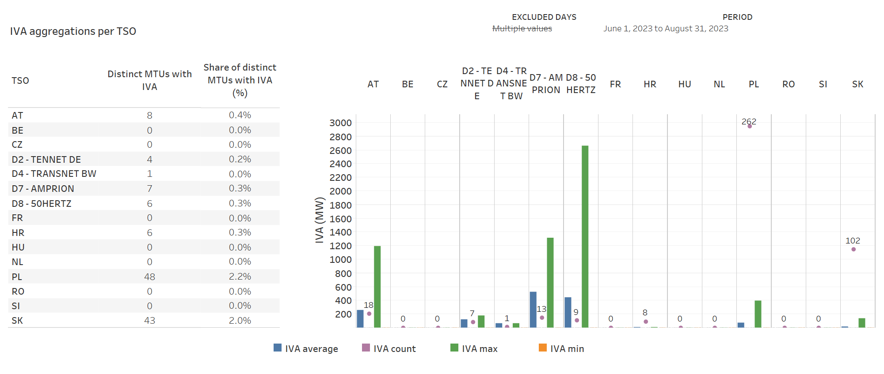
KPI 5
Share of MTUs with intervention per TSO

Slide 10
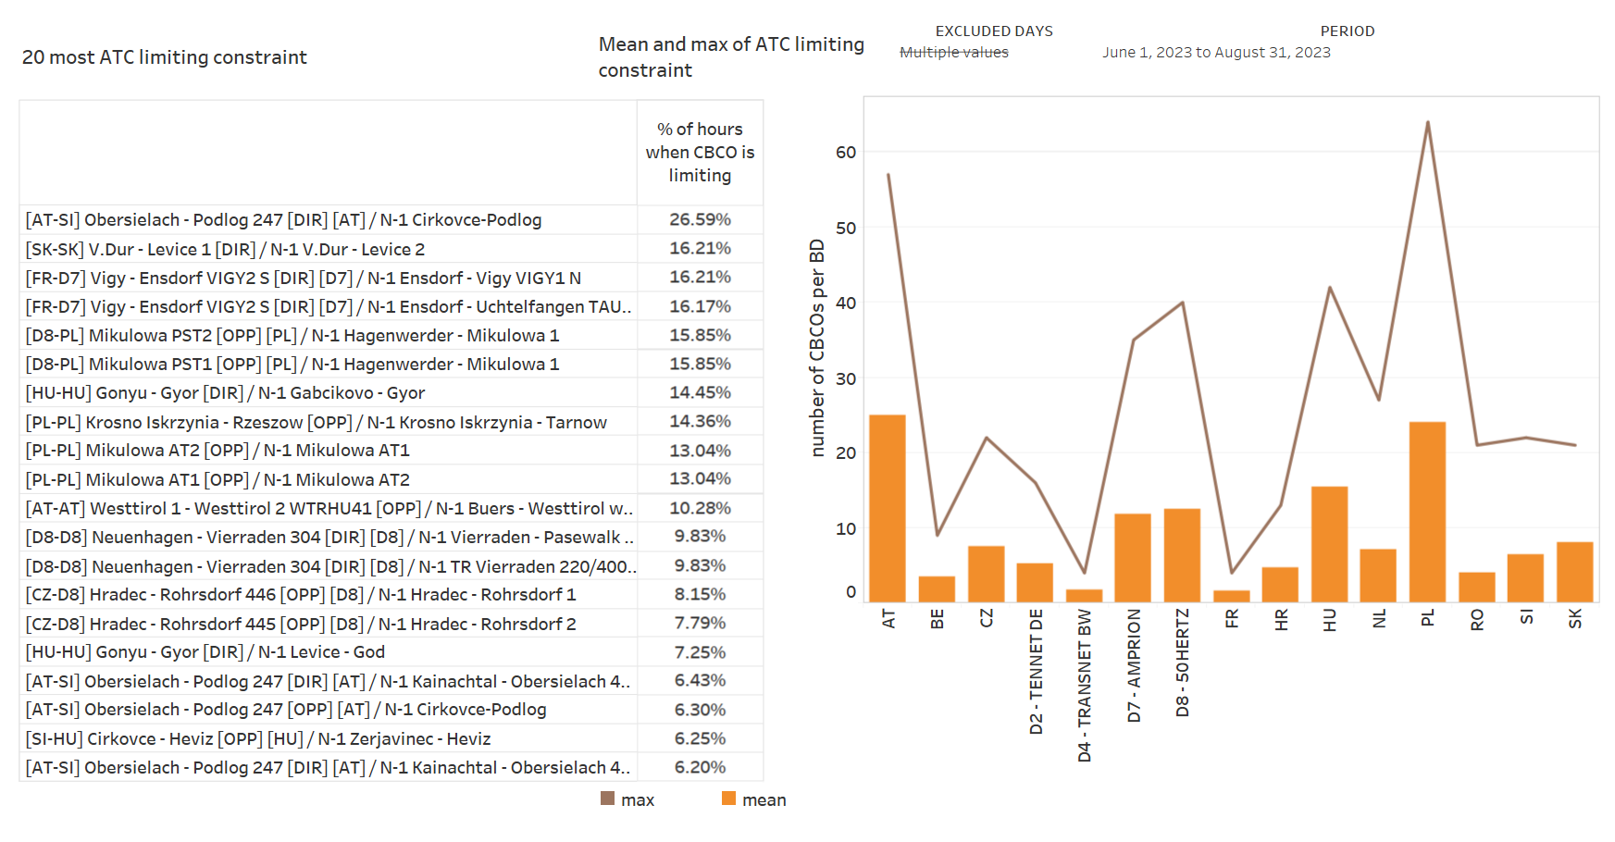
KPI 6
Limiting constraints of the ATC domain​

Slide 11
KPI 6
Limiting constraints of the ATC domain​

Slide 12
KPI 6
Limiting constraints of the ATC domain​

Slide 13
KPI 6
Limiting constraints of the ATC domain​

Slide 14
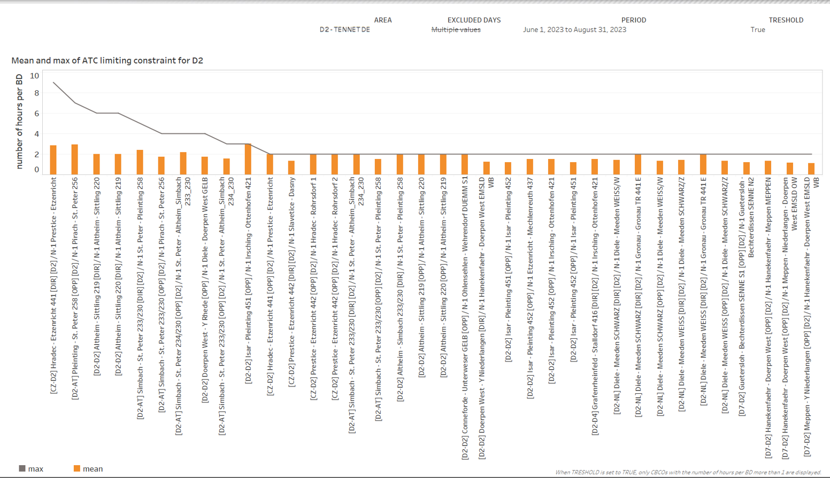
KPI 6
Limiting constraints of the ATC domain​

Slide 15
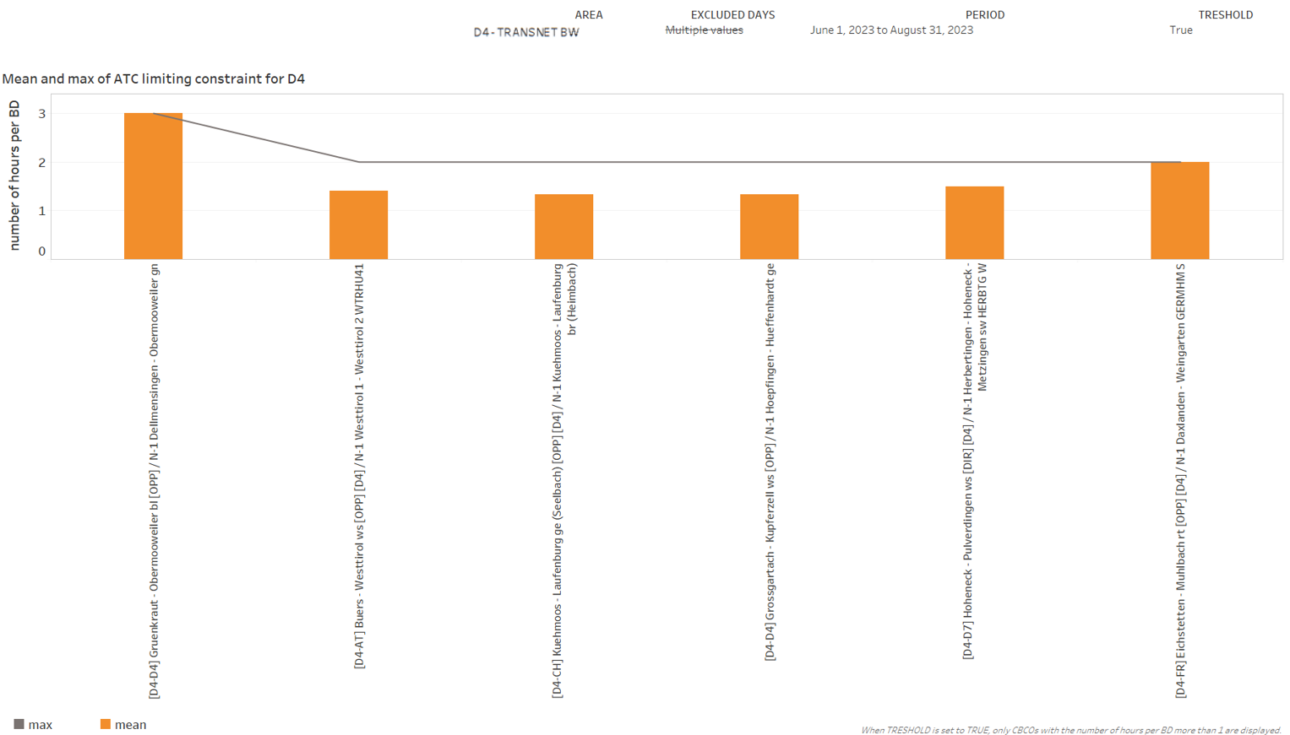
KPI 6
Limiting constraints of the ATC domain​

Slide 16
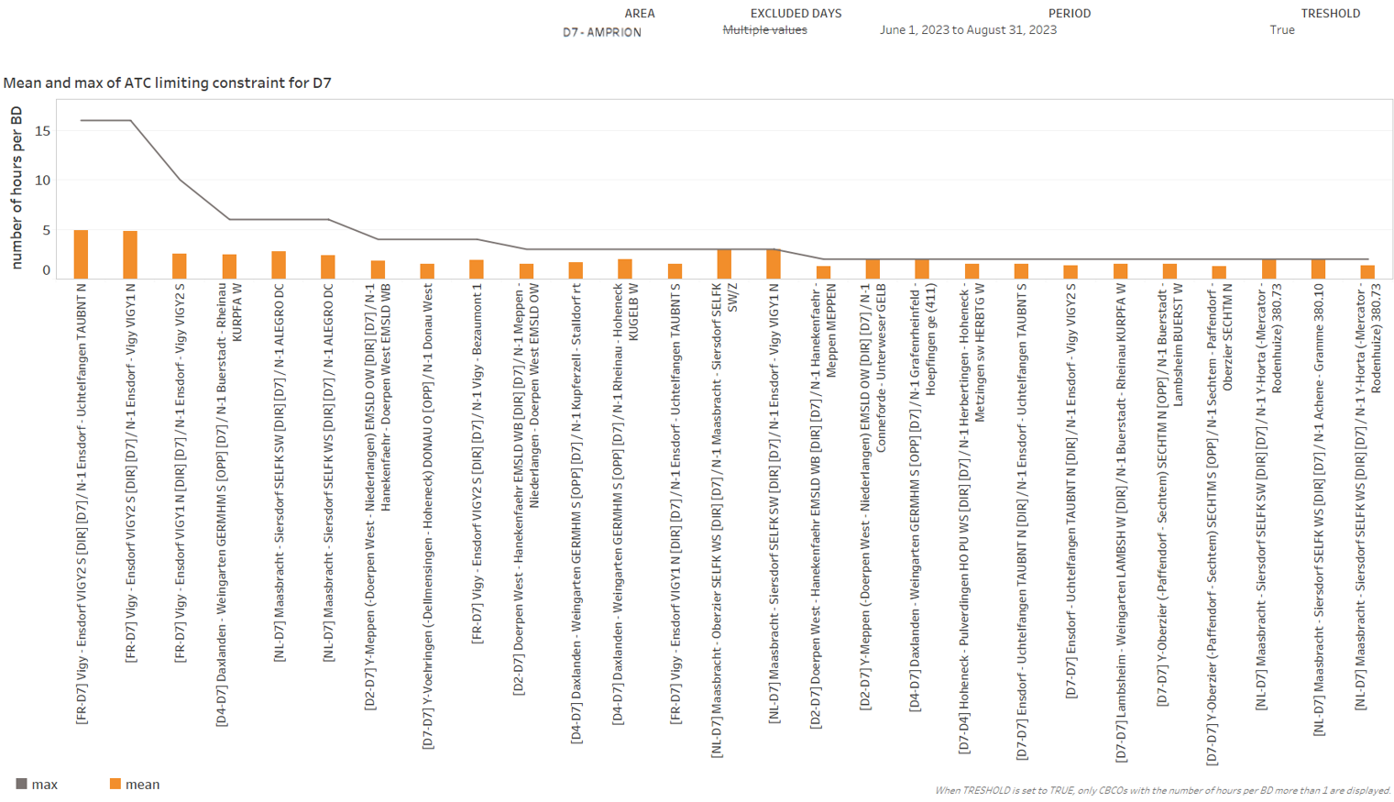
KPI 6
Limiting constraints of the ATC domain​

Slide 17
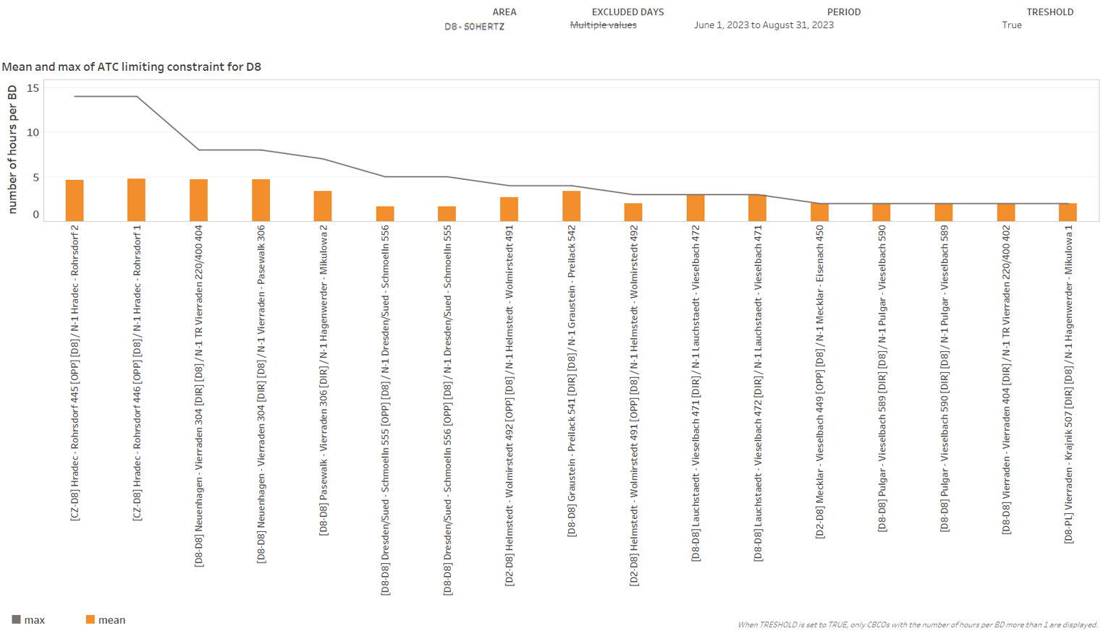
KPI 6
Limiting constraints of the ATC domain​

Slide 18
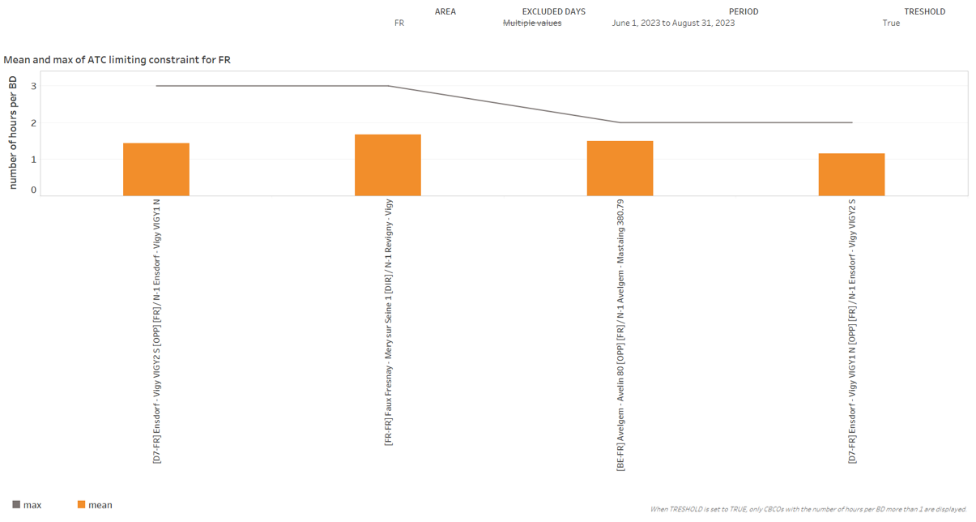
KPI 6
Limiting constraints of the ATC domain​
Disclaimer - Results of the French TSO for KPI 6 (Limiting constraints of the ATC domain) should be interpreted with care, due to the dynamically changing FR CBCO ID. Once this issue has been resolved, this report will be updated to account for those potential inaccuracies. This is expected to be implemented in Q1 2024.

Slide 19
KPI 6
Limiting constraints of the ATC domain​

Slide 20
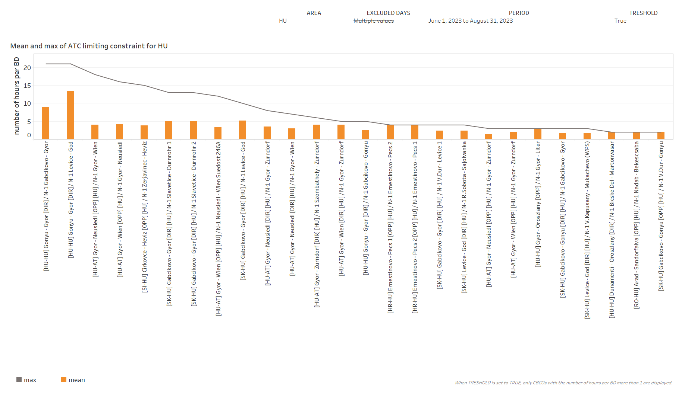
KPI 6
Limiting constraints of the ATC domain​

Slide 21
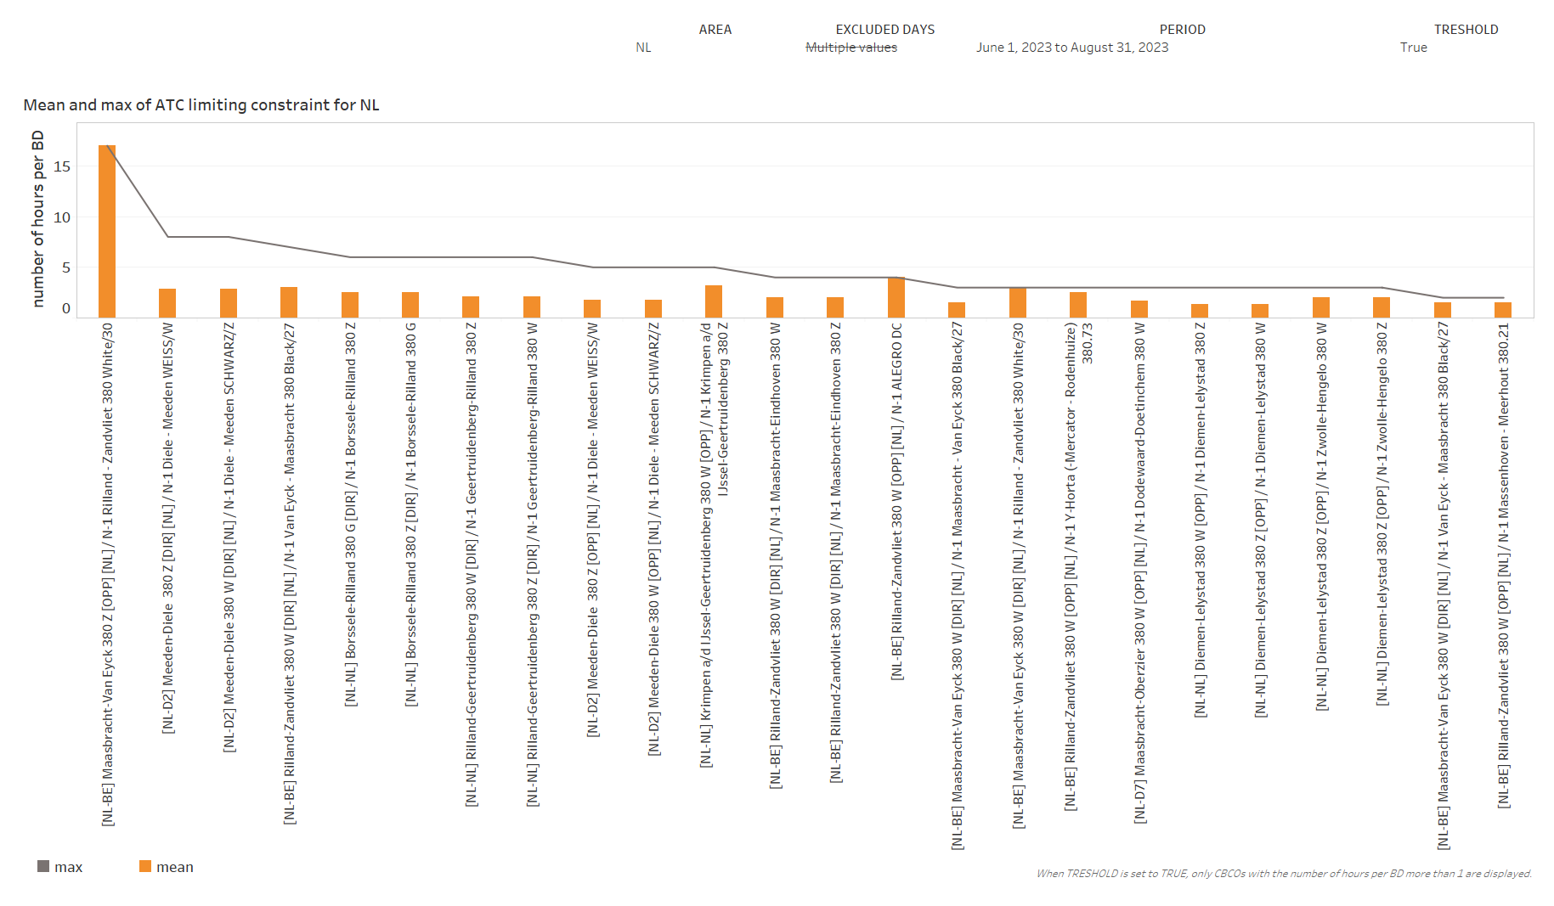
KPI 6
Limiting constraints of the ATC domain​

Slide 22
KPI 6
Limiting constraints of the ATC domain​

Slide 23
KPI 6
Limiting constraints of the ATC domain​

Slide 24
KPI 6
Limiting constraints of the ATC domain​

Slide 25
KPI 6
Limiting constraints of the ATC domain​

Slide 26
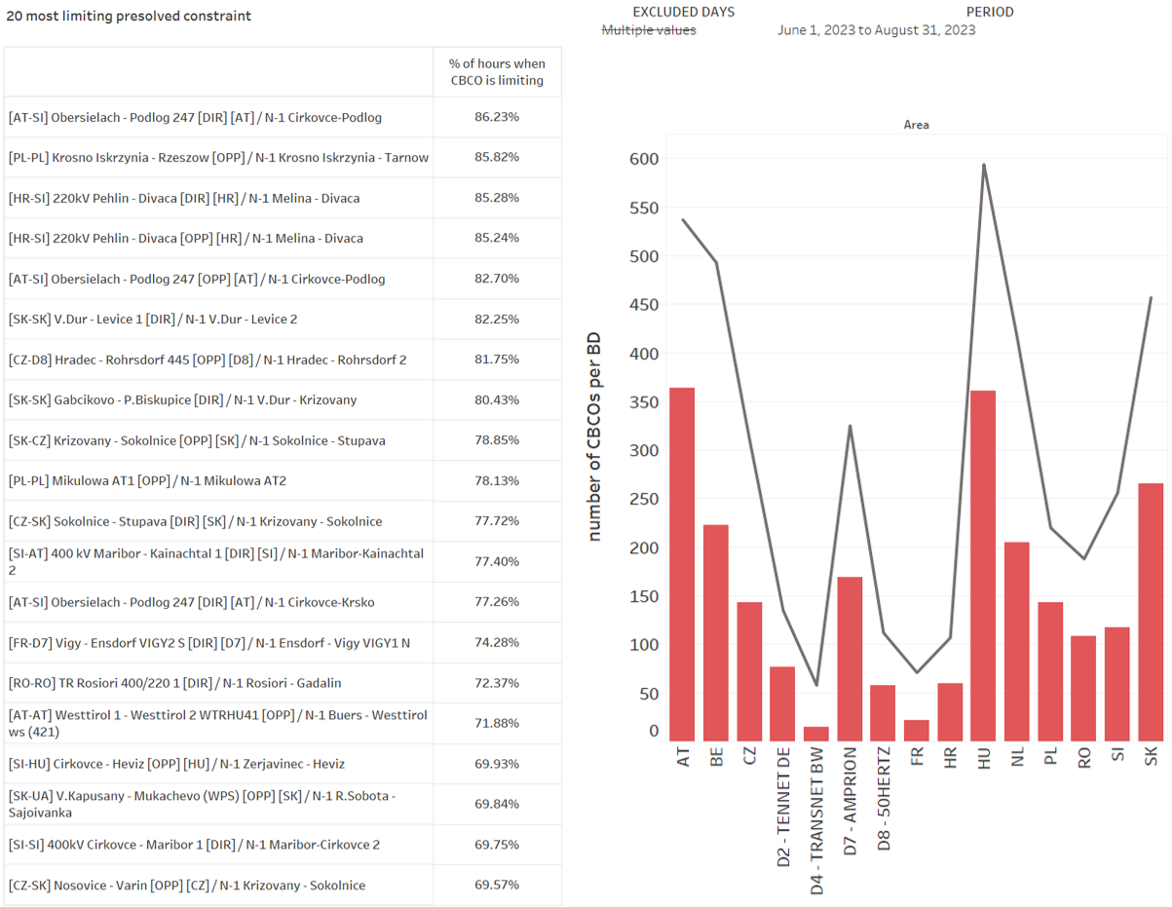
KPI 7
Most often pre-solved CNECs​

Slide 27
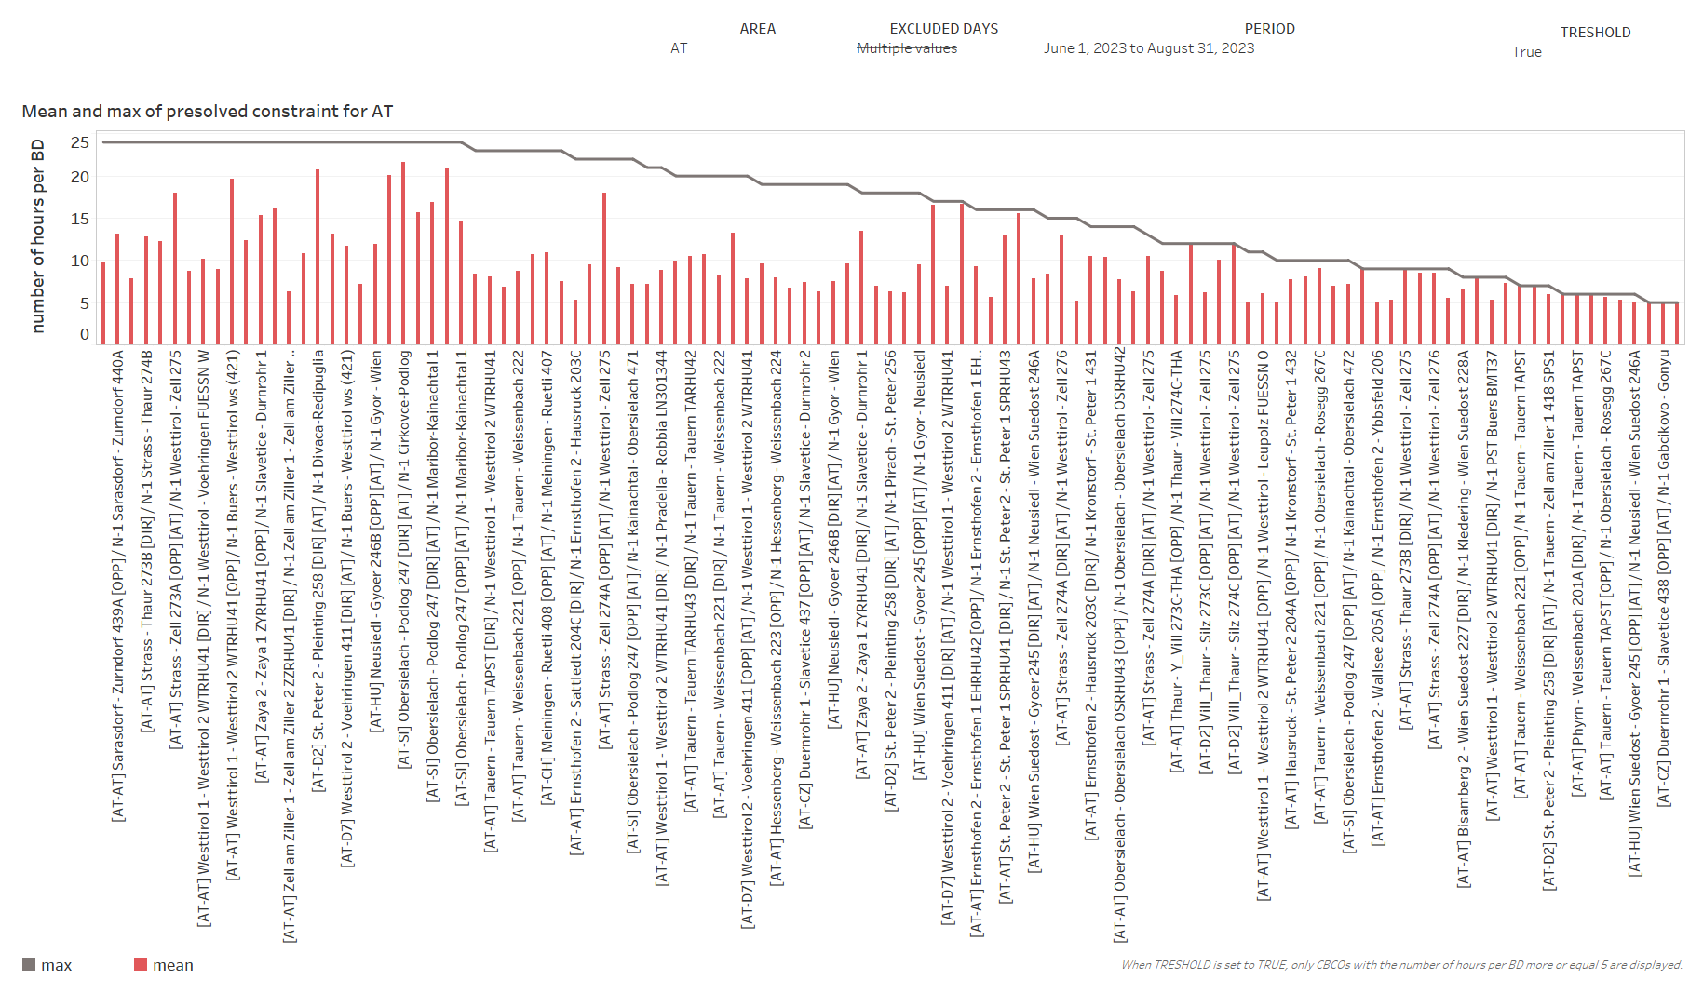
KPI 7
Most often pre-solved CNECs​

Slide 28
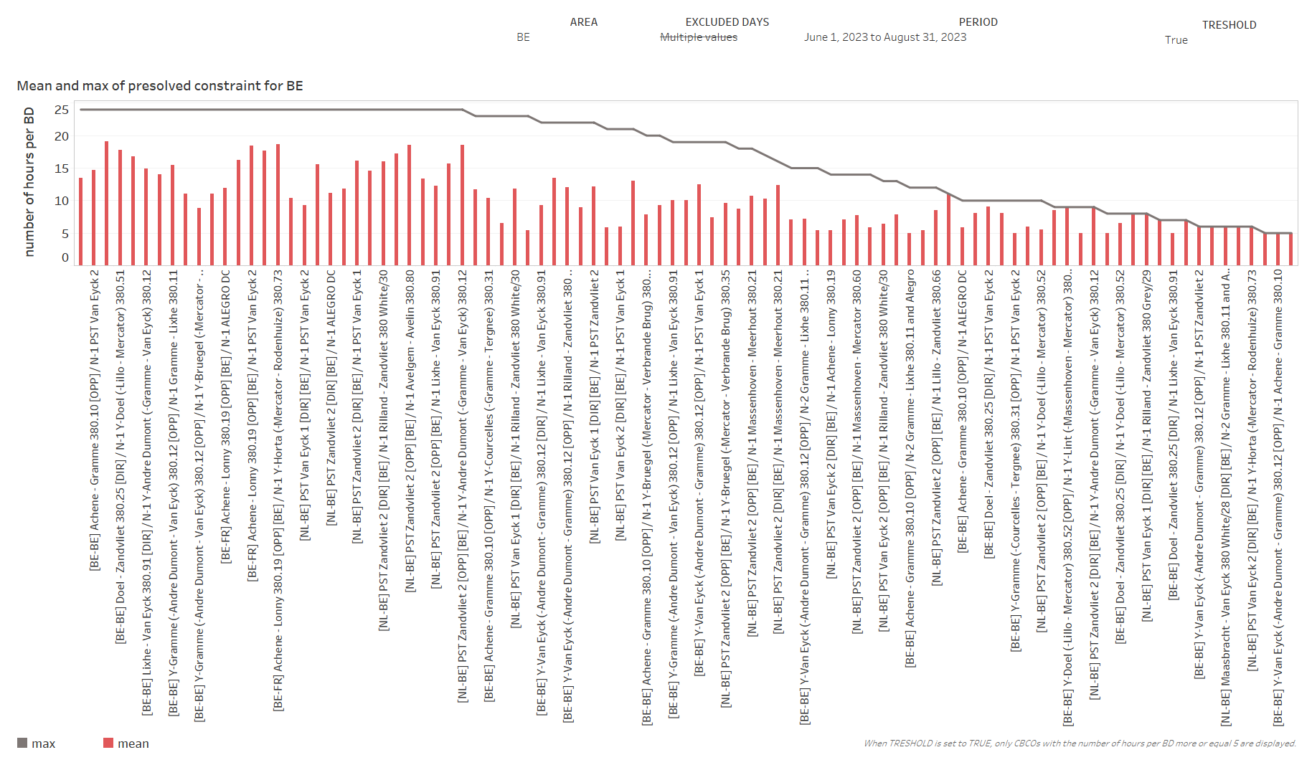
KPI 7
Most often pre-solved CNECs​

Slide 29
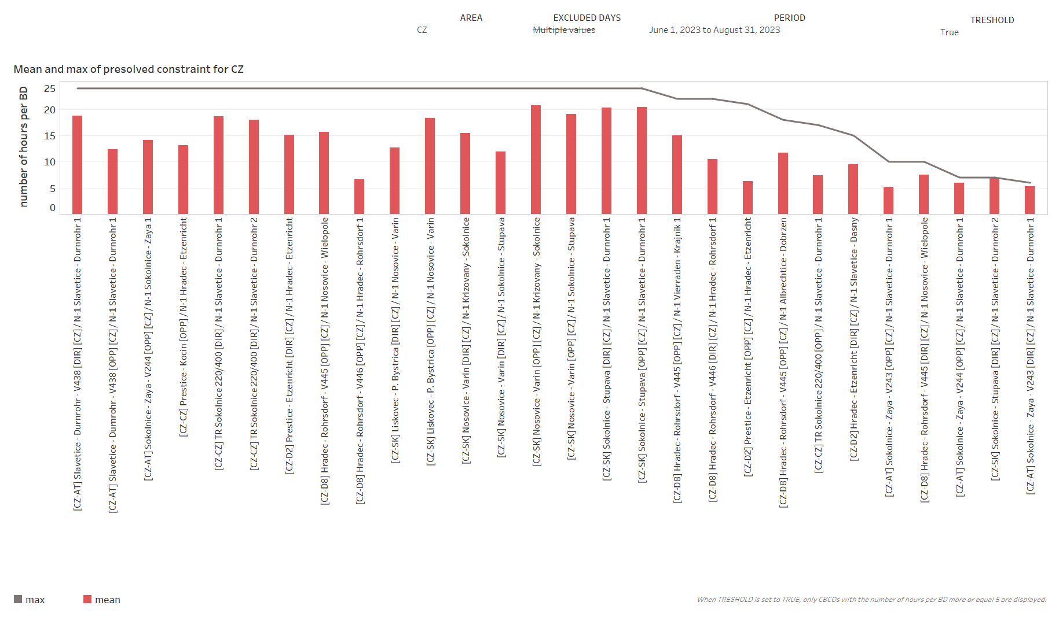
KPI 7
Most often pre-solved CNECs​

Slide 30
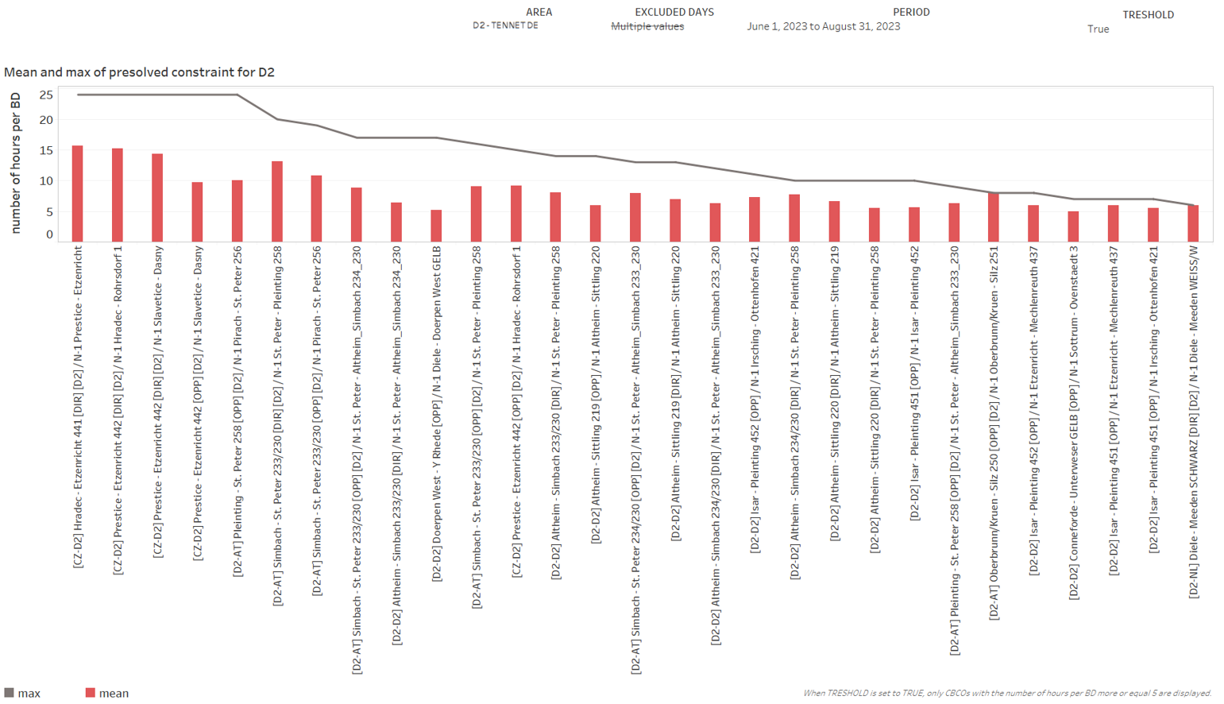
KPI 7
Most often pre-solved CNECs​

Slide 31
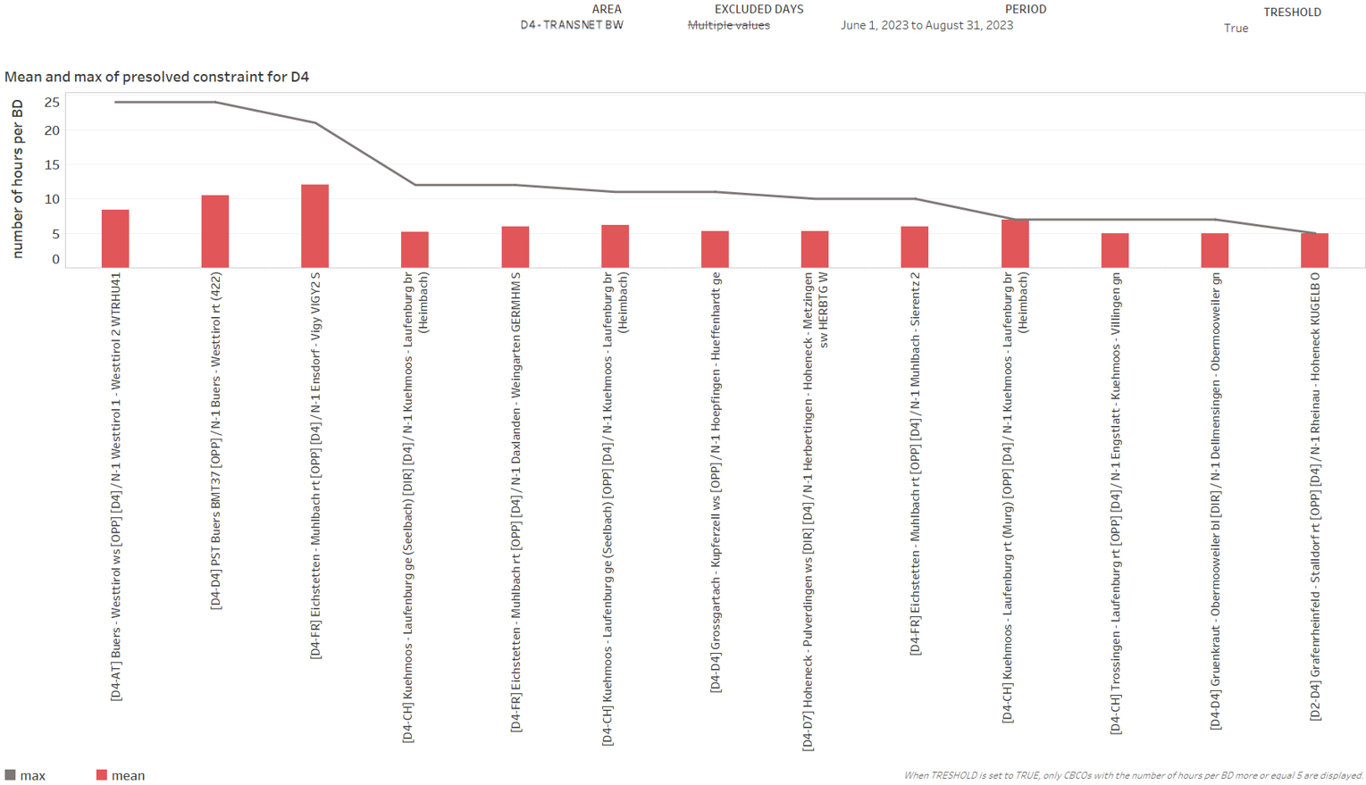
KPI 7
Most often pre-solved CNECs​

Slide 32
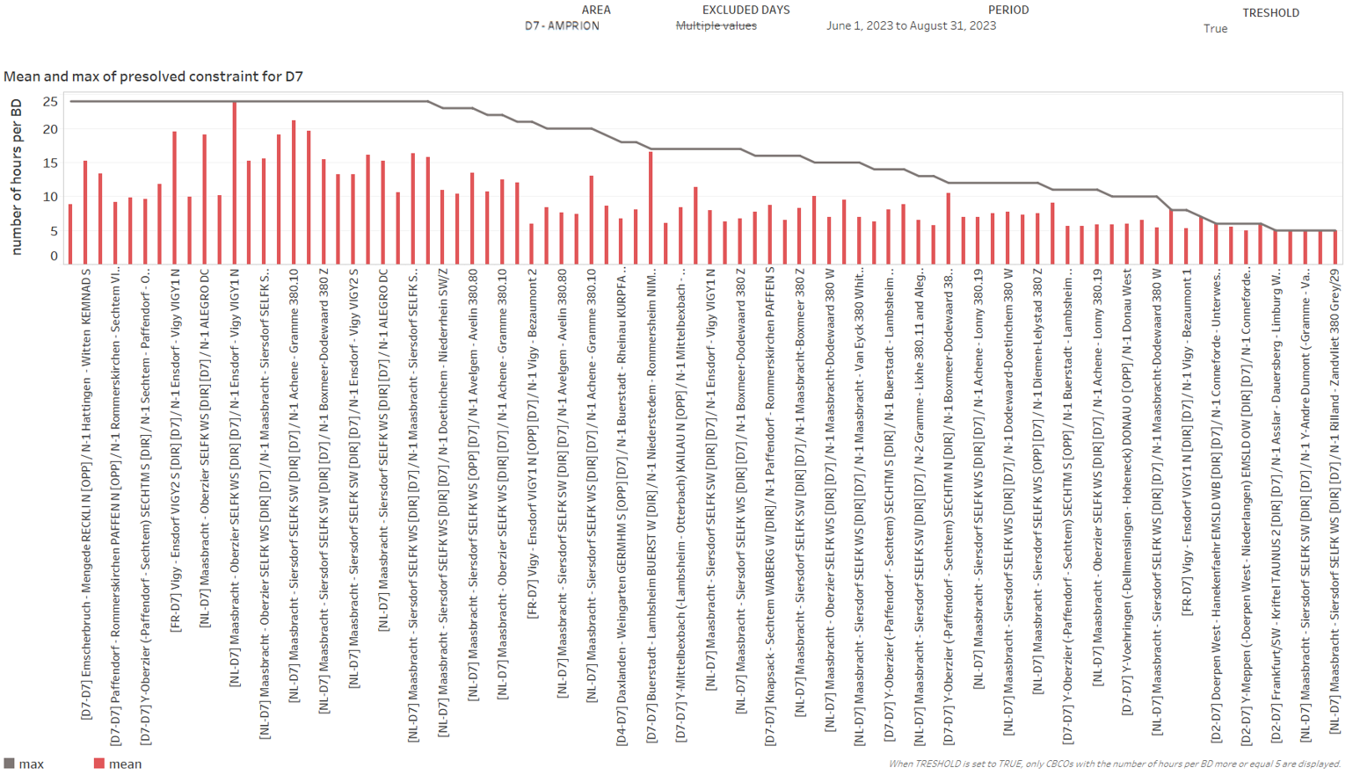
KPI 7
Most often pre-solved CNECs​

Slide 33
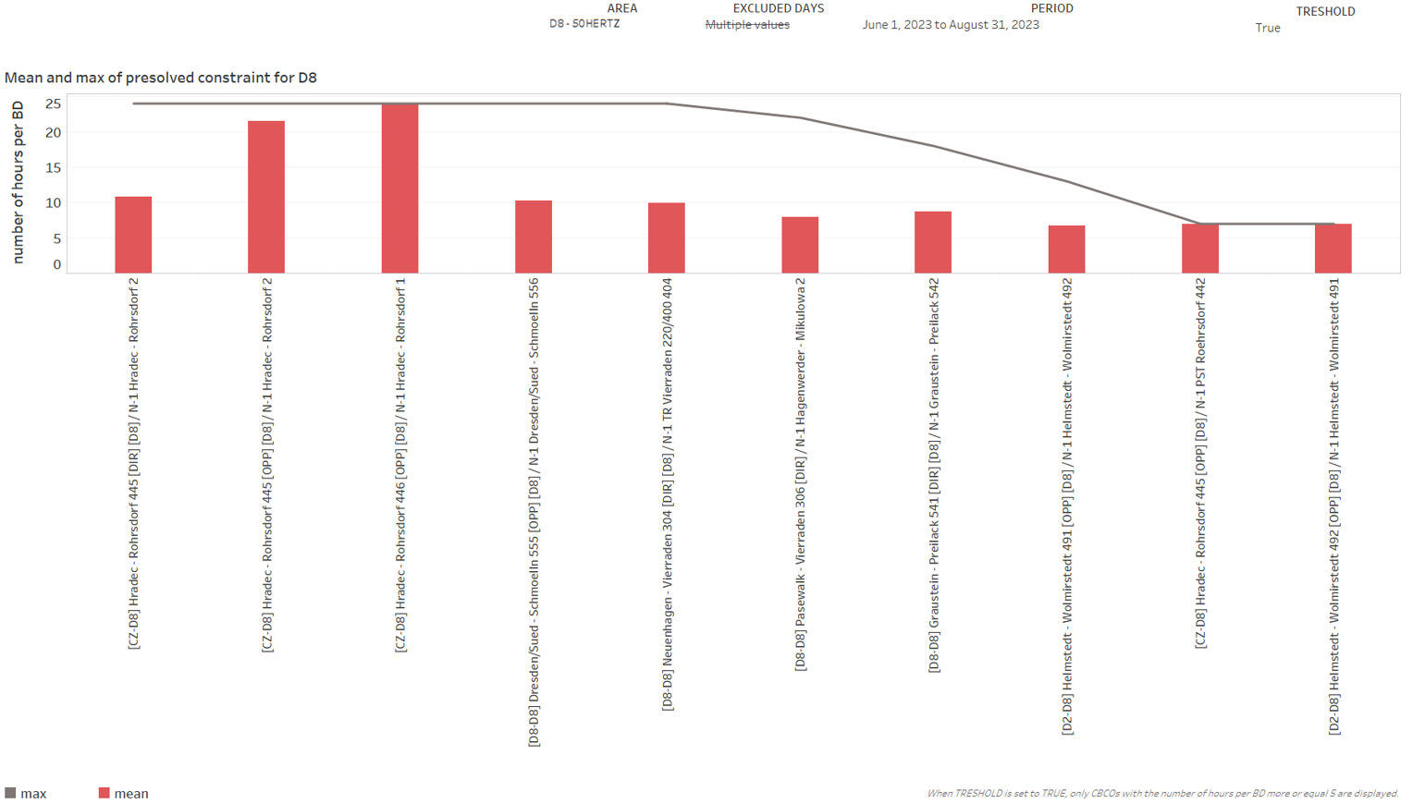
KPI 7
Most often pre-solved CNECs​

Slide 34
KPI 7
Most often pre-solved CNECs​

Slide 35
KPI 7
Most often pre-solved CNECs​

Slide 36
KPI 7
Most often pre-solved CNECs​

Slide 37
KPI 7
Most often pre-solved CNECs​

Slide 38
KPI 7
Most often pre-solved CNECs​

Slide 39
KPI 7
Most often pre-solved CNECs​

Slide 40
KPI 7
Most often pre-solved CNECs​

Slide 41
KPI 7
Most often pre-solved CNECs​

Slide 42
KPI 8 – Min and Max Net Positions per bidding zone
(a) Based on final FB domain

Slide 43
KPI 8 – Min and Max Net Positions per bidding zone
(a) Based on final FB domain

Slide 44
KPI 8 – Min and Max Net Positions per bidding zone
(a) Based on final FB domain

Slide 45
KPI 8 – Min and Max Net Positions per bidding zone
(a) Based on final FB domain
Note - Missing values of min and max net positions for some timestamps are caused by empty domains.

Slide 46
KPI 8 – Min and Max Net Positions per bidding zone
(a) Based on final FB domain
Note - Missing values of min and max net positions for some timestamps are caused by empty domains.

Slide 47
KPI 8 – Min and Max Net Positions per bidding zone
(a) Based on final FB domain
Note - Missing values of min and max net positions for some timestamps are caused by empty domains.

Slide 48
KPI 8 – Min and Max Net Positions per bidding zone
(a) Based on final FB domain
Note - Missing values of min and max net positions for some timestamps are caused by empty domains.

Slide 49
KPI 8 – Min and Max Net Positions per bidding zone
(a) Based on final FB domain
Note - Missing values of min and max net positions for some timestamps are caused by empty domains.

Slide 50
KPI 8 – Min and Max Net Positions per bidding zone
(a) Based on final FB domain
Note - Missing values of min and max net positions for some timestamps are caused by empty domains.

Slide 51
KPI 8 – Min and Max Net Positions per bidding zone
(a) Based on final FB domain
Note - Missing values of min and max net positions for some timestamps are caused by empty domains.

Slide 52
KPI 8 – Min and Max Net Positions per bidding zone
(a) Based on final FB domain
Note - Missing values of min and max net positions for some timestamps are caused by empty domains.

Slide 53
KPI 8 – Min and Max Net Positions per bidding zone
(a) Based on final FB domain
Note - Missing values of min and max net positions for some timestamps are caused by empty domains.

Slide 54
KPI 8 – Min and Max Net Positions per bidding zone
(b) Based on final ID ATC
Note - Missing values of min and max net positions for some timestamps are caused by empty domains.

Slide 55
KPI 8 – Min and Max Net Positions per bidding zone
(b) Based on final ID ATC
Note - Missing values of min and max net positions for some timestamps are caused by empty domains.

Slide 56
KPI 8 – Min and Max Net Positions per bidding zone
(b) Based on final ID ATC
Note - Missing values of min and max net positions for some timestamps are caused by empty domains.

Slide 57
KPI 8 – Min and Max Net Positions per bidding zone
(b) Based on final ID ATC
Note - Missing values of min and max net positions for some timestamps are caused by empty domains.

Slide 58
KPI 8 – Min and Max Net Positions per bidding zone
(b) Based on final ID ATC
Note - Missing values of min and max net positions for some timestamps are caused by empty domains.

Slide 59
KPI 8 – Min and Max Net Positions per bidding zone
(b) Based on final ID ATC
Note - Missing values of min and max net positions for some timestamps are caused by empty domains.

Slide 60
KPI 8 – Min and Max Net Positions per bidding zone
(b) Based on final ID ATC
Note - Missing values of min and max net positions for some timestamps are caused by empty domains.

Slide 61
KPI 8 – Min and Max Net Positions per bidding zone
(b) Based on final ID ATC
Note - Missing values of min and max net positions for some timestamps are caused by empty domains.

Slide 62
KPI 8 – Min and Max Net Positions per bidding zone
(b) Based on final ID ATC
Note - Missing values of min and max net positions for some timestamps are caused by empty domains.

Slide 63
KPI 8 – Min and Max Net Positions per bidding zone
(b) Based on final ID ATC
Note - Missing values of min and max net positions for some timestamps are caused by empty domains.

Slide 64
KPI 8 – Min and Max Net Positions per bidding zone
(b) Based on final ID ATC
Note - Missing values of min and max net positions for some timestamps are caused by empty domains.

Slide 65
KPI 8 – Min and Max Net Positions per bidding zone
(b) Based on final ID ATC
Note - Missing values of min and max net positions for some timestamps are caused by empty domains.

